Slide 1
HVTN Hands-on GitHub Workshop

Slide 2
Hands-on session roadmap.
Install VISCtemplates.
Create a project directory and push to our personal GitHub.
Practice with commit, add, and push.
Create a branch and create a visc report template.
Practice with commit, add, and push to a branch.
Merge the report branch into the main branch.
Use of GitHub pull requests.
Download this ppt to follow along:

Slide 3
1. Install and load VISCtemplates (and VISCfunctions)
remotes::install_github("FredHutch/VISCtemplates”, build_vignettes = T)
remotes::install_github("FredHutch/VISCfunctions”)
library(VISCtemplates)
For VISCtemplates, I recommend installing the package dependencies as suggested by the R console.
If you only install VISCtemplates, you should be able to do all tasks but compile the report.

Slide 4
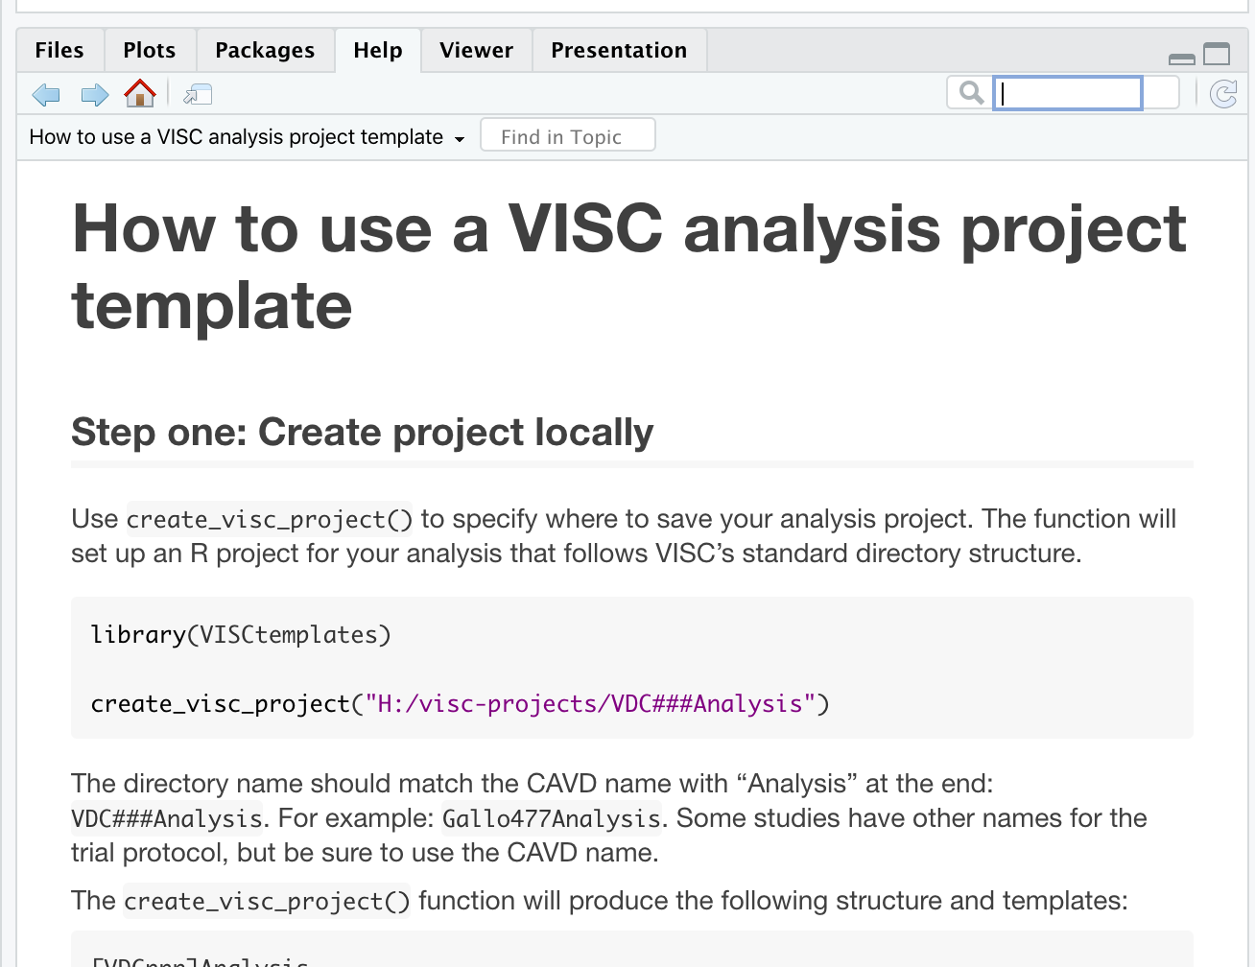
2. Create a project directory.
vignette("create_a_visc_analysis_project")
Click this icon to pop out the vignette window.
Follow-along with step one.
Call the repository:
HVTNGitWorkshop
Next: we’ll create the GitHub repo together using the website.
If you are feeling adventurous, you can create the GitHub repo from R in Step 2.

Slide 5
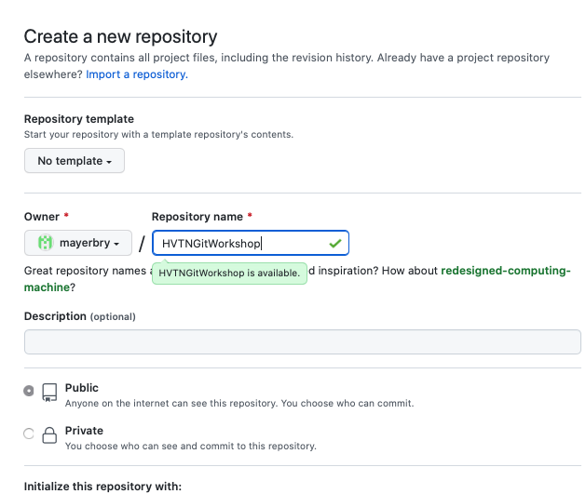
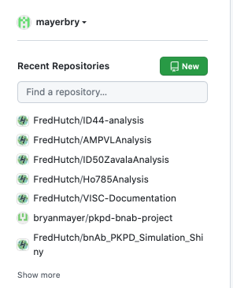
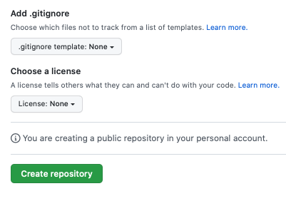
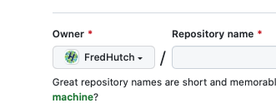
Create GitHub remote repo.
Step 1: Github.com (log in) -> left panel
Click “New” to start making repo.
Step 2: name the repo (use same as last slide).
Make sure the Owner is your username.
We’ll make a public repo.
Bottom of page
DO NOT CREATE THIS REPO ON THE FredHutch org.
Step 3: Click here to create repo then pause there.

Slide 6
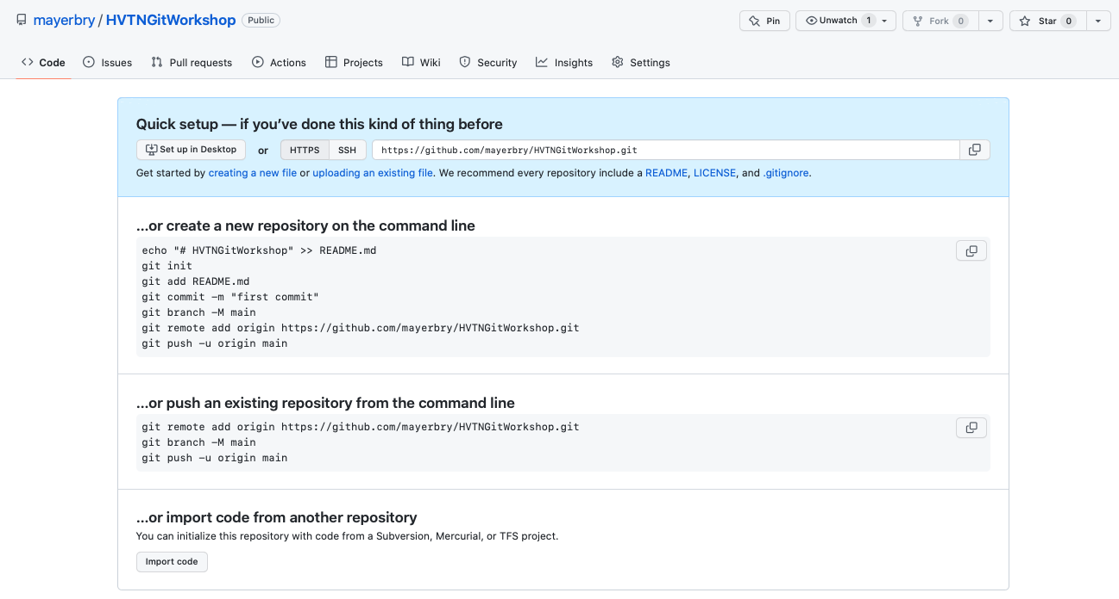
Should be here.

Slide 7
Connecting the local to remote in RStudio
If you are comfortable with a separate command line app, you may use that as well.

