Slide 1
Workshop Exercise Slides
Bryan Mayer
Sr. Staff Scientist, BBE
2022-10-19

Slide 2
Hands-on exercises.
Setup (open RStudio, install VISCtemplates).
Initialize a Git project repo and perform commit and add.
Create a GitHub repo.
Sync local repo with GitHub repo, practice with pushing.
Create a branch with a VISC report template.
Practice with commit, add, and push to a remote branch.
Merge the report branch into the main branch.
Use of GitHub pull requests.

Slide 3
Exercise 1: Setup – install VISCtemplates
remotes::install_github("FredHutch/VISCtemplates", build_vignettes = T)
remotes::install_github("FredHutch/VISCfunctions")
library(VISCtemplates)
For VISCtemplates, I recommend installing the package dependencies as suggested by the R console.
If you do not install VISCfunctions, you should be able to do all tasks but compile the report.
For some hands-on exercises a GitHub account required with Rstudio (or other command line tool) recommended.
Not every exercise requires GitHub.

Slide 4
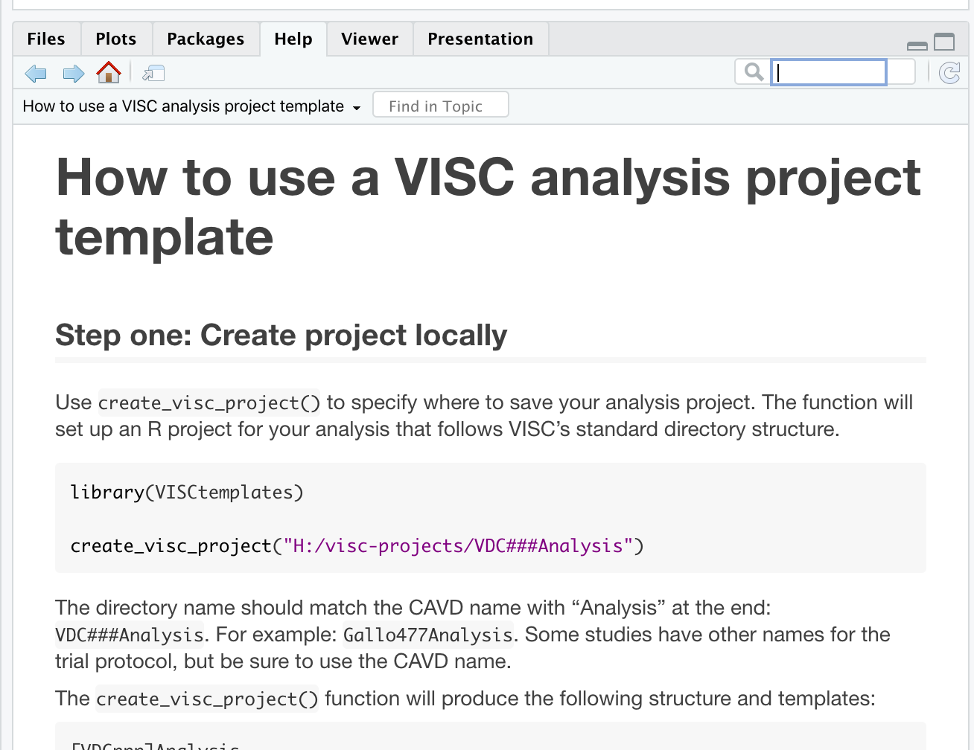
Exercise 2A. Create project directory.
vignette("create_a_visc_analysis_project")
Click this icon to pop out the vignette window.
Follow along with step one.
Call the repository:
HVTNGitExample
Choose a local directory path.
Create directory

Slide 5
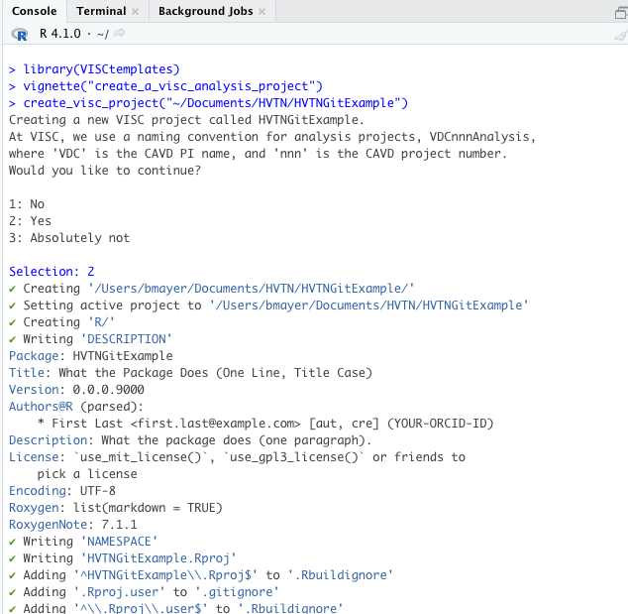
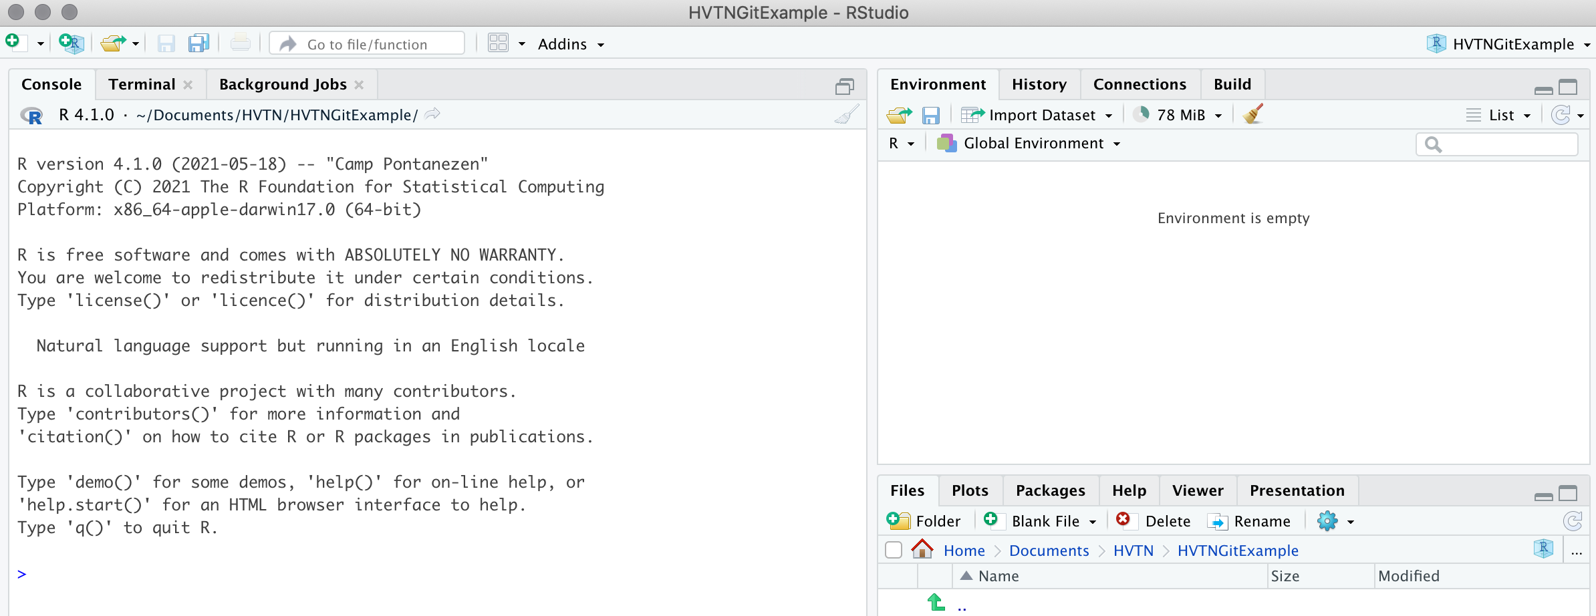
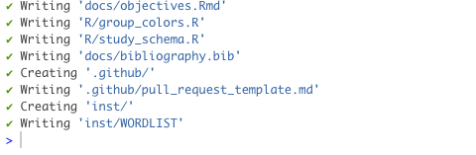
New RStudio instance opened within project directory. Work from here.
Want to make sure that you are in the working directory of the new project.
Alternatively: check with getwd() and manually reset via setwd().

Slide 6
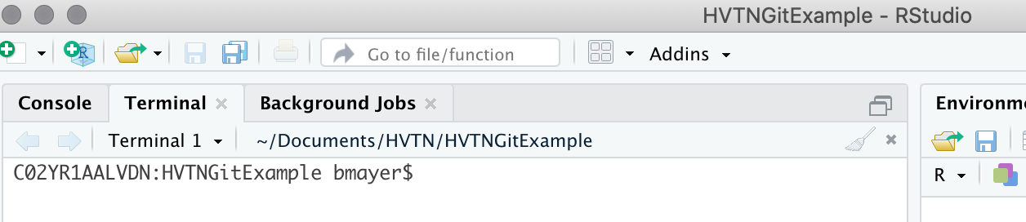
RStudio and Git: Use Terminal feature execute Git commands.
Click here to access Terminal.
Want to make sure that you are in the working directory of the new project. Can double-check by running getwd() in the Console.
If you are comfortable with a separate command line app, you may use that as well.

Slide 7
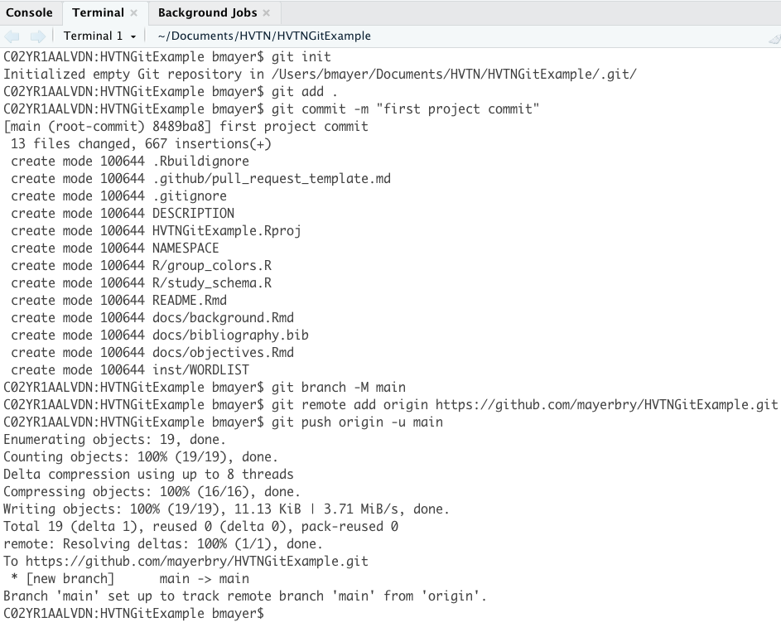
Exercise 2B. Initialize project Git repo.
Git commands
git init
git add .
git commit -m "first project commit”

Slide 8
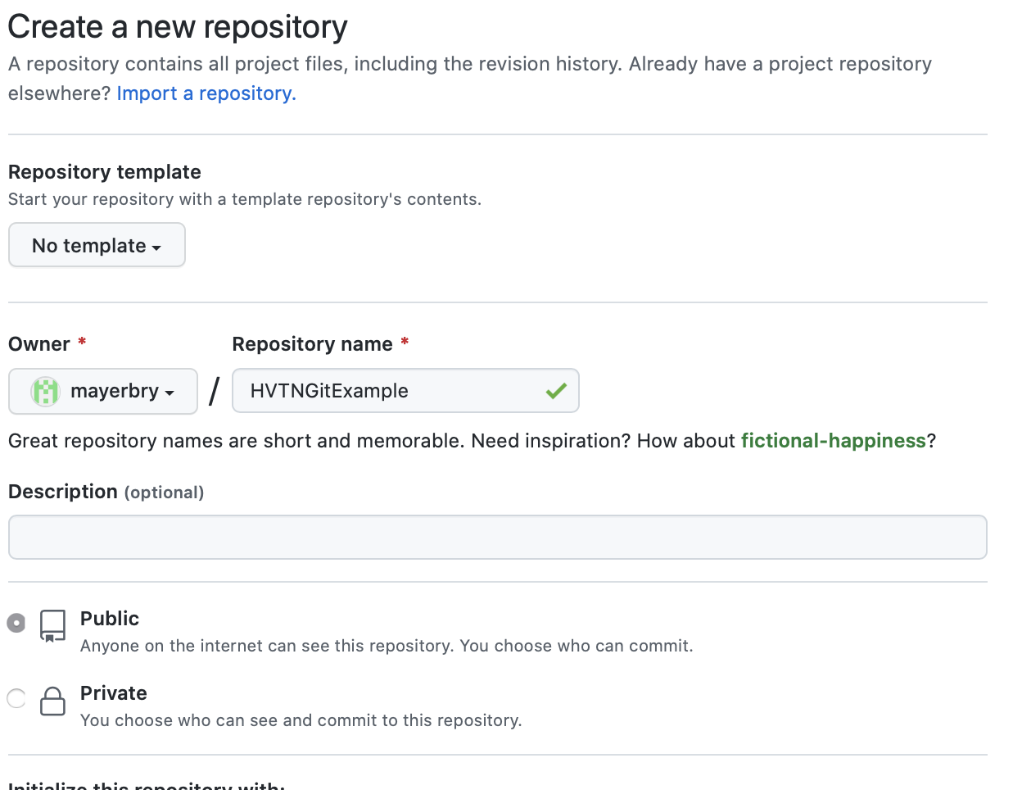
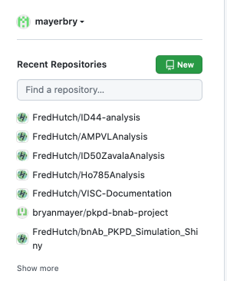
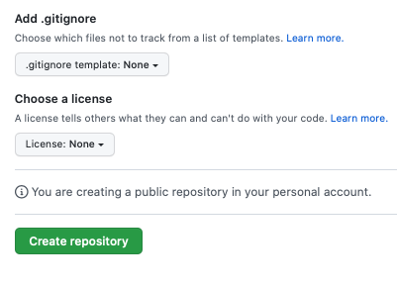
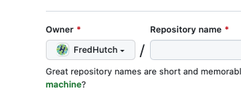
Exercise 3: Create GitHub remote repo.
Step 1: Github.com (log in) -> left panel
Click “New” to start making repo.
Step 2: name the repo (use same as last slide).
Make sure the Owner is your username.
We’ll make a public repo.
Bottom of page
DO NOT CREATE THIS REPO ON THE FredHutch org.
Step 3: Click here to create repo then pause there.

Slide 9
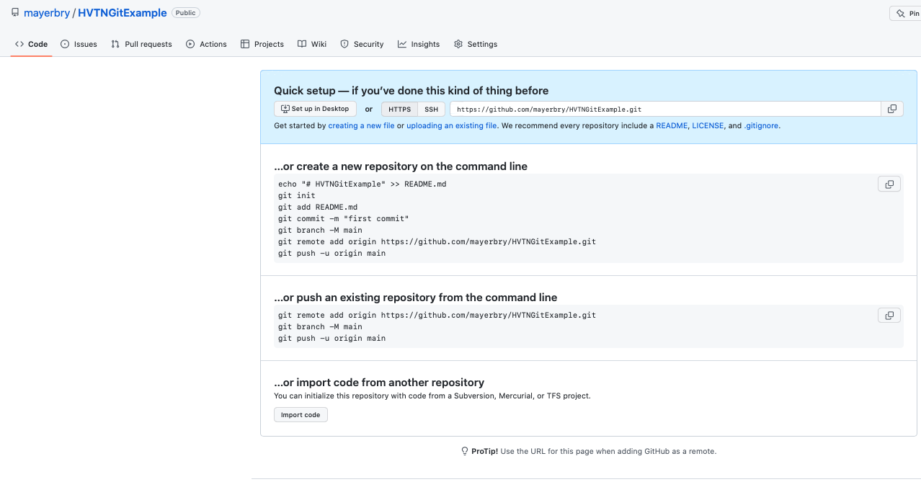
Exercise 3: Stop here.

Slide 10
Exercise 4: Connect local repo with GitHub
Git commands Note: these are provided explicitly by GitHub.
git branch -M main
git remote add origin https://github.com/[your user name]/HVTNGitExample.git
git push origin -u main

Slide 11
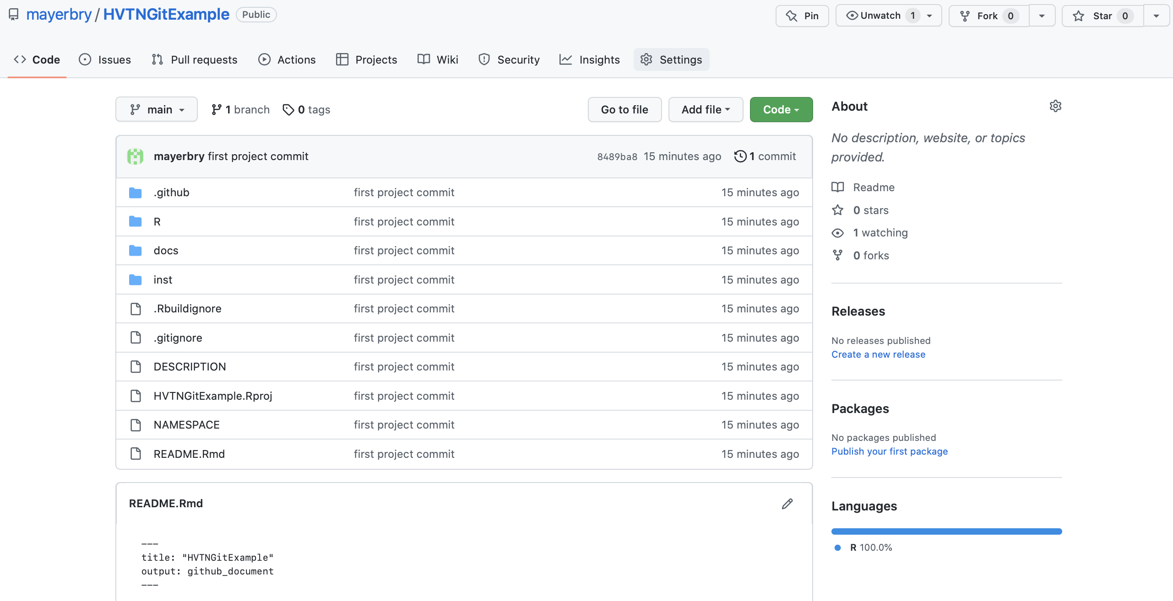
Questions? Short Break.
Refreshed GitHub Page

Slide 12
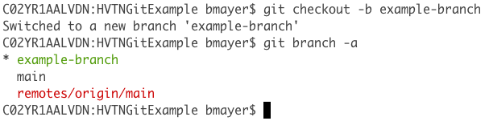
Exercise 5. Making a branch
Create a local branch.
Create a VISC report on the local branch.
(Optional) Compile the report.
Stage, commit, and push changes for the branch.
git checkout -b example-branch
Use of git branch -a shows local and remote branches, highlights current branch (green with *) and your primary branch (red).

Slide 13
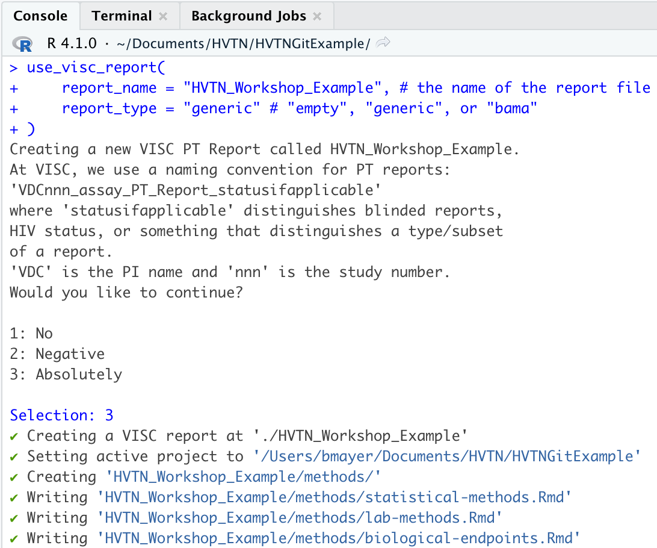
Create a VISC Report
use_visc_report( report_name = ”HVTN_Workshop_Example", # the name of the report file report_type = ”generic" # "empty", "generic", or "bama" )
If you choose to use the path argument, that directory must be created in advance.
More details available in the vignette:
vignette("using_pdf_and_word_template")

Slide 14
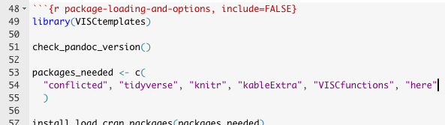
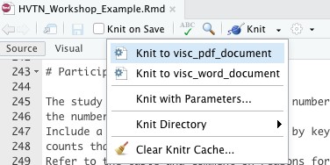
Optional: Compile the Report.
Open file: HVTN_Workshop_Example.Rmd
Fix minor bug (see right).
Knit the file (click knit button).
Optional: knit word via Knit dropdown
Minor bug warning: add “here” package to line 54 or the report will throw an error.

Slide 15
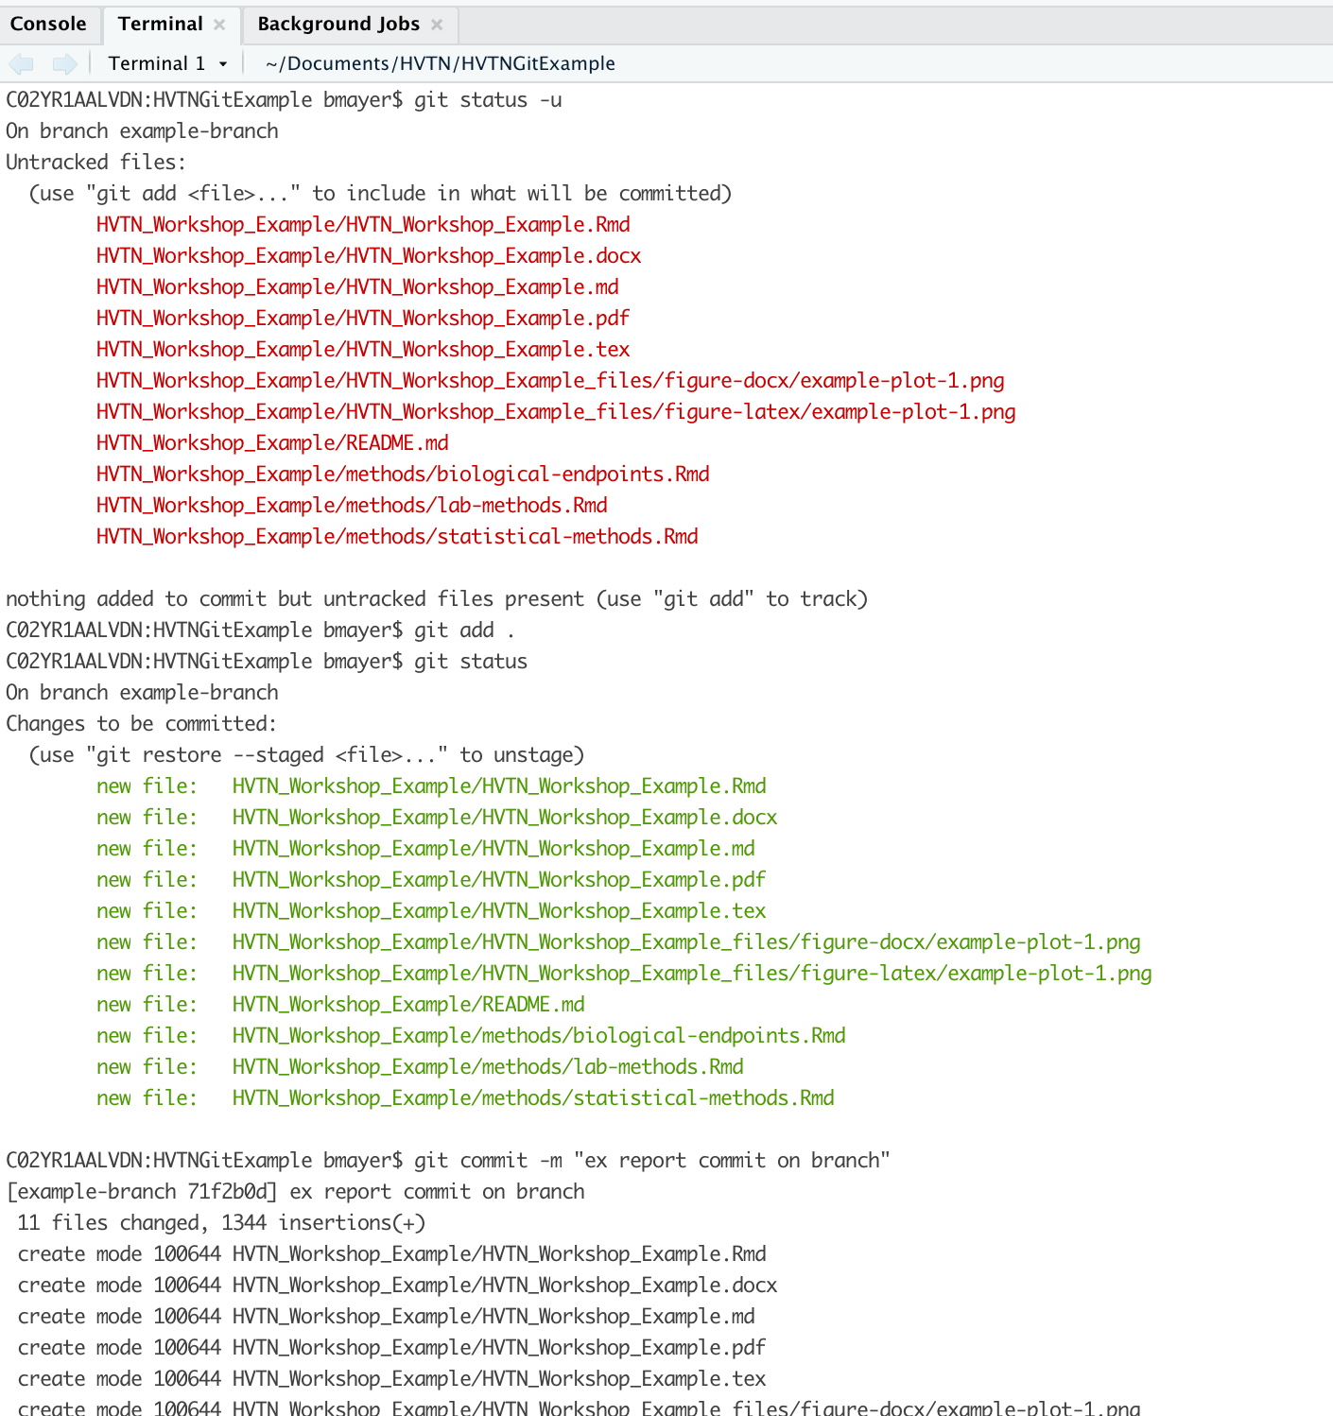
Check, stage, and commit changes.
Git commands.
git status -u
git add .
git commit -m ”[you choose]”

Slide 16
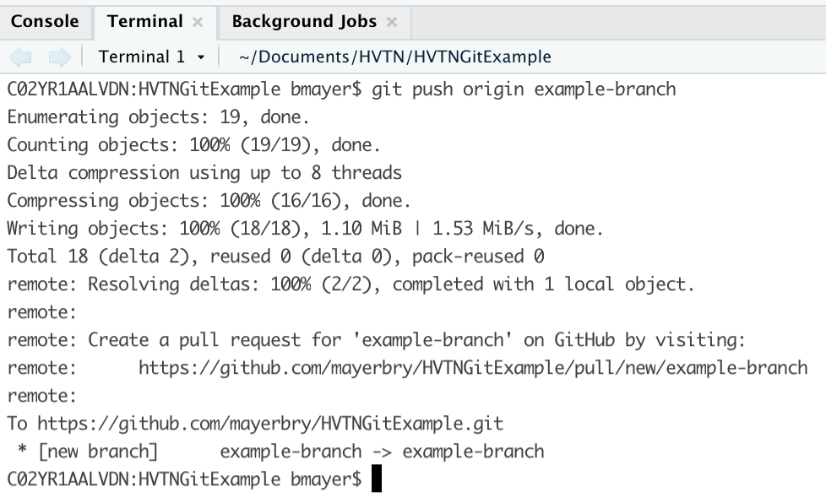
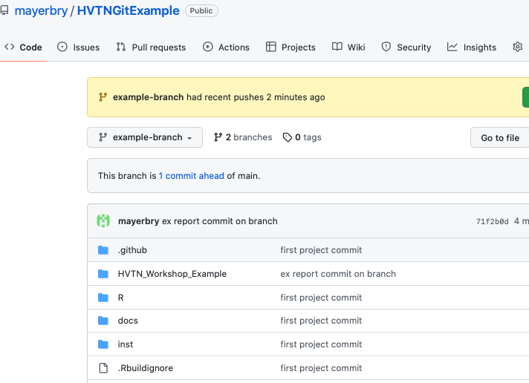
Push to remote (GitHub)
This won’t appear on Main branch.
git push origin example-branch
Toggle your branch on GitHub.
Forgot your branch name? git branch

Slide 17
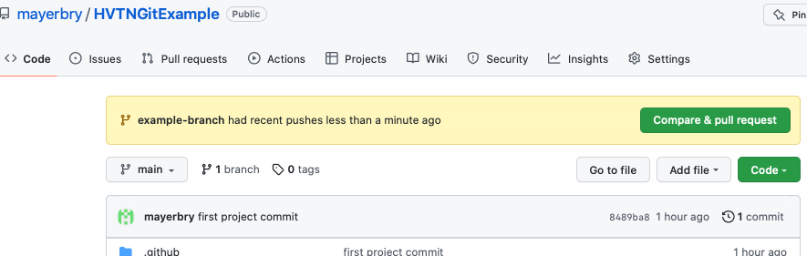
Exercise 6. Merging: Create a Pull Request (PR).
GitHub provides a button for PR on recent pushes.
Branch merges can managed locally but not discussed here.

Slide 18
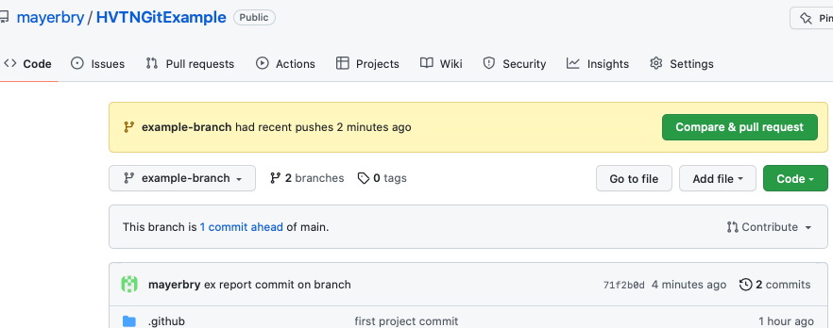
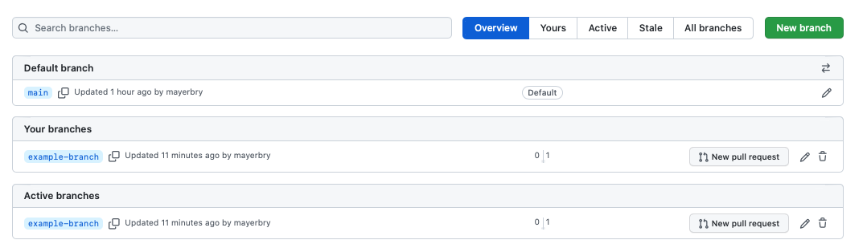
Pull Request: alternative access.
Click on branches
Clicking here also opens a PR.
Opens GitHub branch management window.
Advanced GitHub branch management available here.

Slide 19
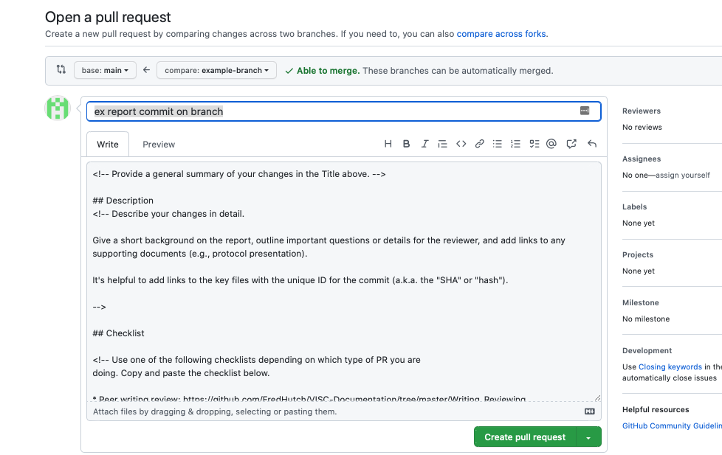
Shows branches, direction of merge, checks for merge conflicts
Assign reviewers here.
VISC PRs must be approved by a reviewer.
Blank by default but VISCtemplates has a PR template.
The PR descriptions is critical to guide a review.

Slide 20
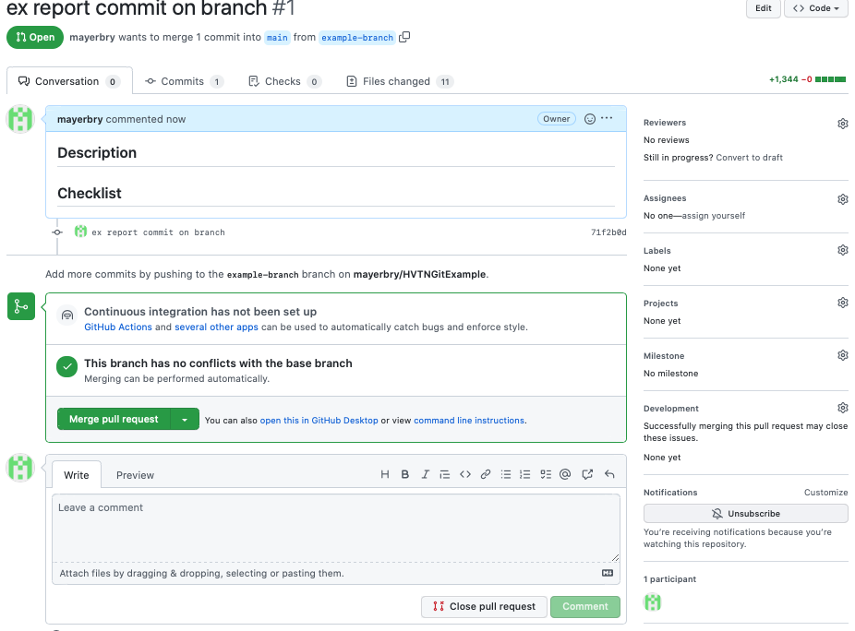
Rendered description here.
Clicking here merges.
Dialogue and future commits stored here.
Comments use markdown language.

Slide 21
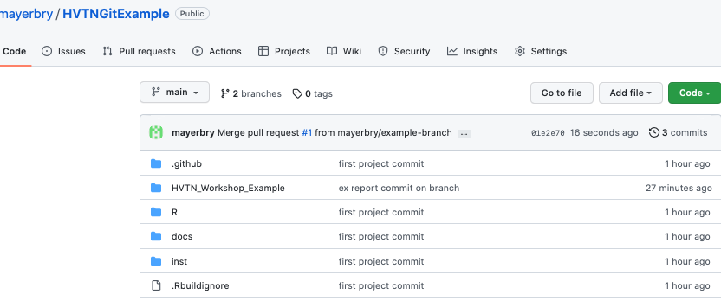
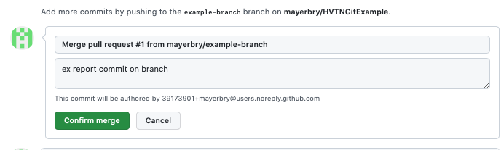
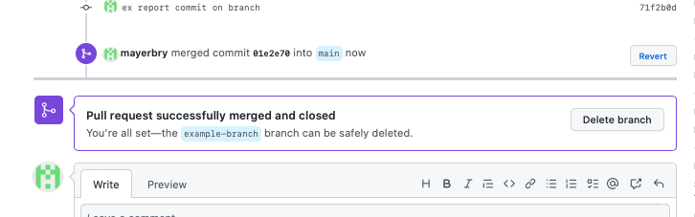
The report now appears on the Main branch.
There is a commit associated with the merge itself.
All merged!

Slide 22
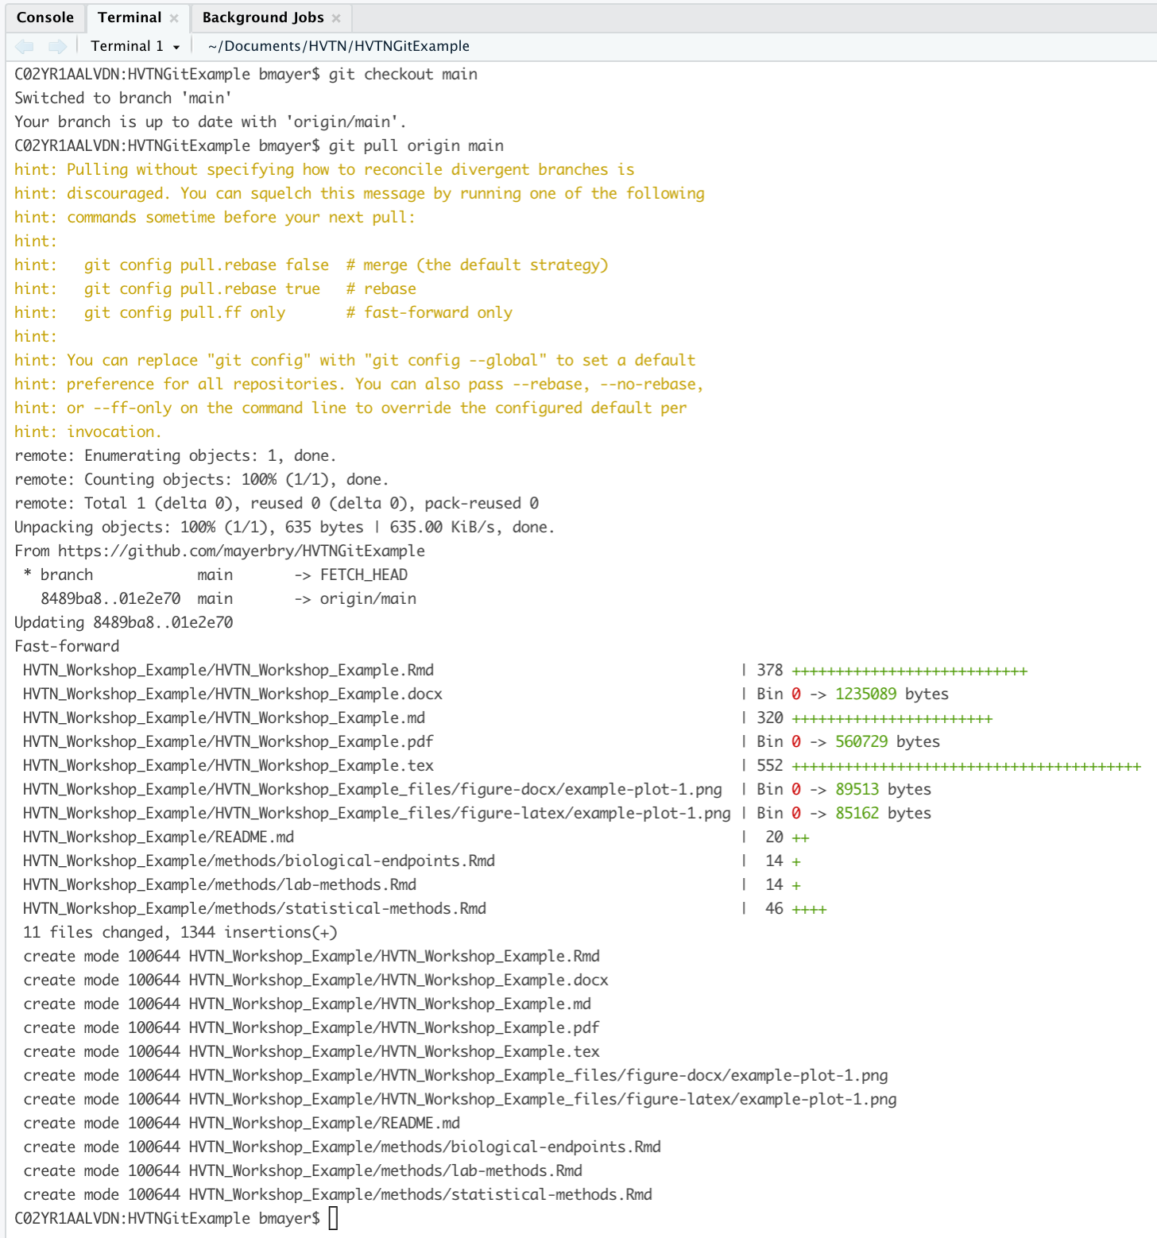
Cleaning up your local repo.
After a remote merge, remember to sync your local repo.
git checkout main
git pull origin main
Generally good practice to delete branch:
git branch –d example-branch
The remote copy of the branch can be deleted on GitHub.

Slide 23
All done!
Questions? Other examples?

