Slide 1

R Package Development and Validation
Package Documentation

Slide 2
Welcome
Documenting Functions with {roxygen2}
Long-form documentation in R packages
Checking your R package

Slide 3
Documenting Functions

Slide 4
?functionname
Notes:
What happens when you type ?functionname
As you may have guessed, especially given prior slide, it gives us the manual page of the function

Slide 5
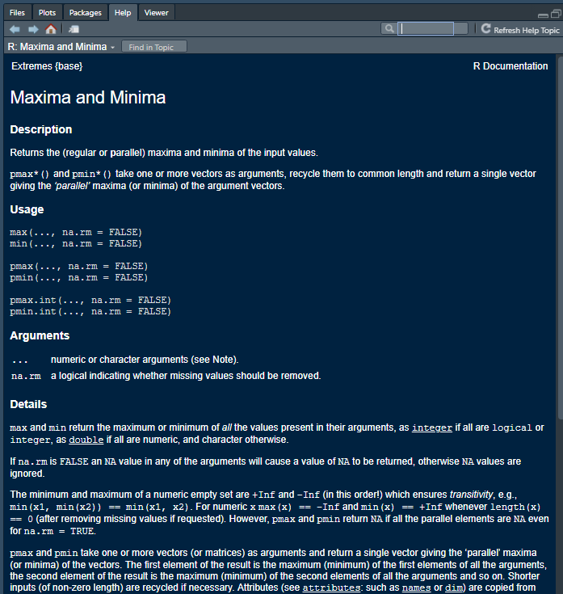
Function manuals
Describe the function
What does it do
What does it return
Identify arguments
What goes into the function
What are optional
Show examples
Notes:
What is a function manual
What does a function manual contain?
What is the value of a manual

Slide 6
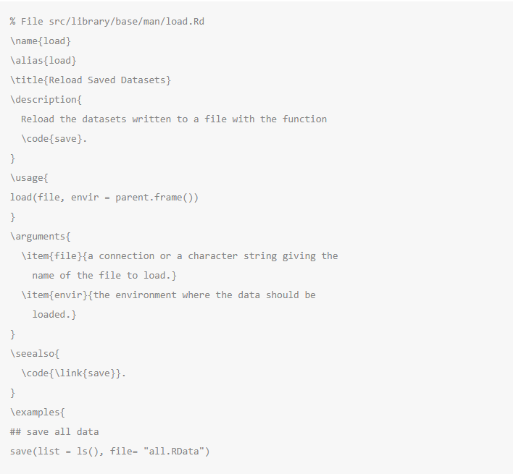
/man folder
Folder in package
“R Documentation“ format
(La)TeX-like
Can be difficult to write correctly
Notes:
Raw manual documents live within the /man folder
Short for manual
Special “Rd” markdown format – R Documentation
Reads similar to LaTeX, but may allow for other input formats inside of it
Key words with “\” ahead to drive linking etc
Stored and maintained separately from the package

Slide 7
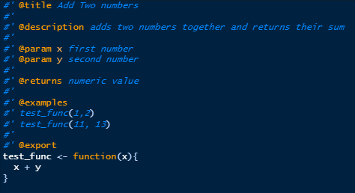
Roxygen2
INLINE with package
Structured comments
Title (@title)
Description (@description)
Arguments (@param)
Returns (@return)
Examples (@examples)
Export (@export)
Notes:
Roxygen2 package
Allows users to write their documentation WITHIN the R code
Specially formatted comments “#’ @argument”
Roxygen2 parses the source code and _generates_ the Rd files automagically for you
Reduces knowledge required to generate proper documentation
- Working in Rstudio means iof

Slide 8
devtools::document()

Slide 9
document
Updates all Rd files
Update NAMESPACE files
Checks outputs make sense
Past functions that were exported
? Will now work for your functions during development

Slide 10
Vignettes
Notes:
AKA Long form documentation

Slide 11
Long form documentation to share with the world how you expect everything to fit together
Notes:
Or Think of it as the instructions manual for your package
What are the various expected work flows
How does the algorithm work inder the hood
Which functions are supposed to work together
It is an easy entry point into the package

Slide 12
vignette(topic = “base”, package = “dplyr”)
Notes:
What happens when you type

Slide 13
usethis::use_vignette()

Slide 14
usethis::use_vignette(“R Package Validation Workshop”)
Creates the “/vignettes folder
Creates a vignette Rmd file with the appropriate header
Updates package information
adds knitr to the list of suggested packages
Adds information around which vignette builder to use to CRAN
Opens the file

Slide 15
Rendering Vignettes
Compiled by user with output left in “vignettes” folder
Compiled when built into bundle
Compiled on installation (if installing from source code)
Notes:
Vignettes are a way to check behavior has not changed, on top of unit testing, since they fail to build if
If working from an Rmd – (which is suggested), easy as any other Rmd build
Compiling will be discussed in the next piece

Slide 16
Check yourself

Slide 17
devtools::check()
Notes:
Runs checks for compatibility and best practices

Slide 18
Check
Checks if R can build package
Checks tests
Checks documentation
Returns warnings/errors/notes indicating things to update or fix if it finds any
Notes:
Can run this through rstudio when building a package in the “build” pane

Slide 19
devtools

Slide 20
devtools
Automates common tasks while developing an R package
Parse documentation – devtools::document()
Evaluate all tests in a package – devtools::test()
Evaluate a specific test file in a package – devtools::test_active_file()
Check package for best practices – devtools::check()
Load all package functions – devtools::load_all()
Install package from source – devtools::install()
Install package from remote source i.e. github – devtools::install_github()
devtools.r-lib.org
Notes:
We only covered a small % of the functions available in devtools, and are not going to go into advanced topics around including other languages, etc.

Slide 21
Materials 02-E2
Materials/Materials-02-Package_Elements_and_Structure/Materials-02-E02-Package_Documentation/
Notes:
Now its your turn! We’ll give you 8 Minutes!

