Slide 1

R Package Validation Workshop
Elements of
Validation

Slide 2
Welcome
{valtools} infrastructure
Elements of Validation
Reports

Slide 3
the setup
Notes:
This is a workshop on R package validation, what do R packages and validation have in common?
R packages are software

Slide 4
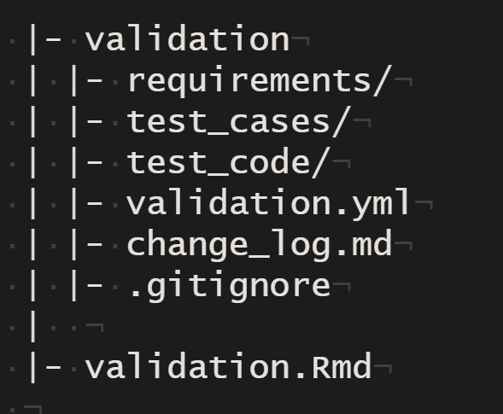
{valtools} infrastructure
report .RMD
validation folder
validation components
validation.yml
Working directory
Output directory
Users
Ordering of validation child files
[optional] change log
[as needed] .gitignore, .here
Notes:
Valtools anticipates that validation information is stored with the following folder structure:
A report RMD file which holds unevaluated code, and depends on contents of validation folder
A validation folder which includes:
Validation components: requirements, test cases and test code, each in their own sub-folder
validation.yml: file containing configuration details. These are accessed and managed via {valtools} helper functions and include information such as:
Working directory
Output directory
User details
Ordering of validation child files
[Optional] change log
Various files for compatibility with git and usethis (via here)
There are a few ways to add this skeleton to your project:
`vt_use_validation`: add just the validation folder to an existing directory
`vt_create_package`: initiate a new R package via {usethis} and include validation infrastructure.

Slide 5
the Elements
Notes:
This is a workshop on R package validation, what do R packages and validation have in common?
R packages are software

Slide 6
Validation Components
“confirmation by examination and provision of objective evidence that software specifications conform to user needs and intended uses, and that the particular requirements implemented through software can be consistently fulfilled.”
Notes:
Taking a step back to FDA guidance, there is no mention of the infrastructure to manage components of validation. {valtools} implements a framework for handling the organization of validation of R packages, so authors can focus on content creation.

Slide 7
Validation Components – what needs to be authored?
Requirements
Test Cases
Test Code
Notes:
{valtools} cannot help you decide what goes into components of validation. Requirements, Test cases, test code still need to be authored and subject to human review.

Slide 8
Validation Reporting – what can be tracked by automating?
Authorship
Most recent edit dates
Testing environment
Test results
Notes:
{valtools} provides tools to quickly grab info including validation components, testing environment details and the results of executing test code in a reproducible manner.

Slide 9
Requirements - vt_use_req()
Key Arguments
name – Name of the new requirement. Automatically adds an `md` extension
username – Name of the person creating the requirement
Notes:
What is needed to author requirements?
valtools::vt_use_req creates a new requirement file with prompts for essential elements. The content is written using markdown syntax, with roxygen2 tags for simple meta info.

Slide 10
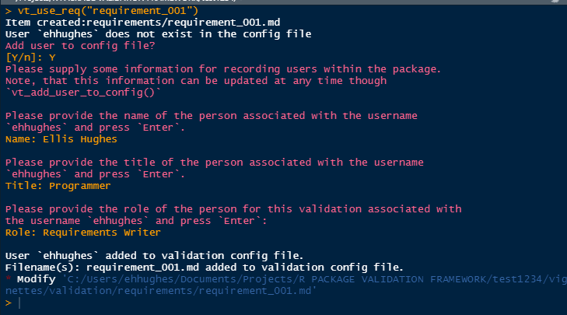
** interactive prompting

Slide 11
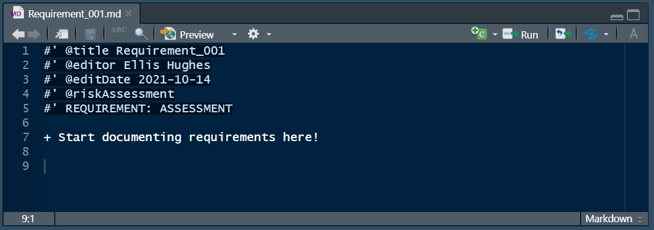
Requirements - vt_use_req()

Slide 12
Complete Exercise 4

