Slide 1

R Package Validation Workshop
The Validation Report

Slide 2
Welcome
Adding Test Cases
Adding Test Code
Validation Reports in R packages

Slide 3
Validation Elements

Slide 4
Test Cases - vt_use_test_case()
Key Arguments
name,
username
Name – requirement name
Username – Person’s name writing test case
Notes:
What is necessary to author test cases?
valtools::vt_use_test_cases creates a new test case file with prompts for essential elements. The content is written using markdown syntax, with roxygen2 tags for simple meta info.

Slide 5
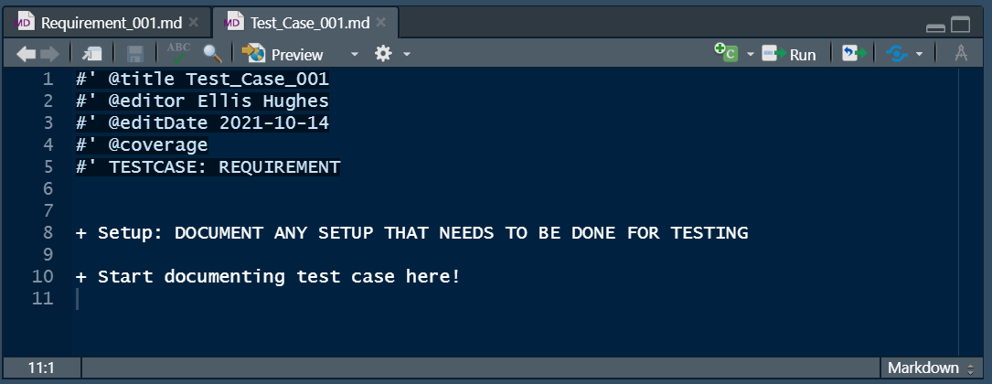
Test Cases - vt_use_test_case()
Notes:
What is necessary to author test cases?
valtools::vt_use_test_cases creates a new test case file with prompts for essential elements. The content is written using markdown syntax, with roxygen2 tags for simple meta info.

Slide 6
Test Code - vt_use_test_code()
Key Arguments
name,
username
Name – requirement name
Username – Person’s name writing test code
Notes:
What is necessary to author test code?
valtools::vt_use_test_code creates a new test code file with prompts for essential elements. The content is written using testthat syntax, with roxygen2 tags for simple meta info.

Slide 7
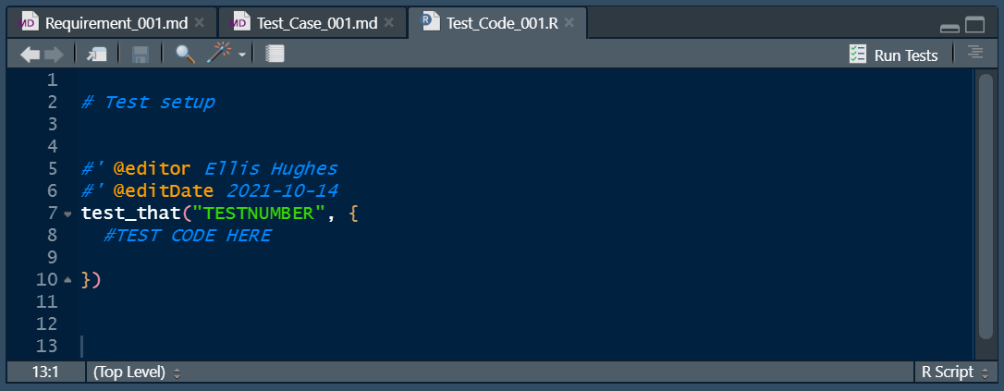
Test Code - vt_use_test_code()
Notes:
What is necessary to author test code?
valtools::vt_use_test_code creates a new test code file with prompts for essential elements. The content is written using testthat syntax, with roxygen2 tags for simple meta info.

Slide 8
Complete Exercise 5 Task A

Slide 9
Report

Slide 10
Report basics
Rmarkdown
Scrapes information saved across various files
Produces kables
Reads in the validation child files and parses them based on order in validation.yml

Slide 11
Validation Report Helpers
vt_path()
here::here(), but for validation contents
vt_file()
Renders contents based on extensions
Rmd parsed
Test code executed and results captured
Any other file contents are printed
Notes:
Validation report helpers manage the expectation of repeated rendering in a variety of scenarios:
Validation separate from a package e.g. validation of third party authored packages
Validation while developing, e.g. as part of c.i or for a git repo
Validation after install, e.g. if the working environment has been updated
Validation as part of distribution, e.g. when bundling for distribution

Slide 12
Child Files
Validation Report contains pointers for repeated evaluation across different validation environments
Order of child files can be specified by validation.yml
Default is grouped by “requirements”, “test_cases”, “test_code” and then alphabetically
Control via vt_get_child_files()
vt_add_file_to_config() & vt_drop_file_from_config()
Specify validation file (req, test case, test code)
Specify which file to add after/before using tidyselect syntax
Files added by default to the end by vt_use_*

Slide 13
Complete Exercise 5 Task B

Slide 14
Creating the validation report Rmd
vt_use_report()
Creates report from template with suggested contents
Adds dependencies to package DESCRIPTION
Two templates included: full validation report and a requirements approval report

Slide 15
Rendering Reports
vt_validate_report() executes the Rmd and saves output
Serves as “snapshot” in time

Slide 16
{valtools} Reports
Reports are Rmd and therefore infinitely customizable
Outputs of Rmd from validation to live in new output location
Serves as “snapshot” in time of package state

Slide 17
Customization options
Modify the report RMD generated via template
Write a report RMD from scratch
Propose a new template via {valtools} issue/PR
Switch between multiple RMDs by updating validation.yml as the project cycles through adoption and validation phases

Slide 18
Complete Exercise 5 Task C

