Slide 1

R Package Validation Workshop
Managing
Validation Projects

Slide 2
Welcome
Multiple Reports
Project Management Models
Ordering validation elements
Adding and removing users

Slide 3
Multiple Reports

Slide 4
{valtools} Reports
Key stake holders may not be programers
Not all stakeholders need a full report

Slide 5
Managing multiple reports
Requirements report – confirming with key stakeholders expectations
Validation report – Runs code and versions outputs

Slide 6

Validation Report Rendering
Valtools::vt_validate_report()
Automatically runs report
Versions and Dates
Runs in fresh R session

Slide 7
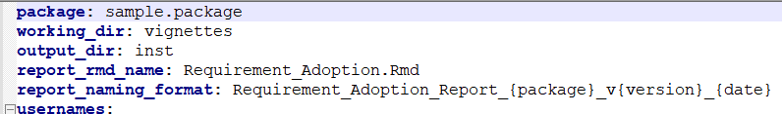
vt_validate_report Behavior
output_dir
report_rmd_name
report_naming_format

Slide 8
Project Management Models

Slide 9
Project Development Models
Waterfall Project Model
All Requirements designed up-font
Tests developed in once all requirements defined
Linear sequencing of events from requirement development to validation report

Slide 10
Project Development Models
Requirement 1
Requirement 2
Requirement 3
Test Case 1
Test Case 2
Test Case 3
Validation
Test Code 1
Test Code 2
Test Code 3
Validation Report

Slide 11
Project Development Models
Agile Project Model
Iterate on all elements based on user feedback
Short sprints to design and add/test features until users needs are met
Validation documentation may be generated and rerun after each sprint

Slide 12
Project Development Models
Requirement 1
Requirement 2
Requirement 3
…
Test Case 1
Test Case 3
Test Case 2
Test Code 1
Test Code 3
Test Code 2
Validation Report
Validation

Slide 13
Validation Element Ordering

Slide 14
Ordering options
Requirements, Test Cases and Test Code are developed over time
Order/Importance of each changes over time

Slide 15
Given Set of Requirements, How would you order them?
Numeric Vector Expectations
Data Ingestion Expectations
Character Vector Expectations
Data Writing Expectations

Slide 16
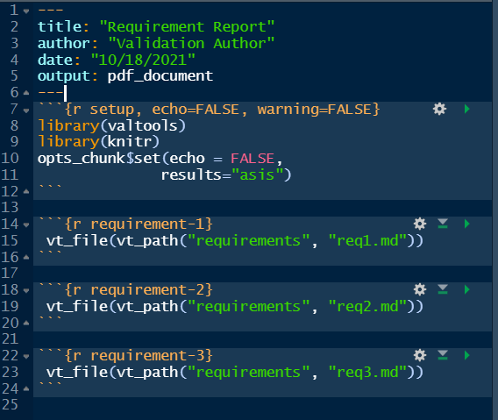
Ordering options
Updating Requirements and Validation Reports by hand
Ensure order matches across updates
If any numbering impacted, need to update

Slide 17
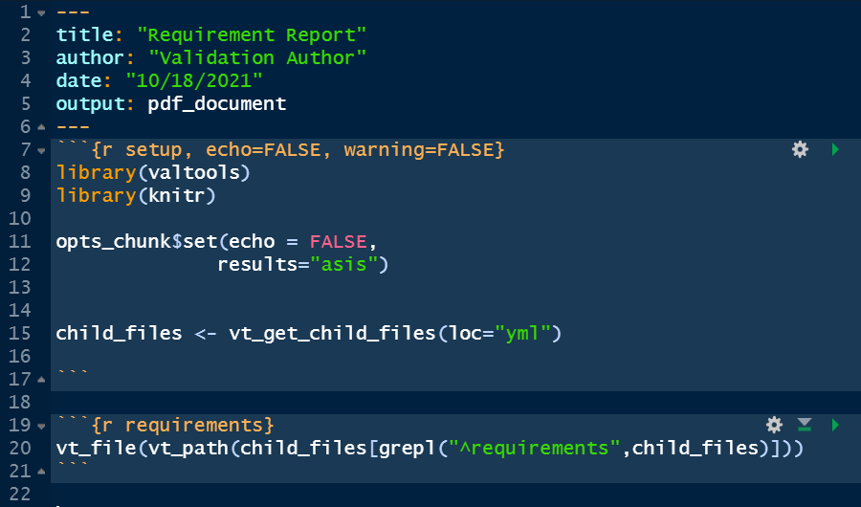
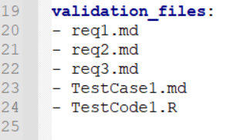
Ordering options
vt_get_child_files(loc=“yml”)
Vector of files in order of yml
vt_file()
Serialized across vectors

Slide 18
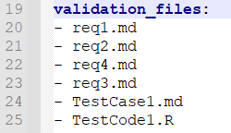
Validation File Order options
vt_add_file_to_config()
filename
before, after (tidyselect verbs)
vt_drop_file_from_config()
filename

Slide 19
Users across time

Slide 20


Slide 21
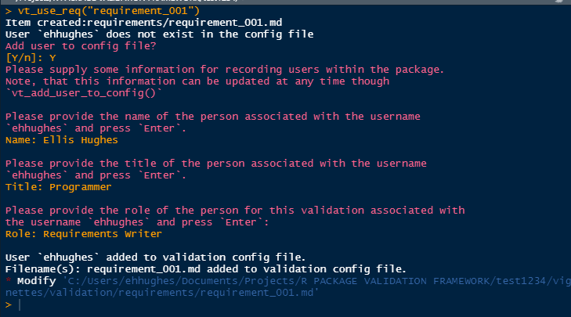
interactive prompting from vt_use_*()

Slide 22
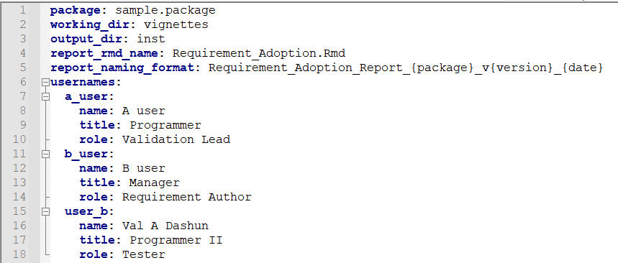
Validation Users

Slide 23
Validation Team Recording options
vt_add_user_to_config()
vt_drop_user_from_config()

Slide 24
Complete Exercise 06
Navigate to Materials/Materials-06-Validation_Project_Management

