Slide 1

R Package Validation Workshop
Elements of
Validation

Slide 2
Welcome
{valtools} setup
Elements of Validation
Reports

Slide 3
the setup
Notes:
This is a workshop on R package validation, what do R packages and validation have in common?
R packages are software

Slide 4
{valtools} Packets
vt_create_packet()
Location
Target of validation
Notes:
Valtools anticipates that validation information is stored with the following folder structure:
A report RMD file which holds unevaluated code, and depends on contents of validation folder
A validation folder which includes:
Validation components: requirements, test cases and test code, each in their own sub-folder
validation.yml: file containing configuration details. These are accessed and managed via {valtools} helper functions and include information such as:
Working directory
Output directory
User details
Ordering of validation child files
[Optional] change log
Various files for compatibility with git and usethis (via here)
There are a few ways to add this skeleton to your project:
`vt_use_validation`: add just the validation folder to an existing directory
`vt_create_package`: initiate a new R package via {usethis} and include validation infrastructure.

Slide 5
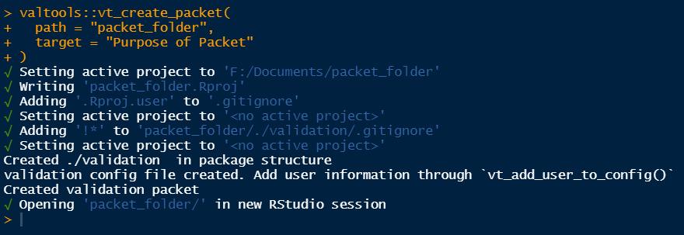
{valtools} Packets
Notes:
Valtools anticipates that validation information is stored with the following folder structure:
A report RMD file which holds unevaluated code, and depends on contents of validation folder
A validation folder which includes:
Validation components: requirements, test cases and test code, each in their own sub-folder
validation.yml: file containing configuration details. These are accessed and managed via {valtools} helper functions and include information such as:
Working directory
Output directory
User details
Ordering of validation child files
[Optional] change log
Various files for compatibility with git and usethis (via here)
There are a few ways to add this skeleton to your project:
`vt_use_validation`: add just the validation folder to an existing directory
`vt_create_package`: initiate a new R package via {usethis} and include validation infrastructure.

Slide 6
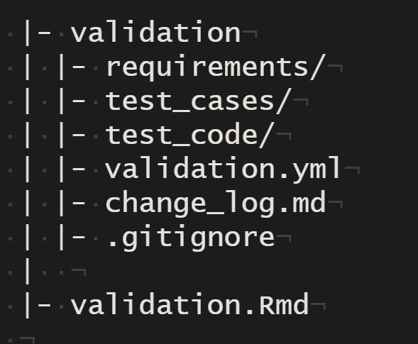
{valtools} infrastructure
Validation folder
Validation Elements
validation.yml
R Markdown Report located at the root directory
Not created by default
Notes:
Valtools anticipates that validation information is stored with the following folder structure:
A report RMD file which holds unevaluated code, and depends on contents of validation folder
A validation folder which includes:
Validation components: requirements, test cases and test code, each in their own sub-folder
validation.yml: file containing configuration details. These are accessed and managed via {valtools} helper functions and include information such as:
Working directory
Output directory
User details
Ordering of validation child files
[Optional] change log
Various files for compatibility with git and usethis (via here)
There are a few ways to add this skeleton to your project:
`vt_use_validation`: add just the validation folder to an existing directory
`vt_create_package`: initiate a new R package via {usethis} and include validation infrastructure.

Slide 7
the Elements - Requirements-
Notes:
This is a workshop on R package validation, what do R packages and validation have in common?
R packages are software

Slide 8
Validation Components
“confirmation by examination and provision of objective evidence that software specifications conform to user needs and intended uses, and that the particular requirements implemented through software can be consistently fulfilled.”
Notes:
Taking a step back to FDA guidance, there is no mention of the infrastructure to manage components of validation. {valtools} implements a framework for handling the organization of validation of R packages, so authors can focus on content creation.

Slide 9
Validation Components – what needs to be authored?
Requirements
Test Cases
Test Code
Notes:
{valtools} cannot help you decide what goes into components of validation. Requirements, Test cases, test code still need to be authored and subject to human review.

Slide 10
Requirements
Record the expectations, goals, and risks of project
Test Cases
Test Code
Implementation of the test cases in code
Validation Report
Describes how code meets specifications
Combines all prior content into report documenting proof that code meets specifications

Slide 11
Requirements - vt_use_req()
Key Arguments
name – Name of the new requirement. Automatically adds an `md` extension if not provided. `md` and `Rmd` acceptable extensions
username – Name of the person creating the requirement
Notes:
What is needed to author requirements?
valtools::vt_use_req creates a new requirement file with prompts for essential elements. The content is written using markdown syntax, with roxygen2 tags for simple meta info.

Slide 12
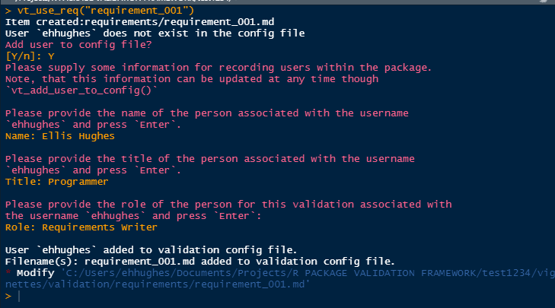
** interactive prompting

Slide 13
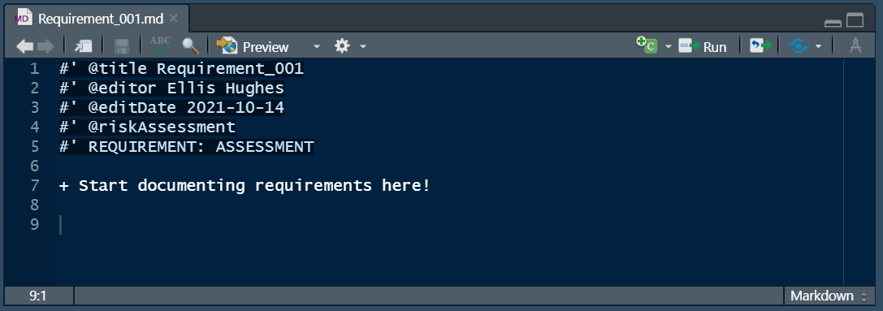
Requirements - vt_use_req()

Slide 14
Requirements Report
Notes:
This is a workshop on R package validation, what do R packages and validation have in common?
R packages are software

Slide 15
{valtools} infrastructure

Slide 16
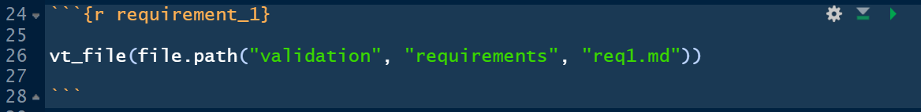
Report Helper – vt_file
Key Arguments
file – path to the file to render
Strips roxygen header and renders file into markdown
Vectorized

Slide 17
Complete Exercise 4
Navigate to Materials/Materials-04-Requirements_Report

