Slide 1

R Package Validation Workshop
The Validation Report

Slide 2
Welcome
Adding Test Cases & Test Code
Validation Reports

Slide 3
Validation Elements

Slide 4
Requirements
Record the expectations, goals, and risks of project
Test Cases
Test Code
Implementation of the test cases in code
Validation Report
Describes how code meets specifications
Combines all prior content into report documenting proof that code meets specifications

Slide 5
Test Cases - vt_use_test_case()
Key Arguments
name – Test case name
username - Person’s name writing test case
Generates file and opens for editing
Notes:
What is necessary to author test cases?
valtools::vt_use_test_cases creates a new test case file with prompts for essential elements. The content is written using markdown syntax, with roxygen2 tags for simple meta info.

Slide 6
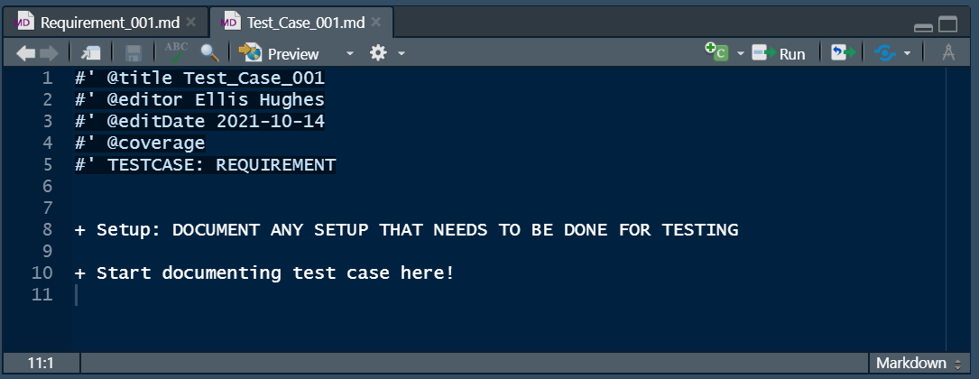
Test Cases - vt_use_test_case()
Notes:
What is necessary to author test cases?
valtools::vt_use_test_cases creates a new test case file with prompts for essential elements. The content is written using markdown syntax, with roxygen2 tags for simple meta info.

Slide 7
Requirements
Record the expectations, goals, and risks of project
Test Cases
Test Code
Implementation of the test cases in code
Validation Report
Describes how code meets specifications
Combines all prior content into report documenting proof that code meets specifications

Slide 8
Test Code - vt_use_test_code()
Key Arguments
name – Test code name
username - Person’s name writing test cod
Generates file and opens for editing
Notes:
What is necessary to author test code?
valtools::vt_use_test_code creates a new test code file with prompts for essential elements. The content is written using testthat syntax, with roxygen2 tags for simple meta info.

Slide 9
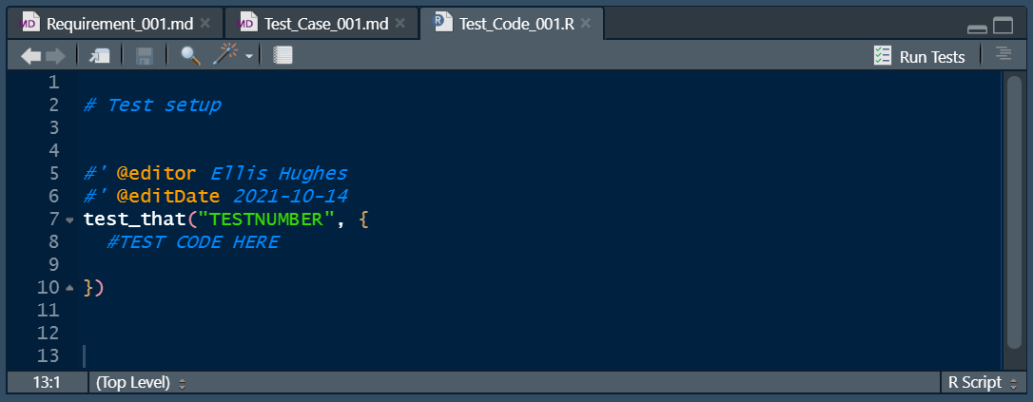
Test Code - vt_use_test_code()
Notes:
What is necessary to author test code?
valtools::vt_use_test_code creates a new test code file with prompts for essential elements. The content is written using testthat syntax, with roxygen2 tags for simple meta info.

Slide 10
Validation Report

Slide 11
Requirements
Record the expectations, goals, and risks of project
Test Cases
Test Code
Implementation of the test cases in code
Validation Report
Describes how code meets specifications
Combines all prior content into report documenting proof that code meets specifications

Slide 12
Report basics
Parse each requirement and test case file
Evaluate and capture test code results and print

Slide 13
{valtools} Reports
Reports are Rmd and therefore infinitely customizable
Provided many helper functions with valtools
Environment
Scraping Validation information
Recording News, etc

Slide 14
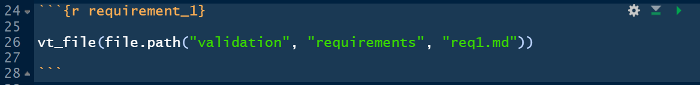
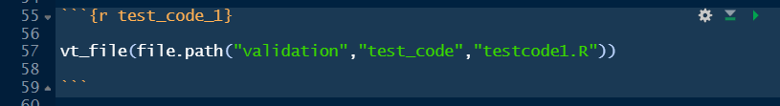
Report Helper – vt_file
Key Arguments
file – path to the file to render

Slide 15
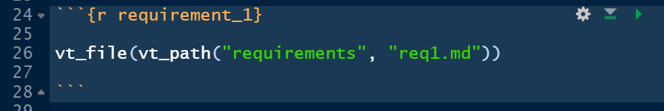
Report Helper – vt_path
Key Arguments
file – path components to a file
Like here::here(), reference is the validation folder
Useful for other validation contexts (within package)

Slide 16
Rendering Reports
vt_validate_report() executes the Rmd and saves output
Serves as “snapshot” in time
Rmd result from validation to output location

Slide 17
Complete Exercise 5
Navigate to Materials/Materials-05-Validation_Report

