Slide 1

R Package Validation Workshop
Internal R Package
Validation

Slide 2
Welcome
Internal Packages
Validation Approaches for Internal Packages

Slide 3
Internal Packages

Slide 4
{valtools} Packages
vt_create_package()
Package folder
Valid package name
Creates package infrastructure
Creates valtools validation infrastructure
Notes:
Valtools anticipates that validation information is stored with the following folder structure:
A report RMD file which holds unevaluated code, and depends on contents of validation folder
A validation folder which includes:
Validation components: requirements, test cases and test code, each in their own sub-folder
validation.yml: file containing configuration details. These are accessed and managed via {valtools} helper functions and include information such as:
Working directory
Output directory
User details
Ordering of validation child files
[Optional] change log
Various files for compatibility with git and usethis (via here)
There are a few ways to add this skeleton to your project:
`vt_use_validation`: add just the validation folder to an existing directory
`vt_create_package`: initiate a new R package via {usethis} and include validation infrastructure.

Slide 5
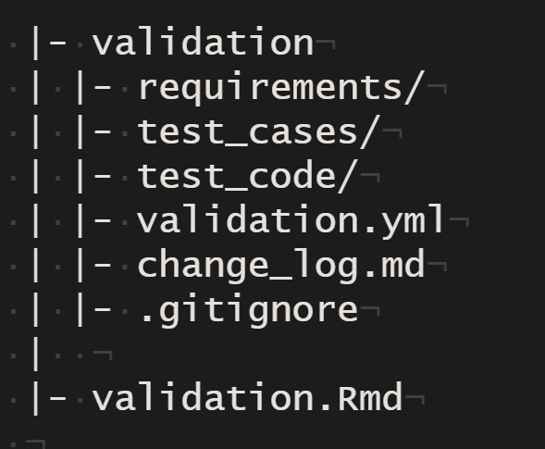
{valtools} Packages
Vignettes folder (default)
Validation Elements
validation.yml
Vignette serves as validation report
Notes:
Valtools anticipates that validation information is stored with the following folder structure:
A report RMD file which holds unevaluated code, and depends on contents of validation folder
A validation folder which includes:
Validation components: requirements, test cases and test code, each in their own sub-folder
validation.yml: file containing configuration details. These are accessed and managed via {valtools} helper functions and include information such as:
Working directory
Output directory
User details
Ordering of validation child files
[Optional] change log
Various files for compatibility with git and usethis (via here)
There are a few ways to add this skeleton to your project:
`vt_use_validation`: add just the validation folder to an existing directory
`vt_create_package`: initiate a new R package via {usethis} and include validation infrastructure.

Slide 6
Package Development
Validation Report
R Package Development
Test Cases
Test Code
Requirements
Record the expectations, goals, and risks of project
Implementation of requirements into R package
Describes how code meets specifications
Implementation of the test cases in code
Combines all prior content into report documenting proof that code meets specifications

Slide 7
Package Development
Validation Report
R Package Development
Test Cases
Test Code
Requirements
Record the expectations, goals, and risks of project
Implementation of requirements into R package
Describes how code meets specifications
Implementation of the test cases in code
Combines all prior content into report documenting proof that code meets specifications

Slide 8




Package Development
Standard Package Development Process
usethis
devtools
roxygen2
rmarkdown
testthat
Notes:
Why this should NOT be used for package development/distribution:
Validation reports PDFs are not visible to users after installation
Validation RMD cannot be run after install for re-validation

Slide 9

Package Development
Standard Package Development Process
usethis
devtools
roxygen2
rmarkdown
testthat
valtools set at an imported package
Support specialized roxygen tags
editor
editdate
Validation Vignette Compilation
Notes:
Why this should NOT be used for package development/distribution:
Validation reports PDFs are not visible to users after installation
Validation RMD cannot be run after install for re-validation

Slide 10
Sharing Your Package Validation

Slide 11
Source

Slide 12
vt_validate_source()
For testing/release of source code
Temporary installation to test on system

Slide 13
Build

Slide 14
vt_validate_build()
Builds source code, includes all components of validation into tarball
For release of source code with controlled versions
Users have access to install as necessary
Notes:
https://r-pkgs.org/package-structure-state.html#bundled-package

Slide 15
INSTALL

Slide 16
vt_validate_install()
Builds tarball and Installs
Runs validation report on installed system

Slide 17
Re-Validation

Slide 18
vt_validate_installed_package()
ONLY works for the following
vt_validate_install()
tarball created by `vt_validate_build()`
Run when environment has changed, but installation has not

