Slide 1

R Package Development and Validation
Welcome and Orientation

Slide 2
Welcome
Who are we
Why are we here
How are we going to get there
When is this going to be done
Where do we go from here

Slide 3
Who are we

Slide 4
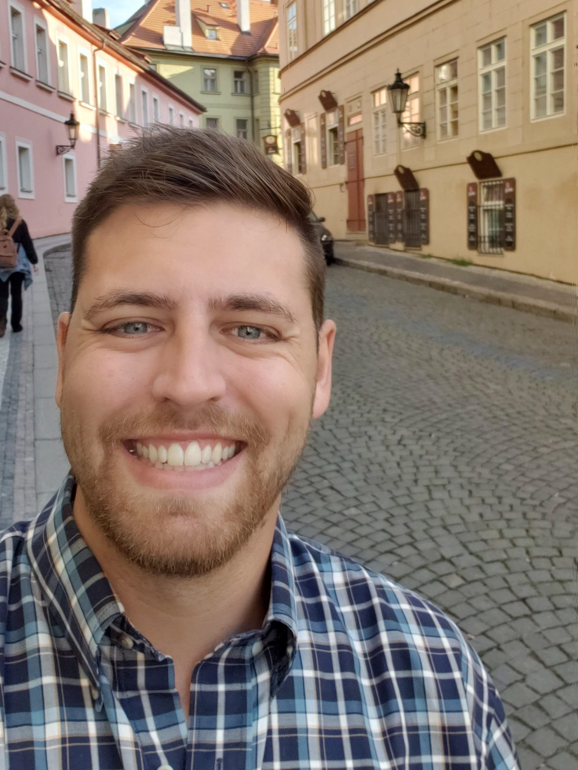


Ellis Hughes
Statistical Programmer
Statistical Genetics
Vaccine Research
Community
Seattle UseR
Cascadia R
R/Pharma
TidyX Screencast
@ellis_hughes
thebioengineer

Slide 5
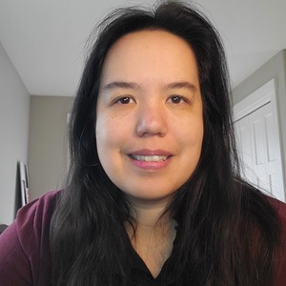

Marie Vendettuoli
Statistical Programmer
R package developer
Industry & gov regulatory experience
Recovering wet lab scientist
mariev
www.linkedin.com/in/mvendettuoli
@mvendettuoli

Slide 6
Why are we here

Slide 7
Workshop Goals
An understanding of basic package development
Structure
Function writing
Documentation
How to Validate an R Package
what is validation
the R Package validation Framework
{valtools} R package

Slide 8
Workshop Code of Conduct
Review the Cascadia R Conference Code of Conduct
https://cascadiarconf.com/policies/
Issues can be brought to our attention by
contacting an organizer
email cascadiarcon@gmail.com
Do not record this workshop to respect the privacy of others.
We do this to create an open, collaborative space where people can feel comfortable to learn and grow.

Slide 9
How are we going to get there

Slide 10
Workshop Materials
bit.ly/R_Validation_Tutorial
Slides folder contains presentation slides
Materials folder contains 2 types of exercises: Sparse or Verbose
Workshop slides and exercises are online now and will be available after the conference too.

Slide 11

R Studio Cloud workspace
R Package Validation Workshop
Please check your email for invites!

Slide 12
Slack Chat
bit.ly/cascadia_validation_slack
Polls to understand where the everyone is on the examples
Pose questions for the instructors to answer
Alternatively, directly message one of the instructors
Pose questions to the rest of the class
Zoom Chat has been disabled

Slide 13
When are we getting there

Slide 14
Workshop Schedule
Time | Section | Content
10:00-10:10 | Welcome and Orientation
10:10-11:20 | Package Elements & Structure | Package Elements & Structure
 |  | Package Documentation
 |  | Deploying R Packages
11:20 - 11:30 | Break
11:30 - 12:00 | Concepts of R Package Validation | Introduction to the R Package Validation Framework
12:00 - 1:30 | Lunch
130 - 2:30 | Introduction to {valtools} | Intro to {valtools}
 |  | Structure of Test Cases and Code
 |  | Elements of a Validation Report
2:30- 2:40 | Break
2:40-3:10 |  | Re-Validating a Package
3:10 -3:30 | Closeout
Notes:
During lunch the Digital track for Cascadia R will be released – Be sure to check it out!

Slide 15
Where do we go from here

Slide 16
What if this is too much?!
Notes:
Please ask questions - we are here to help! Also, we will work through the examples together.
Post questions into the slack channel is preferred to raising your hand on zoom or posting into zoom chat so it is preserved for the future and we can make improvements to the workshop.

Slide 17
What if this is too basic?!
Notes:
Bear with us. We will get into more complex topics in validation. This workshop is specifically trying to build a foundation for knowledge. And you never know, you might learn something.
Also, as we go into breakout rooms, it would be helpful if you could work with the rest of the members of the breakout group to answer any questions. There are more of you than us, and any help we can get is appreciated!

Slide 18
What if I find an issue in the documentation?
Notes:
Please open an issue in the github page. We are human, we did our best, but would love to do better and make this easy for you to understand these concepts
Also, anything that would help make things clearer we would love to know too!

Slide 19
What if I get stuck?
Notes:
That is okay – if you are working on the sparse exercise documentation, go back to the more verbose set! Also, we will be setting up break out rooms, so see if any other members are also stuck. You can also pose a question in slack to the rest of the workshop or directly message the instructors.
Finally, we will work through all the answers together!

Slide 20
What if we are in the middle of a pandemic, there are killer bees, and ...!?
Notes:
I don’t think I can help you there..

Slide 21
Ready? Lets Go!
Clone https://github.com/FredHutch/R_Package_Validation_Tutorial
OR view “R Package Validation Workshop” project space in RStudio Cloud
Notes:
If you have not yet, clone the R Package Validation Tutorial repository or make sure you have access to materials via RStudio Cloud.
Github.com/FredHutch/R_Package_Validation_Tutorial
We will move onto the first series – basics of package building!

