Slide 1

R Package Development and Validation
Elements of
Validation

Slide 2
Welcome
{valtools} infrastructure
Elements of Validation
Reports

Slide 3
the setup
Notes:
This is a workshop on R package validation, what do R packages and validation have in common?
R packages are software

Slide 4
{valtools} infrastructure
vt_use_validation()
Create valdation folder
Create validation.yml
Working directory
Output directory
Users
Validation files
Notes:
Valtools is reliant on the valdation.yml file to tell it a lot of the intentions and locations for the validation
Most of the time users will not have to interact with the yml, provided helper functions

Slide 5
the Elements
Notes:
This is a workshop on R package validation, what do R packages and validation have in common?
R packages are software

Slide 6
Validation Components
“confirmation by examination and provision of objective evidence that software specifications conform to user needs and intended uses, and that the particular requirements implemented through software can be consistently fulfilled.”

Slide 7
Validation Components
Requirements
Test Cases
Test Code & Results

Slide 8
Validation Components
Requirements
Test Cases
Test Code & Results

Slide 9
Requirements - vt_use_req()
Key Arguments
name,
username
Name – requirement name
Username – Person’s name writing requirement
Markdown document with proper roxygen headers
Editor
editDate
riskAssessment

Slide 10
Test Cases - vt_use_test_case()
Key Arguments
name,
username
Name – requirement name
Username – Person’s name writing test case
Markdown document with proper roxygen headers
Editor
editDate
coverage

Slide 11
Test Code - vt_use_test_code()
Key Arguments
name,
username
Name – requirement name
Username – Person’s name writing test code
Markdown document with proper roxygen headers
Editor
editDate

Slide 12
Users
valtools tracks users and their roles in the validation.yml file
If a user creates a file not seen before, prompted for their user information
Manually add a person via vt_add_user_to_config()
Need: username, name, role, title

Slide 13
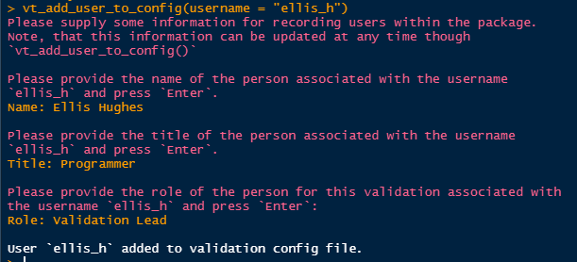

Slide 14
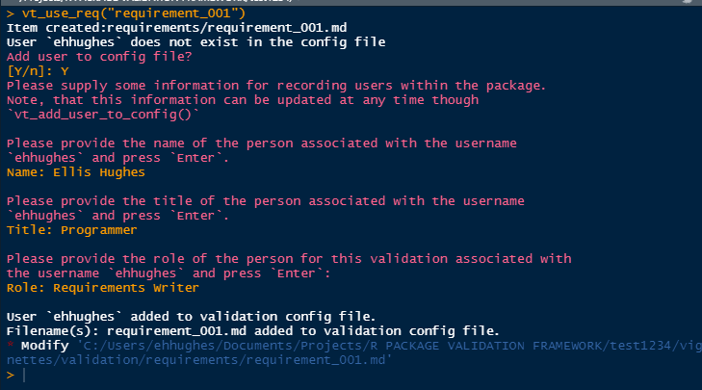
vt_use_* prompting

Slide 15
Report

Slide 16
Creating the validation report Rmd
vt_use_report()
Creates report from template with suggested contents
Adds dependencies to package DESCRIPTION
Two types: full validation report and a requirements approval template

Slide 17
Report basics
Rmarkdown
Scrapes information saved across various files
Produces kables
Reads in the validation child files and parses them based on order in validation.yml

Slide 18
Report basics
Rmarkdown
Scrapes information saved across various files
Produces kables
Reads in the validation child files and parses them based on order in validation.yml

Slide 19
Validation Report Helpers
vt_path()
here::here(), but for validation contents
vt_file()
Renders contents based on extensions
Rmd parsed
Test code executed and results captured
Any other file contents are printed

Slide 20
Child Files
Validation Report intended to be dynamic
Order of child files determined by validation.yml
vt_add_file_to_config() & vt_drop_file_from_config()
Specify validation file (req, test case, test code)
Specify which file to add after/before using tidyselect syntax
Files added by default to the end by vt_use_*

Slide 21
Rendering Reports
vt_validate_report() executes the Rmd and saves output
Serves as “snapshot” in time

Slide 22
Materials 04-E1
Materials/Materials-04-Introduction_to_Valtools/Materials-04-E01-Validation_Test_Code

