Slide 1

R Package Validation Workshop
Elements of
Validation

Slide 2
Welcome
{valtools} infrastructure
Elements of Validation
Reports

Slide 3
the setup
Notes:
This is a workshop on R package validation, what do R packages and validation have in common?
R packages are software

Slide 4
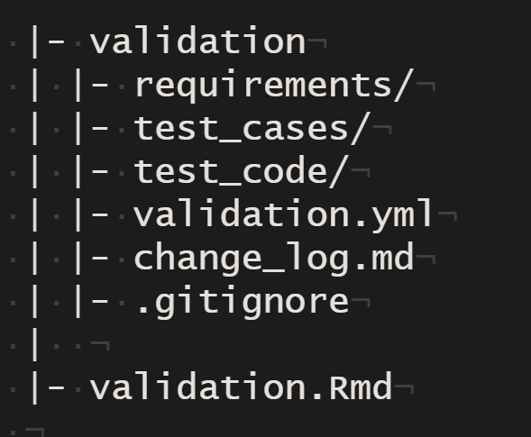
{valtools} infrastructure
report .RMD
validation folder
validation components
validation.yml
Working directory
Output directory
Users
Ordering of validation child files
[optional] change log
[as needed] .gitignore, .here
Notes:
Valtools anticipates that validation information is stored with the following folder structure:
A report RMD file which holds unevaluated code, and depends on contents of validation folder
A validation folder which includes:
Validation components: requirements, test cases and test code, each in their own sub-folder
validation.yml: file containing configuration details. These are accessed and managed via {valtools} helper functions and include information such as:
Working directory
Output directory
User details
Ordering of validation child files
[Optional] change log
Various files for compatibility with git and usethis (via here)
There are a few ways to add this skeleton to your project:
`vt_use_validation`: add just the validation folder to an existing directory
`vt_create_package`: initiate a new R package via {usethis} and include validation infrastructure.

Slide 5
the Elements
Notes:
This is a workshop on R package validation, what do R packages and validation have in common?
R packages are software

Slide 6
Validation Components
“confirmation by examination and provision of objective evidence that software specifications conform to user needs and intended uses, and that the particular requirements implemented through software can be consistently fulfilled.”
Notes:
Taking a step back to FDA guidance, there is no mention of the infrastructure to manage components of validation. {valtools} implements a framework for handling the organization of validation of R packages, so authors can focus on content creation.

Slide 7
Validation Components – what needs to be authored?
Requirements
Test Cases
Test Code
Notes:
{valtools} cannot help you decide what goes into components of validation. Requirements, Test cases, test code still need to be authored and subject to human review.

Slide 8
Validation Reporting – what can be tracked by automating?
Authorship
Most recent edit dates
Testing environment
Test results
Notes:
{valtools} provides tools to quickly grab info including validation components, testing environment details and the results of executing test code in a reproducible manner.

Slide 9
Requirements - vt_use_req()
Key Arguments
name,
username
Name – requirement name
Username – Person’s name writing requirement
Markdown document with proper roxygen headers
Editor
editDate
riskAssessment
Notes:
What is needed to author requirements?
valtools::vt_use_req creates a new requirement file with prompts for essential elements. The content is written using markdown syntax, with roxygen2 tags for simple meta info.

Slide 10
Test Cases - vt_use_test_case()
Key Arguments
name,
username
Name – requirement name
Username – Person’s name writing test case
Markdown document with proper roxygen headers
Editor
editDate
coverage
Notes:
What is necessary to author test cases?
valtools::vt_use_test_cases creates a new test case file with prompts for essential elements. The content is written using markdown syntax, with roxygen2 tags for simple meta info.

Slide 11
Test Code - vt_use_test_code()
Key Arguments
name,
username
Name – requirement name
Username – Person’s name writing test code
Markdown document with proper roxygen headers
Editor
editDate
Notes:
What is necessary to author test code?
valtools::vt_use_test_code creates a new test code file with prompts for essential elements. The content is written using testthat syntax, with roxygen2 tags for simple meta info.

Slide 12
Users
valtools tracks users and their roles in the validation.yml file
If a user creates a file not seen before, prompted for their user information
Manually add a person via vt_add_user_to_config()
Need: username, name, role, title
Notes:
{valtools} defines users as the group of individuals that need to sign off on the report.

Slide 13
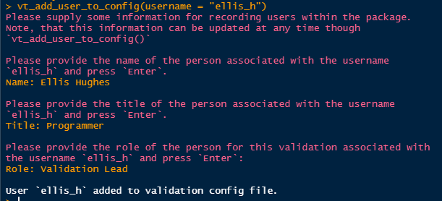

Slide 14
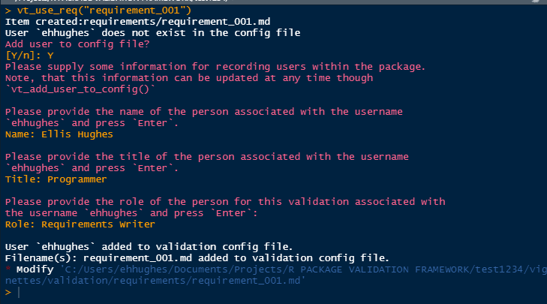
vt_use_* prompting

Slide 15
Complete Exercise 4 Task A

Slide 16
Report

Slide 17
Creating the validation report Rmd
vt_use_report()
Creates report from template with suggested contents
Adds dependencies to package DESCRIPTION
Two templates included: full validation report and a requirements approval report

Slide 18
Report basics
Rmarkdown
Scrapes information saved across various files
Produces kables
Reads in the validation child files and parses them based on order in validation.yml

Slide 19
Validation Report Helpers
vt_path()
here::here(), but for validation contents
vt_file()
Renders contents based on extensions
Rmd parsed
Test code executed and results captured
Any other file contents are printed
Notes:
Validation report helpers manage the expectation of repeated rendering in a variety of scenarios:
Validation separate from a package e.g. validation of third party authored packages
Validation while developing, e.g. as part of c.i or for a git repo
Validation after install, e.g. if the working environment has been updated
Validation as part of distribution, e.g. when bundling for distribution

Slide 20
Child Files
Validation Report contains pointers for repeated evaluation across different validation environments
Order of child files can be specified by validation.yml
Default is grouped by “requirements”, “test_cases”, “test_code” and then alphabetically
Control via vt_get_child_files()
vt_add_file_to_config() & vt_drop_file_from_config()
Specify validation file (req, test case, test code)
Specify which file to add after/before using tidyselect syntax
Files added by default to the end by vt_use_*

Slide 21
Rendering Reports
vt_validate_report() executes the Rmd and saves output
Serves as “snapshot” in time

Slide 22
Complete Exercise 4 Task B

Slide 23
Report Ordering

Slide 24
Validation Reporting Order– How does valtools know the order to report everything
validation.yml
Updated as vt_use_* called
On creation call, can set location
Edit yml directly or relocate through:
vt_drop_file_from_config()
Vt_add_file_to_config()
Notes:
{valtools} provides tools to quickly grab info including validation components, testing environment details and the results of executing test code in a reproducible manner.

Slide 25
Complete Exercise 4 Task C

