Slide 1

R Package Development and Validation
Package Elements
& Structure

Slide 2
Welcome
Functions
Unit Testing
Building a package

Slide 3
Functions

Slide 4
UDFs (User defined functions)
Functions help keep your code DRY
Functions abstract concepts
Functions are testable

Slide 5
Don’t Repeat Yourself

Slide 6
Don’t Repeat Yourself

Slide 7
Don’t Repeat Yourself
DRY

Slide 8
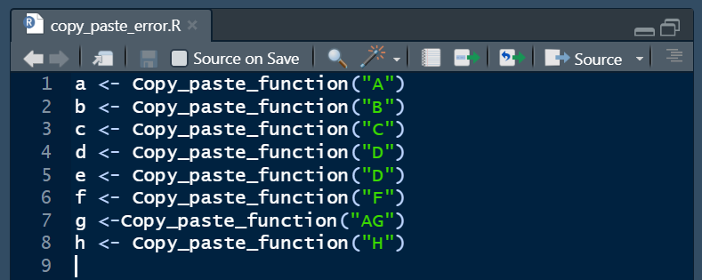
DRY
Copy Paste Errors
Updating errors
Propagation of updates

Slide 9
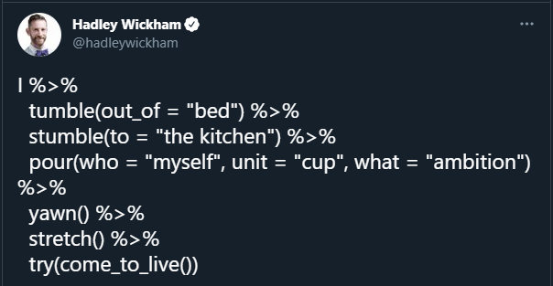
Abstracting Concepts
Quote Tweet from Hadley Wickham (@hadleywickham)
February 11, 2021
https://twitter.com/hadleywickham/status/1359852563726819332
Notes:
Examples of functions and arguments implementing Dolly Parton’s `9 to 5`

Slide 10
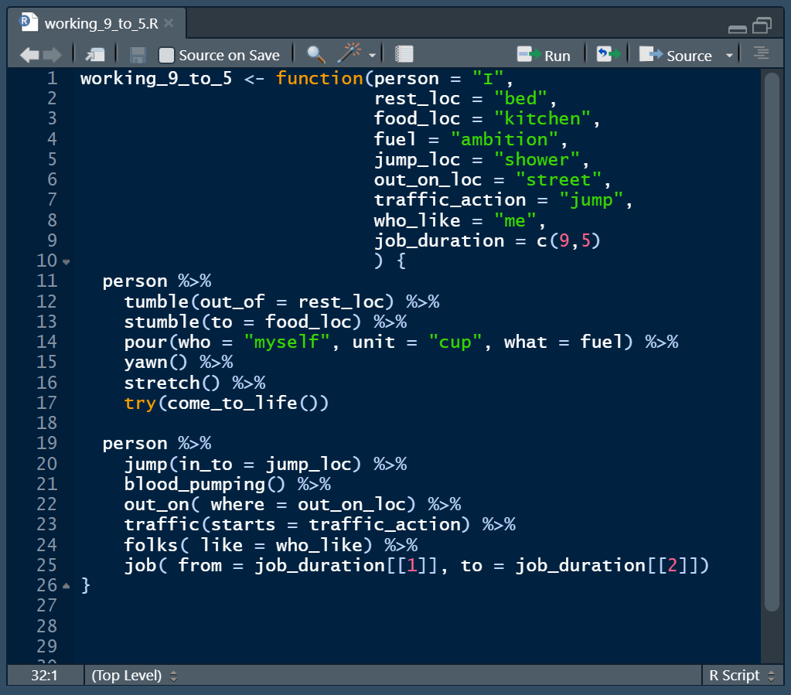
Abstracting Concepts
Functions allow you to abstract processes
Functions can be built from other functions
Functions can be used for specific returned objects or side effects
Side effects: Plots, changes to environment or object

Slide 11
Testable
Specific behavior
Known input means known output
Reproducible

Slide 12
Unit Testing

Slide 13
Unit Testing
Test to show code behave as function author expects
Repeatable to show code behavior does not change over time

Slide 14
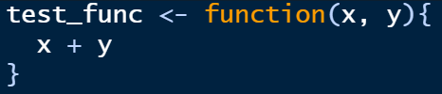
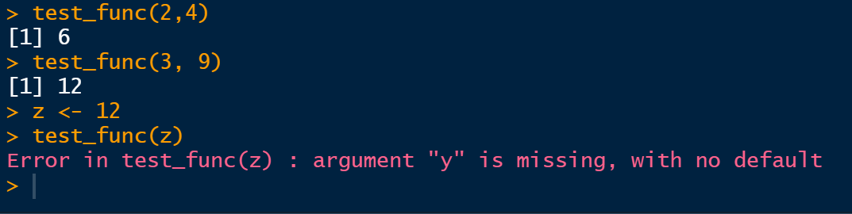
Unit Testing
Notes:
How many of you write out a function, like this simple example, run it,
then immediately your console looks like this

Slide 15

Congratulations!
You were UNIT TESTING!
Notes:
well,… kind of

Slide 16
Congratulations!
You were Manually UNIT TESTING!

Slide 17
Test Function behavior as unit tests
Formalize the testing being done
Units
Given an input, function returns an expected output
Expectations

Slide 18
Testthat unit testing framework
Units ➔ test_that()
Expectations ➔ expect_* family of functions
expect_equal()
expect_true() / expect_false()
expect_error()
expect_warning()
https://testthat.r-lib.org/reference/index.html - full list of expectations

Slide 19
Formalize Testing
Notes:
Turn this into a testthat test

Slide 20
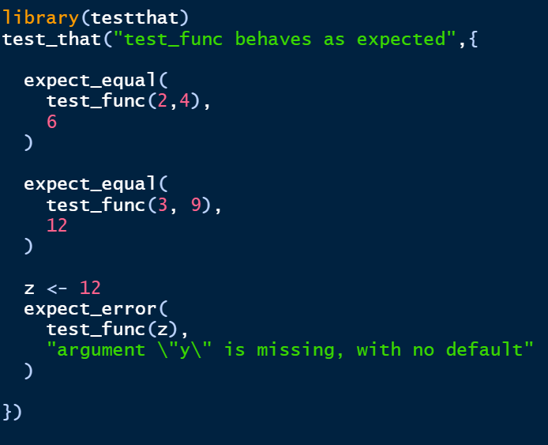
Notes:
Convert all our tests into expectations
The first one was checking if the output was 6
Second checking if the output was 12
The last one checked if we got an error when the didn’t pass the second argument

Slide 21
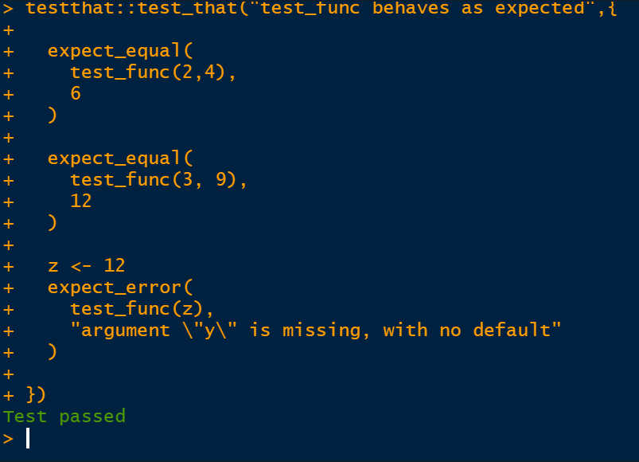
Notes:
Now we can just run it and see if it passes

Slide 22

Repeatably Test Function when it updates
When you update the function, you can now test that your expectations still hold!
Notes:
Note that now we

Slide 23
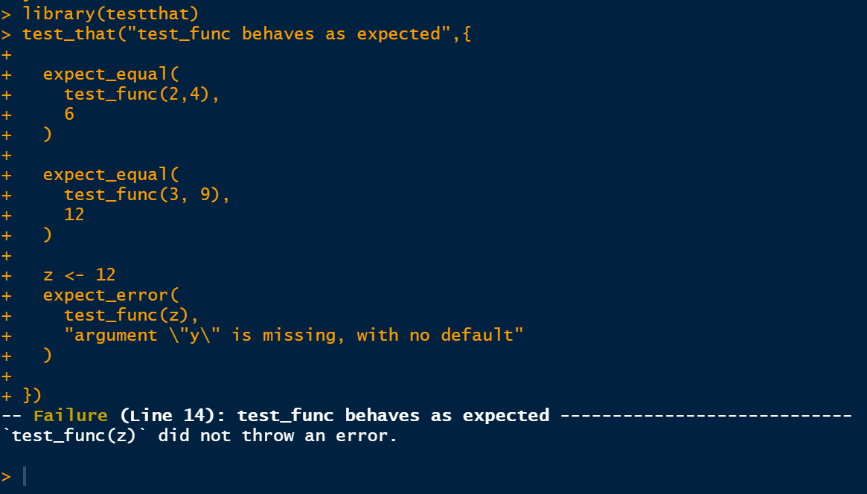
Notes:
Now we can just run it and see if it passes….
And we can see at the bottom we had a failure. This is that the expectations were not held, not that the function failed
If we look at the failure, it is saying we no longer had an error thrown when a single argument is provided

Slide 24
Notes:
we need to update the test – how?

Slide 25
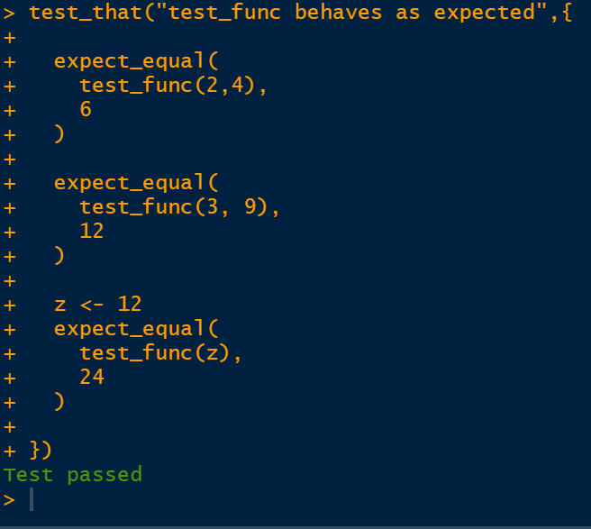
Notes:
We need to update the test – how?
We’ve now have an expectation for an output!

Slide 26
Whats a Package

Slide 27
A collection of functions with a set of conventions that is intended to make code reusable and shareable

Slide 28
Making your Package

Slide 29
usethis::create_package()
Notes:
Creates a package folder with a _recommended_ set of files
- De

Slide 30
DESCRIPTION File
Basic package information – name, version, authors, dependencies
NAMESPACE File
What information does R need to know – Functions that are shared, dependencies, methods
R Folder (/R)
Folder to house the R code of the package
.Rbuildignore, .gitignore, .Rproj.user
Notes:
DESCRIPTION – Lots of “meta” information around the package
What the name of the package is, the version of the package, sentence summary and description
Who the authors and contributors are
Which packages this package Depends, Imports, Suggests, etc on
Any other software requirements
NAMESPACE – How should R handle your package
Which of your functions should it share out?
Which methods did you write – behaviors of objects
Which functions from the other packages does it need to load
R Folder
Store all your R functions here!
Misc files useful but not directly related to packages

Slide 31
usethis::use_r()

Slide 32
Creates a new R script
Within /R
Organize Code within R Script to be related
Give a meaningful name to the script
usethis::use_r(“new_file_name”)
Notes:
DESCRIPTION – Lots of “meta” information around the package
What the name of the package is, the version of the package, sentence summary and description
Who the authors and contributors are
Which packages this package Depends, Imports, Suggests, etc on
Any other software requirements
NAMESPACE – How should R handle your package
Which of your functions should it share out?
Which methods did you write – behaviors of objects
Which functions from the other packages does it need to load
R Folder
Store all your R functions here!
Misc files useful but not directly related to packages

Slide 33
usethis::use_test()

Slide 34
Creates a new test script for unit testing
Unit testing allows the developer to repeatedly test across all expectations
Creates tests/testthat folders
Creates new test within tests/testthat folder
Organize tests within to be related
usethis::use_test(“new-test-name”)
Notes:
DESCRIPTION – Lots of “meta” information around the package
What the name of the package is, the version of the package, sentence summary and description
Who the authors and contributors are
Which packages this package Depends, Imports, Suggests, etc on
Any other software requirements
NAMESPACE – How should R handle your package
Which of your functions should it share out?
Which methods did you write – behaviors of objects
Which functions from the other packages does it need to load
R Folder
Store all your R functions here!
Misc files useful but not directly related to packages

Slide 35
usethis
Automates workflows and creation of files and folders done as part of package development
Creating the R package skeleton – usethis::create_package()
Adding a license – usethis::use_license()
Create a new R script – usethis::use_r()
Add package to DESCRIPTION file – usethis::use_package()
Create a new test – usethis::use_test()
Create Vignette – useths::use_vignette()
usethis.r-lib.org
Notes:
We only covered a small % of the functinos available in usethis

Slide 36
Materials 02-E1
Materials/Materials-02-Package_Elements_and_Structure/Materials-02-E01-Package_Basics/
Notes:
Now its your turn! We’ll give you 8 Minutes!

