Slide 1

R Package Validation Workshop
Managing
Validation Projects

Slide 2
Welcome
Multiple Reports
Ordering validation elements
Adding and removing users

Slide 3
Multiple Reports

Slide 4
{valtools} Reports
Key stake holders may not be programers
Not all stakeholders need a full report

Slide 5
Managing multiple reports
Requirements report – confirming with key stakeholders expectations
Validation report – Runs code and versions outputs
validation.yml
Controls which report is run
Output location

Slide 6

Validation Report Rendering
Valtools::vt_validate_report()
Automatically runs report
Versions and Dates
Runs in fresh R session

Slide 7
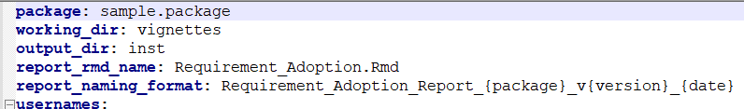
vt_validate_report Behavior
output_dir
report_rmd_name
report_naming_format

Slide 8
Validation Element Ordering

Slide 9
Ordering options
Requirements, Test Cases and Test Code are developed over time
Order/Importance of each changes over time

Slide 10
Given Set of Requirements, How would you order them?
Numeric Vector Expectations
Data Ingestion Expectations
Character Vector Expectations
Data Writing Expectations

Slide 11
Ordering options
Updating Requirements and Validation Reports by hand
Ensure order matches across updates
If any numbering impacted, need to update

Slide 12
Ordering options
vt_get_child_files(loc=“yml”)
Vector of files in order of yml
vt_file()
Serialized across vectors

Slide 13
Users across time

Slide 14


Slide 15
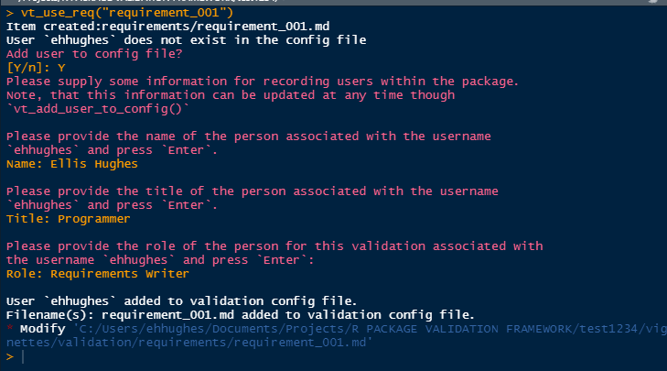
interactive prompting from vt_use_*()

Slide 16
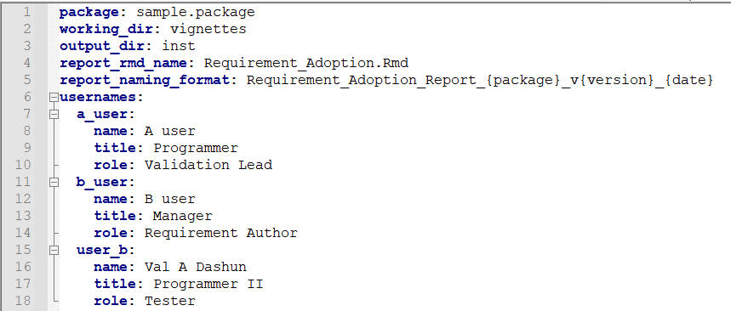
Validation Users

Slide 17
Validation Team Recording options
vt_add_user_to_config()
vt_drop_user_from_config()

Slide 18
Complete Exercise 06

