Slide 1

R Package Validation Workshop
Welcome and Orientation

Slide 2
Welcome
Who Are We
Why are we here
What do I need to know
How are we going to get there
When is this going to be done
Where do we go from here

Slide 3
Who ARE WE

Slide 4
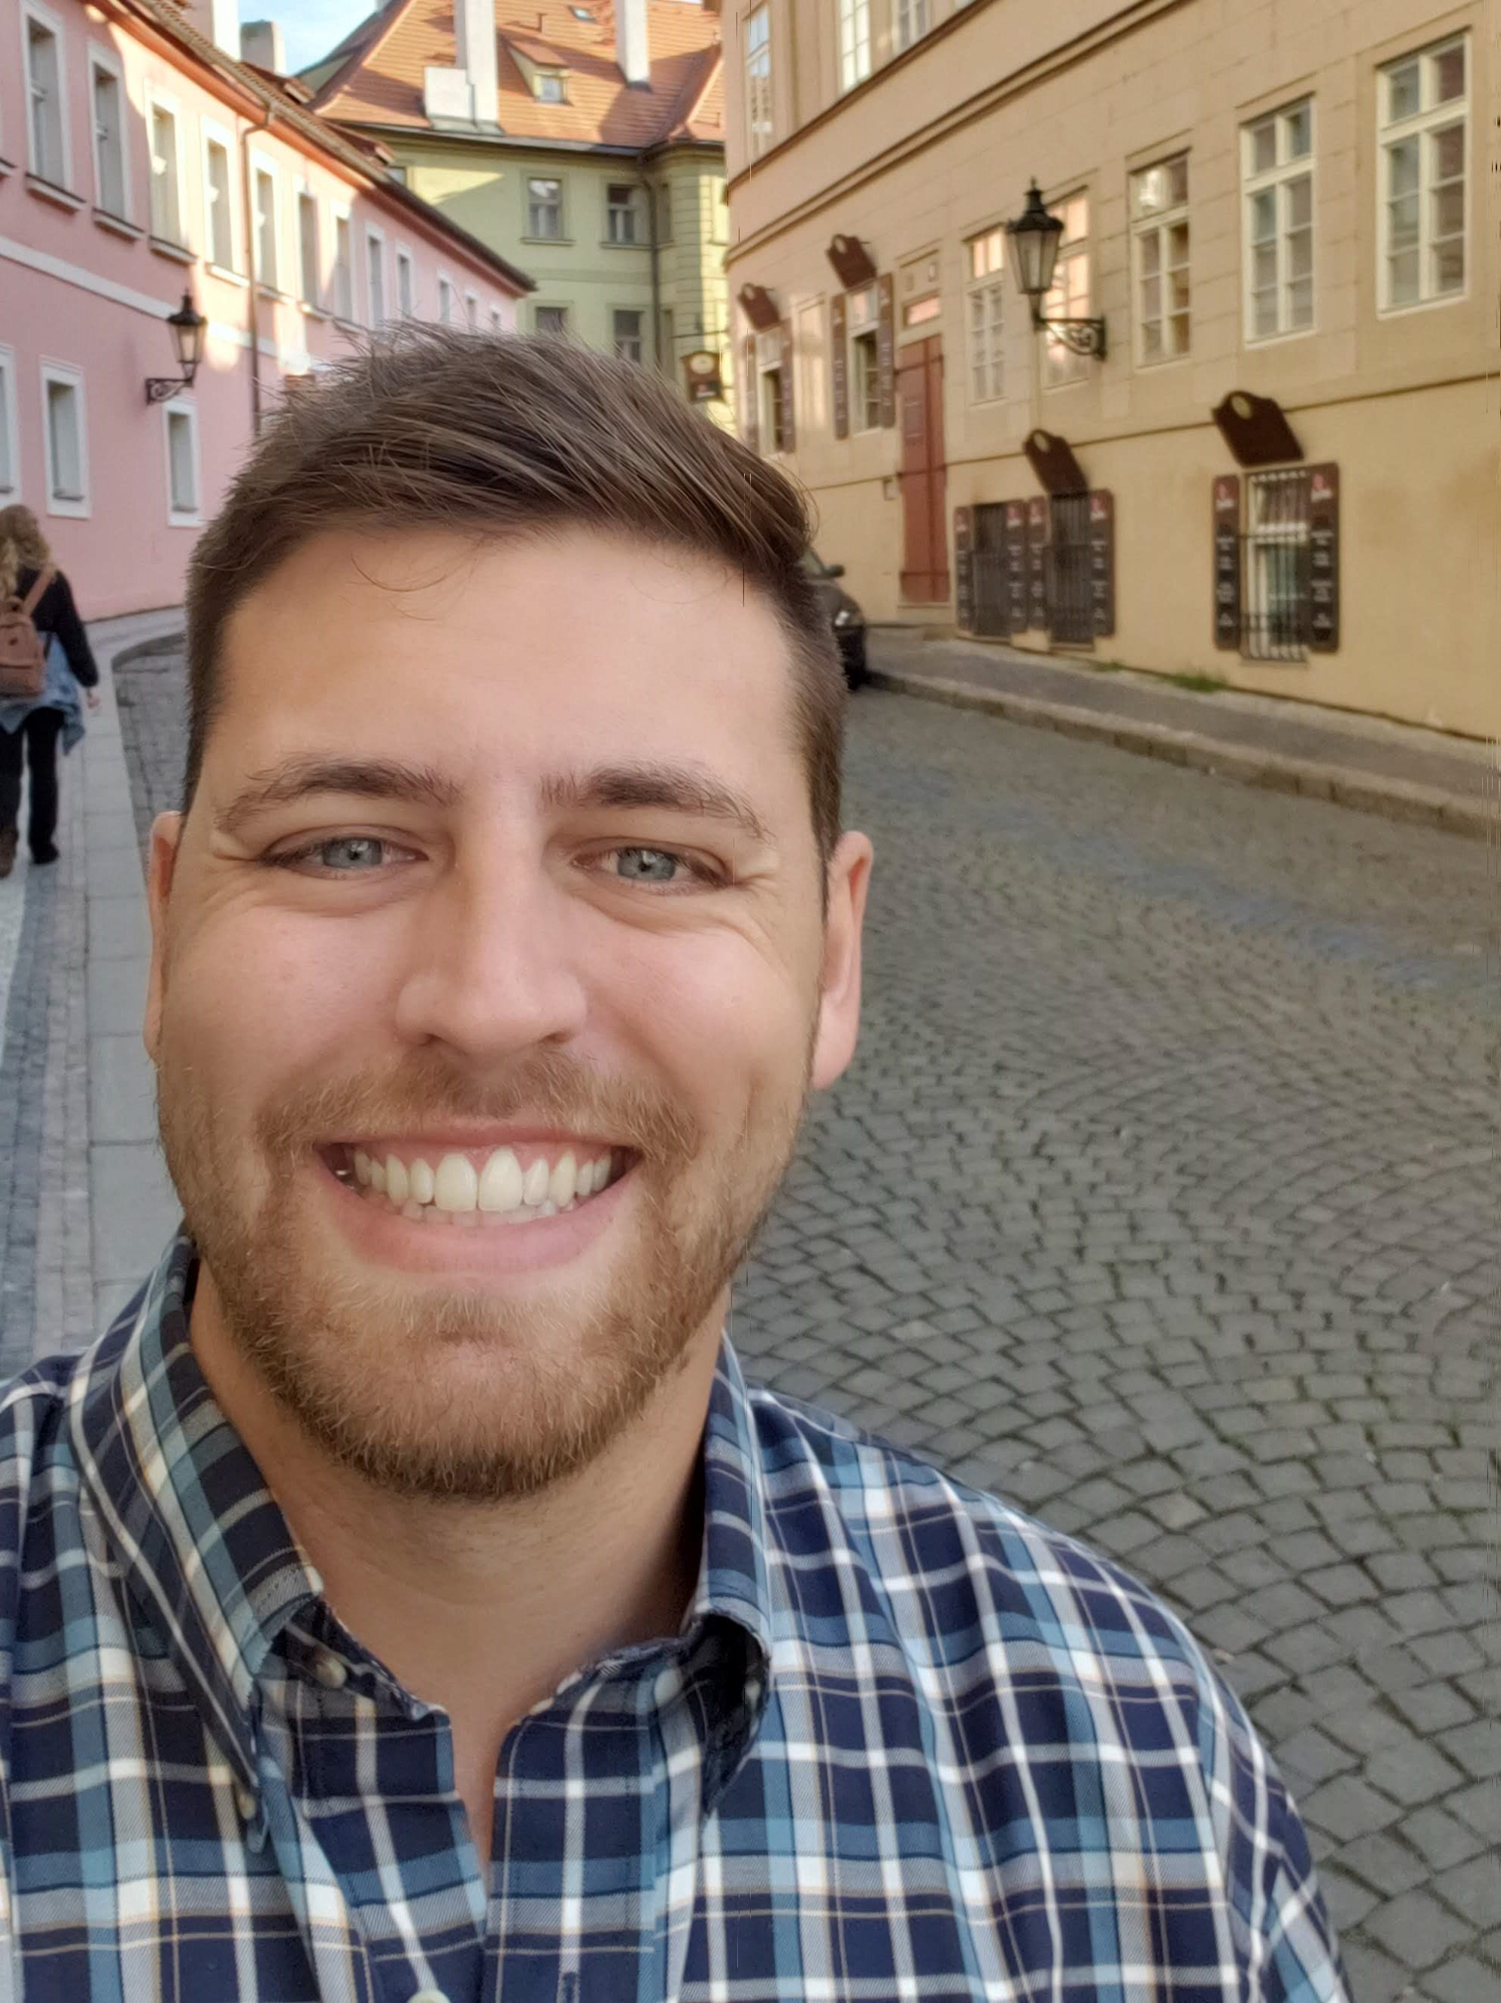


Ellis Hughes
Seattle UseR
Cascadia R
R/Pharma
TidyX Screencast
@ellis_hughes
thebioengineer

Slide 5
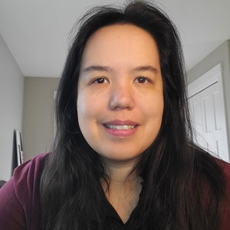

Marie Vendettuoli
Statistical Programmer
R package developer
Industry & gov regulatory experience
Recovering wet lab scientist
mariev
www.linkedin.com/in/mvendettuoli
@mvendettuoli

Slide 6
Welcome to our TA’s!
Eli Miller
Peyman Eshghi
Eric Simms-
Juliane Mantiz

Slide 7
Why are we here

Slide 8
Workshop Goals
R Package validation Framework
How to use {valtools}
Develop a simple package

Slide 9
What do I need to know

Slide 10
Expected Knowledge
R Package Development
devtools, usethis, roxygen, testthat
Literate Programming
rmarkdown

Slide 11
How are we going to get there

Slide 12
Workshop Materials
bit.ly/valtools_workshop
Slides folder contains presentation slides
Materials folder contains 2 types of exercises:
Sparse or Verbose
Named according to the
Slides they correspond with
Workshop slides and exercises are online now and will be available after the conference too.

Slide 13

R Studio Cloud workspace
R Package Validation Workshop
Please check see the chat email for the URL!
Notes:
Many thanks to R/Pharma for providing this resource

Slide 14
When are we getting there

Slide 15
Workshop Schedule
Time | Section | Content
0 -10 minutes | Welcome and Orientation
10 - 30 minutes | Concepts of R Package Validation | Intro to the R Package Validation Framework
30 - 40 minutes | Break / Q&A
40 - 50 minutes | Introduction to {valtools} | Intro to {valtools}
50 - 90 minutes | Using {Valtools} | Elements of Validation
 | Break
90 - 125 minutes | Validation Reports | Elements of a Validation Report
125 -135 minutes | Break / Q&A
140 -180 minutes | Types of Validation & Q&A | Re-Validating a Package

Slide 16
Where do we go from here

Slide 17
What if this is too much?!
Notes:
Please ask questions - we are here to help! Also, we will work through the examples together.
Post questions into the slack channel is preferred to raising your hand on zoom or posting into zoom chat so it is preserved for the future and we can make improvements to the workshop.

Slide 18
What if this is too basic?!
Notes:
Bear with us. We will get into more complex topics in validation. This workshop is specifically trying to build a foundation for knowledge. And you never know, you might learn something.
Also, as we go into breakout rooms, it would be helpful if you could work with the rest of the members of the breakout group to answer any questions. There are more of you than us, and any help we can get is appreciated!

Slide 19
What if I find an issue in the documentation?
Notes:
Please open an issue in the github page. We are human, we did our best, but would love to do better and make this easy for you to understand these concepts
Also, anything that would help make things clearer we would love to know too!

Slide 20
What if I get stuck?
Notes:
That is okay – if you are working on the sparse exercise documentation, go back to the more verbose set! Also, we will be setting up break out rooms, so see if any other members are also stuck. You can also pose a question in slack to the rest of the workshop or directly message the instructors.
Finally, we will work through all the answers together!

Slide 21
Ready? Lets Go!
Notes:
If you have not yet, clone the R Package Validation Tutorial repository or make sure you have access to materials via RStudio Cloud.
Github.com/thebioengineer/R_Package_Validation_Tutorial
We will move onto the first series – basics of package building!

