Slide 1

R Package Validation Workshop
The Validation Report

Slide 2
Welcome
Adding Test Cases
Adding Test Code
Validation Reports in R packages

Slide 3
Validation Elements

Slide 4
Test Cases - vt_use_test_case()
Key Arguments
name,
username
Name – requirement name
Username – Person’s name writing test case
Notes:
What is necessary to author test cases?
valtools::vt_use_test_cases creates a new test case file with prompts for essential elements. The content is written using markdown syntax, with roxygen2 tags for simple meta info.

Slide 5
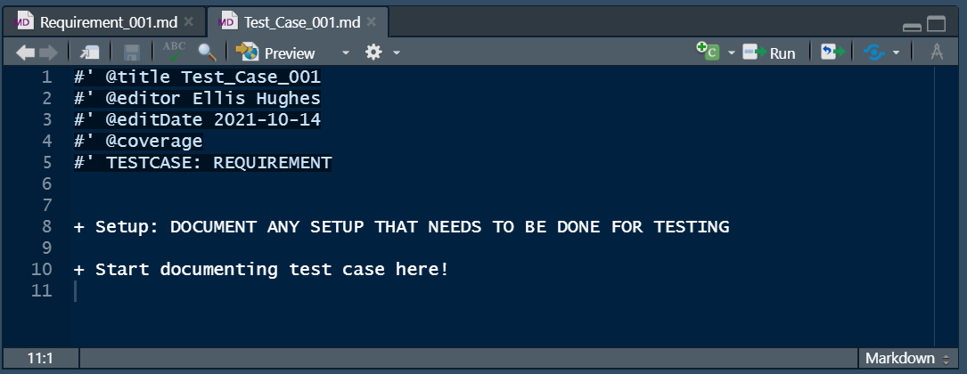
Test Cases - vt_use_test_case()
Notes:
What is necessary to author test cases?
valtools::vt_use_test_cases creates a new test case file with prompts for essential elements. The content is written using markdown syntax, with roxygen2 tags for simple meta info.

Slide 6
Test Code - vt_use_test_code()
Key Arguments
name,
username
Name – requirement name
Username – Person’s name writing test code
Notes:
What is necessary to author test code?
valtools::vt_use_test_code creates a new test code file with prompts for essential elements. The content is written using testthat syntax, with roxygen2 tags for simple meta info.

Slide 7
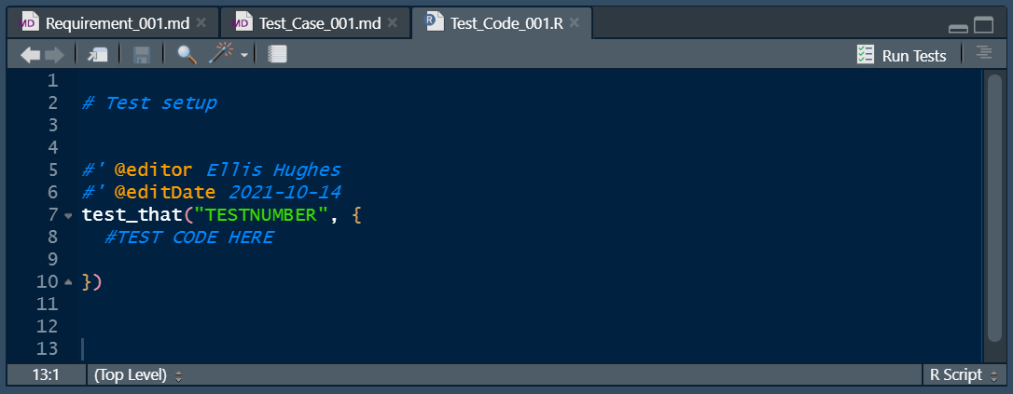
Test Code - vt_use_test_code()
Notes:
What is necessary to author test code?
valtools::vt_use_test_code creates a new test code file with prompts for essential elements. The content is written using testthat syntax, with roxygen2 tags for simple meta info.

Slide 8
Validation Report

Slide 9
Report basics
Parse each requirement and test case file
Evaluate and capture test code results and print

Slide 10
{valtools} Reports
Reports are Rmd and therefore infinitely customizable
Provided many helper functions with valtools
Environment
Scraping Validation information
Recording News, etc

Slide 11
Rendering Reports
vt_validate_report() executes the Rmd and saves output
Serves as “snapshot” in time
Rmd result from validation to output location

Slide 12
Complete Exercise 5
Navigate to Materials/Materials-05-Validation_Report

