Slide 1

R Package Validation Workshop
Welcome and Orientation

Slide 2
Welcome
Who Are We
Why are we here
What do I need to know
How are we going to get there
When is this going to be done
Where do we go from here

Slide 3
Who ARE WE

Slide 4
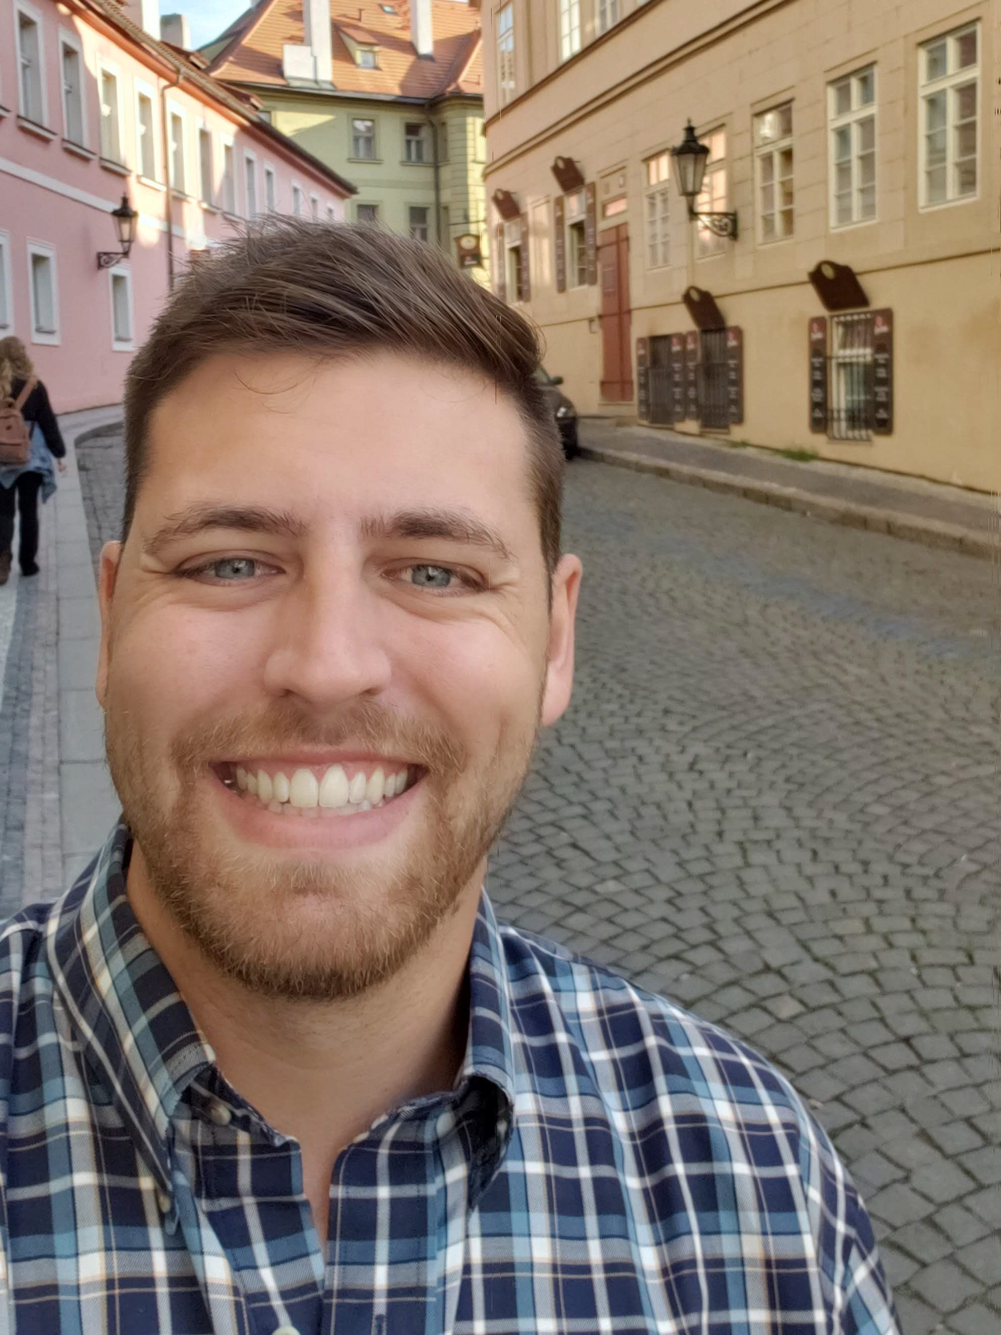


Ellis Hughes
Seattle UseR
Cascadia R
R/Pharma
TidyX Screencast
@ellis_hughes
thebioengineer

Slide 5


Marie Vendettuoli
Statistical Programmer
R package developer
Industry & gov regulatory experience
Recovering wet lab scientist
mariev
www.linkedin.com/in/mvendettuoli
@mvendettuoli

Slide 6
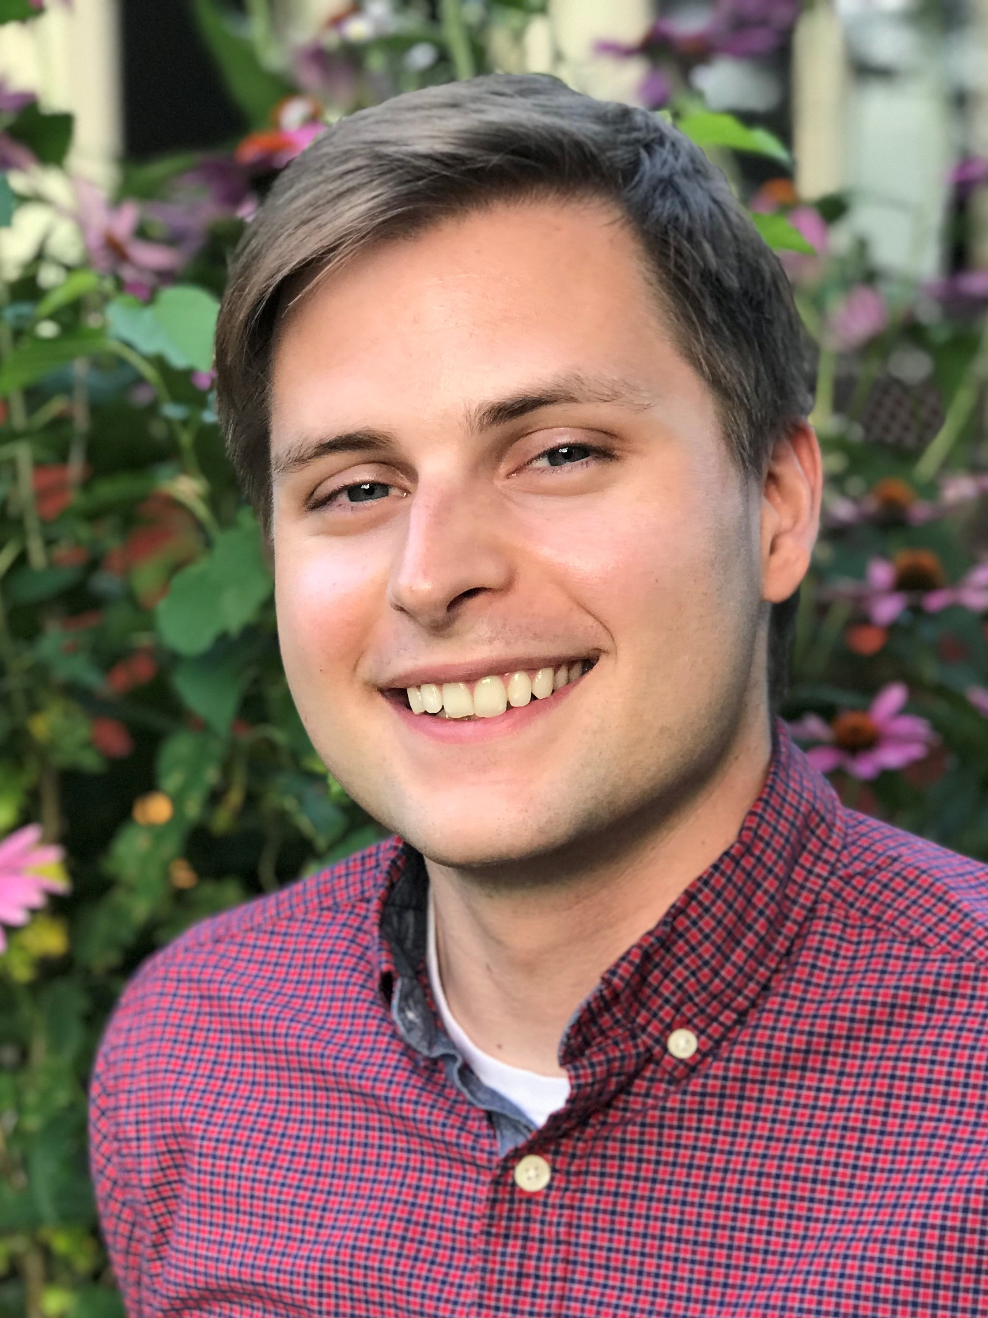
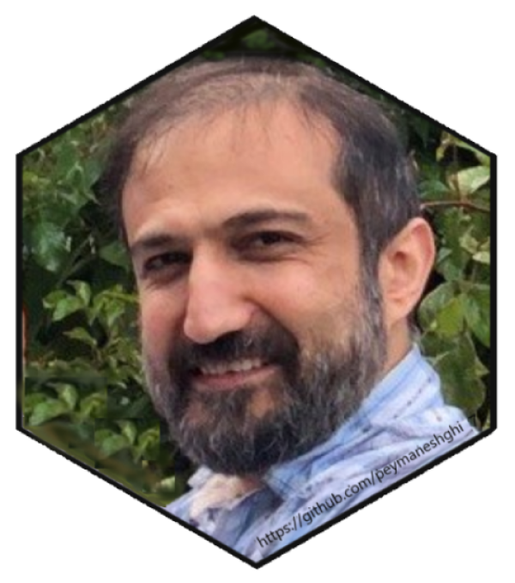
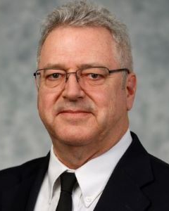
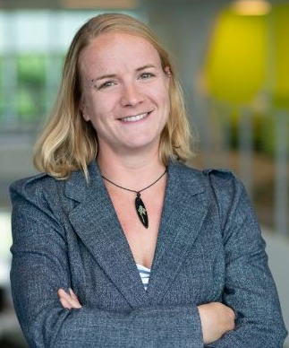
Welcome to our TA’s!
Eli Miller
Peyman Eshghi
Eric Simms
Juliane Mantiz

Slide 7
Why are we here

Slide 8
Workshop Goals
R Package validation Framework
How to use {valtools} to create a validation Packet
Applying {valtools} to a package

Slide 9
What do I need to know

Slide 10
Expected Knowledge
R
Interacting with R
Applying functions
Setting working directories
Literate Programming
Markdown, knitr/Rmarkdown

Slide 11
Expected Knowledge
R
Interacting with R
Applying functions
Setting working directories
Literate Programming
Markdown, knitr/Rmarkdown
R Package Development (optional)
devtools, usethis, roxygen, testthat

Slide 12
How are we going to get there

Slide 13

R Studio Cloud workspace
bit.ly/valtools_rstudio_cloud
Link is posted into the chat
Notes:
Many thanks to R/Pharma for providing this resource

Slide 14
Workshop Materials
Slides folder contains presentation slides
Available for review during exercises
bit.ly/valtools_workshop
Workshop slides and exercises are online now and will be available after the conference too.

Slide 15
Workshop Materials
Materials folder contains 2 types of exercises:
Sparse or Verbose
Named according to the slides they correspond with
bit.ly/valtools_workshop
Workshop slides and exercises are online now and will be available after the conference too.

Slide 16
When are we getting there

Slide 17
Workshop Schedule
Time | Section
0 -5 minutes | Welcome and Orientation
5 - 25 minutes | Concepts of R Package Validation
25 - 35 minutes | Introduction to {valtools}
35 - 70 minutes | Elements of Validation Part 1
70 - 80 minutes | Break
80 - 120 minutes | Elements of Validation Part 2
120 - 150 minutes | Managing Validation Projects
150 -160 minutes | Internal R Packages
160 -180 minutes | Q&A

Slide 18
Where do we go from here

Slide 19
What if this is too much?!
Notes:
Please ask questions - we are here to help! Also, we will work through the examples together.
Post questions into the slack channel is preferred to raising your hand on zoom or posting into zoom chat so it is preserved for the future and we can make improvements to the workshop.

Slide 20
What if this is too basic?!
Notes:
Bear with us. We will get into more complex topics in validation. This workshop is specifically trying to build a foundation for knowledge. And you never know, you might learn something.
Also, as we go into breakout rooms, it would be helpful if you could work with the rest of the members of the breakout group to answer any questions. There are more of you than us, and any help we can get is appreciated!

Slide 21
What if I find an issue in the documentation?
Notes:
Please open an issue in the github page. We are human, we did our best, but would love to do better and make this easy for you to understand these concepts
Also, anything that would help make things clearer we would love to know too!

Slide 22
What if I get stuck?
Notes:
That is okay – if you are working on the sparse exercise documentation, go back to the more verbose set! Also, we will be setting up break out rooms, so see if any other members are also stuck. You can also pose a question in slack to the rest of the workshop or directly message the instructors.
Finally, we will work through all the answers together!

Slide 23
Ready? Lets Go!
bit.ly/valtools_rstudio_cloud
Notes:
If you have not yet, clone the R Package Validation Tutorial repository or make sure you have access to materials via RStudio Cloud.
Github.com/thebioengineer/R_Package_Validation_Tutorial
We will move onto the first series – basics of package building!

