Slide 1
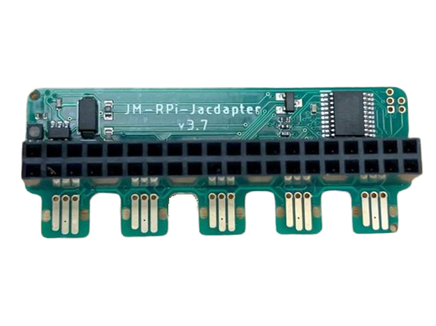
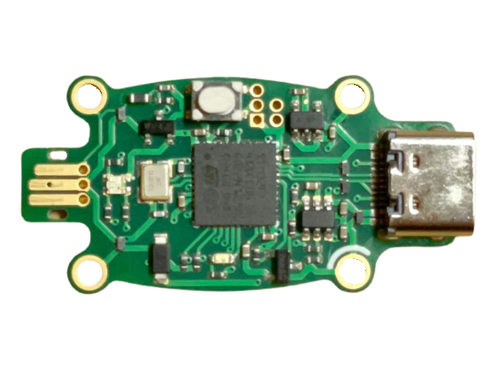
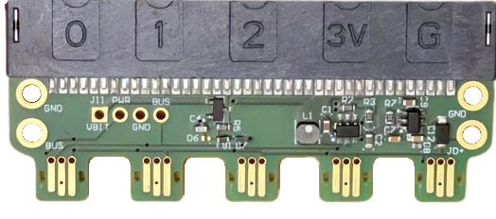
Plays Well With Others
USB
RPi
micro:bit

Slide 2
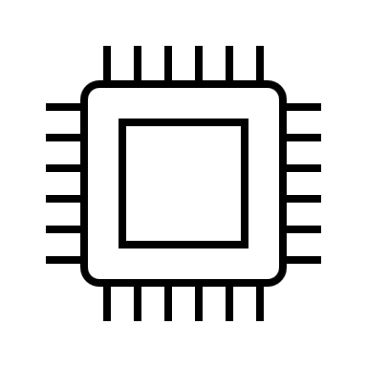
module/server
module/server
brain/client
sensors, …
sensors, …
application
MCU
MCU
MCU
Jacdac
packets
Jacdac
packets
Jacdac
packets
Jacdac bus

