Slide 1
Hack Day – Liu et. al Dataset
December 10th, 2024
Constanza Marini
Aaron Seese
Suraj Prabhu
Lauren Bennetts
Vera Okolo

Slide 2
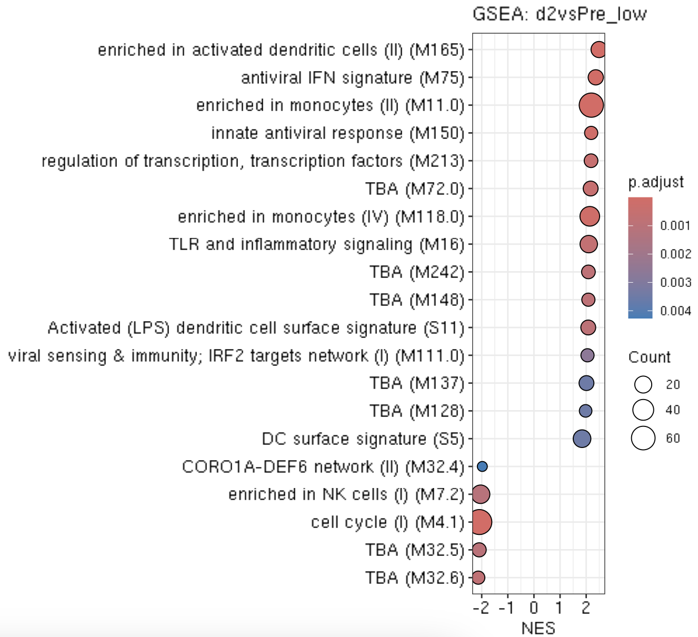
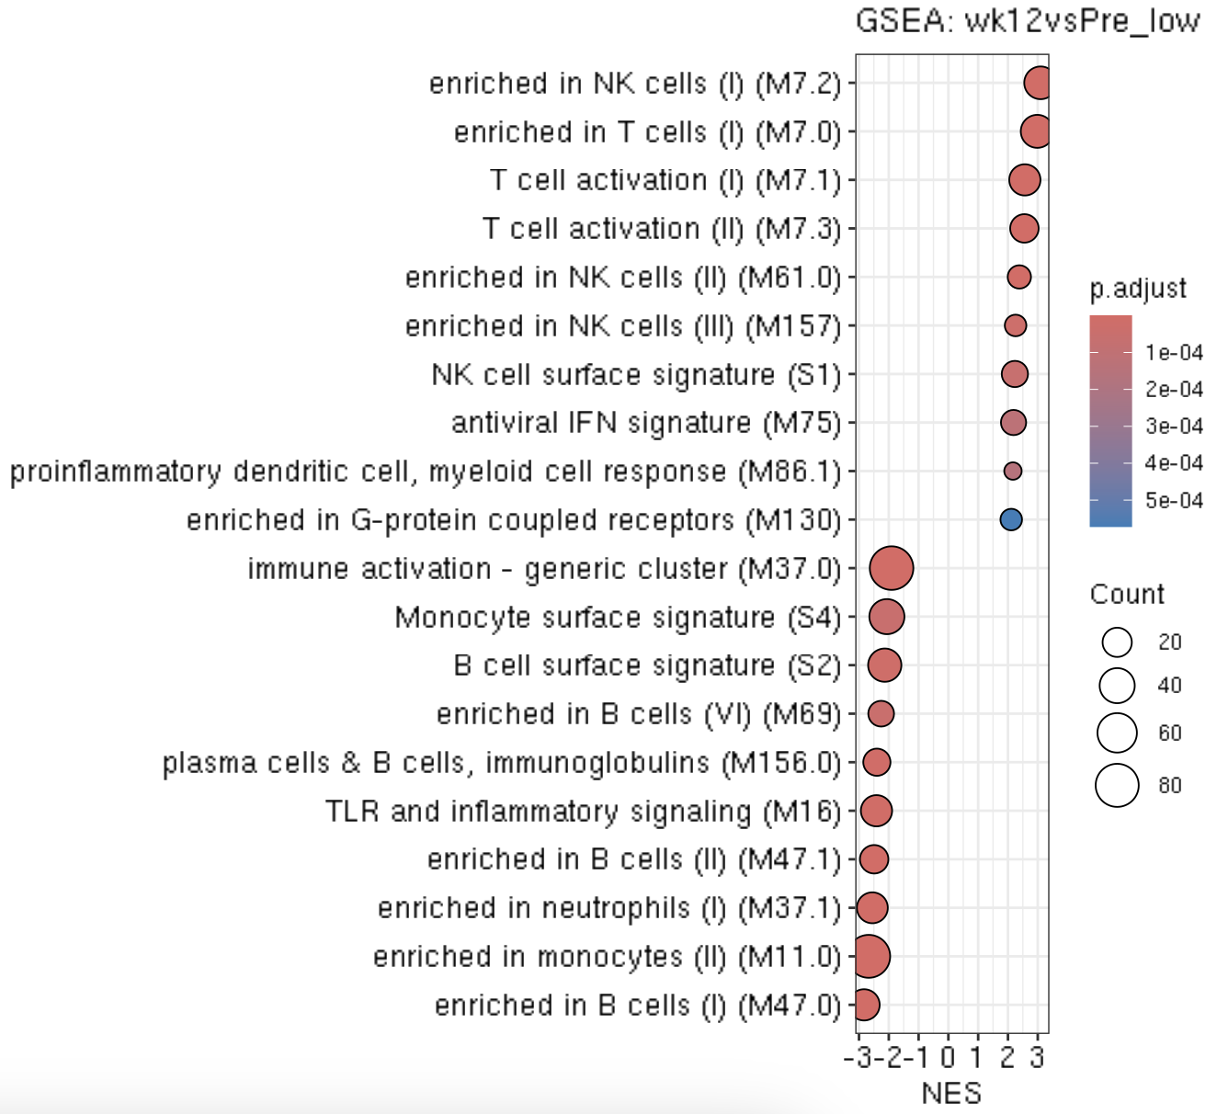
Study ID: Route Route: IV
Constanza

Slide 3
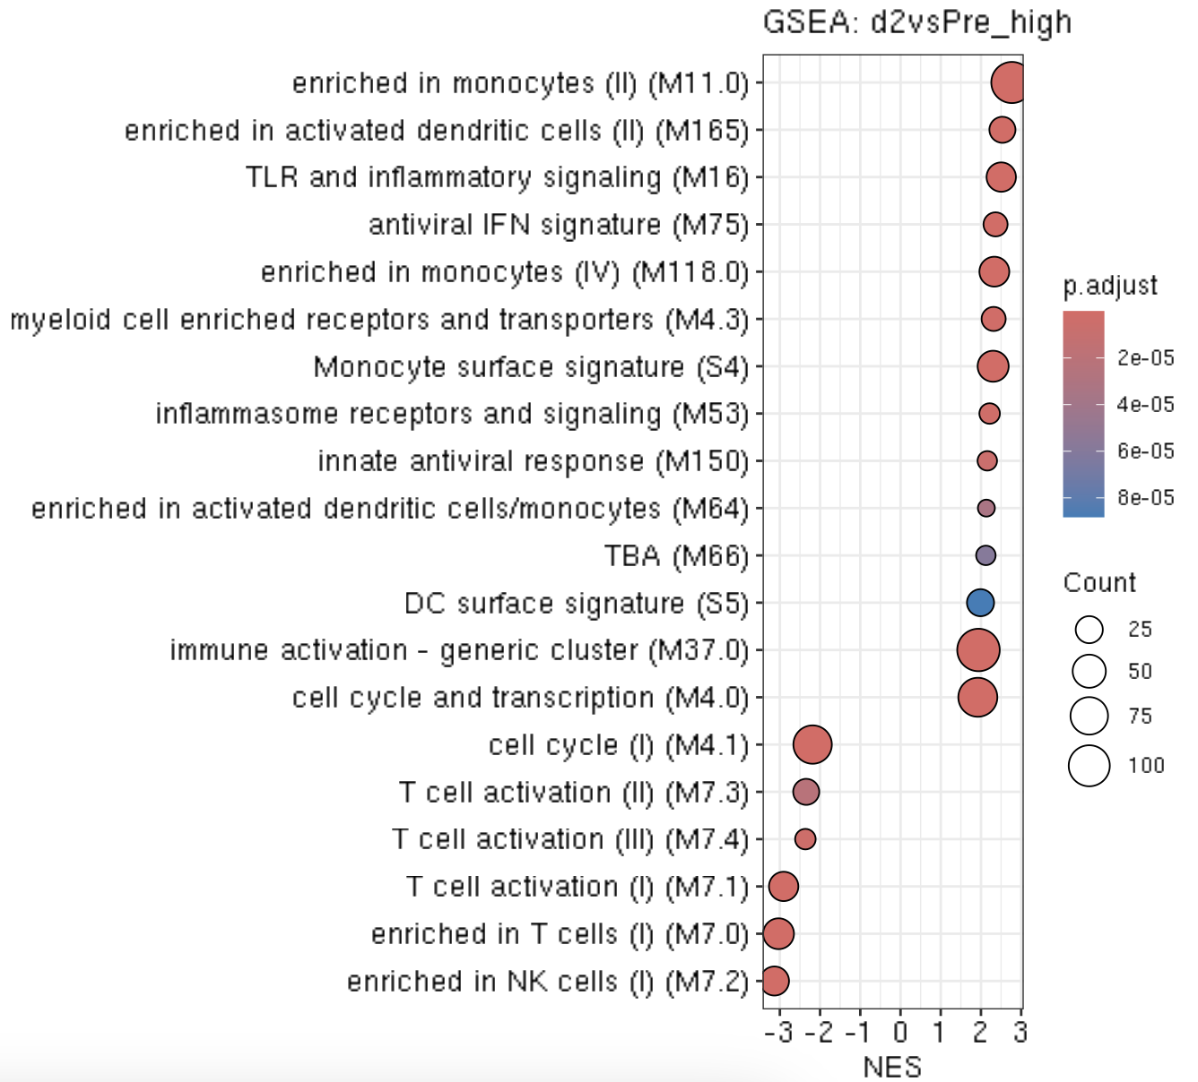
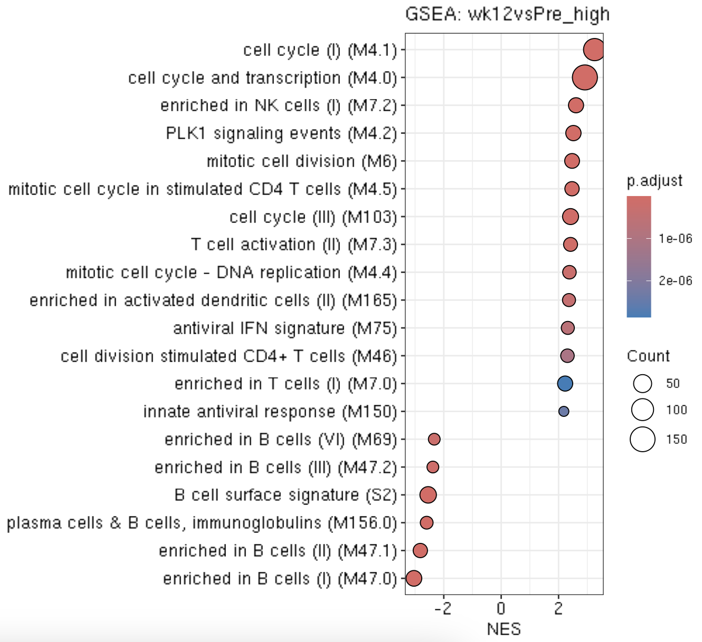
Constanza

Slide 4
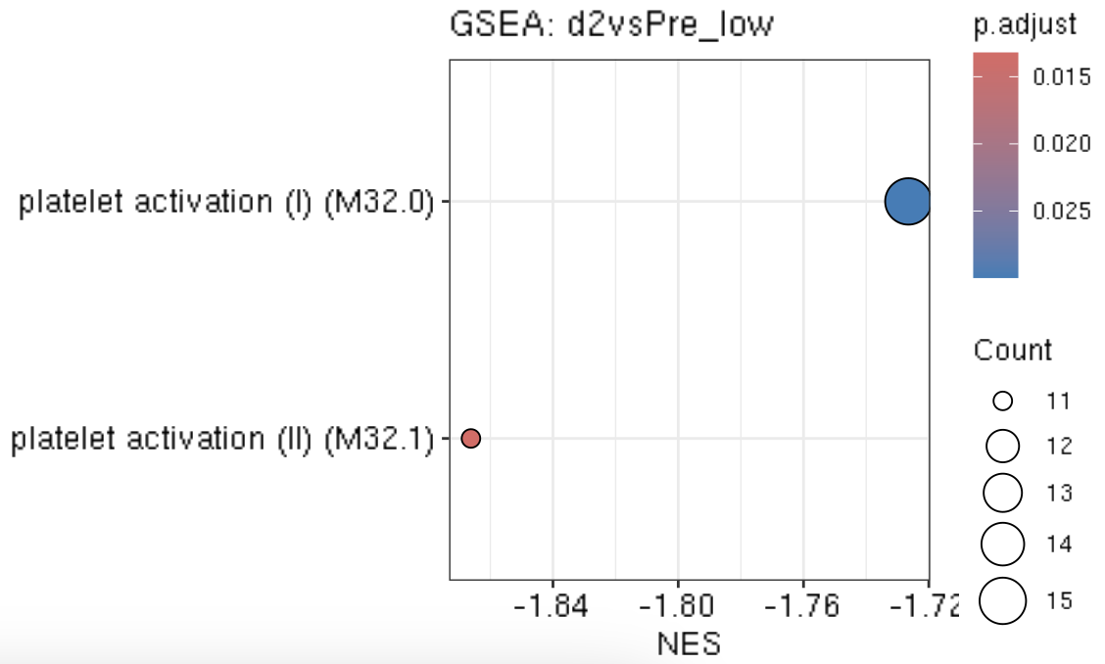
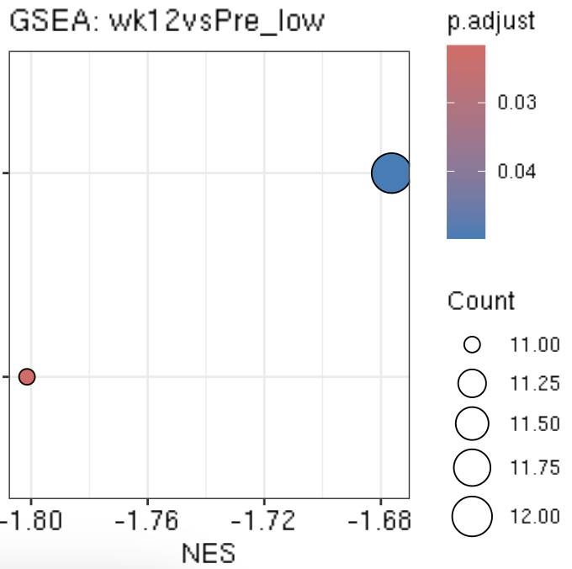
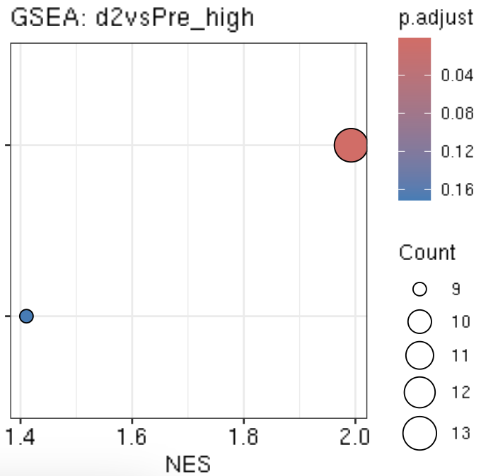
Constanza

Slide 5
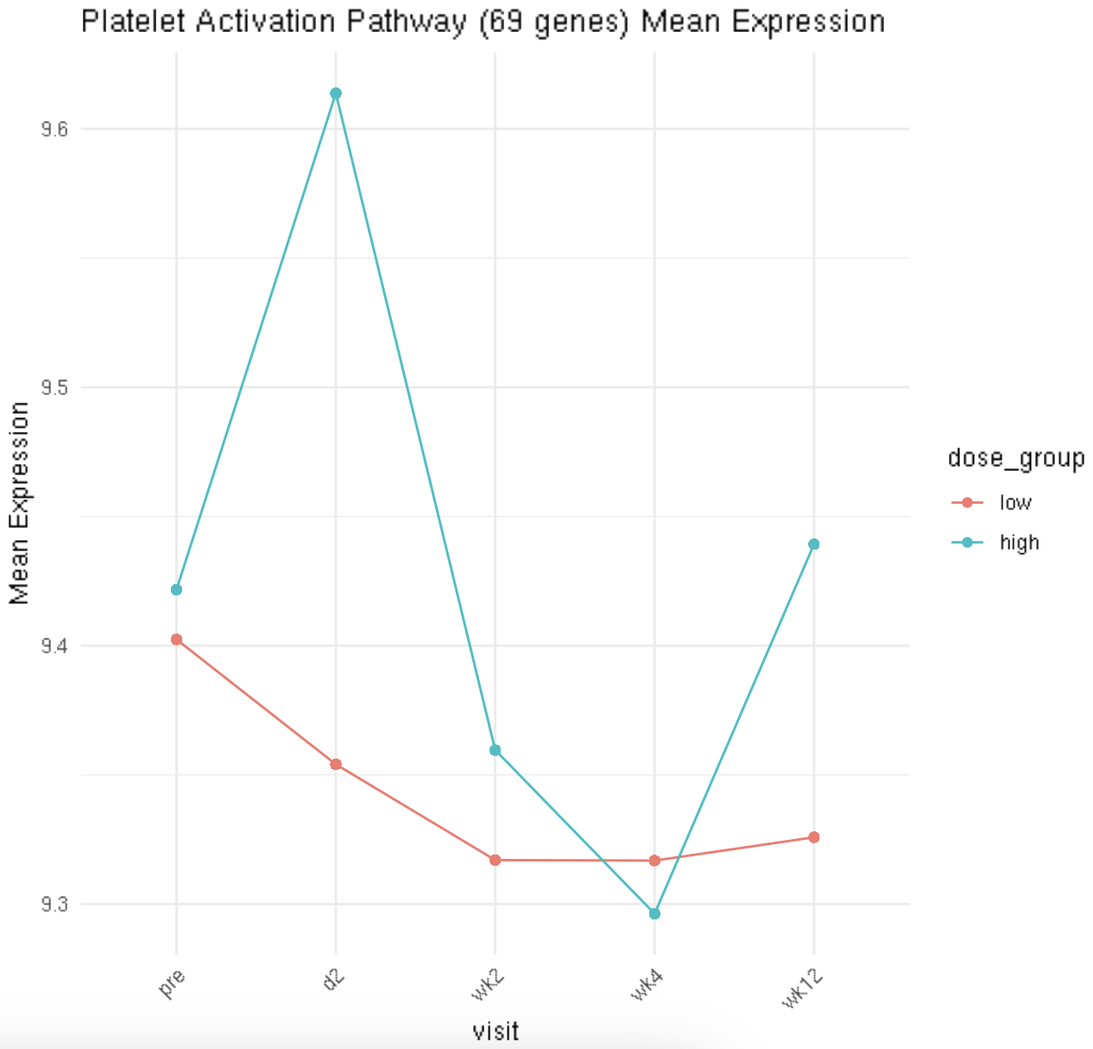
Constanza

Slide 6
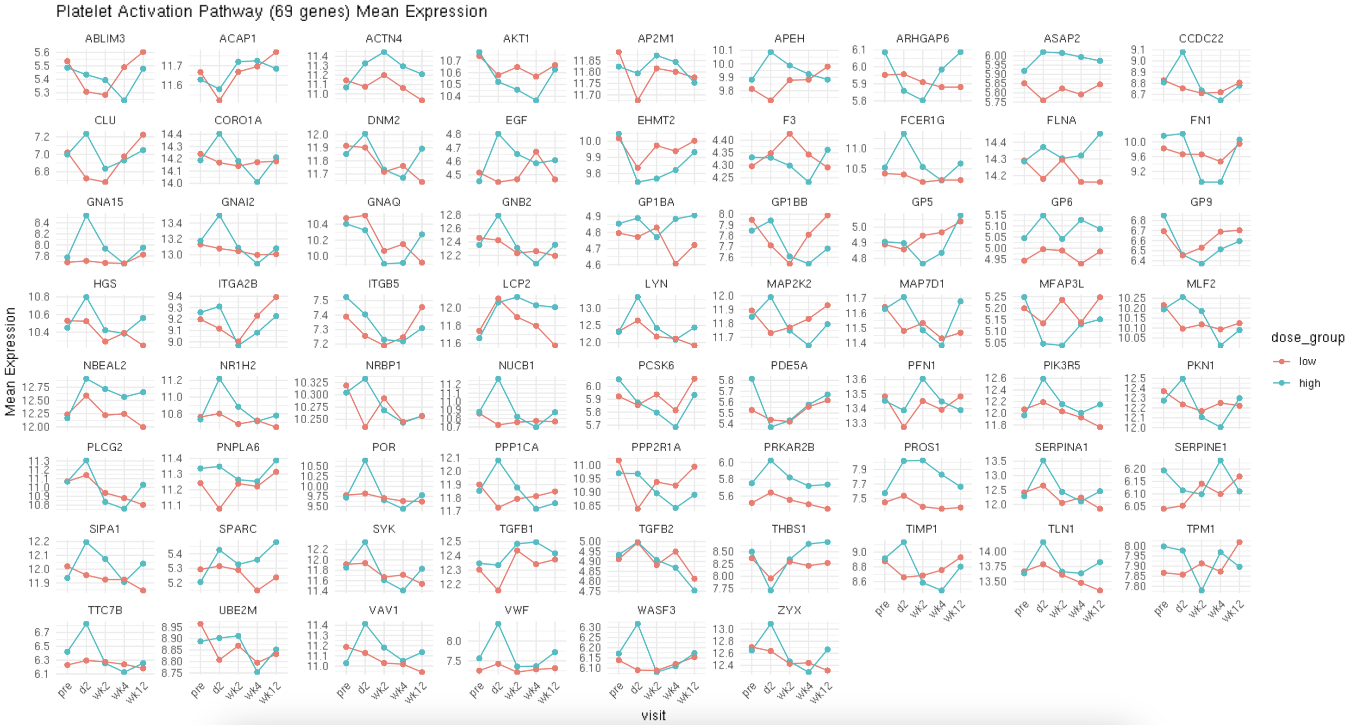
Constanza

Slide 7
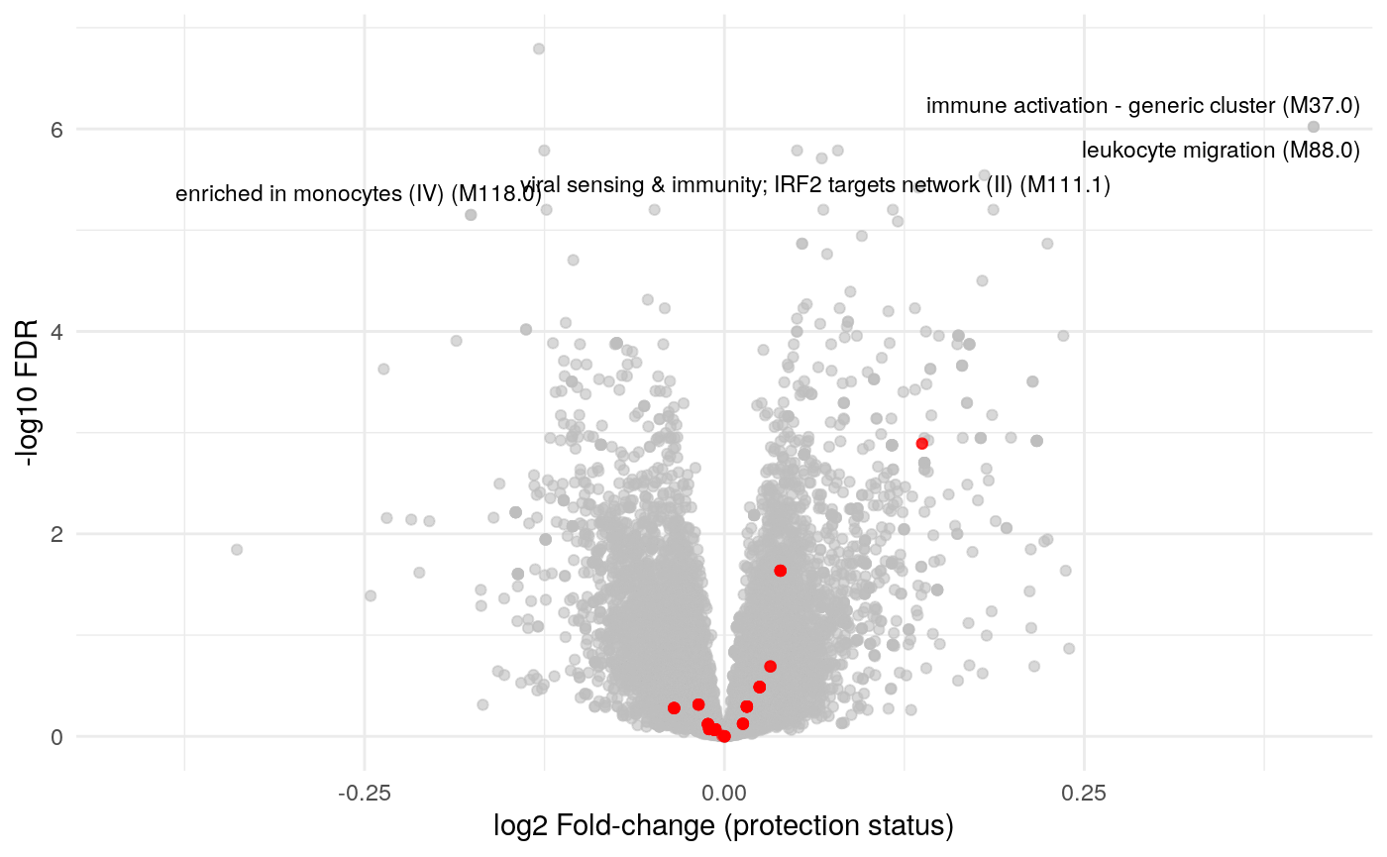
In red, Th2 associated genes Visit pre vs Week 2, 12
Study ID: Route
Aaron

Slide 8
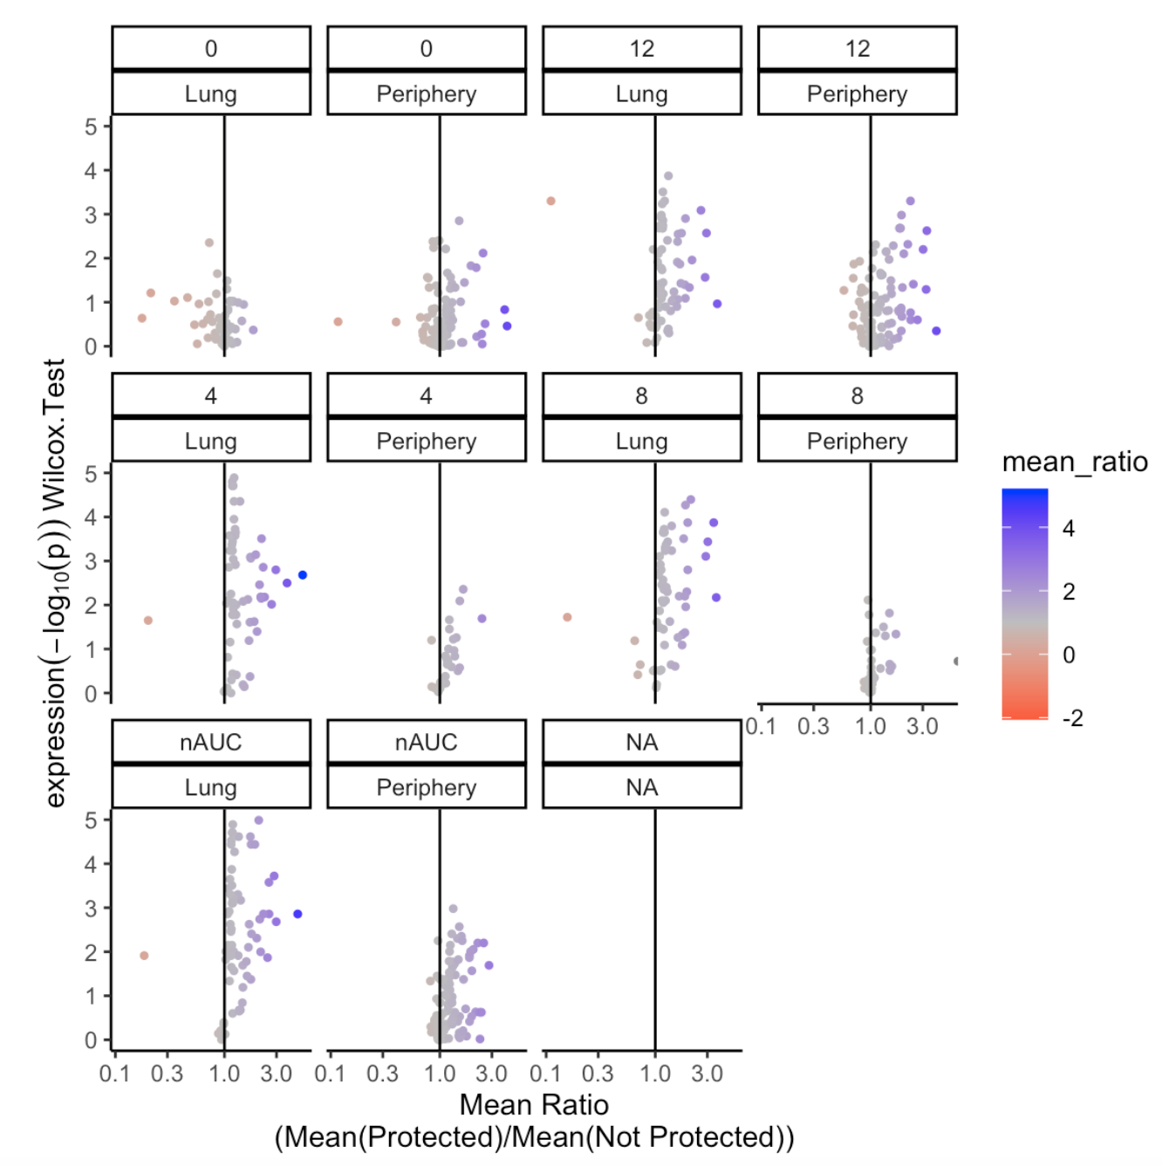
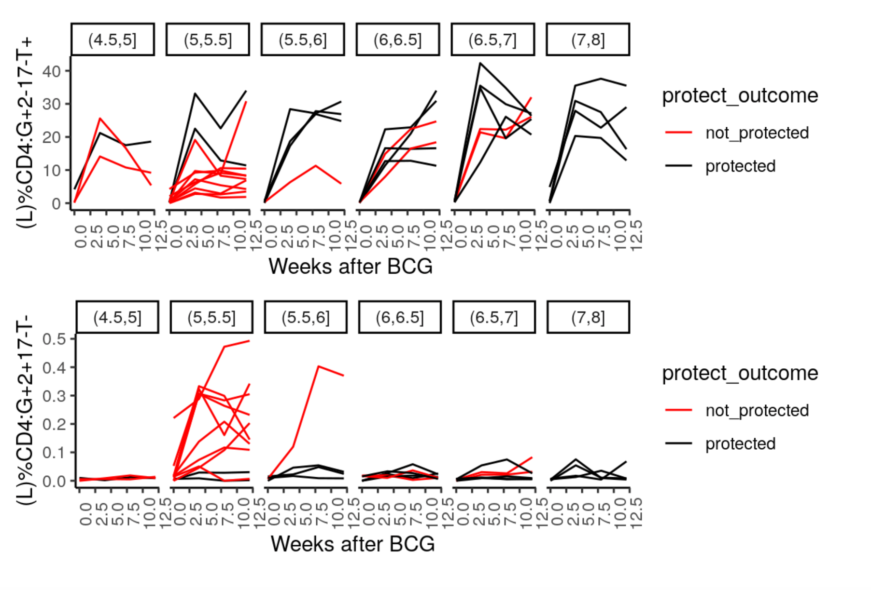
Immune correlates of protection in Lung selected by AUC
Each line is an animal
Laura

Slide 9
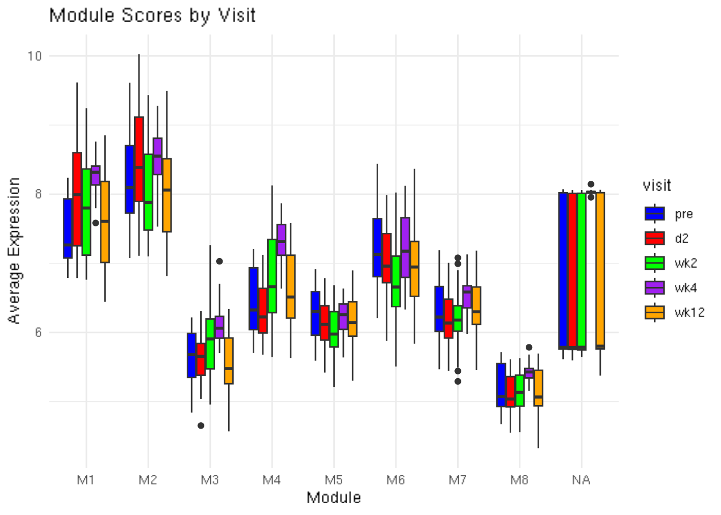
WGCNA module per timepoint
Vera

