Slide 1
EB Results

Slide 2
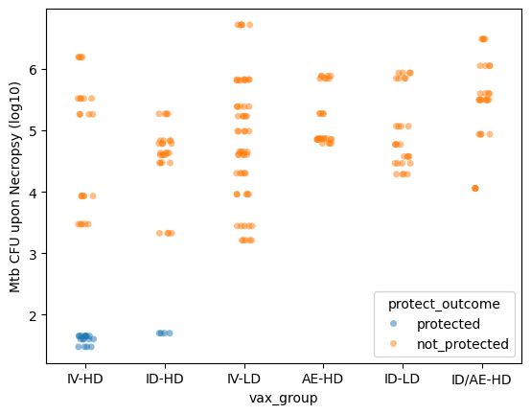
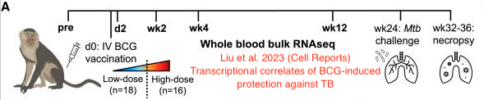
Mtb CFU between groups
Are there genetic determinants of these differences, before treatment?
Can slicing the genes different from how Liu et al. did provide different insight?

Slide 3
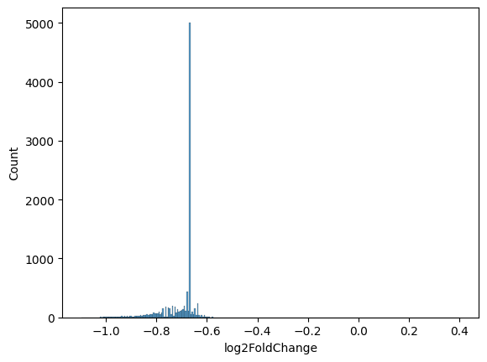
Significantly differentially expressed genes
(protected vs non-protected)
Significant DEGs Count
all genes | 22496
all DEGs | 9875
|l2fc|>0.5 | 9872
|l2fc|0.6 | 9848
|l2fc|>0.7 | 3042
|l2fc|>0.8 | 1066
|l2fc|>0.9 | 293
|l2fc|>1 | 41

Slide 4
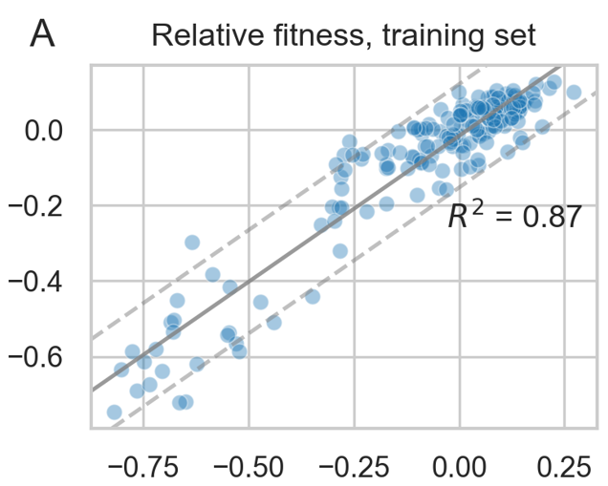
Regression

Slide 5
GBM Model
(take residuals…)
(take residuals…)
If A
If C
…
If B
Then 1
If D
Then 1
Then 2
Then 3
Then 2
Then 3

Slide 6
Model Results
Model 1
Model 2
Train on all monkeys
R² = 0.275
Train only on IV-HD cohort
R² = 0.937

Slide 7
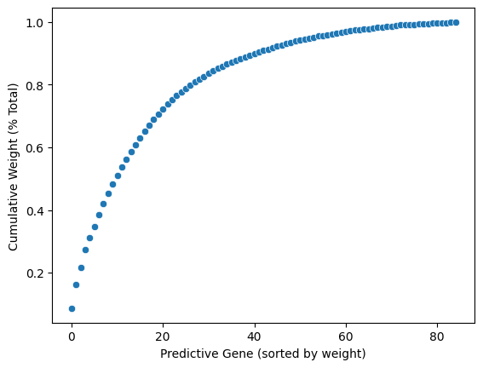
Predictive Genes
Gene | Weight
AHR | 107
ENSMMUG00000003532 | 94
ENSMMUG00000049015 | 69
ENSMMUG00000050761 | 69
ENSMMUG00000041076 | 47
ENSMMUG00000058325 | 46
ENSMMUG00000063877 | 46
ENSMMUG00000038373 | 44
ENSMMUG00000054067 | 41
ENSMMUG00000061938 | 36
ENSMMUG00000009425 | 35
ENSMMUG00000030042 | 33
CALM1 | 32
MAMU-E | 29
ENSMMUG00000023477 | 28
ENSMMUG00000062573 | 27
LTV1 | 26
SENP3 | 25
EIF3C | 23
ENSMMUG00000062735 | 22
Cum. Wgt. | # of Genes
50%: | 10
75%: | 22
80%: | 27
85%: | 32
90%: | 41
95%: | 53
all: | 85

Slide 8
Next Steps
Do these genes represent specific pathways?
Do these genes actually explain the difference between responses within cohorts?
Retrain with cohorts as covariates

