Slide 1
Service Fabric
Fred

Slide 2
Service Fabric Jumpstart
Mark Fussell
Haishi Bai

Slide 3
A lap around Service Fabric

Slide 4






Stateless Services Pattern
Load Balancer
Load Balancer
Scale stateless services backed by partitioned storage
Increase reliability and ordering with queues
Reduce read latency with caches
Manage your own transactions for state consistency
More moving parts each managed differently
Front End
(Stateless
Web)
Stateless
Middle-tier
Compute
Cache
Queues Storage

Slide 5

Stateful Services Pattern Simplify design, reduce latency
Load Balancer
Application state resides in the compute tier
Low latency reads and writes
Partitions are first class at the service layer for scale-out
Built in transactions
Fewer moving parts
External stores for exhaust and offline analytics
Front End
(Stateless
Web)
Stateful
Middle-tier
Compute
Cold Data Stores
For Exhaust
(Optional)

Slide 6
Problem
How do I design/dev/host an application on cloud?
You don’t own the hardware
Failure is norm
Dynamic scale
Security
Managing cost
Service operation
Productivity

Slide 7
Q&A: Microservices and Service Fabric
What is driving the change in application development? Why are we starting to talk about microservices?
Why choose microservices and how would you define them?
Can you talk about moving from a monolith to a microservice design? What have you seen and does this mean a rewrite of the application?
We hear about contracts between microservices. What does this mean and how should I design for this?
With these distributed microservices, what are other problems and challenges that developers have to think about up front?

Slide 8
Application design
Traditional application
Compile-time contract validation
Local operations
Easier to reason about
Expensive to scale application
Hard to scale data access
Upgrades are long and costly

Slide 9
Application design
Application composed of microservices
Runtime contract validation
Network operations
Harder to reason about
Cheaper to scale application
Easier to scale data access
Upgrade continuously

Slide 10
Migrating a traditional application
Decide on the problems you are solving
Scale, agility, resilience
Decided on a well define area to re-architect
You can have mixture of traditional and microservice designs

Slide 11
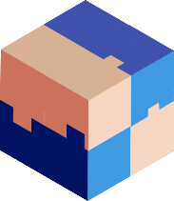
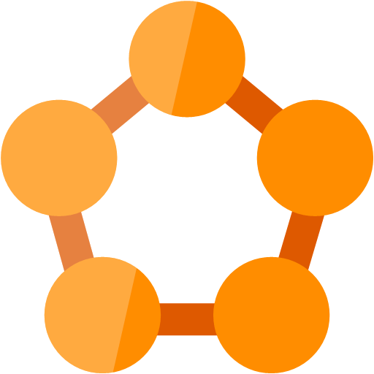

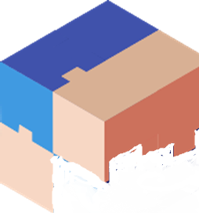



Stages of migrating a traditional application
2) Traditional app hosted as guest executable or container in Service Fabric
3) Traditional app with new microservices
4) Breaking the Traditional app into microservice
5) Transformed into microservices

Slide 12

Migrating a traditional application
Traditional app
Hosted as guest executable or container in Service Fabric
With new microservices added alongisde
Breaking into microservices
Transformed into microservices
…You can stop at any stage

Slide 13





Common design pattern using gateways
Web Gateway
REST/Websockets
Load
Balancer
API Management
IoT Hub
Event Hub

Slide 14


Using a gateway to integrate a traditional app with Service Fabric
Gateway
Client
Client

Slide 15
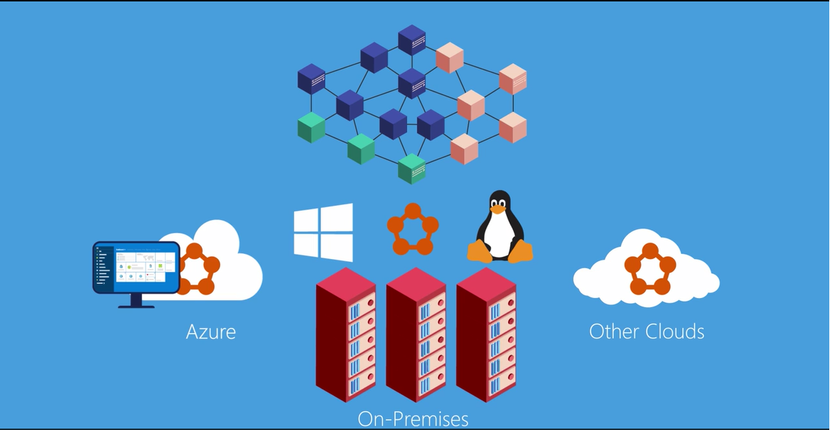
How do I explain Service Fabric ?
Demo
http://aka.ms/servicefabricvideo

