Slide 1
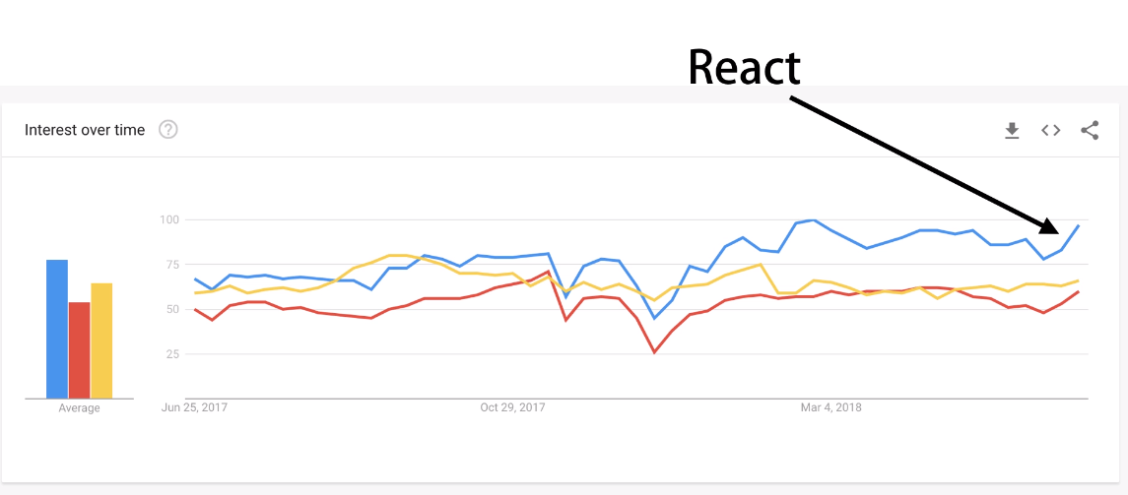

Slide 2
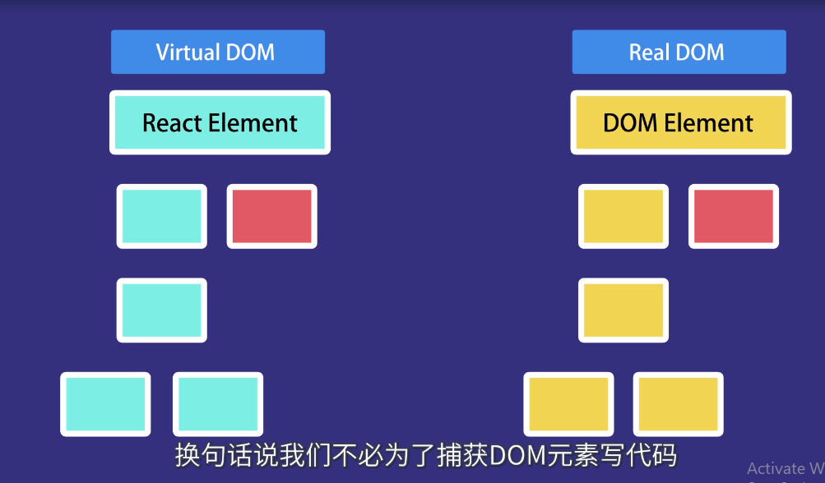

Slide 3


Slide 4
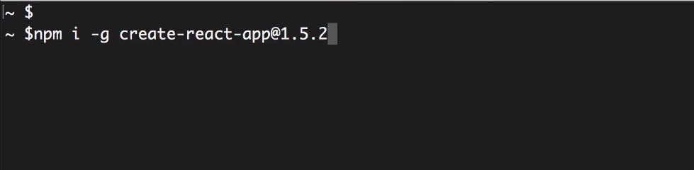

Slide 5
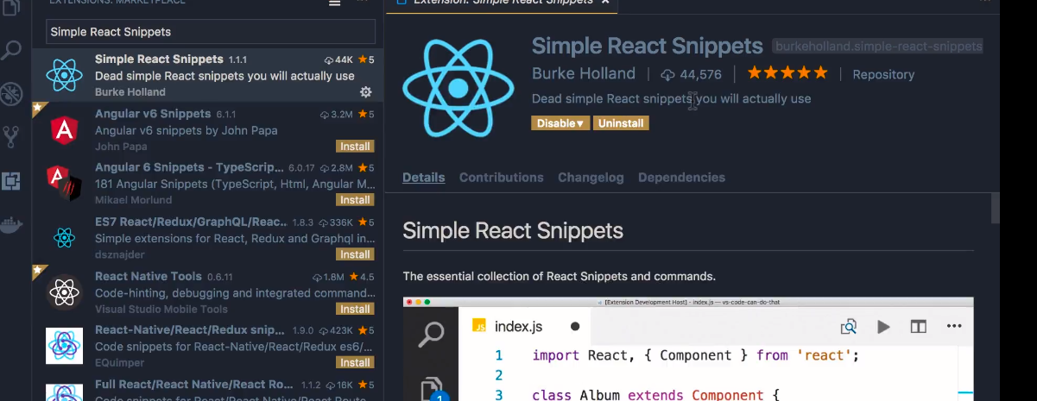

Slide 6
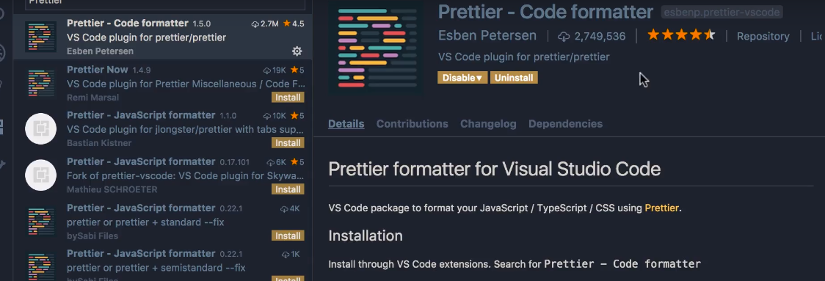

Slide 8
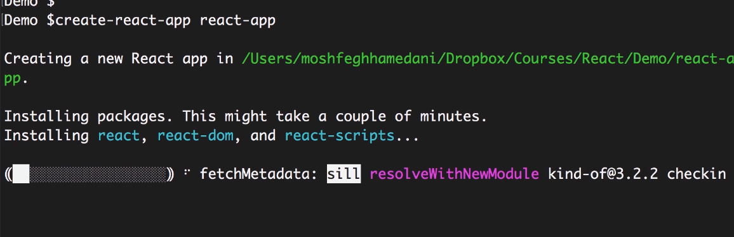

Slide 9
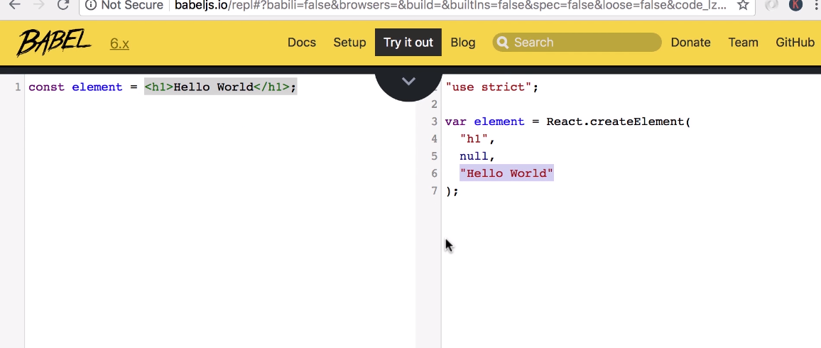

Slide 10
Hello world
import React from 'react';
import ReactDOM from 'react-dom';
const ele = <h1>Hello world</h1>; ReactDOM.render(ele, document.getElementById('root'));

Slide 11
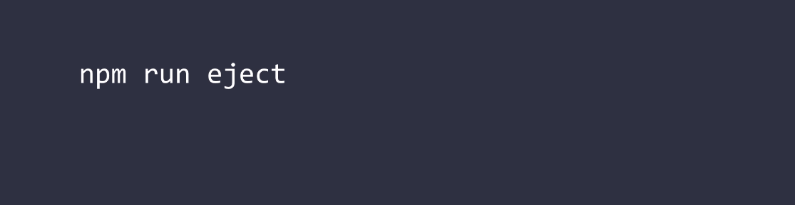

Slide 12
