Slide 1
Why we need Cloud Computing

Slide 2
Datacenter is past

Slide 3
Virtualization
High upfront cost
Monthly expense even if not using
Difficult to Scaling
Manteance

Slide 4
What is Cloud Computing
Renting IT Resources
Microsoft, AWS, Google

Slide 5
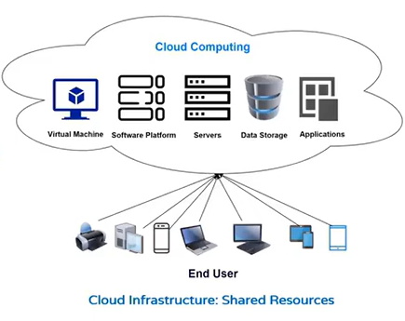

Slide 6
灯，发电厂
Pay only what you use
No plant maintence
Scaling

Slide 7
Azure free account
https://azure.microsoft.com/en-in/free/

Slide 8
Azure Portal Overview

Slide 9
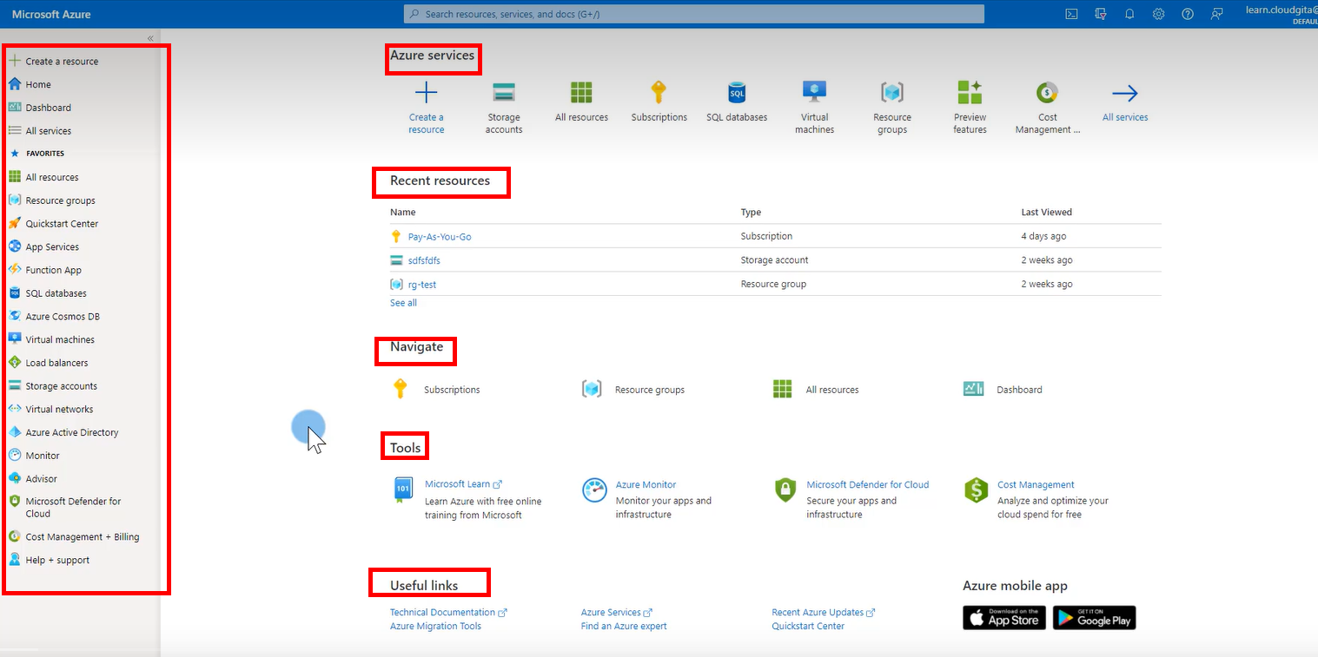

Slide 10
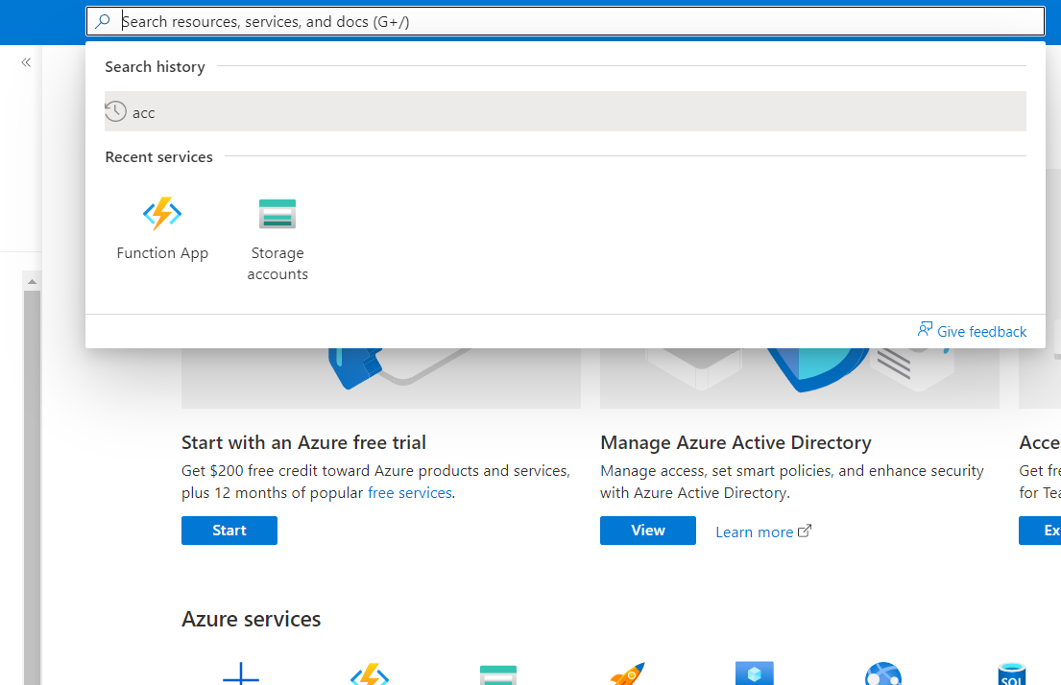
Search

Slide 11
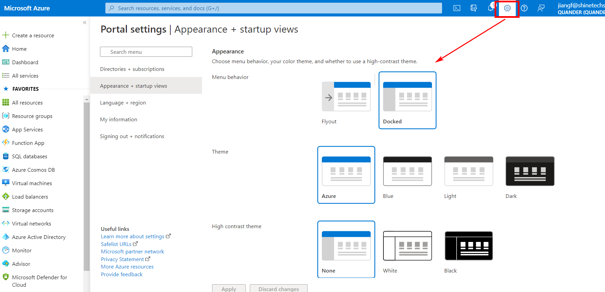
Portal settings

