Slide 1
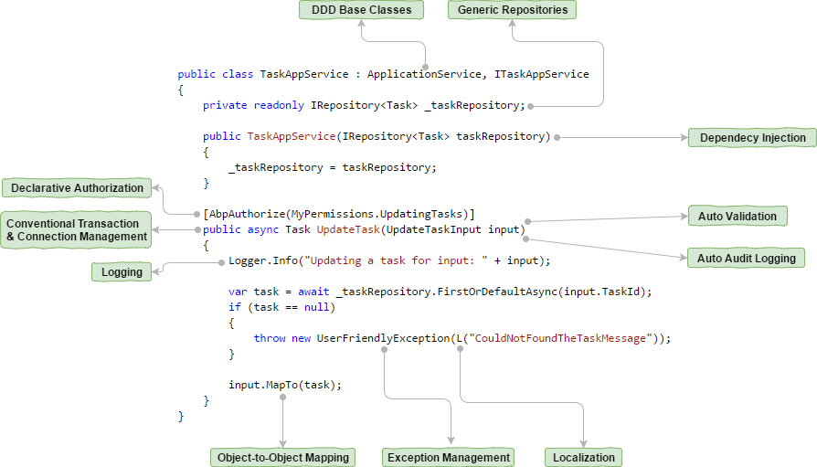

Slide 2
Introduction
ASP.NET Boilerplate (ABP) is an open source and well documented application framework started idea of "developing a common framework for all companies and all developers!

Slide 3
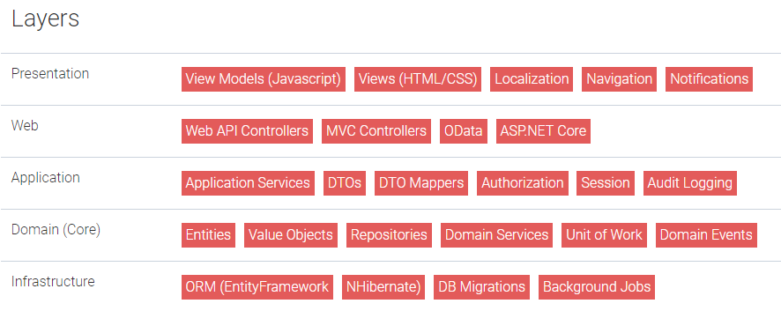
NLayer Architecture
Presentation Layer:表现层
Application Layer:
Domain Layer:
Infrastructure Layer: ORM framework or email provider
Distributed Services Layer： ASP.NET Web API and WCF

Slide 4
Domain (Core) Layer 应该尽量独立于第三方的类库
Domain Layer is where all business rules should be implemented.
Entities: 数据和业务逻辑，映射到table
Repositories: 存取Entities，Domain Layer定义，Infrastructure Layer实现。
Domain Events：定义，触发，控制领域事件。
Domain services：与entities一起工作，实现与不属于单一entity的业务。
Unit of Work：管理数据连接和事物的设计模式，跟踪entity变化并保存。 Domain Layer定义，Infrastructure Layer实现。
Application Layer
被Presentation Layer.使用，接收和返回DTO，
User input validation AutoMapper ，session
Infrastructure Layer
实现 repositories, unit of work and other services
Database Migrations
send SMS messages

Slide 5
Web & Presentation Layers
ASP.NET MVC, Web API and ASP.NET Core
Single-Page Applications or Multi-Page Applications
SignalR is a perfect tool to send push-notifications from the server to the client. It can be used to provide a rich, real-time experience to the user.

Slide 6
Module System
Generally, an assembly is considered as a module.
Module Definition
Lifecycle Methods
A depends on module B, module B is initialized before module A.
Exact order of startup methods: PreInitialize-B, PreInitialize-A, Initialize-B, Initialize-A, PostInitialize-B and PostInitialize-A.
PreInitialize
在initialize之前配置框架和模块，依赖注入注册之前。
Initialize
完成依赖注入。
PostInitialize
Startup的最后一步，可以调用依赖注入。
Shutdown

Slide 7
Module Dependencies
[DependsOn(typeof(MyBlogCoreModule))]
PlugIn Modules
Custom Module Methods

Slide 8
Startup Configuration
//Add languages for your application
//Add a localization source
//Configure navigation/menu
Configuring ASP.NET Boilerplate
Replacing Built-In Services
Configuration.ReplaceService<IAbpSession, MySession>(DependencyLifeStyle.Transient);
Configuring Modules
Configuration.Modules.AbpWebCommon().SendAllExceptionsToClients = true;
Creating Configuration For a Module
注入： IocManager.Register<MyModuleConfig>();
使用： Configuration.Get<MyModuleConfig>().SampleConfig1 = false;

Slide 9
Multi Tenancy

