Slide 1

Propositional Logic
CSCI 2824, Fall 2015

Slide 2
From last time…

Slide 3
A Graph Theory Problem
Imagine that we have a gathering of six people, some of whom know each other and some of whom do not. Show that there must be a trio of people who are mutual friends or who are mutually unknown to each other.

Slide 4
Assignments
• To read this week: Sections 1.1-1.3 (Ensley/Crawley)
• Next week: Chapter 1.4-1.6

Slide 5

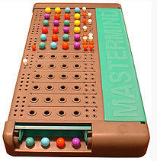
Playing with Logic: Mastermind

Slide 6
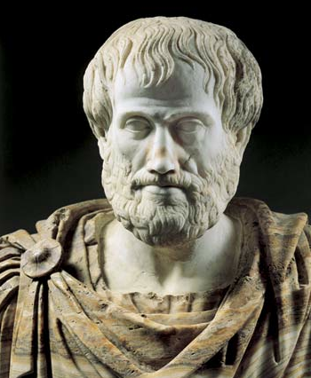
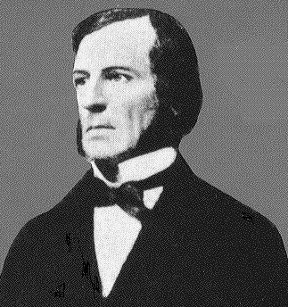
Logic: A Bit about History

Slide 7
Why Study Logic?
The “cognitive” reason (it’s good exercise for the mind)
The “truth” reason (it’s the proper way to think)
The “artificial intelligence” reason (it’s a good fit for computer programs that exhibit intelligence)

Slide 8
Propositional Logic: the Basic Lingo
Atomic propositions (P, Q, etc.) with binary truth values
Connectives AND, OR, NOT, IMPLIES, XOR, IFF
Values of compound sentences are determined as functions of the truth values of individual propositions (truth tables)
Rules of inference: Modus Ponens, various equivalence forms (like De Morgan’s rules)

Slide 9
Recurring Themes in Logic (not just propositional logic, by the way)
Satisfiability
Contradiction
  Classic contradiction: P AND (NOT P)
Tautology
  Classic tautology: P OR (NOT P)
Entailment (implication)
Equivalence

Slide 10
Let’s See if We Can Represent Mastermind Ideas in Propositional Logic…
First, let’s make some proposition symbols. We’ll say that BLUE1 stands for the proposition “In the correct code, the blue peg is in position 1”.
There are a bunch of these propositions: BLUE2, BLUE3, BLUE4, ORANGE1, ORANGE2…

Slide 11
More Mastermind
Each guess that we make (and the solution that we want to find) will be expressed in the form of a propositional logic statement, like this:
BLUE1 AND ORANGE2
AND PURPLE3 AND BLUE4

Slide 12
The Mastermind Rules
“In the correct code, there is one peg (of some color) in position 1”:
  BLUE1 OR ORANGE1 OR RED1 OR WHITE1 OR YELLOW1 OR PURPLE1
  But that’s not quite enough… The statement above is consistent with the (incorrect) possibility that both a blue and orange (say) are in position 1.

Slide 13
So we need some additional statements:
NOT (ORANGE1 AND BLUE1)
NOT (ORANGE1 AND RED1)
NOT (ORANGE1 AND PURPLE1)
etc.
These statements say “It is not the case that there are two distinct colors in position 1”

Slide 14
What do we learn from a guess?
My guess:
RED BLUE WHITE ORANGE
Answer:
X,0
From the X, I get:
RED1 OR BLUE2 OR WHITE3 OR ORANGE4
NOT (RED1 AND BLUE2)
NOT (RED1 AND WHITE3)
NOT (RED1 AND ORANGE4)
NOT (BLUE2 AND WHITE3)
NOT (BLUE2 AND ORANGE4)
NOT (WHITE3 AND ORANGE4)

Slide 15
What do we learn from a guess?
My guess:
RED BLUE WHITE ORANGE
Answer:
X,0
From the 0, I get:
RED2 OR RED3 OR RED4 OR BLUE1 OR BLUE3 OR BLUE4 OR WHITE1 OR WHITE2 OR WHITE4 OR ORANGE1 OR ORANGE2 OR ORANGE3
NOT (RED2 AND BLUE1)… many others of this form

Slide 16
How do we solve a code?
Suppose we know:
ORANGE1 OR BLUE1
NOT ORANGE1
Then we can conclude:
BLUE1

Slide 17
What have we learned about propositional logic from this?
One thing that we’ve learned–on the good side–is that propositions do allow us to represent situations like Mastermind.
On the not-so-good side, we’ve found that doing real tasks with propositional logic (if you want to call Mastermind a real task) can require a surprising amount of “infrastructure”.

Slide 18
Why (or why not?) Propositional Logic
It’s simple to understand
… But it’s highly inexpressive
• And “simple to understand” does not mean that all problems are simple:
(x1 OR ~x5 OR x3) AND
(~x1 OR ~x2 OR x6) AND
(x3 OR x5 OR ~x6) AND….

Slide 19
A Brief Aside: Illogical Humans?
Problems with Modus Ponens and Modus Tollens
When are we logical?

Slide 20
K
E
4
7
If a card has a vowel on one side, then it has an even
number on the other side.

Slide 21
Drinking
Coke
Drinking
Beer
21 years
old
18 years
old
If a person is drinking an alcoholic beverage, then
that person is at least twenty years old.

Slide 22
Propositional Logic: Where We’ve Come So Far
Basic “objects” are sentences with T/F values
Connectors (AND, OR, NOT, etc.) are used to make compound sentences
Basic rules of inference (Modus Ponens, etc.) are used to derive new sentences from a “knowledge base” of existing sentences

