Slide 1



mealmajor
The Cool group
Marie Ella Cambay • Charles Dahan• Ilyess Diyane
Frederic Gagne • Pablo Hermandez • Quentin Malichecq-Laroche

Slide 2


Problem statement
No Structured Planning
Grocery Inefficiency
Recipe Discovery Gap
Students don’t plan meals, leading to poor nutrition and wasted time
Buying groceries without a plan causes overspending and food waste
No centralized tool to find store recipes

Slide 3

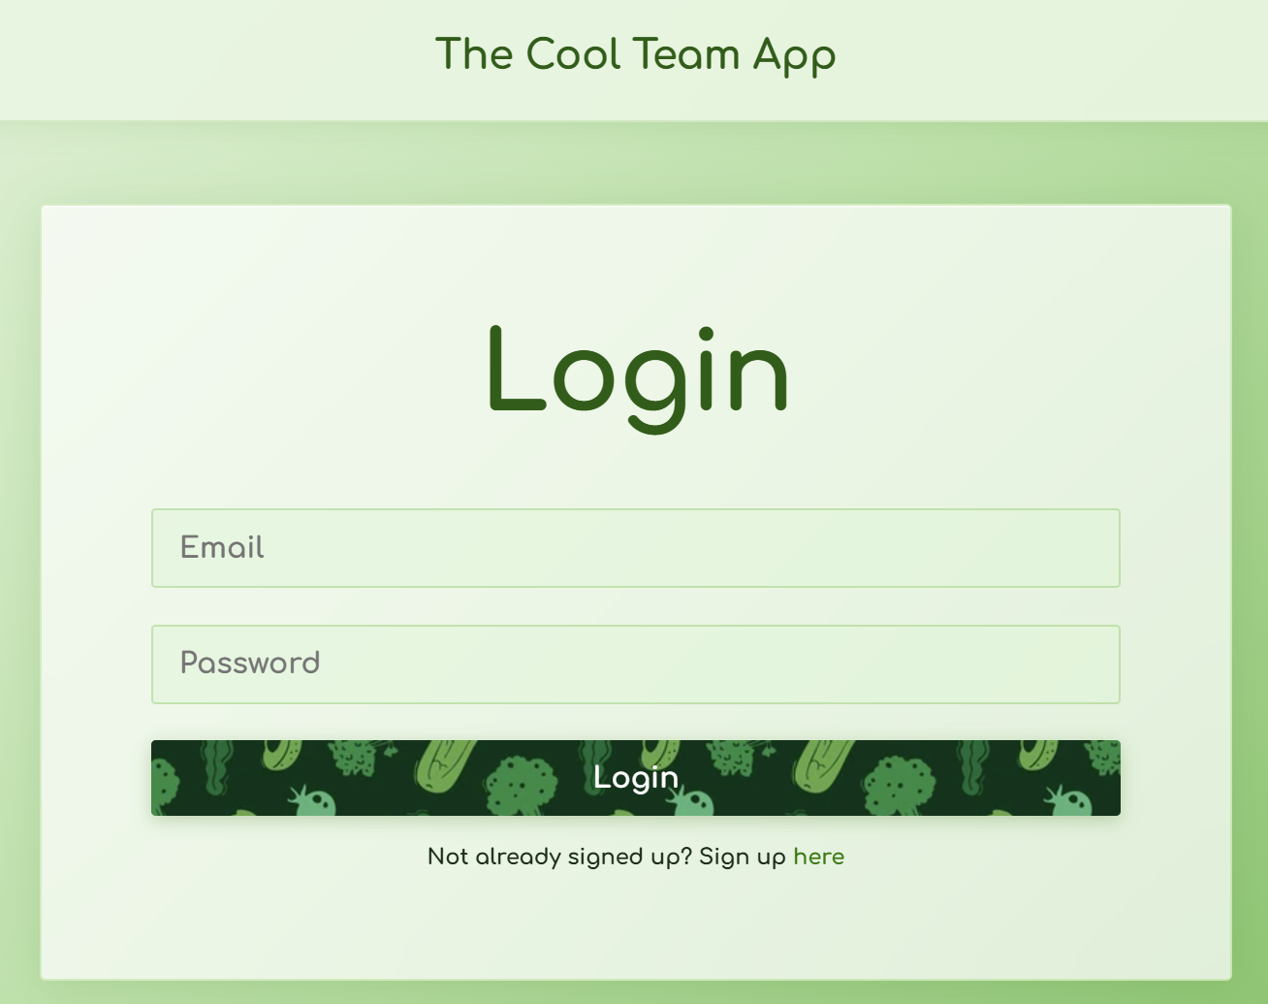
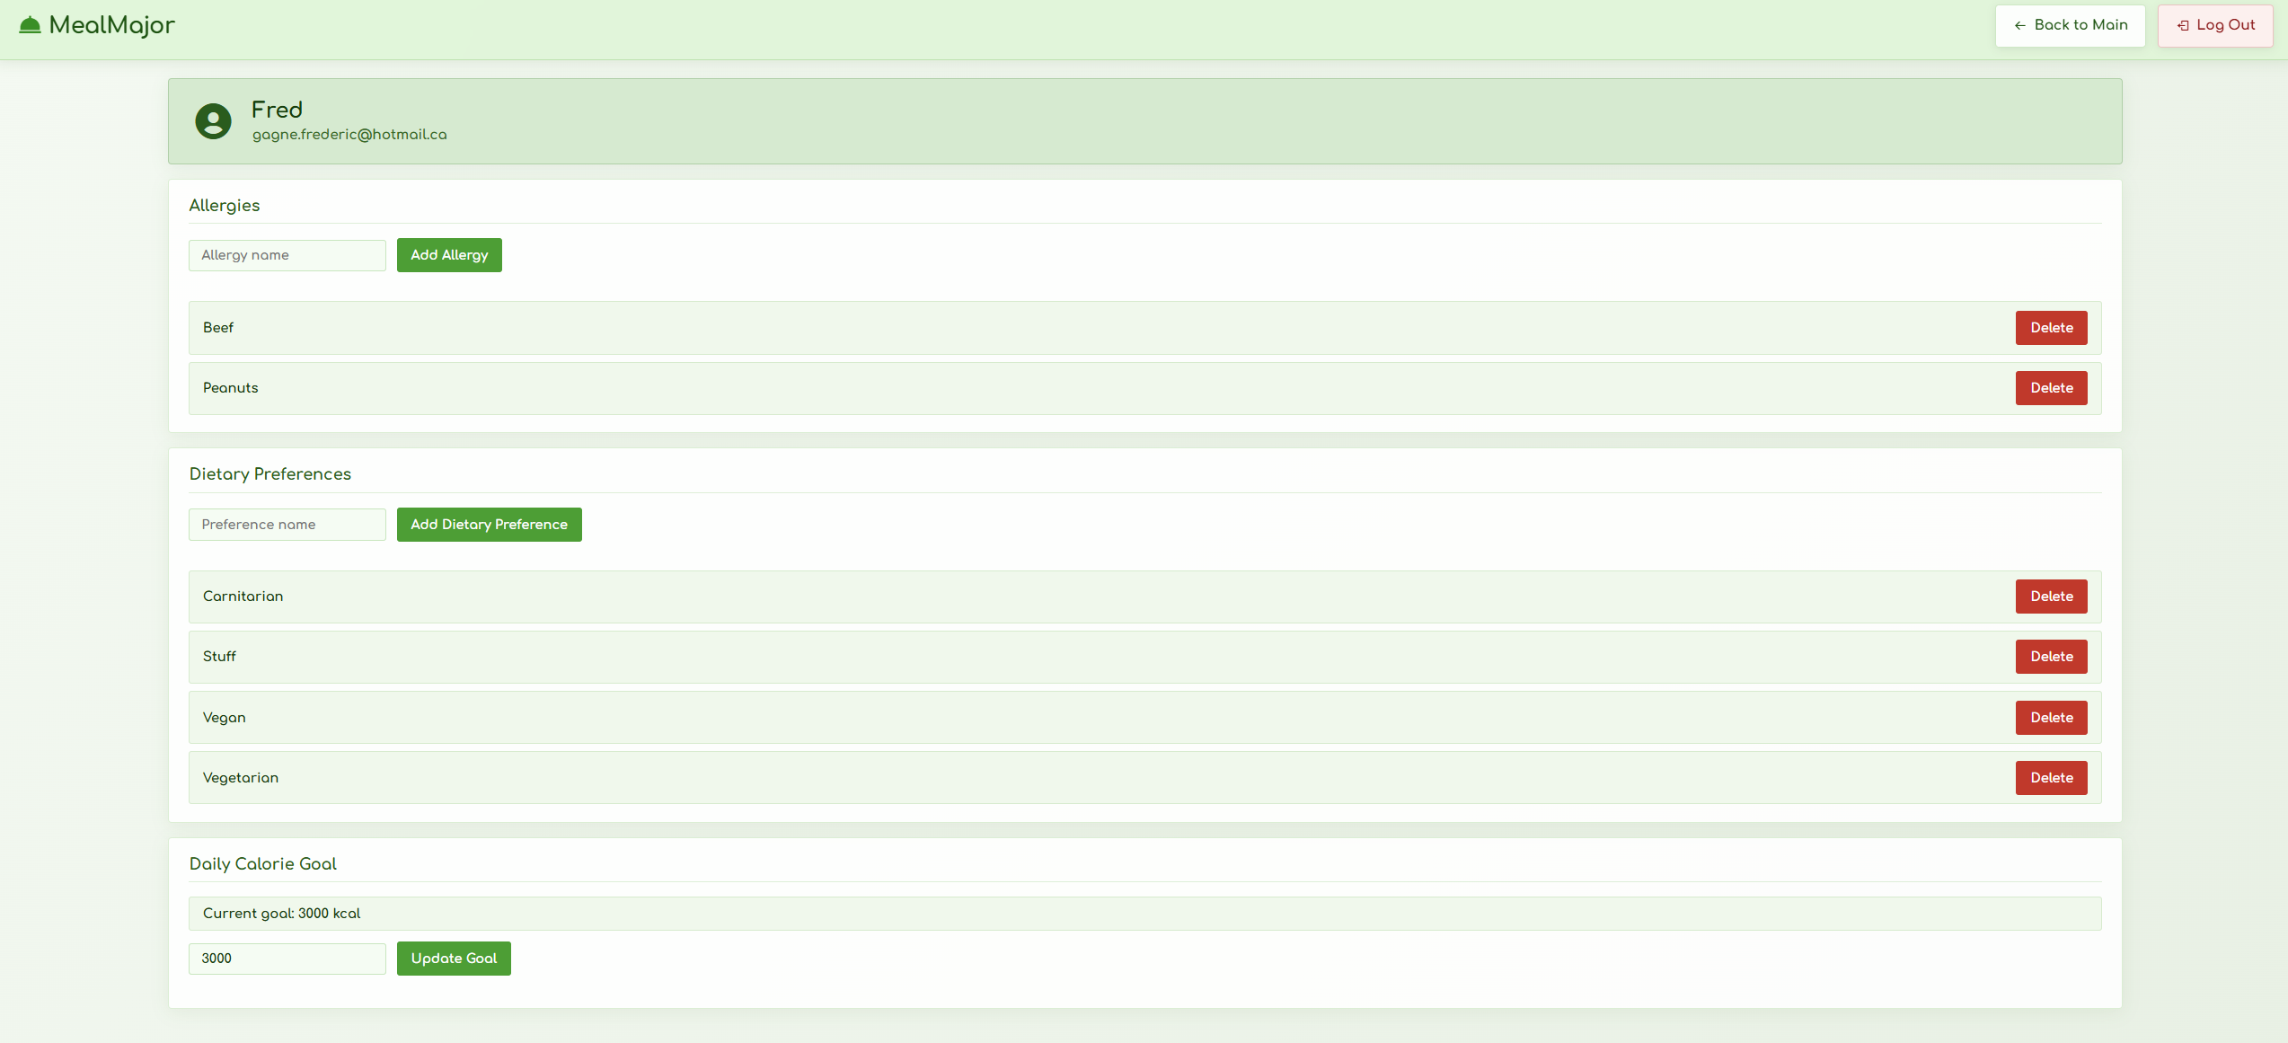
Solution overview
User Accounts
Registration, login & dietary profile management

Slide 4
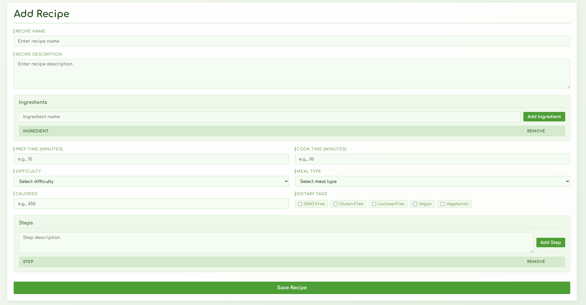
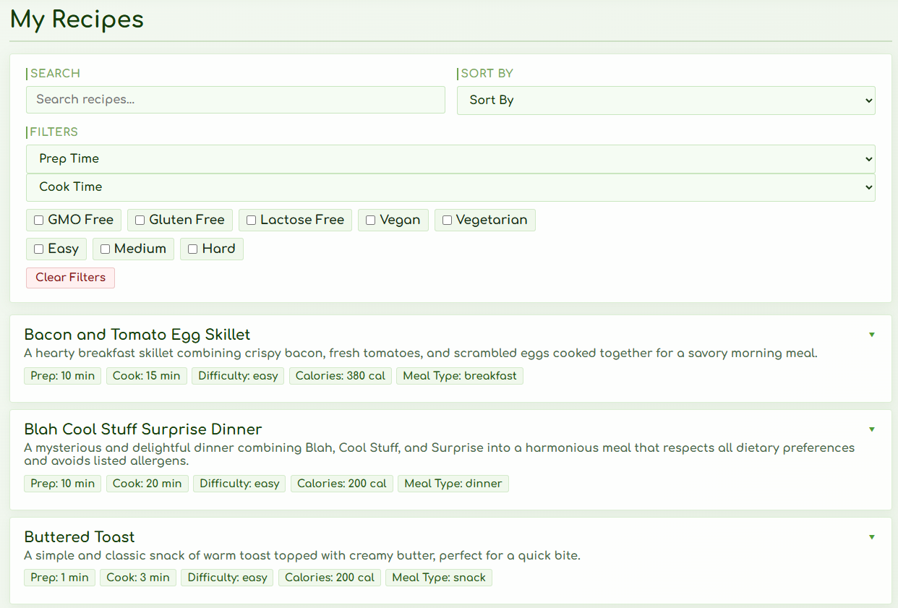
Solution overview
Recipe Manager
Create, edit, search & filter recipes by time, cost, diet

Slide 5

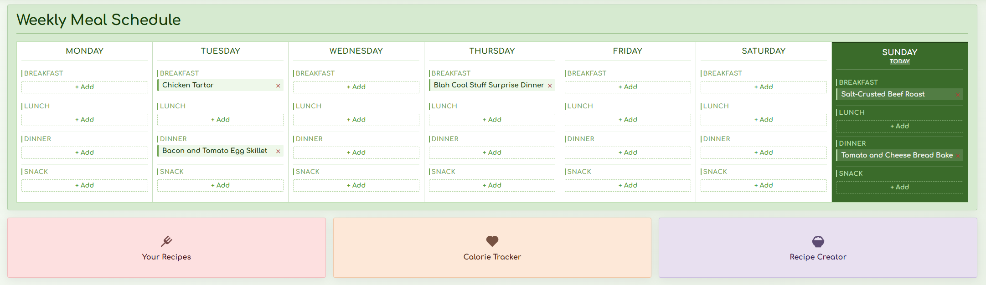
Solution overview
Weekly Planner
Plan your weekly meal schedule

Slide 6

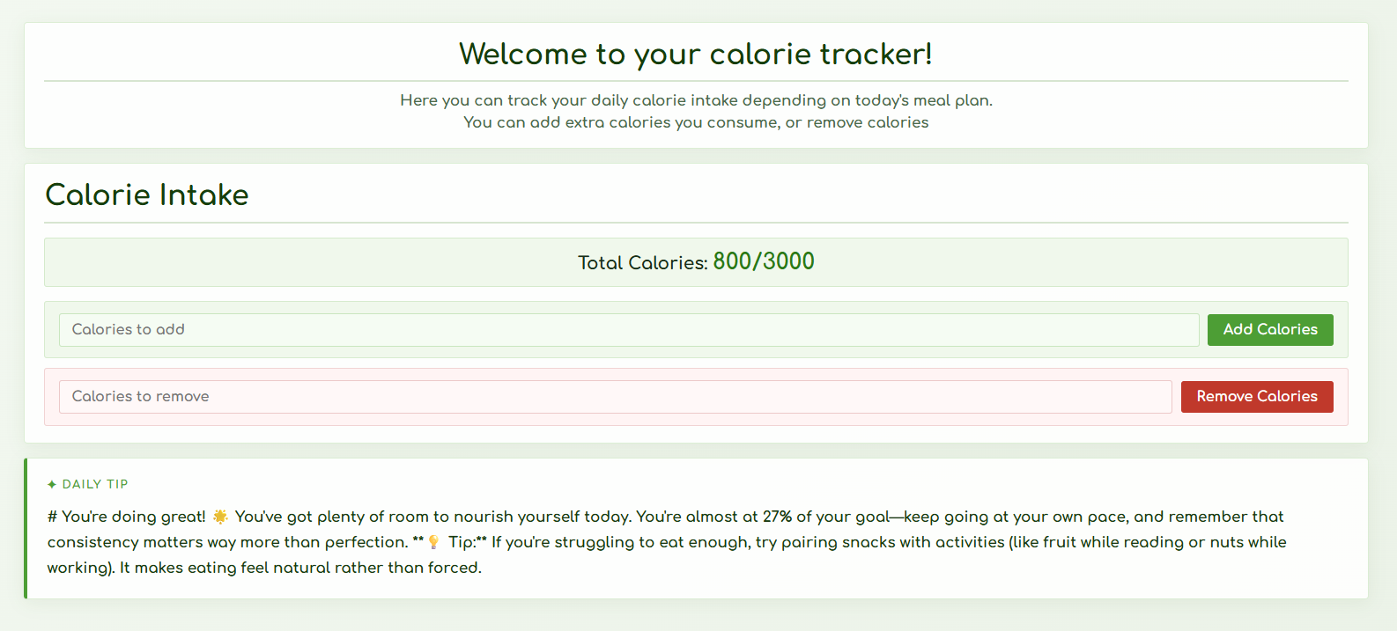
Competitive edge
Built-in Calorie Tracker
Integrated calorie monitoring tied directly to the meal planner.

Slide 7
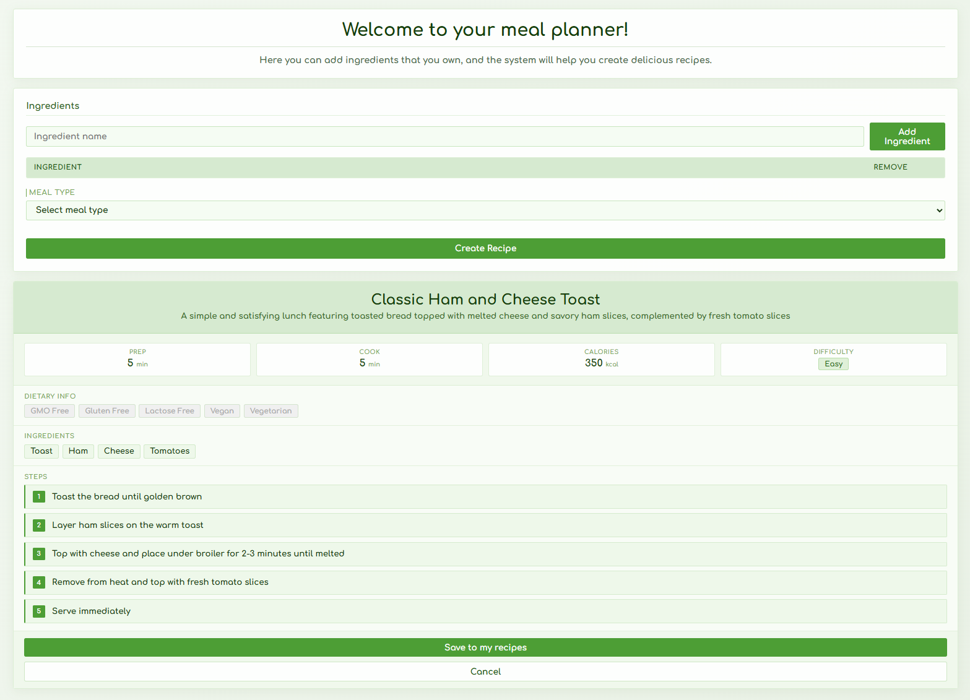
Competitive edge
AI Recipe Generator
Input ingredients you have, get a complete recipe

Slide 8

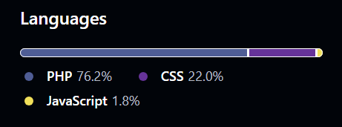
Product overview
PHP
7
HTML
CSS JS
Primary Language
Web Pages
Supporting Languages
Frameworks & Tools
Paragonie | Anti-CSRF
Anthropic AI | SDK
PHPUnit
GitHub
MySQL
Lines of code
Frontend
Backend
Tests
3039 Lines
1127 Lines
2006 Lines

Slide 9



Process overview
12 pts/sprint
Avg Velocity
197
Total Commits
62
Total Issues

Slide 10
demo
Key User Story: Filter Recipes

Slide 11

Thank you for listening!

