Slide 1
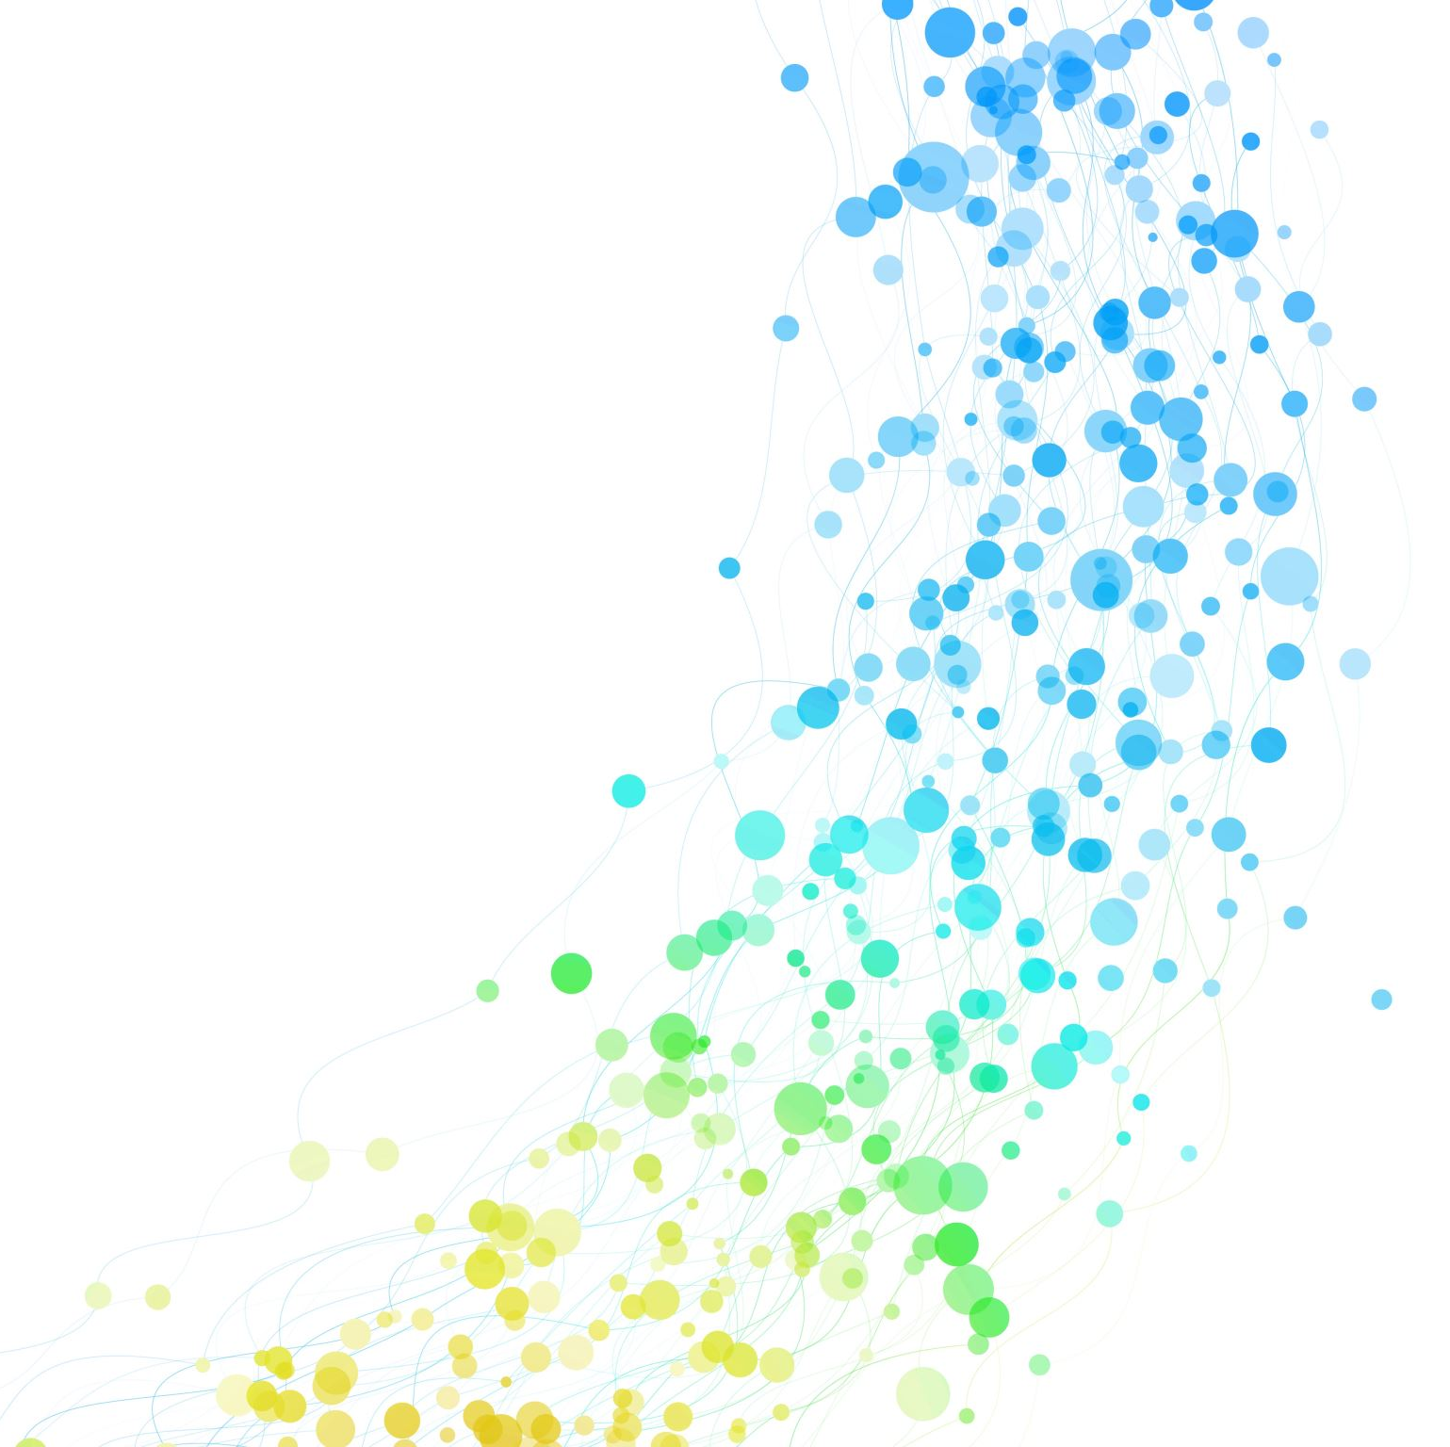
Scrum-Agile in Practice
Fred Wahab
CS 250

Slide 2
Team Roles
Product Owner: Manages product backlog including expressing and prioritizing items. Provides communication between the client and the team.
Scrum Master: Plans and executes Scrum events including sprints and daily stand-ups.
Developers: Responsible for the build of the project. Determines the difficulty of each task to generate accurate time management and progress updates.
Testers: Go through the user stories, translate the story into functional tests, run the tests, and then send the results to the development team.
(Cobb, 2015)

Slide 3
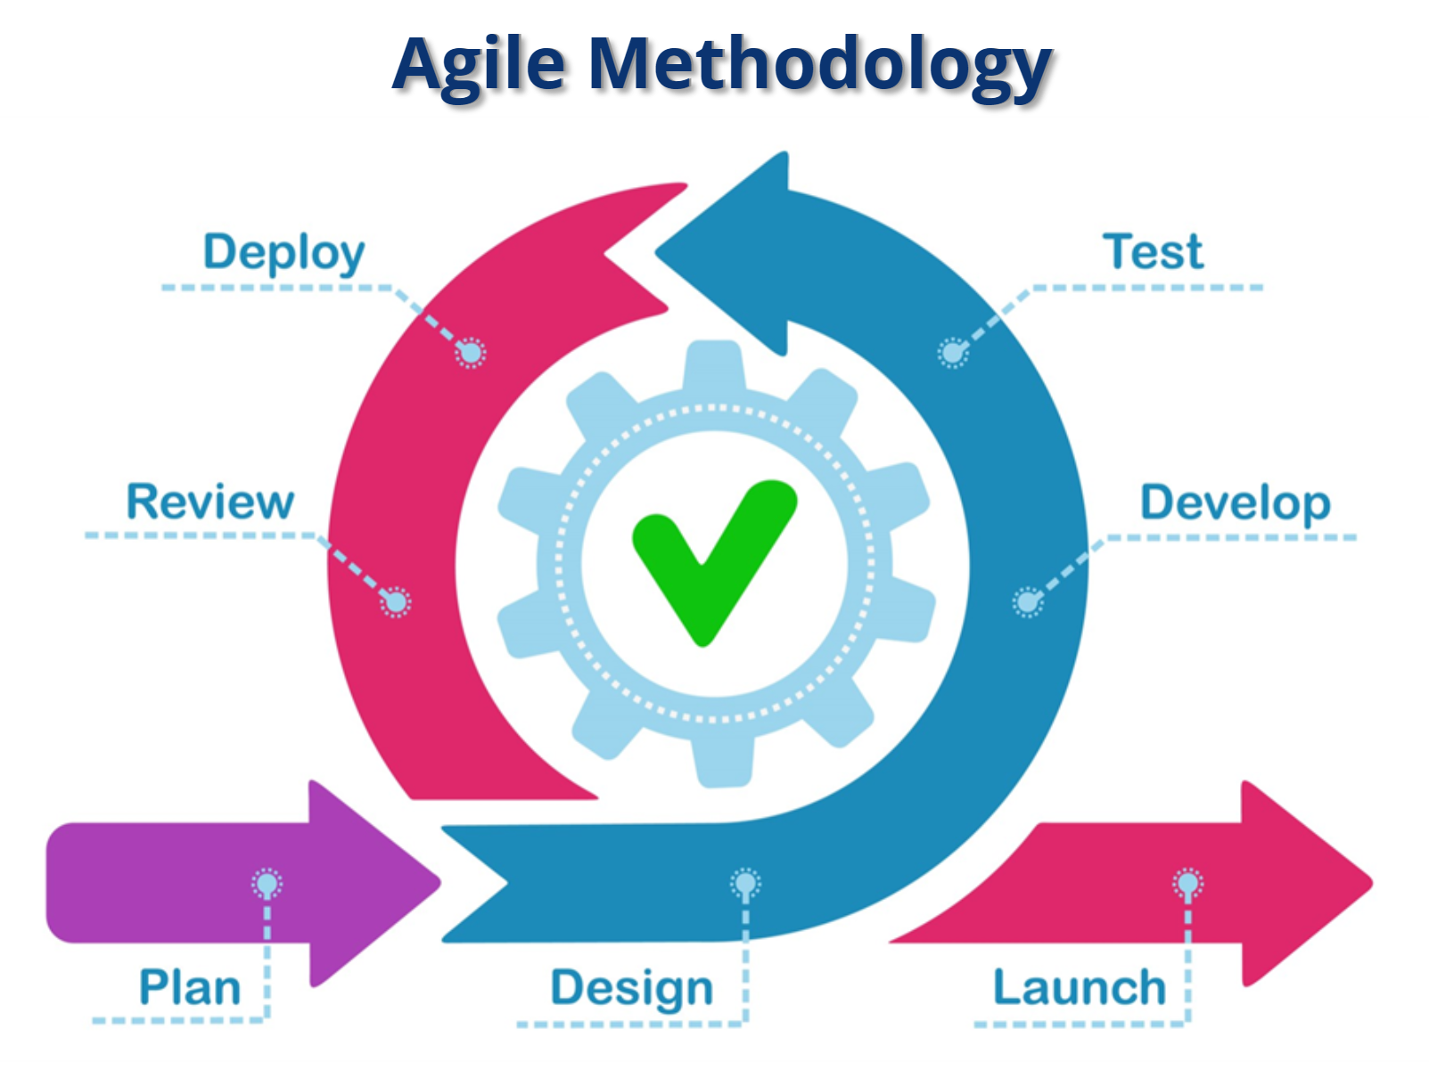
SDLC Phases
Plan: Evaluate the scope of the problem and determine the solutions.
Design: Detail the specifications, features and operations.
Develop: Begin production.
Test: Determine if proposed design meets desired goals.
Deploy: Integrate data and components into system.
Review: Analyze system to identify any issues.
Launch: Support and maintenance.
(Jefferies, 2019)

Slide 4
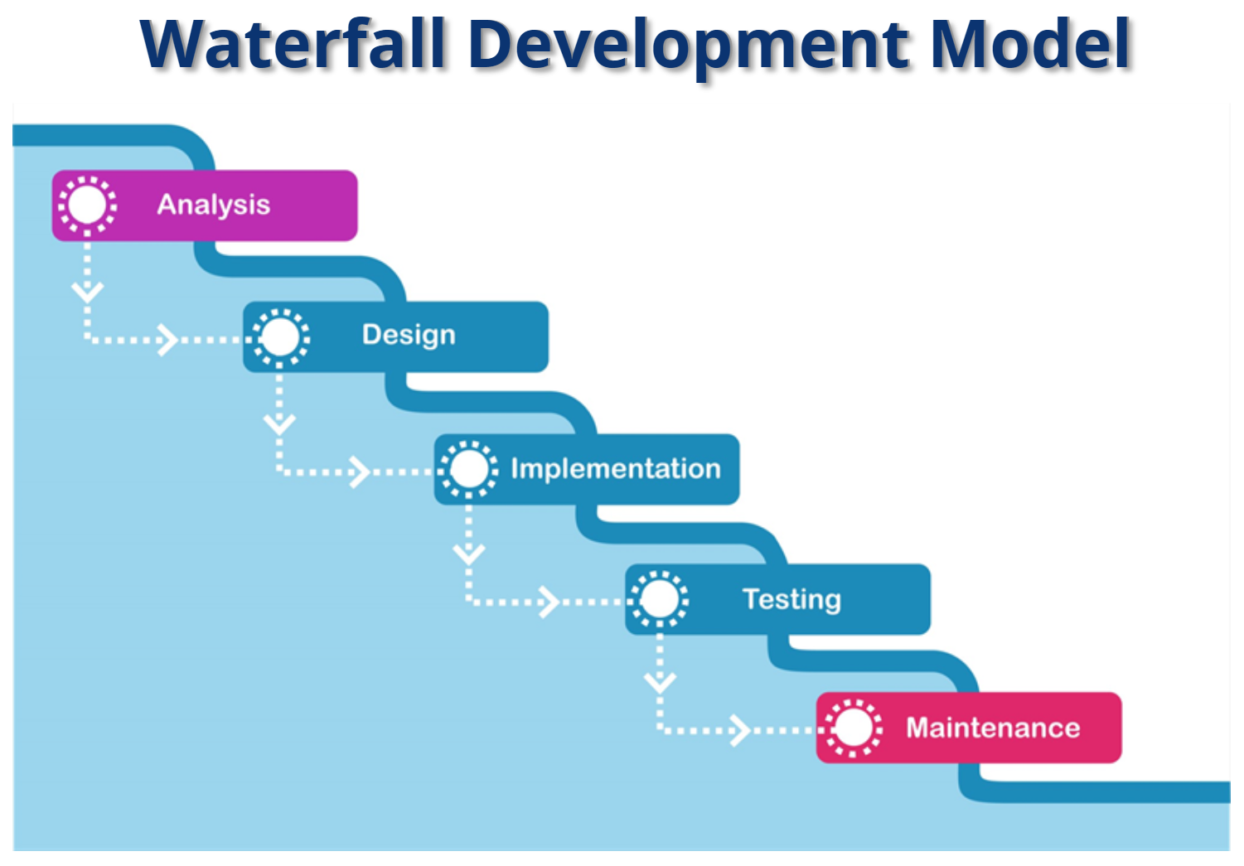
The Waterfall Development Model is a linear methodology. That requires the previous step to be completed prior to starting the next. For the SNHU Travel project, when the client requested to change the focus to wellness destinations, the Waterfall Development Model would have required going back to the first Analysis stage and starting from scratch.
(Coffin, 2006)

Slide 5
Choosing a Model
If the project is simple and straight forward, the Waterfall Development Model should be used.
Larger projects with more complex components should be executed using the Scrum-Agile Development Model.
Cost is a factor. Waterfall is usually less expensive than Scrum-Agile.
They are not mutually exclusive. A project can integrate both Waterfall and Scrum-Agile for different components.

Slide 6
References
Cobb, C. G. (2015). The project manager’s guide to mastering agile: principles and practices for an adaptive approach. Hoboken, NJ: Wiley.
Coffin, R. and Lane, D. (2006). Figure 2: The crystal Family of methodologies [Diagram]. Retrieved from: http://www.devx.com/supportitems
/showSupportItem.php?co=32826&supportitem=figure2
Jeffries, R. (2019). Circle of life [Diagram]. Reprinted from Clean agile: back to basics, by R. Martin. 2019, Prentiss Hall.

