Slide 1

DriverPass System Analysis
Fred Wahab
Notes:
[No speaker notes required for this slide.]

Slide 2

System Requirements
Hardware Requirements – Desktop or mobile device with compatible operating system and web browser.
Internet Connection – At least 3mbps.
Account Creation – Users will create unique accounts to log in, schedule sessions, and make payments.
Schedule Sessions – Driving sessions can be scheduled and edited by the customer or by authorized employees.
Notes:
The DriverPass system is designed to be lightweight and compatible with a variety of different types of devices. Users may use a traditional desktop device or a mobile device to access the DriverPass system. DriverPass will run on all major operating systems including Windows, MacOS, Android, iOS, and Linux. It will also require a supported web browser like Edge, Chome, Safari, Firefox, or Opera. To connect to the system the user will need at leas a 3mbps internet connection speed.
One of the goals for the system is to make is simple enough for all users to easily access it. This is done by creating an account scheduling driving sessions and making payments online. If a customer needs to make changes to the driving session, they should be able to do this through the system or have and authorized DriverPass employee do it for them.

Slide 3
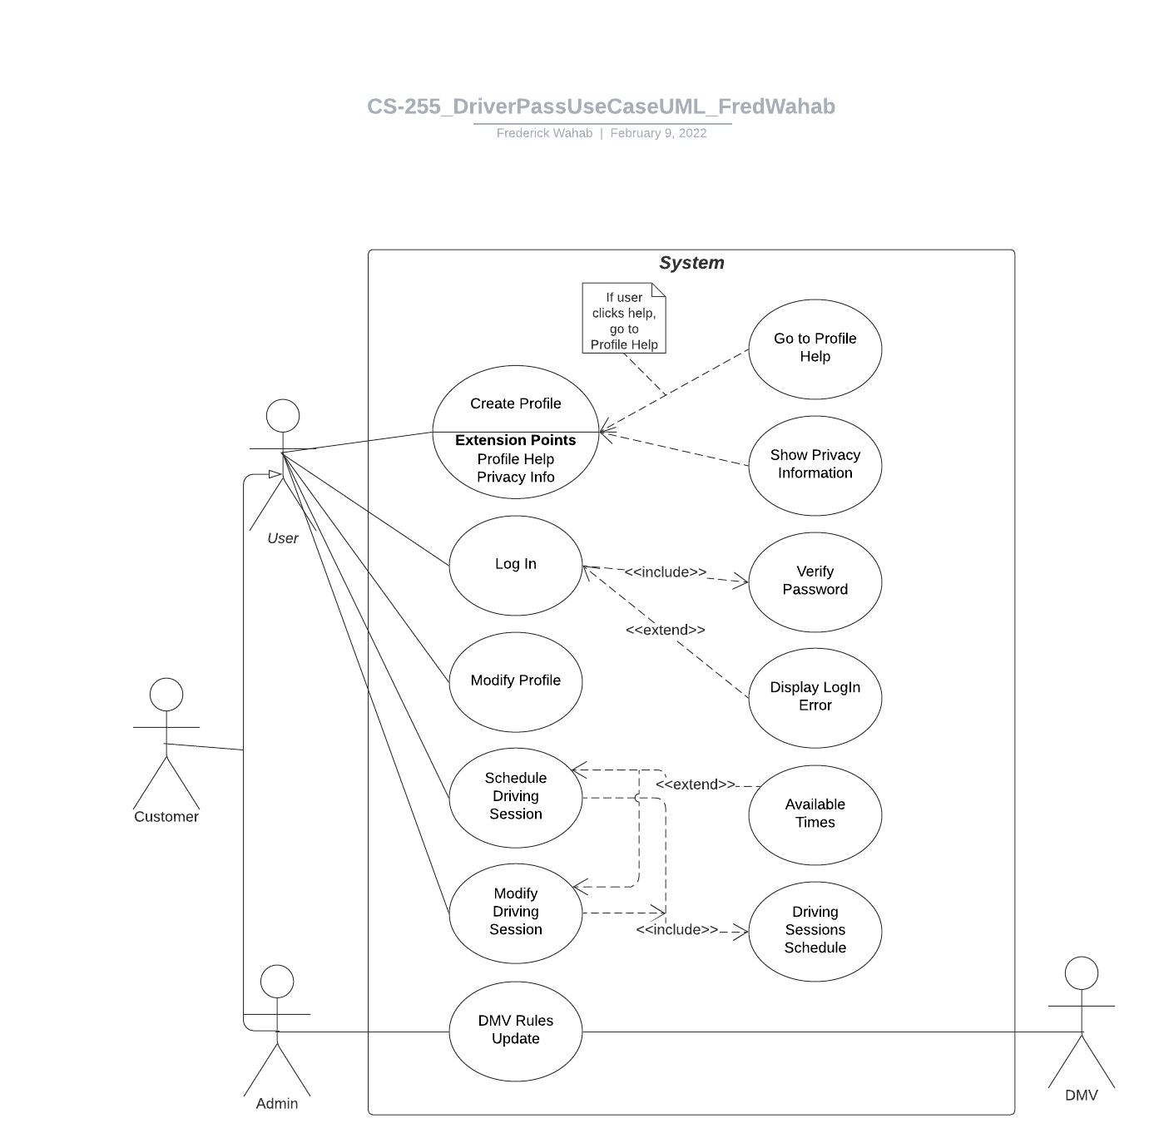
Use Case Diagram
[Insert your use case diagram here.]
Notes:
How does the system work? Here is a simple Use Case Diagram to get a high-level view of the system and how users can interact with it. The two main goals of this system is simplicity and accessibility. Primary users of the DriverPass system can be broken down into two major groups, the customers and the administrators. The only other group that will have access to the system is the DMV and that is to only provide rules updates to keep the DriverPass system up to date on all regulations. Primary users will have the ability to create a profile, log in, modify the profile, schedule a driving session, and modify a scheduled session.

Slide 4
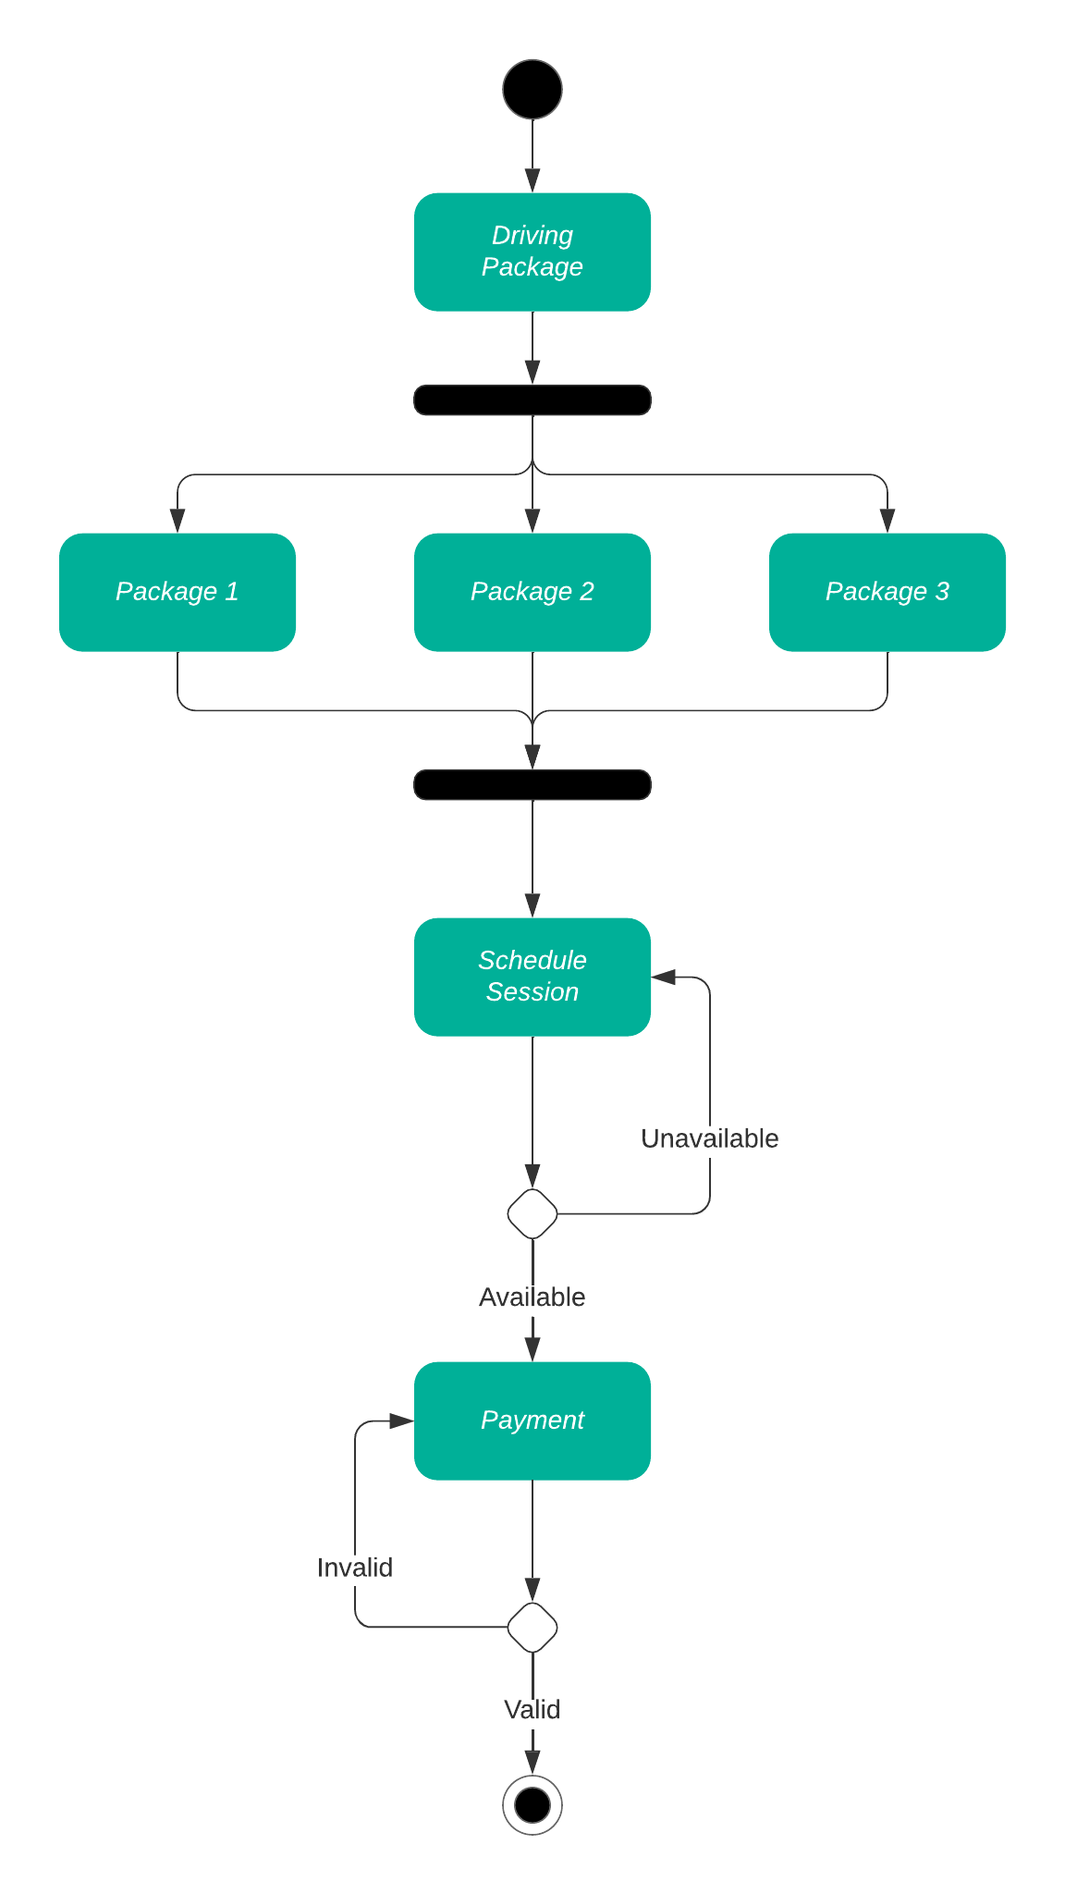
Activity Diagram
Notes:
Since creating a scheduled driving session is the primary function of the system, let’s take a closer look at this activity and break down how it works. When the user creates a driving session, they will be given the option of 3 different 2-hour packages to choose from. From there, they have a schedule of available dates, times and instructors to choose from. This is important not only to cater to the schedule of the customer, but they may have had a positive experience with a particular instructor that they may want to continue with. Once the schedule is selected, they will have several major payment options to make purchasing simple.

Slide 5
Security
Unique username
Password – Minimum length, at least 1 capital letter, 1 lower case, 1 number, and 1 special character
Asymmetrically encrypted data
Password change authentication
Failed attempt lockout
Notes:
[How did you consider security in your design? In your explanation, keep your audience in mind by avoiding the use of technical terms.]
DriverPass system puts the security of the customer first. This begins with account creation. Every user will need to make a unique username and a password that has at least 8 characters, a capital letter, a lowercase letter, a number and a special character. The data passed between the user and DriverPass will be asymmetrically encrypted to ensure maximum security during transmission. Password changes will need to authenticated by the user. DriverPass employees will not have the ability to change customer passwords but will be able initiate a reset request that will go to the customer’s email. If an account access attempt fails more than 3 times, the account will be locked. The customer will need to contact DriverPass who can then unlock the account by initializing a password reset request.

Slide 6
System Limitations
Additional features may not be able to be deployed on shorter time frames.
Additional features may require additional hardware.
Payments will made through third-party systems.
Users without compatible devices.
Notes:
[What are the limitations of your design? In your explanation, keep your audience in mind by avoiding the use of technical terms.]
As adaptable as the DriverPass system is, there are some limitations that need to be acknowledged. The first couple of limitations revolve around adding additional features to the system in future updates. Additional features will need be built and tested in an isolated environment and may not be able to be deployed on shorter time frames. They may also require additional hardware to house, which would increase the operating cost of the system.
The DriverPass system also uses third party finance institutions to process transactions. While this insures a secure and reliable experience for the customer, it does restrict DriverPass’s ability to quickly make billing and finance changes. The last limitation of the system is the most obvious. Customers will need to have access to a compatible device with and internet connect to make use of all the features in the DriverPass system. DriverPass customer service representatives will also have this ability in order to help customers who don’t have access to these requirements.

