Slide 1
Coder Dojo
Elliott Sperlazza
Minecraft: Manually Loading Mods
Networking Basics

Slide 2
Learning about Computers
Many individual parts which build on each other

Slide 3
How I've Learned
Operating Systems
PC Hardware
Servers
Networking
Electrical Hardware

Slide 4
Looking at Mod Source Code
Quick Java intro:
  Classes: are things
  Methods: do stuff
  Variables: hold information
Our simple mod
Iron Chests
Buildcraft

Slide 5
Minecraft Forge
Minecraft is not open source, but it is extremely Mod friendly.
Forge is a set of APIs (tools) which help people make mods

Slide 6
Mods: Launchers
Tekkit or Feed The Beast to play mods
  Takes care of compatibility issues, mod installation

Slide 7
Mods: Manually Installing
We updated our test version of MC to 1.6.2
Launch the Forge Installer, choose “client”
Choose forge profile, start MC, close
Start MC again, edit the Forge profile, get game directory, go there.
Copy mod into mods folder

Slide 8
Load a Mod
Forge (the mod for mods!)
NEI
BuildCraft
IronChests

Slide 9
Networking
Server/Clients
IP Addresses
DHCP
Routers/Switches

Slide 10
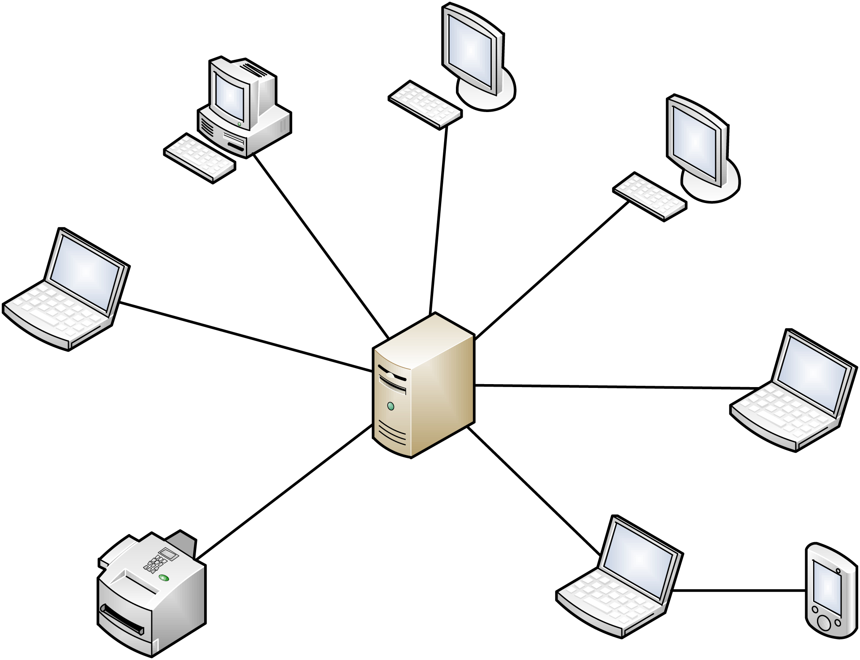
Server/Client
Server – the remote computer you connect to, the authority
Client – the local computer you are using
But what is a server really? (ISPs TOS)

Slide 11
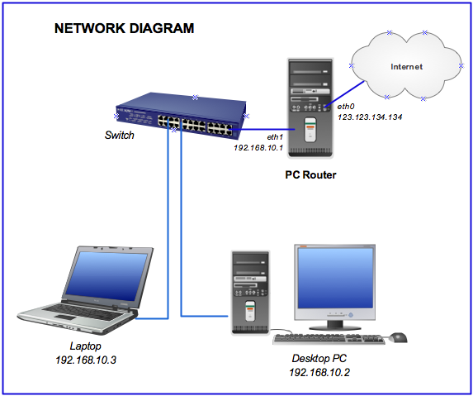
IP Addresses
How do servers and clients connect? They need an address!
Light speed postal mail
0.0.0.0 – 255.255.255.255

Slide 12
DHCP
Dynamic Host Configuration Protocol
This is one way how we get IP Addresses (automatic vs manual)
Will be assigned addresses for a local network from a predefined block (192.168.1.*) (IPv4)
To find your IP address on a network, open a terminal and type ipconfig
We need something to act as a DHCP server

Slide 13
Switches/Routers
Switches allow you to physically connect multiple machines together with CAT5 cable
Does not have DHCP server
Routers can have many features including: DHCP server, wireless interface, a switch, and sometimes even a modem
Typically lets you connect on 192.168.1.1 to manage the router

Slide 14
Create a network
Let's come up with some ways to create some networks with this hardware
How many different networks can we create?
Can we hook all the equipment into one network?
Let's play minecraft! Pick some friends and decide who will be the server and who will be the clients
  Note the port!
  Use ipconfig to find your IP address
  Example address 192.168.1.5:12345
What happens if we try to play someone who has different mods than we do?

Slide 15
Your Mod
Dojo Veterans will remember:
  Launch Eclipse
  Create a Recipe
  Create a block

Slide 16
Homework
Find a friend to play our mod with over a network. What happens if one of you changes the icon of our custom block?
Load another mod manually and share what it is and how you liked it
Take a look at the buildcraft source. What do you see in here that you want to do?

