Slide 1

Social Coding
Intro to Git and GitHub

Slide 2
Why Social Coding?
Standing on the shoulders of giants – when you write software you are already using tools really smart people created
Better learning – being social helps you better solve problems (googling problems, asking others for help, etc). Everybody needs (and can give!) help. (IT Crowd reference)
Better code – when you find ways to solve problems better you'll write better code. Always write beautiful code!
Good fit with Open Source – Open Source code is inherently social (everybody can see it) and values the creator over the creation. Meritocracy where best ideas rise to the top

Slide 3
What is Git/GitHub?
Git: version control system – you will never write all your code in one sitting and usually not by yourself. It will take weeks/months/years and many people. The product will be shown at many stages and you'll need to keep track of many versions of the code.
GitHub: a place to store your code – GitHub offers free code hosting for open source projects. All coder dojo projects will be open source so that the greatest number of people can benefit from them.

Slide 4
Projects on GitHub
Bootstrap – what the fredxcoders site uses!
Node.js – popular server side javascript platform
Jquery – popular javascript library
Django – popular web framework
Many minecraft mods! - Galacticraft, Tinker's Construct, OpenBlocks, many more!

Slide 5
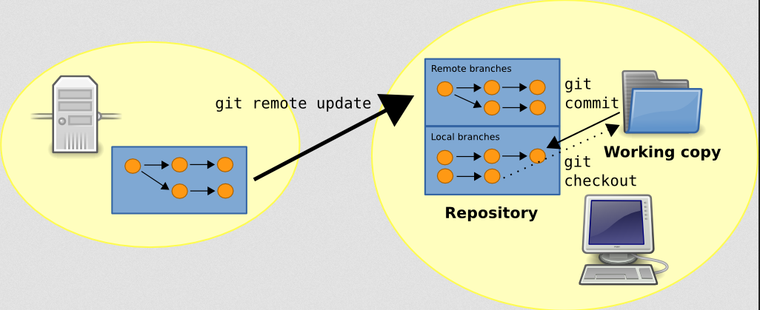
Git -
GitHub
(Remote)
Your Computer
(Local)

Slide 6
Git Terms
Repo (Repository): a place to store code – organized per project
Fork: a personal copy of another repo – you will be forking a fredxcoders repo for this lesson
Clone: a copy of a repo that's on your computer – we will be cloning the fredxcoders repo to make changes to it
Commit: saving a change in git – to your cloned repo
Push: taking changes on your computer and sending them to your repo on GitHub
Pull: getting changes from a repo on GitHub – (checkout) you push TO GitHub and pull FROM GitHub https://help.github.com/articles/github-glossary

Slide 7
Steps
Create a GitHub Account - Free
Download Git GUI (notepad ++, FireFox/IE) – and log in. I'll be demoing Windows
Fork FredXCoders/WebProject – search for it on GitHub and click “fork”
Clone the WebProject
Look at the firstwebsite page – some other tutorials/projects exist in this repo
Update the info.json – set your name
Test your changes – Use Firefox or IE
Commit your changes – leave a nice message about what you did
Sync your changes – The Git GUI will

