Slide 1
理解意图和实体
BUILDING CHATBOTS IN PYTHON

Slide 2
例子
我正在新街口寻找烧烤店
NLU
意图：
-- 餐馆搜索
实体：
-- 类型：烧烤
-- 地点：新街口
新街口的怒烧烤怎么样？
数据库

Slide 3
意图
寻找吃饭的地方可以用许多不同的方式表达：
我饿了
看看美团美食排行榜
走啊，一起撸串去
也可以是建议沟通

Slide 4
实体
NER =命名实体识别

Slide 5
识别意图和实体的正则表达式
比机器学习方法更简单
计算效率高
缺点：
调试正则表达式可能变得困难

Slide 6
正则表达式的使用
'|' 等价于 '或'
\b匹配单词的开头或结尾
In [1]: re.search(r"(hello|hey|hi)", "hey there!") is not None
Out[1]: True
In [2]: re.search(r"(hello|hey|hi)", "which one?") is not None
Out[2]: True
In [3]: re.search(r"\b(hello|hey|hi)\b", "hey there!") is not None
Out[3]: True
In [4]: re.search(r"\b(hello|hey|hi)\b", "which one?") is not None
Out[4]: False

Slide 7
用正则表达式识别实体
In [1]: pattern = re.compile('[A-Z]{1}[a-z]*')
In [2]: message = """
Mary is a friend of mine,
she studied at Oxford and
now works at Google"""
In [3]: pattern.findall(message)
Out[3]: [‘Mary’, ‘Oxford’, ‘Google’]

Slide 8
词向量

Slide 9
机器学习
可以通过使用更多的数据来完成任务（数据越多预测越准）
识别用户消息属于哪个意图

Slide 10
向量表示
如何以计算机语言表达 can you help me please?
Units
examples
vectors
characters
"c", "a", "n", ...
v_c, v_a, v_n, ...
words
"can", "you", ...
v_{can}, v_{you}, ...
sentences
"can you help..."
v_{can you help ...}

Slide 11
词向量
Context
Candidates
let's meet at the ___ tomorrow
office, gym, park, beach, party
I love going to the ___ to play with the dogs
beach, park
词向量试图用一个固定长度的数值向量表示单词的含义
出现在类似上下文中的单词具有相似的向量
具有相似语义的单词具有相似的向量

Slide 12
词向量是计算密集型的
训练词向量需要大量数据
高质量的词向量可供任何人使用
GloVe算法
word2vec派系
spaCy

Slide 13
spaCy中的词向量
In [1]: import spacy
In [2]: nlp = spacy.load('en_core_web_md')
In [3]: nlp.vocab.vectors_length
Out[3]: 300
In [4]: doc = nlp('hello can you help me?')
In [5]: for token in doc:
...: print("{} : {}".format(token, token.vector[:3]))
hello : [ 0.25233001 0.10176 -0.67484999]
can : [-0.23857 0.35457 -0.30219001]
you : [-0.11076 0.30785999 -0.51980001]
help : [-0.29370001 0.32253 -0.44779 ]
me : [-0.15396 0.31894001 -0.54887998]
? : [-0.086864 0.19160999 0.10915 ]

Slide 14
词语语义的相似度
向量的方向很重要
单词之间的“距离”= 向量之间的角度
余弦相似度
1：向量指向相同的方向（词语语义高度相关）
0：它们是垂直的（词语语义并无相关）
-1：它们指向相反的方向（词语语义完全相反）

Slide 15
.similarity()
can 和 cat 拼写相似，但相似度较低
但 cat 和 dog 有很高的相似性
In [1]: import spacy
In [2]: nlp = spacy.load('en_core_web_md')
In [3]: doc = nlp("cat")
In [4]: doc.similarity(nlp("can"))
Out[4]: 0.30165292161215396
In [5]: doc.similarity(nlp("dog"))
Out[5]: 0.80168555173294953

Slide 16
意图识别和分类问题

Slide 17
监督学习
分类器预测给定句子的意图标签
通过训练数据调整“适合”分类器
评估测试数据的性能
准确度：我们正确预测的标签分数

Slide 18
ATIS数据集I
成千上万的带有标记意图和实体的句子
从真实的航班预订服务中收集
意图如:
atis_flight
atis_ticket

Slide 19
ATIS数据集II
In [1]: sentences_train[:2]
Out[1]: [
"i want to fly from boston at 838 am and arrive in denver at 1110 in the morning",
"what flights are available from pittsburgh to baltimore on thursday morning"
]
In [2]: labels_train[:2]
Out[2]: [
"atis_flight",
"atis_flight"
]
In [3]: import numpy as np
In [4]: X_train_shape = (len(sentences_train),nlp.vocab.vectors_length)
In [5]: X_train = np.zeros(X_train_shape)
In [6]: for sentence in sentences_train:
...: X_train[i,:] = nlp(sentence).vector

Slide 20
最近邻分类
需要训练数据
每个句子都被标上了他们的意图
最简单的方法
寻找最相似的标签示例
使用其意图作为最佳猜测
最近邻分类

Slide 21
scikit-learn中的最近邻分类
In [1]: from sklearn.metrics.pairwise import cosine_similarity
In [2]: test_message = """
i would like to find a flight from charlotte
to las vegas that makes a stop in st. louis""”
In [3]: test_x = nlp(test_message).vector
In [4]: scores = [
...: cosine_similarity(X[i,:], test_x)
...: for i in range(len(sentences_train)
...: ]
In [5]: labels_train[np.argmax(scores)]
Out[5]: 'atis_flight'

Slide 22
支持向量机
最近邻非常简单 - 我们可以做得更好
SVM / SVC：支持向量机/分类器
In [1]: from sklearn.svm import SVC
In [2]: clf = SVC()
In [3]: clf.fit(X_train, y_train)
In [4]: y_pred = clf.predict(X_test)

Slide 23
实体抽取

Slide 24

关键字之外：语境
关键字方法不适用于之前未见过的实体
其他方法，比如使用上下文线索：
拼字
大写
之前出现的词或者之后
模式识别

Slide 25
预建的命名实体识别
In [1]: import spacy
In [2]: nlp = spacy.load('en')
In [3]: doc = nlp("my friend Mary has worked at Google since 2009")
In [4]: for ent in doc.ents:
...: print(ent.text, ent.label_)
...:
Mary PERSON
Google ORG
2009 DATE

Slide 26
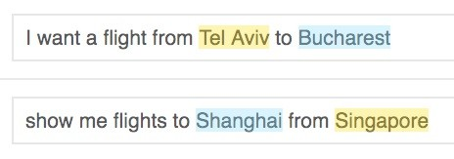
角色
In [1]: pattern_1 = re.compile('.* from (.*) to (.*)')
In [2]: pattern_2 = re.compile('.* to (.*) from (.*)')

Slide 27
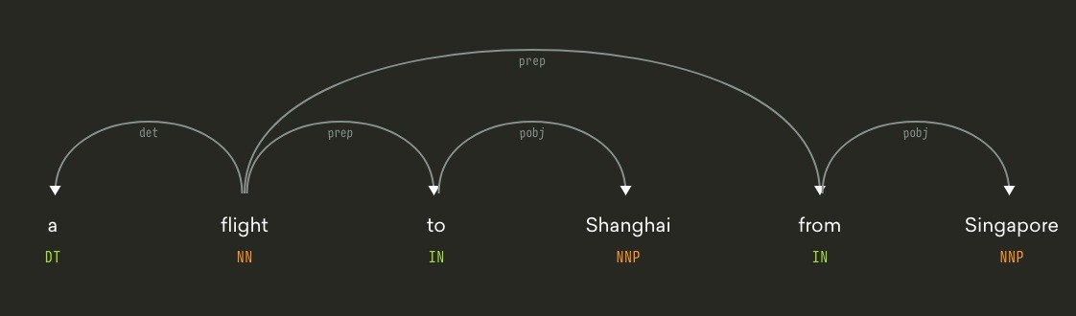
依赖分析
In [1]: doc = nlp(‘a flight to Shanghai from Singapore')
In [2]: sh, sg = doc[3], doc[5]
In [3]: list(sh.ancestors)
Out[3]: [to, flight]
In [4]: list(sg.ancestors)
Out[4]: [from, flight]
NNP (Proper Noun)
DT (Determiners)
IN (Prepositions and Subordinating Conjunctions)
NN (Common Noun)
https://sites.google.com/site/partofspeechhelp/home/nn_nnp
https://sites.google.com/site/partofspeechhelp/home/dt_in

Slide 28
购物例子
In [1]: doc = nlp("let's see that jacket in red and some blue jeans")
In [2]: items = [doc[4], doc[10]] # [jacket, jeans]
In [3]: colors = [doc[6], doc[9]] # [red, blue]
In [4]: for color in colors:
...: for tok in color.ancestors:
...: if tok in items:
...: print("color {} belongs to item {}".format(color, tok))
...: break
color red belongs to item jacket
color blue belongs to item jeans

Slide 29
基于Rasa的NLU

Slide 30
Rasa NLU
用于意图识别和实体提取的库
基于spaCy，scikit-learn和其他库
内置支持聊天机器人特定任务

Slide 31
Rasa训练数据的格式
ln [1]: from rasa_nlu.training_data import load_data
In [2]: training_data = load_data(”/PATH/TO/training_data.json")
In [3]: import json
In [4]: print(json.dumps(training_data.entity_examples[0].data, indent=2))
Out[4]: {
"intent": "restaurant_search",
"entities": [
{
"start": 31,
"end": 36,
"value": "north",
"entity": "location"
}
]
}
/Users/fzhang/Documents/projects/rasa_nlu/data/examples/rasa/demo-rasa.json

Slide 32
Interpreters
In [1]: message = "I want to book a flight to London"
In [2]: interpreter.parse(message))
Out[2]: {
"intent": {
"name": "flight_search",
"confidence": 0.9
},
"entities": [
{
"entity": "location",
"value": "London",
"start": 27,
"end": 33
}
]
}

Slide 33
Rasa的使用
from rasa_nlu.training_data import load_data
from rasa_nlu.config import RasaNLUModelConfig
from rasa_nlu.model import Trainer
from rasa_nlu import config
# Create a trainer
trainer = Trainer(config.load("/PATH/TO/CONFIG_FILE"))
# Load the training data
training_data = load_data('/PATH/TO/TRAINING_DATA')
# Create an interpreter by training the model
interpreter = trainer.train(training_data)
/Users/fzhang/Documents/projects/rasa_nlu/sample_configs/config_spacy.yml
/Users/fzhang/Documents/projects/rasa_nlu/data/examples/rasa/demo-rasa.json

Slide 34
条件随机场
机器学习模型，流行用于命名实体识别
即使使用小的训练数据也可以表现良好

Slide 35
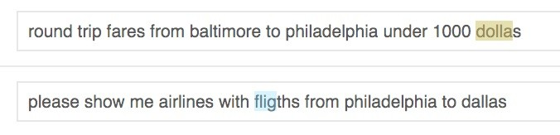
错别字处理
In [1]: pipeline = [
...: "nlp_spacy",
...: "intent_featurizer_spacy",
...: "intent_featurizer_ngrams",
...: "intent_classifier_sklearn"
...: ]

