Slide 1




Phase-shift layer
Time-delay layer
User
PS
$x_{1}$
………
RF chain
TTD
………
$x_{2}$
User
Digital Beamformer
………
RF chain
TTD
………
………
………
………
………
$x_{K}$
RF chain
TTD
………
User

Slide 2
User
Pilot sequences
………
Base Station
User
Channel data
………
………
Beamformer
User

Slide 3
User
Pilot sequences
User
………
Base Station
Channel data
User
………
………
Beamformer

Slide 4
User
Pilot sequences
User
………
Base Station
………
User
Channel data
………
Beamformer

Slide 5






$𝓕_{θ}$
$𝓖_{φ}$
User
linear
linear
linear
Tanh
linear
Dropout
linear
Dropout
Normalization
vectorize
Decode
LeakyRelu
LeakyRelu
$z$
LeakyRelu
LeakyRelu
$Y$
$z^{′}$
$W$
User
Quantization & entropy encoding
Framing &
feedback
………
UE side
User
BS side

Slide 6




$𝓖_{φ}$
$𝓕_{θ}$
Feedback Module
User
Embedding
Source encoder
Source decoder
Linear
Linear
Linear
Tanh
De-quantizer
Linear
Linear
Normalization
vectorize
Quantizer
Dropout
Dropout
LeakyRelu
LeakyRelu
LeakyRelu
LeakyRelu
User
$Y$
$z$
$\hat{z}$
$w$
Uplink
channel
User
UE side
BS side

Slide 7











$𝓖_{φ}$
Linear
Linear
Tanh
Quantize &
Source encoding
$𝓕_{θ}$
${\tilde{H}}_{1}$
LeakyRelu
$$z_{1}$$
User 1
Linear
Dropout
Linear
Normalization
LeakyRelu
$W$
$𝓖_{φ}$
Linear
Linear
Tanh
Quantize &
Source encoding
${\tilde{H}}_{2}$
LeakyRelu
$$z_{2}$$
$\hat{z}$
User 2
Dequantize &
Source decoding
$𝓙_{ψ}$
………
Uplink channel
Linear
Dropout
Linear
Normalization
$\hat{z}$
Linear
$𝓖_{φ}$
LeakyRelu
$\hat{H}$
Linear
Linear
Tanh
Quantize &
Source encoding
${\tilde{H}}_{K}$
LeakyRelu
$$z_{K}$$
User K
BS side
BS side
UE side

Slide 8

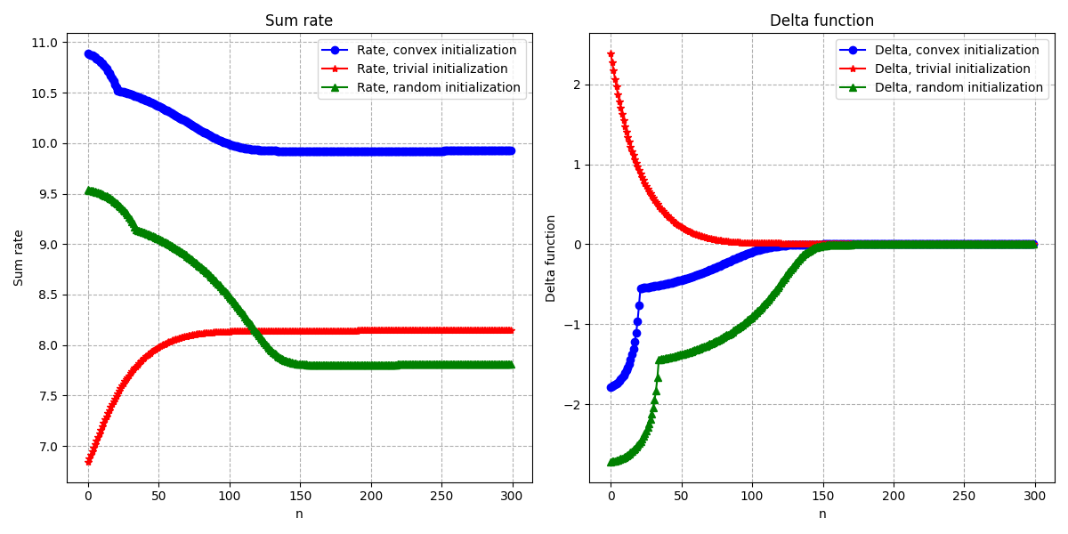

Slide 9
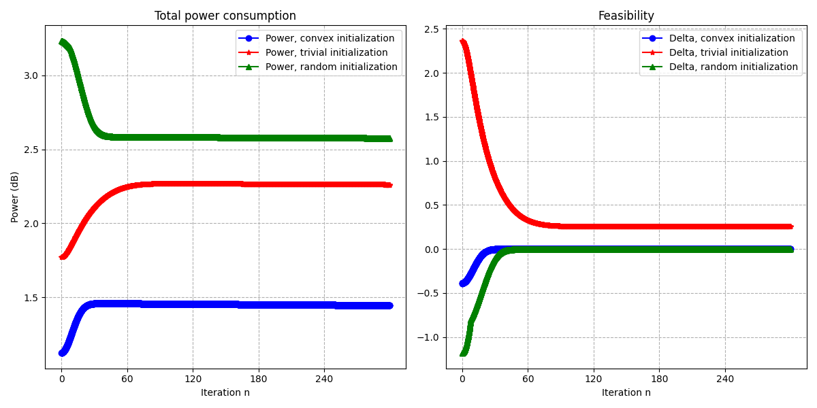

Slide 10
