Slide 1
Comparative Analysis of Neural Networks and General NLP Methods on An Academic Journal Article Database
Self-collected database; NLP methods used; FNN tuned; DNN constructed and compared, thourough analysis
(Freda) Xiaoyun Yu
Feb 2023

Slide 2
Template I Use
CM3015-Machine Learning and Neural Network.
I have combined the two templates (1. Deep Learning on a public dataset; 2. Gather your own dataset) in this course provided, to do my own project.
I have done a deep learning classification project, on a topic - academic journal articles, use the whole article body text as the data.

Slide 3
Features of My Project
Collect dataset on my own (using an API)
Outstanding text-cleansing work
Tune hyperparameters in FNN using controlled experiments
Try to find the best FNN using GridSearchCV
Have constructed DNN based on pre-trained existing models, including CNN, RNN with LSTM layer, etc.
Use different combinations of 3 vectorizers (TF-IDF, Count Vectorizer, Bigram) and 4 classifiers (SVC, MNB, Random Forest, KNN) in NLP and compare their performance
Have attempted to use the methods in literature review (AWD-LSTM, ULMFiT FastAI, Wikipedia2Vec, BERT-for-Task, …)

Slide 4
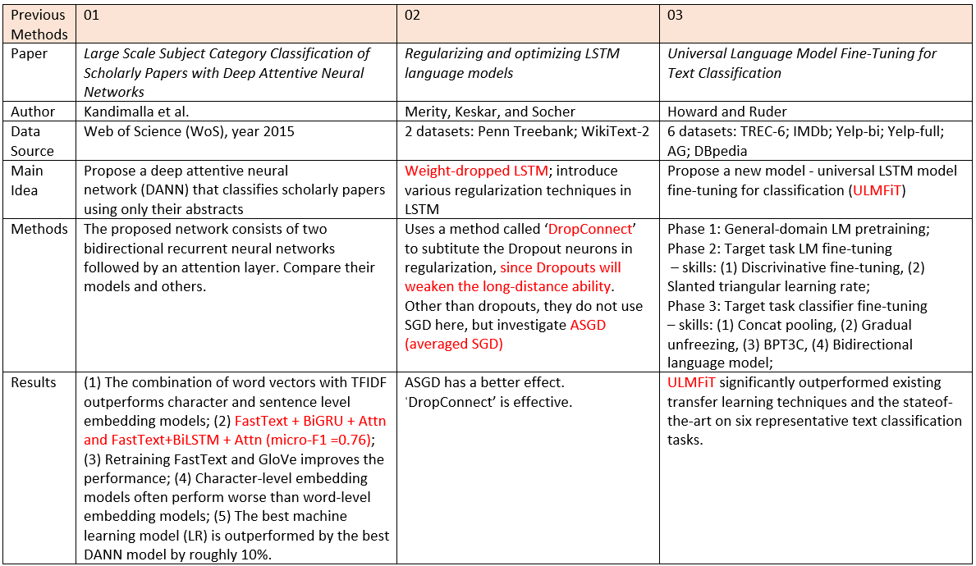
Literature Review – Text Classification

Slide 5
Justified Based on Domain and Users
(1) real journal platforms in academia (e.g. Nature, Science, etc.) to classify newly received articles and therefore simplify the procedure before posting new articles, and will make the news being published more timely without manual work; may stimulate an interdisciplinary collaboration between these platforms and data science platforms to add comprehensive metadata for information retrieval;
(2) librarianship field, by boosting the development of computer-based technologies to do part of the librarian jobs, and to stimulate the debate of human work vs. computer work;
(3) real journal platforms if I can find any obstacles or difficulties when developing my project, and will contribute furthermore if I could possibly propose methods to solve them;
(4) philosophical field, by exploring potential difficulties and proposing possible solutions, since classification is a very basic concept in philosophy;
(5) students studying in academia (e.g. postgraduate applicants, doctoral students) who have a strong pressure or focus on publishing papers, by receiving stimulation and inspirations found from my project. For instance, the top list of keywords shown in each academic subject can be a hint to expand the students’ academic vocabulary set;
(6) teachers working in academia who need a timely update for the recent research trend, to stimulate their own research and to give their students a prospective working direction;
(7) data scientists and computer scientists who are also interested in text classification methods. If my models are well-tuned, they may be applied more widely as a transfer learning example, not only in my own dataset, but also in other label-classifications in NLP field, such as sentiment classification, or even image classification. Data scientists may find new inspirations on labelling articles.

Slide 6
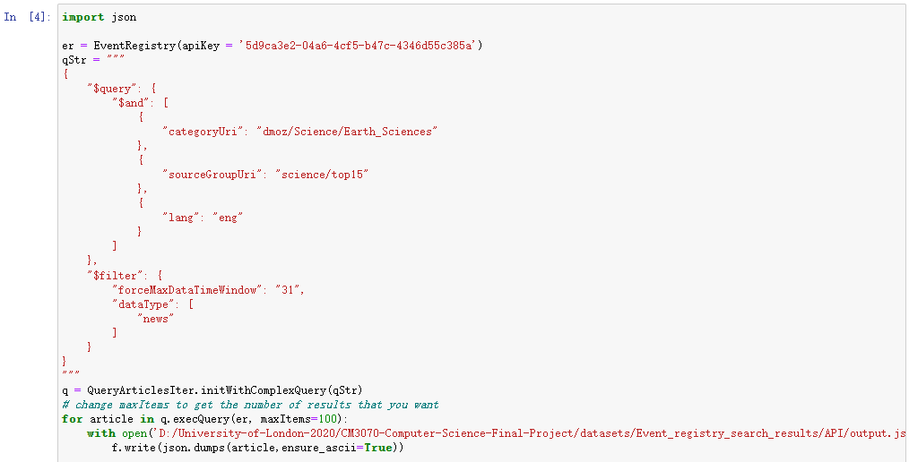
Collect Data – from EventRegistry.org
Their API: https://www.newsapi.ai/documentation/sandbox?tab=searchArticles
I copied their codes from the sandbox to my own Jupyter Notebook file, and output the retrieved data into JSON files.

Slide 7
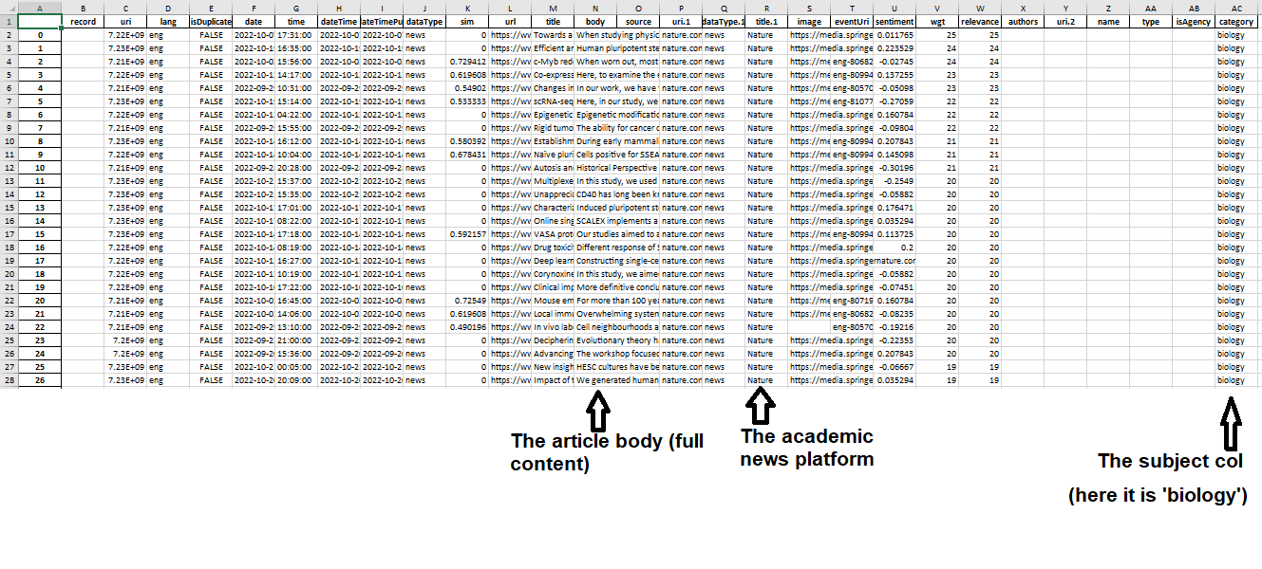
Collect Data – from EventRegistry.org
Then I convert those JSON files into EXCEL format, and combine them. The following is the snapshot for the combined file.
Feature X
Target Y

Slide 8
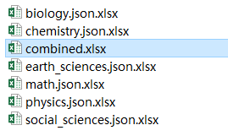
Collect Data – from EventRegistry.org
6 classes:
Biology
Chemistry
Earth Sciences
Math
Physics
Social Sciences
Commonsense baseline = 1/6 = 0.167

Slide 9
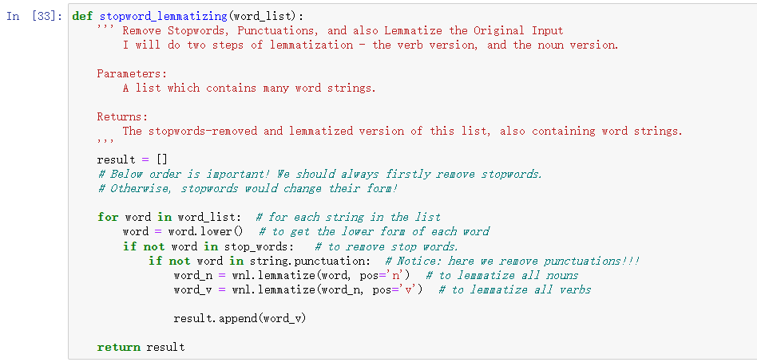
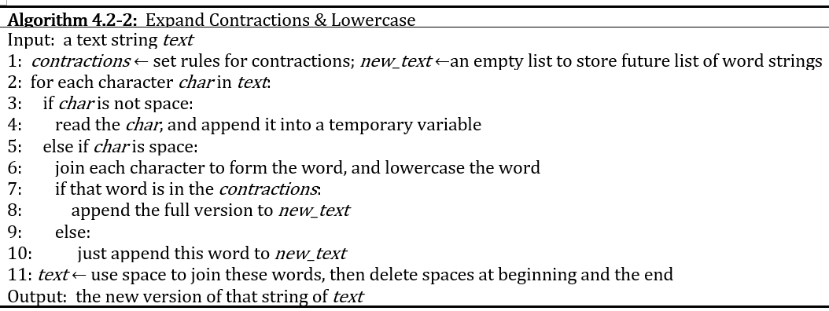
Codes Implemented
Preprocessing: Remove unwanted characters; Lowercase and expand contractions; Remove stopwords & lemmatisation.
I have also output my cleansed text data into files, for later to use.

Slide 10
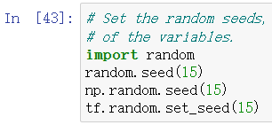
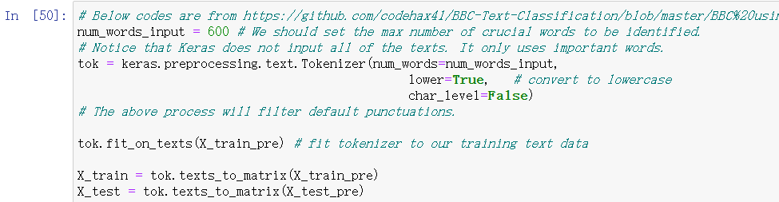
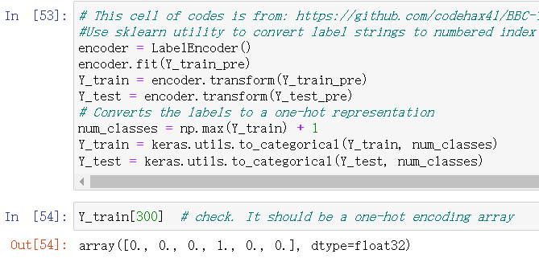
Codes Implemented
Control randomness
Transform and feed data to Keras
Text data → numerical data

Slide 11
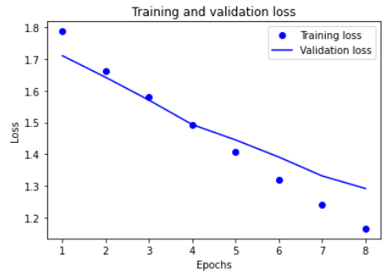
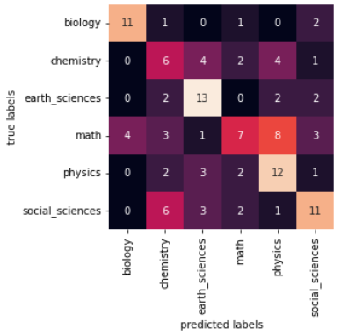
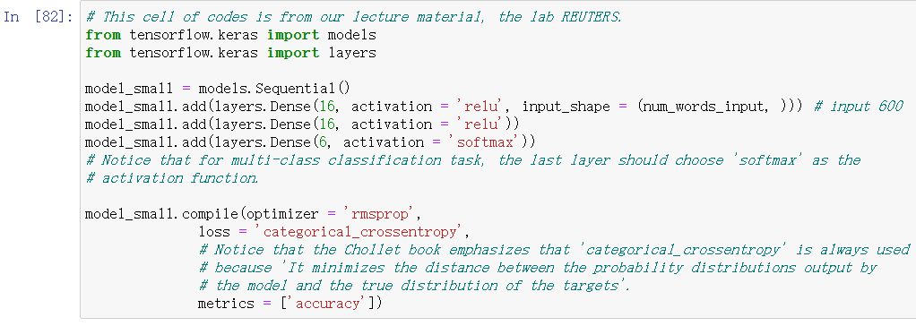
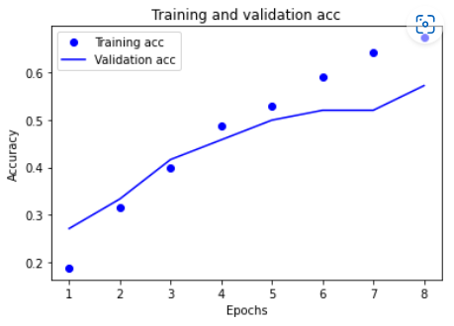
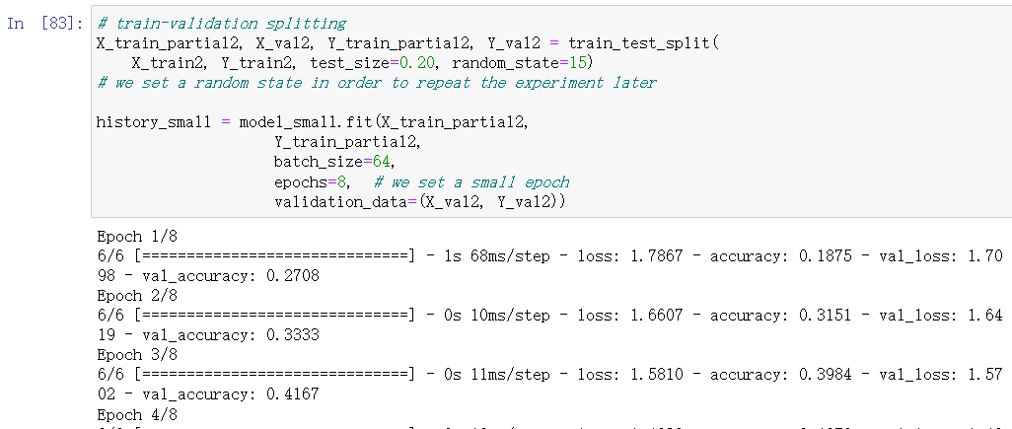
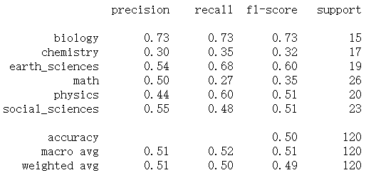
Codes Implemented
A small underfitting ML model (Chollet Step 5)

Slide 12
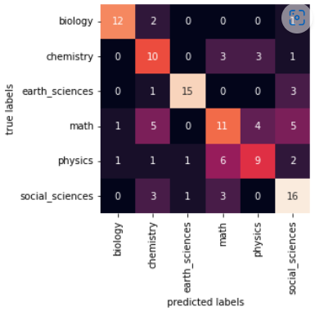
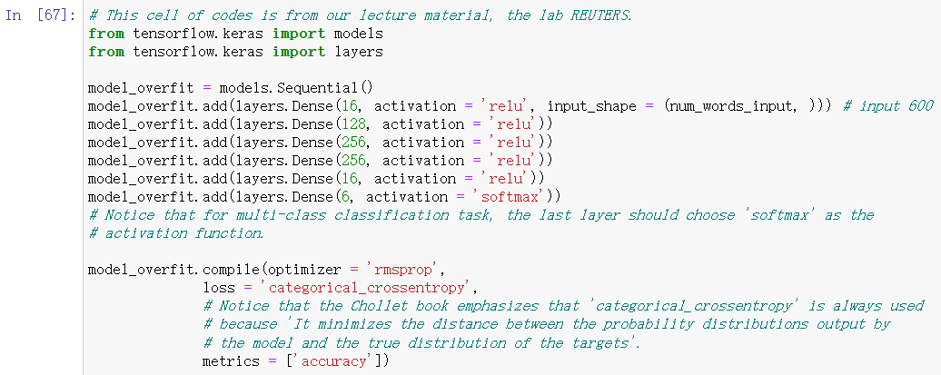

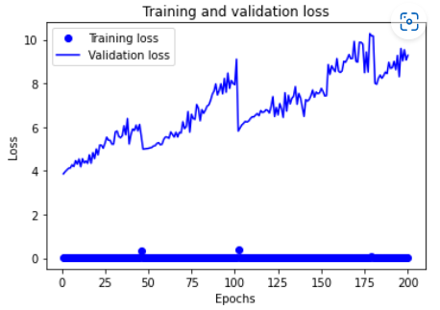
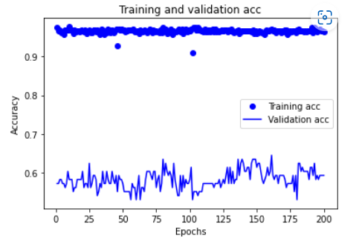
Codes Implemented
An overfitting ML model (Chollet Step 6)

Slide 13
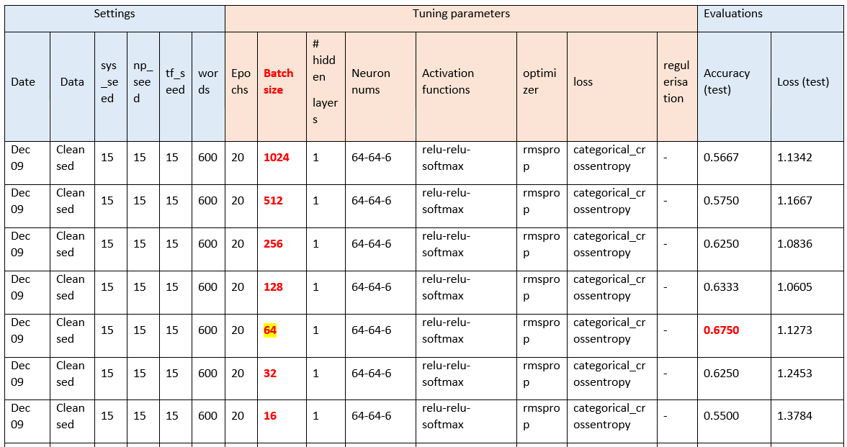
Controlled experiments results – batch size
Based on my controlled settings, the best performing batch size is 64 when operated on Feb 09, with accuracy=0.675. I have found an increasing-then-decreasing pattern of the accuracies when the batch size goes down.

Slide 14
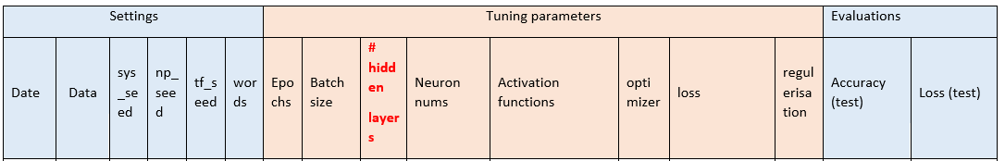
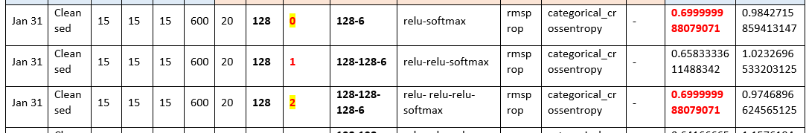
Controlled experiments results – number of layers
I have run 7 records * (3 settings * 2 repetitions) = 42 experiments, using different settings. The best numbers of layers are quite unpredictable.
The best layer number covers all from 0 to 4 in my 6 groups of experiments.

Slide 15
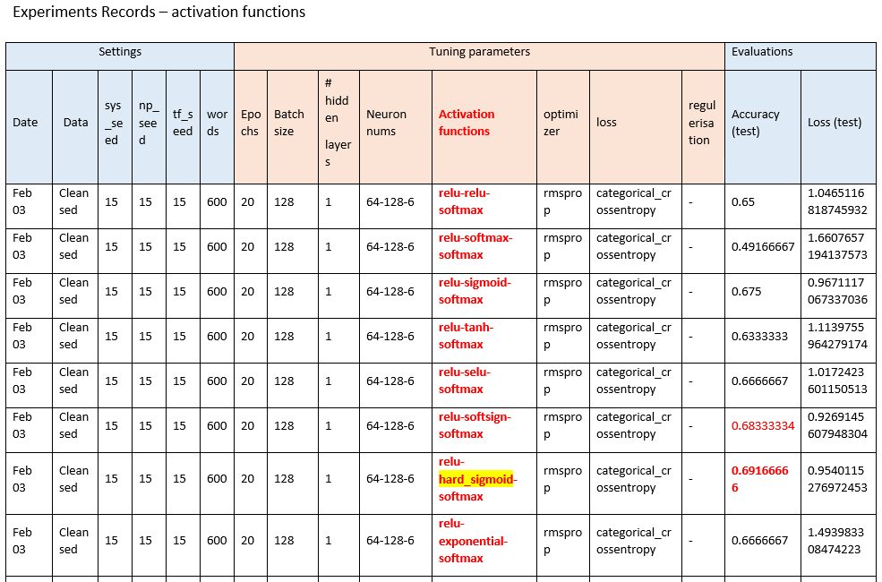
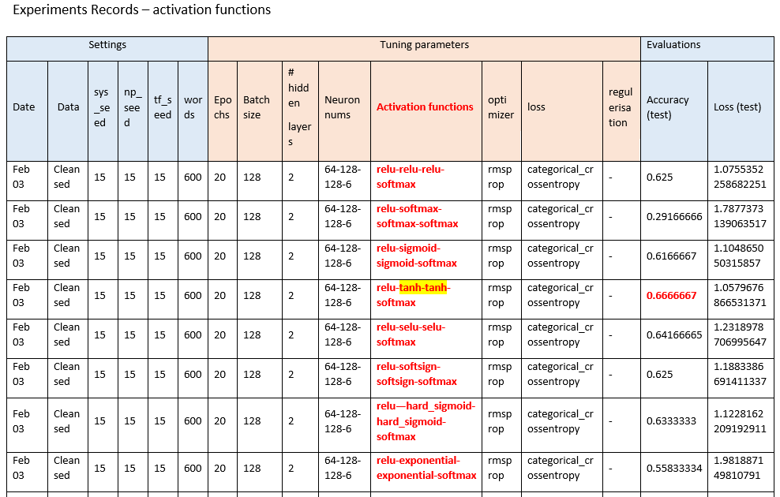
Controlled experiments results – activation functions
From the two groups of experiment, I find that putting hard_sigmoid inside the inner layer achieves the best accuracy, and softsign and sigmoid perform the second and third best;
If using two same activation functions inside the inner layers, then use tanh.
Never try to put softmax inside inner layers, since it has got 0.49 and 0.29 when using once and twice. Others are just viable as well.

Slide 16
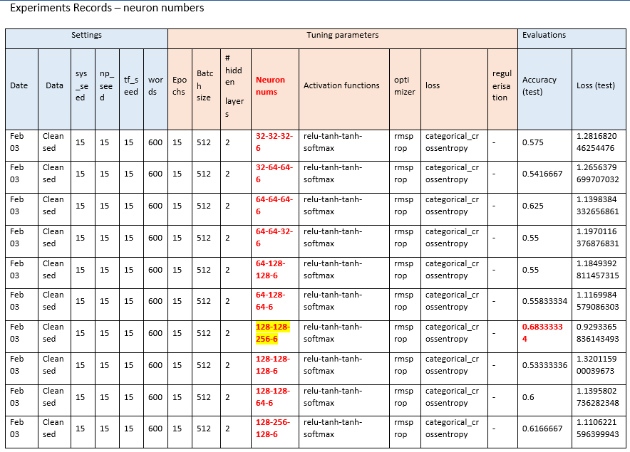
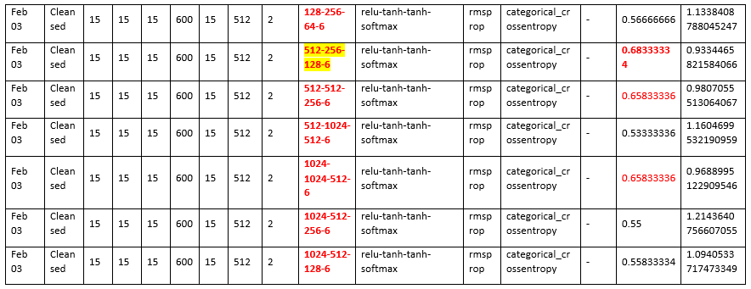
Controlled experiments results – neuron numbers
It seems that, with the same settings,
128-128-256-6 neurons, and 512-256-128-6 neurons
perfoms the best, with accuracy=0.68333334.
The second best are
512-512-256-6 and
1024-1024-512-6.
Less neurons or bottleneck effects (128-128-128-6) indeed cannot get a high score.

Slide 17
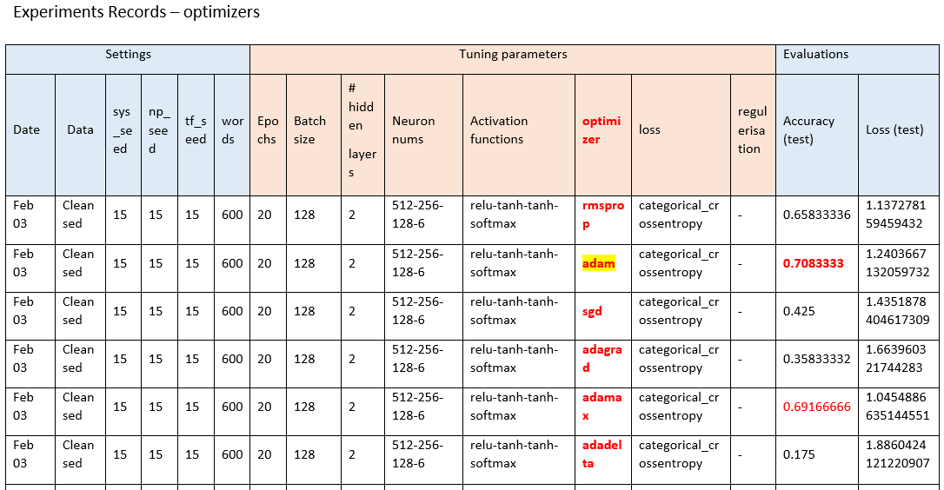
Controlled experiments results – optimizer
Adam performs really well, with accuracy of nearly 0.708. Adamax and RMSprop are both good to use. Never try to use AdaDelta or AdaGrad. SGD performs with a rather low score as well.

Slide 18
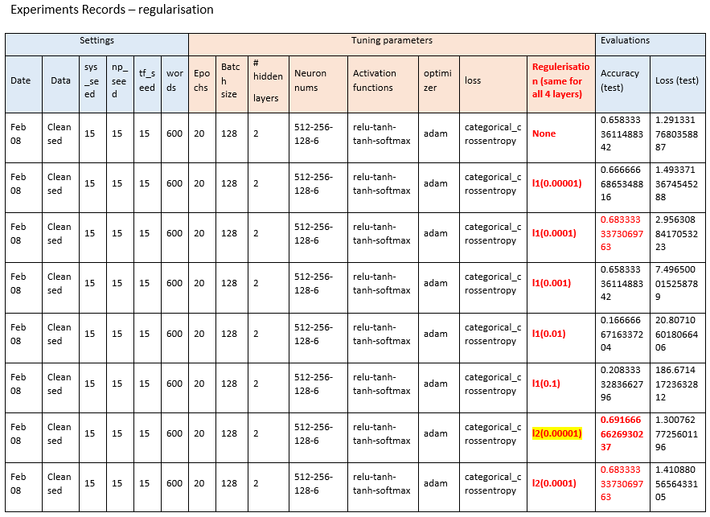
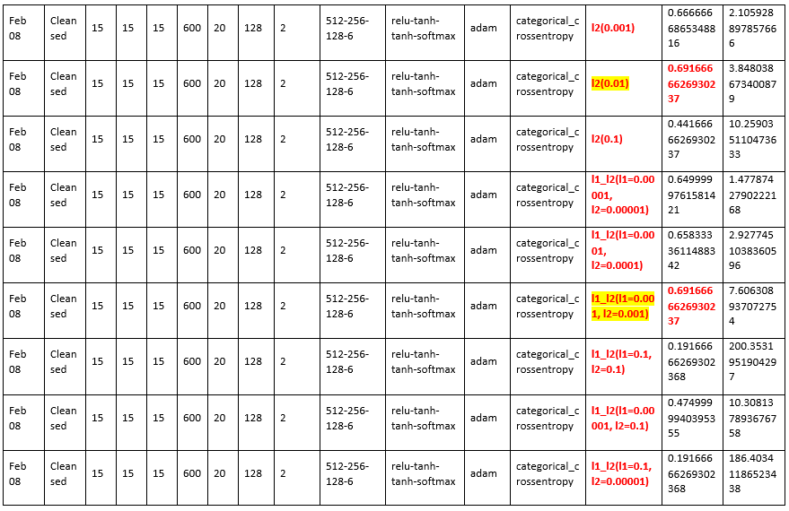
Controlled experiments results – regularizer
I have settled 17 experiments. I find that, there are three sets of regularizers perform the best, with test accuracy of 0.6916666626930237. They are:
all layers use l2(0.00001)
all layers use l2(0.01)
all layers use l1_l2(l1=0.001, l2=0.001)
Notice: should never use l1(0.01) or l1(0.1) or l1_l2(l1=0.1, l2=0.1) or l1_l2(l1=0.1, l2=0.00001) in all layers.
L2 can be allowed to be big, but l1 can never be big.

Slide 19
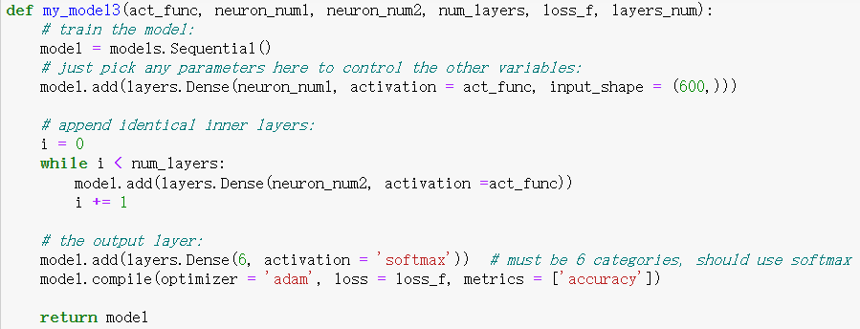
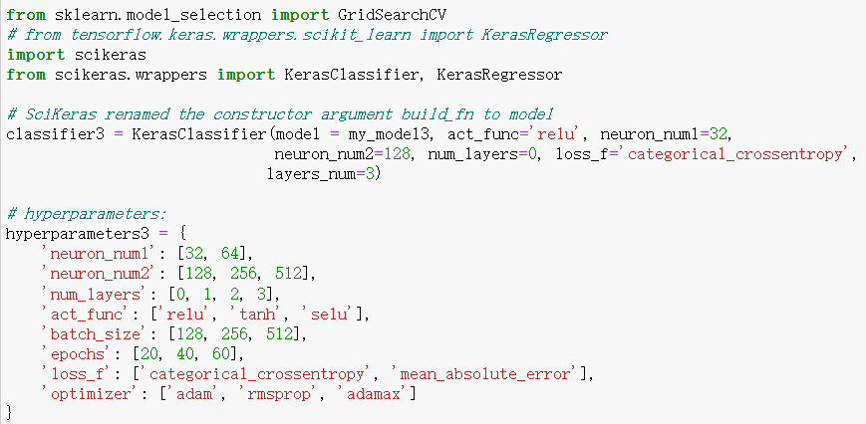
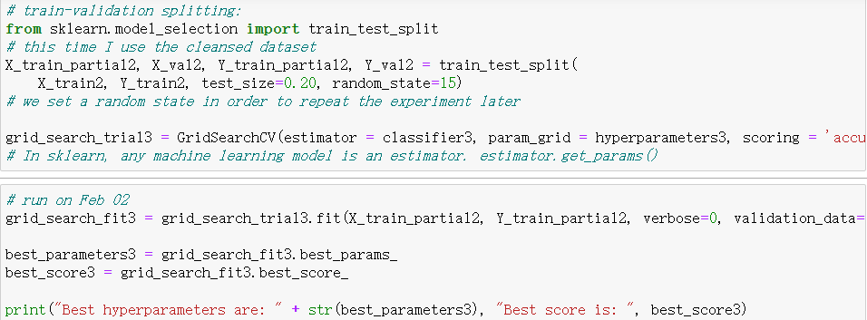
Codes
Sklearn.model_selection.GridSearchCV on FNN
Best hyperparameters are: {'act_func': 'relu', 'batch_size': 256, 'epochs': 60, 'loss_f': 'mean_absolute_error', 'neuron_num1': 64, 'neuron_num2': 256, 'num_layers': 0, 'optimizer': 'adam'} Best score is: 0.5625

Slide 20
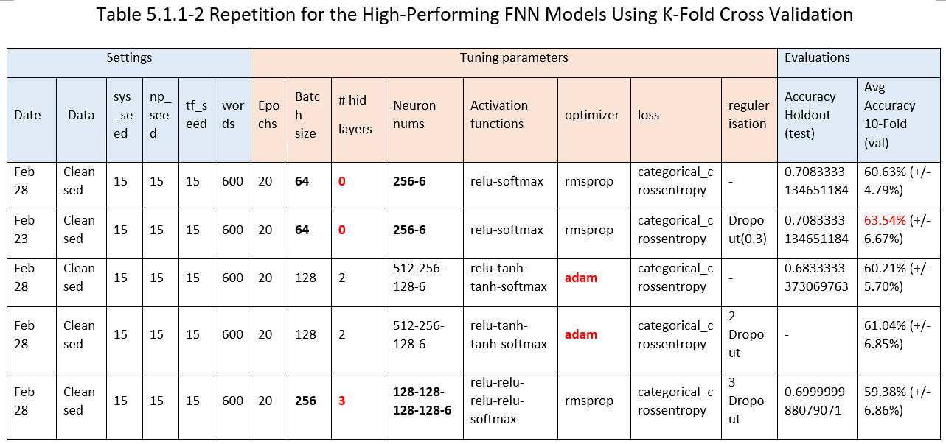
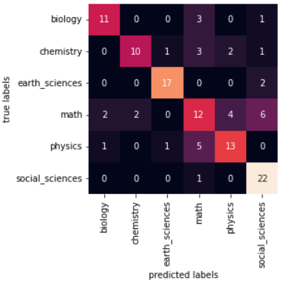
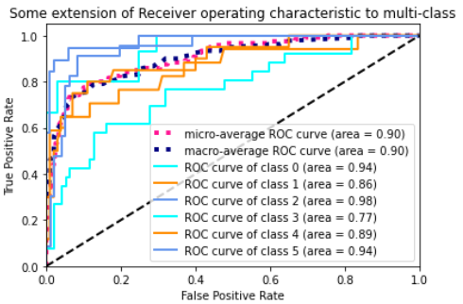
Repetition of The Best FCNN Model
Accuracy is different, may caused by randomness of Dropout, randomness of weight, …
Dropout layers can increase the K-Fold accuracy
Best Hold-Out accuracy is about 0.708; Best K-Fold accuracy is about 0.635

Slide 21
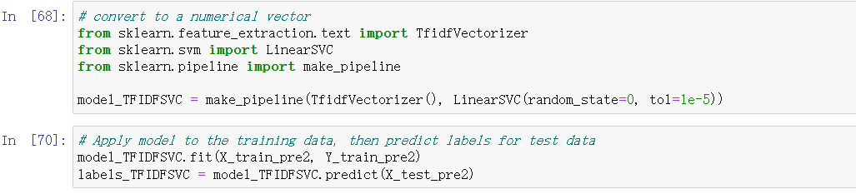
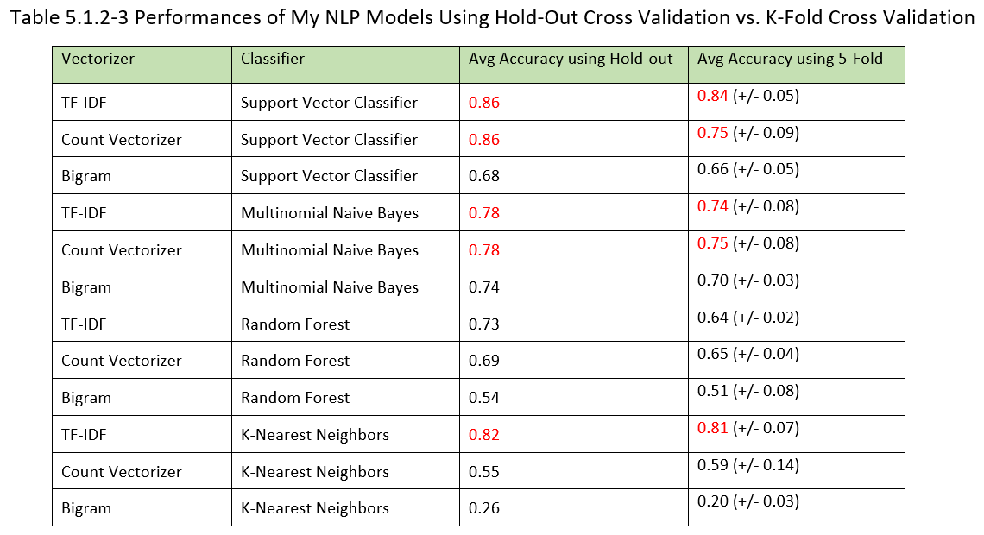
Codes Implemented
Classification Using Classical NLP methods
They score really high!
(1) Classifier: SVC is No.1, MNB is No.2, both are impressive. Random Forest provides just a passing performance; while KNN must combine with TF-IDF vectorizer to be outstanding.
(2) Vectorizer: TF-IDF is always excellent with all classifiers; Count Vectorizer almost the same but should not combine with KNN; Bigram performs always the worst, and should never combine with KNN.

Slide 22
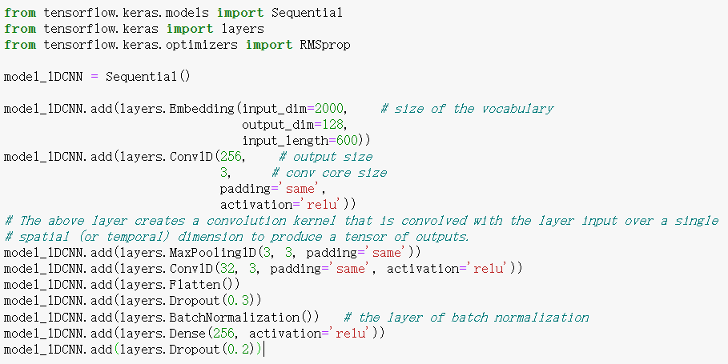
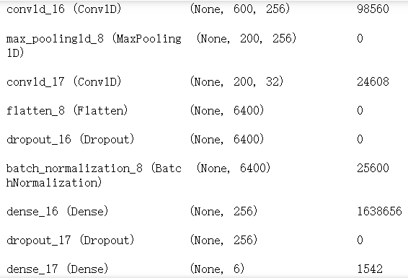
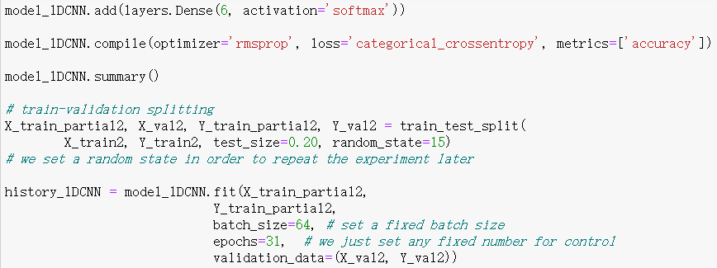
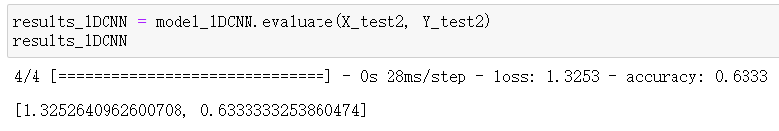
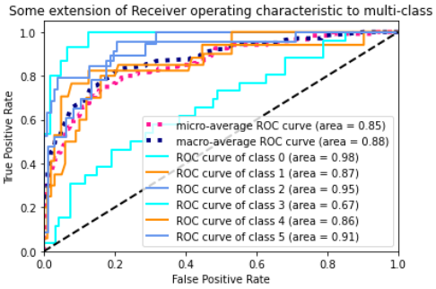
Codes Implemented
Pre-trained model source: Bilibili video tutorial https://www.bilibili.com/video/BV1u7411d7zU/?share_source=copy_web&vd_source=296c14837e03501f00801a512d70f87e
The best CNN
Hold-Out Accuracy=0.633
K-Fold Accuracy=0.531

Slide 23
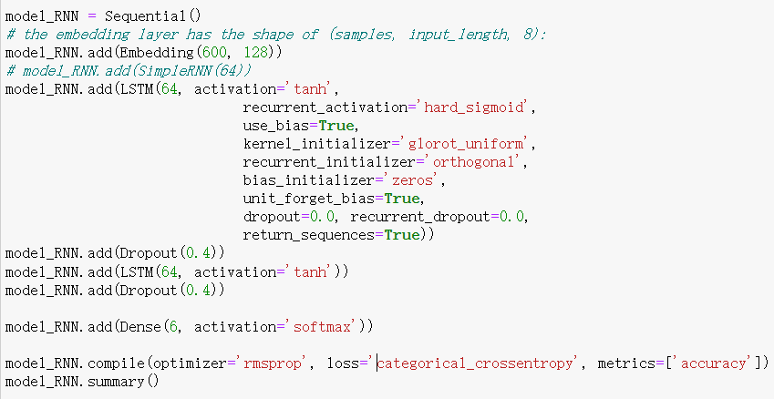
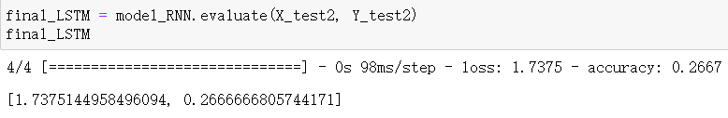
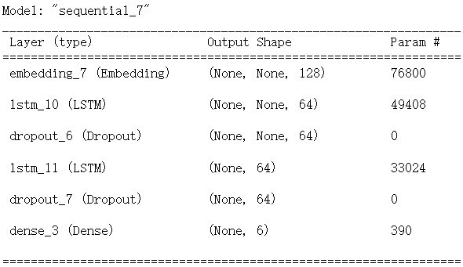
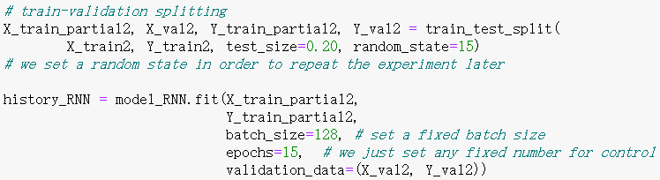
Codes Implemented
RNN with LSTM layer
Accuracy=0.267
Pre-trained model source: Chollet's ML book Ch.6

Slide 24
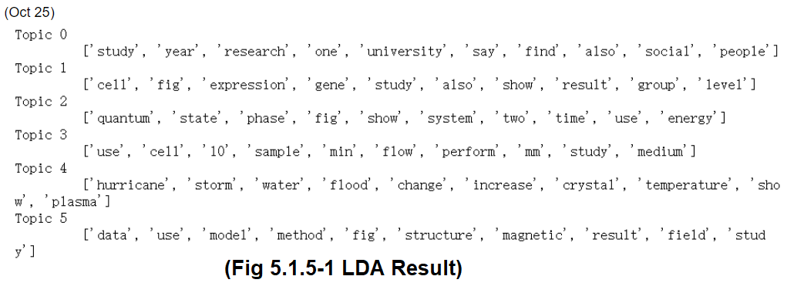
Codes Implemented
Latent Dirichlet Allocation

Slide 25
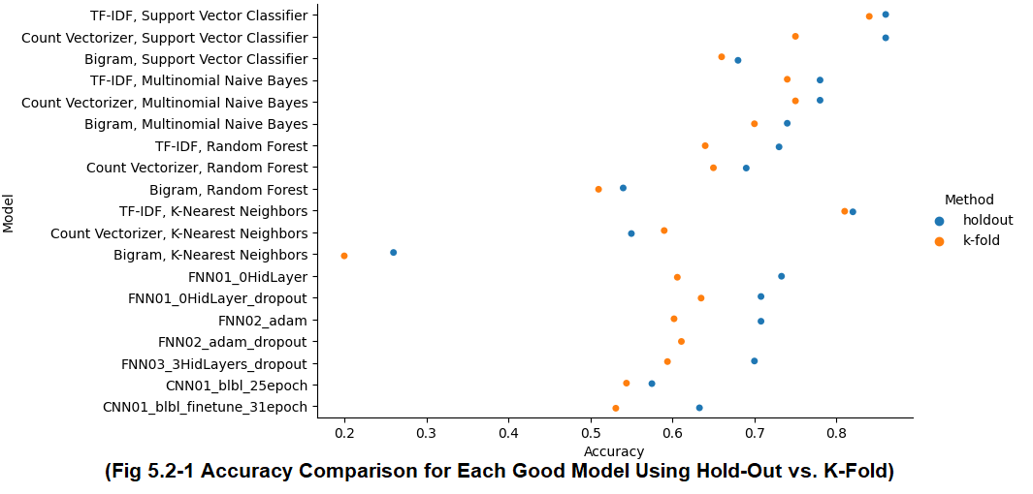
Final Comparison
The best Neural Network models cannot compare with other NLP models. The best Neural Network models in general can achieve an accuracy of 0.733 using Hold-Out (0.635 using K-Fold), while the best NLP models can get 0.86 using Hold-Out (0.84 using K-Fold). Among the Neural Networks, the best FCNN win against the best CNN models. Among the Neural Networks, using Dropout can slightly improve accuracy.

Slide 26
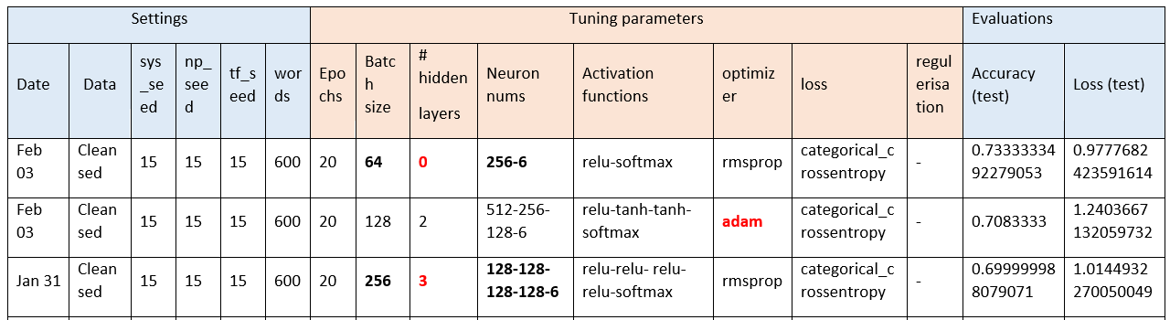
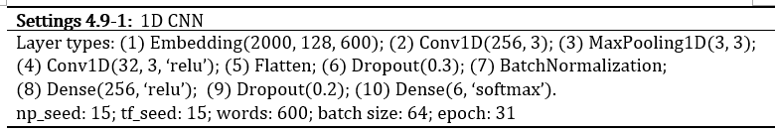
Final Comparison
The best FCNN I can bring to you is with Hold-Out accuracy=0.733, K-Fold accuracy=0.606, which has no hidden layers.
The best DNN model is a CNN model for which I get Hold-Out accuracy=0.633, fine-tuned by a pre-trained model mentioned by a video in Bilibili website.
The best model is the 'TF-IDF with SVC' model, with both the Hold-Out and K-Fold accuracy about 0.85.
The second-best: the 'Count Vectorizer with SVC' model, and 'TF-IDF with KNN'. The former has a very high accuracy using Hold-Out (0.86), but has a lower accuracy using K-Fold (0.75). The latter has both Hold-Out and K-Fold accuracy=0.82.
The third-best: the 'TF-IDF with MNB ', and the 'Count Vectorizer with MNB' model, with accuracy of above 0.75.

Slide 27
Discussions
It is interesting why SVC and MNB Classifiers outperform all the Neural Network models.
TF-IDF and Count Vectorizer apparently help its model to get a high accuracy. Can I implement them into a NN as a layer?
Inspired by LDA result, can I purify my subject-classification scheme by eliminating the classification based on research methods?
Journal editors may adapt my model(s), but should manually scan for errors. Editors’ work is irreplaceable.

Slide 28

Arrangement - Gantt Chart, Milestone Tasks
Milestone dates
Milestone tasks

Slide 29

Thank You for reviewing my project!

