Slide 1
Using Regression Models to Predict Home Affordability Ratios
Author: Freda Xin

Slide 2
Problem Statement: What is home affordability ratio?
Home Affordability Ratio = Median Home Price / Median Annual Household Income
Example: Manhattan, 2018
Median Home Price = $ 944,600
Median Annual Household Income = $ 82,459
Home Affordability Ratio ≈ 11. 5 years
* Data Source: U.S. Census

Slide 3
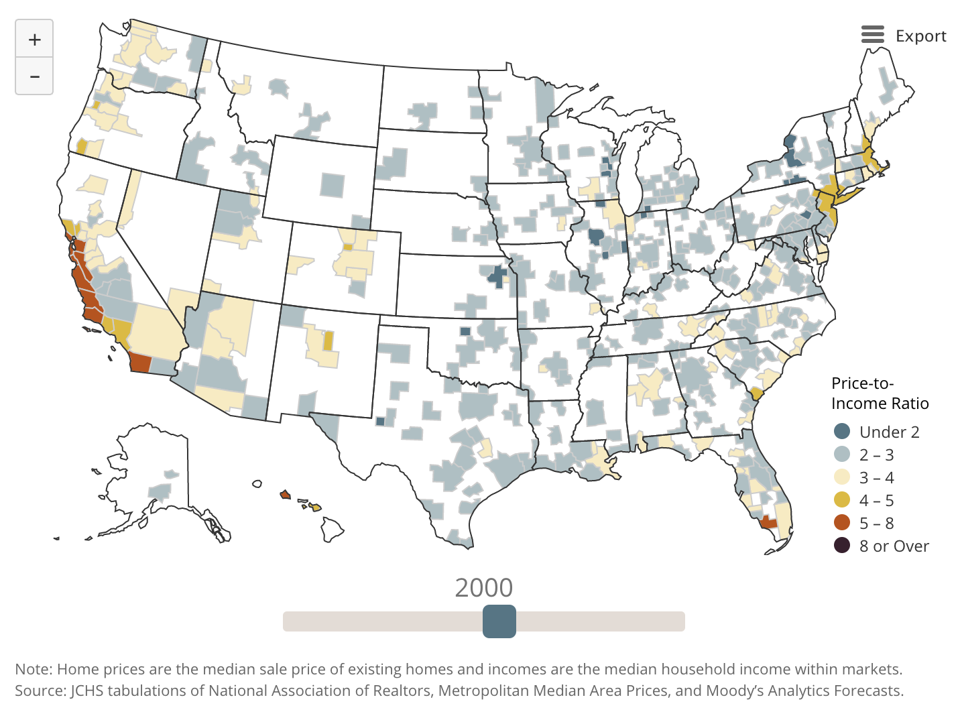
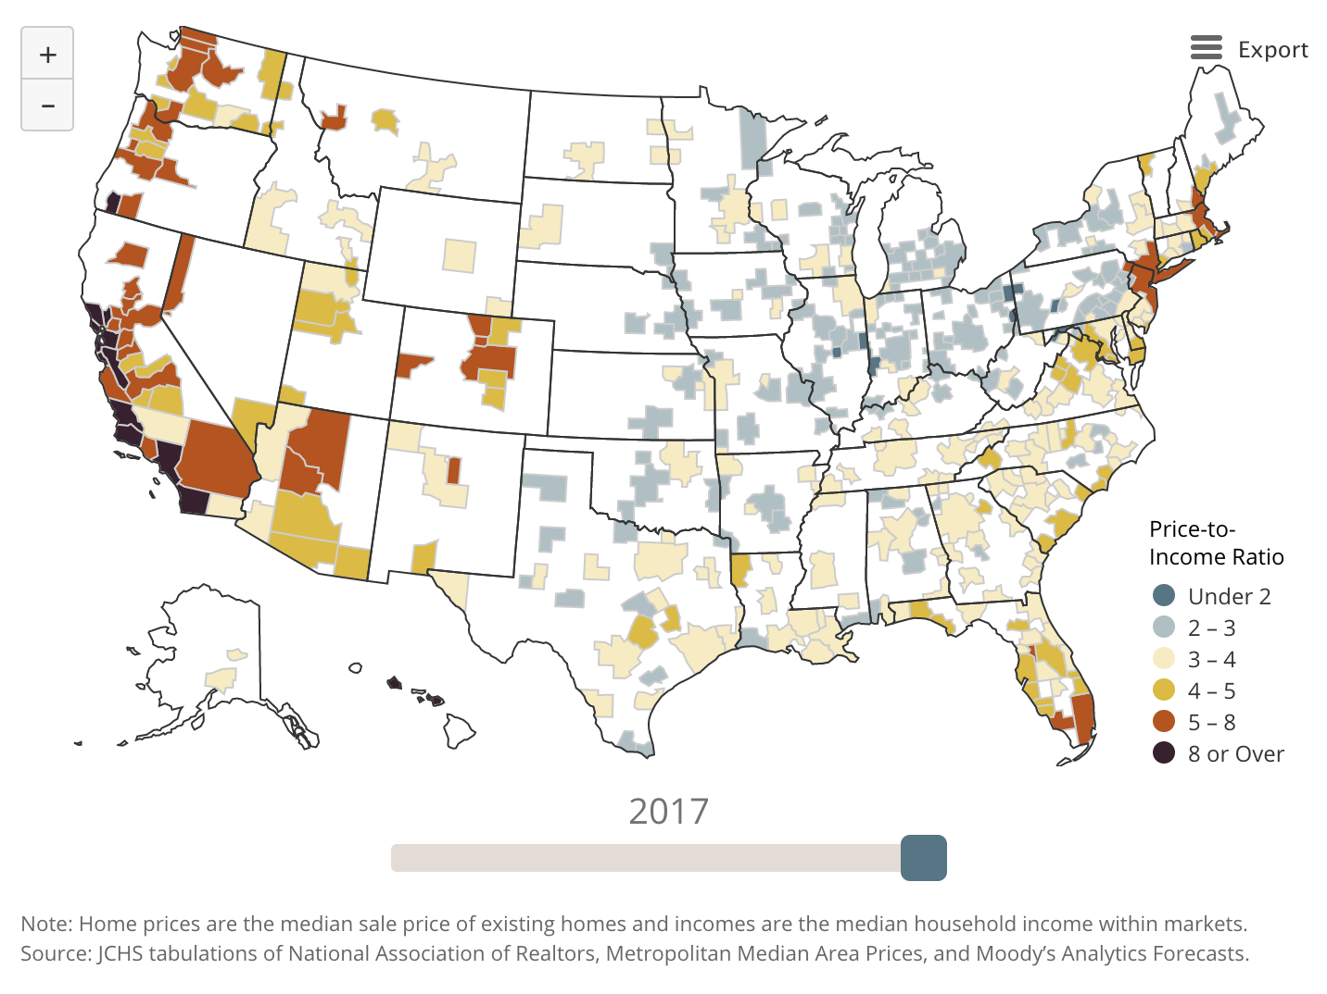
Problem Statement: Why is home affordability ratio important? Who should care about it?
Image Source: Home Price-to-Income Ratios by Joint Center for Housing Studies of Harvard University

Slide 4
Problem Statement: Project Scope Using Regression Models to Predict Home Affordability Ratios
Project Scope: explore whether commercial activities in a given neighborhood can be predictive for home affordability ratios.
Project Goal: to develop regression models that can make quick predictions given the latest commercial activities in a neighborhood.
Target Client: municipalities and the general public
Metric: R2 score

Slide 5
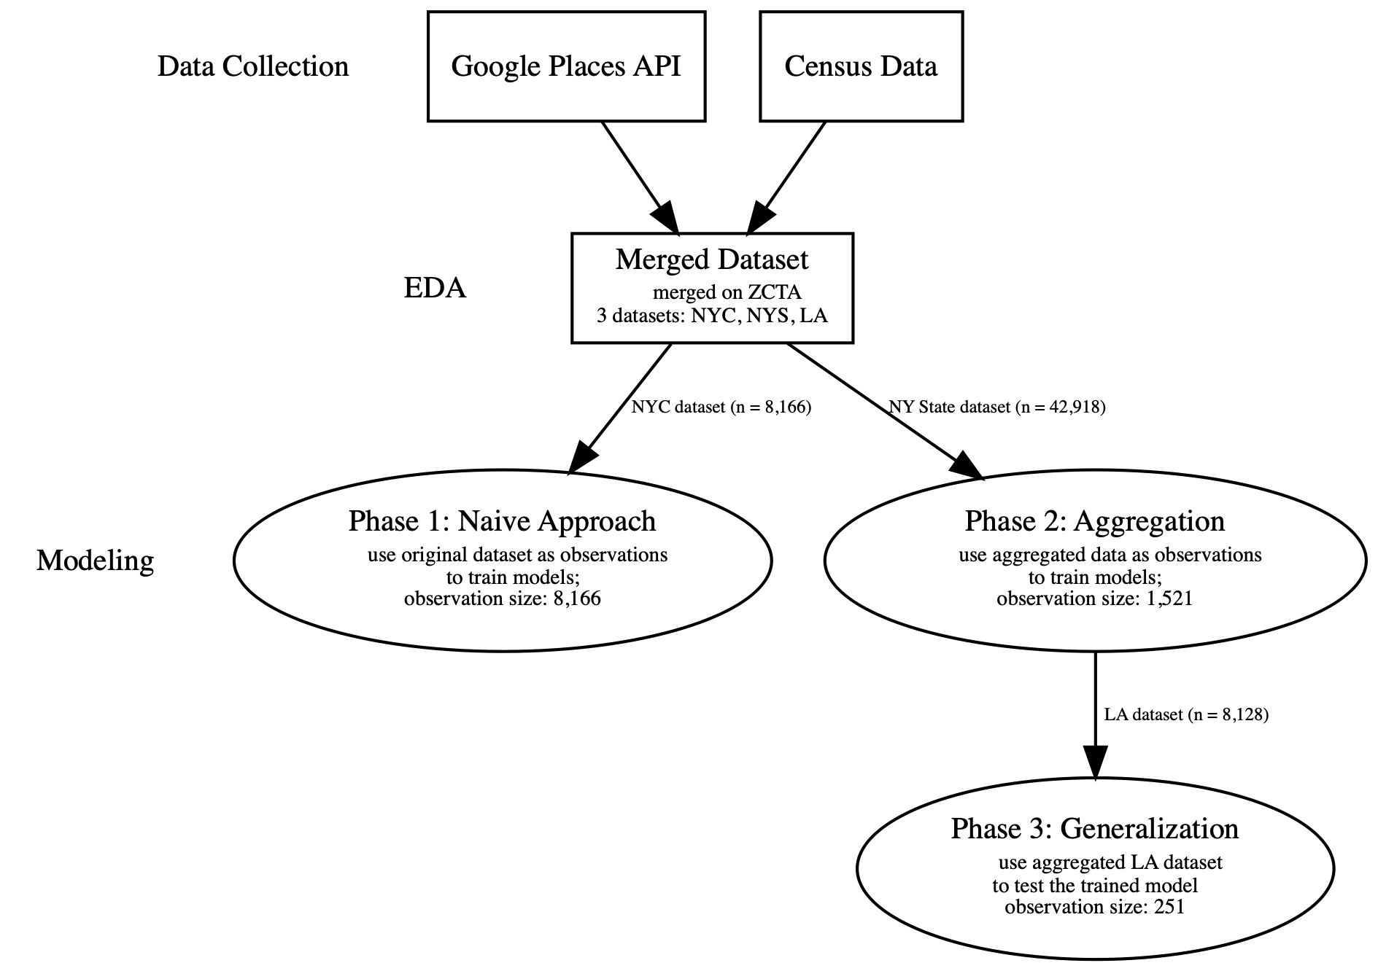
Project Workflow

Slide 6
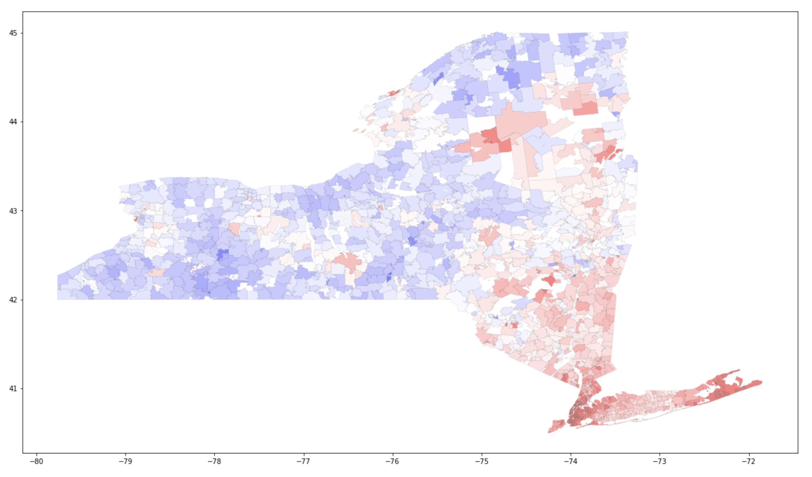
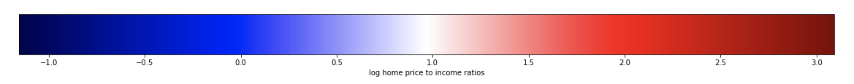
EDA: Analysis of Target – Home Affordability Ratios in NYS

Slide 7
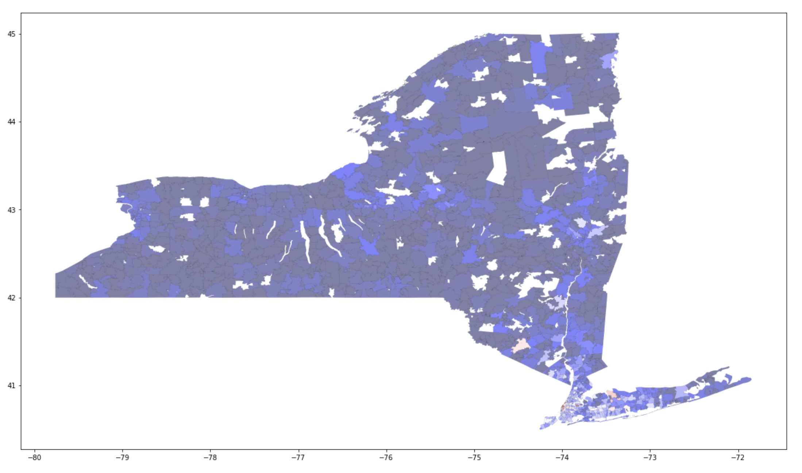
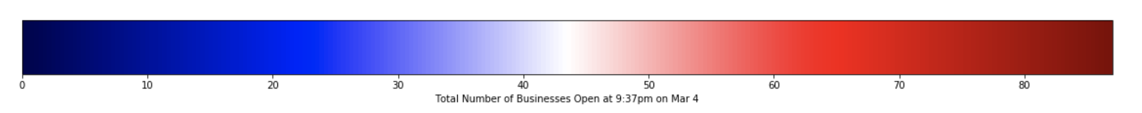
EDA: Analysis of Feature – “total_open_ now_True”

Slide 8
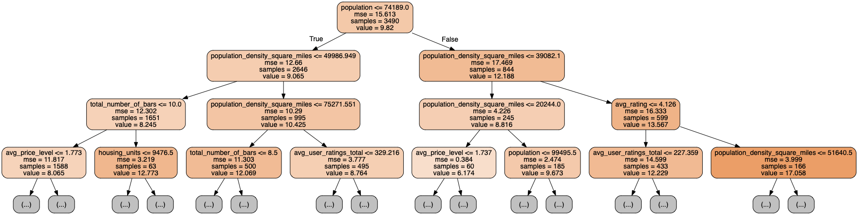
Modeling Phase 1: Naive Approach Observations: NYC dataset (n=8,166) Models: Linear Regression, KNN, Decision Tree Best Model: Decision Tree (Test R2 Score = 0.99)

Slide 9

Modeling Phase 1: Naive Approach Conclusion: Data Leakage!

Slide 10
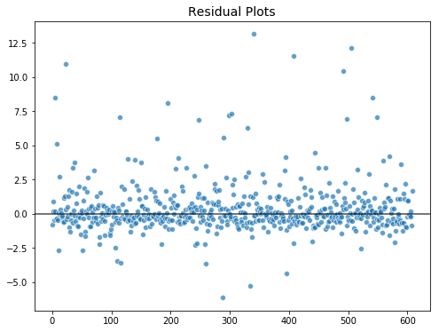
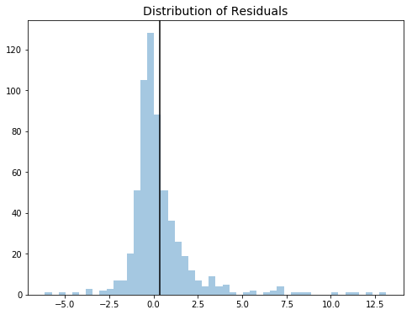
Modeling Phase 2: Aggregation • Original NYS dataset (n = 42,918) -> Aggregated by ZCTA (n = 1,521) • Method: Pattern submodel technique to divide dataset into Pattern 0 & Pattern 1 • Model Types: Linear Regression(combined with L1, L2, PCA), Polynomial Regression, KNN, Tree Based, SVR, Stochastic Gradient Decent • Best Model: BaggingRegressor • Test R2: Pattern 0 = 0.6541; Pattern 1 = 0.0046 • Baseline R2: Pattern 0 = -0.0057; Pattern 1 = -0.0128

Slide 11
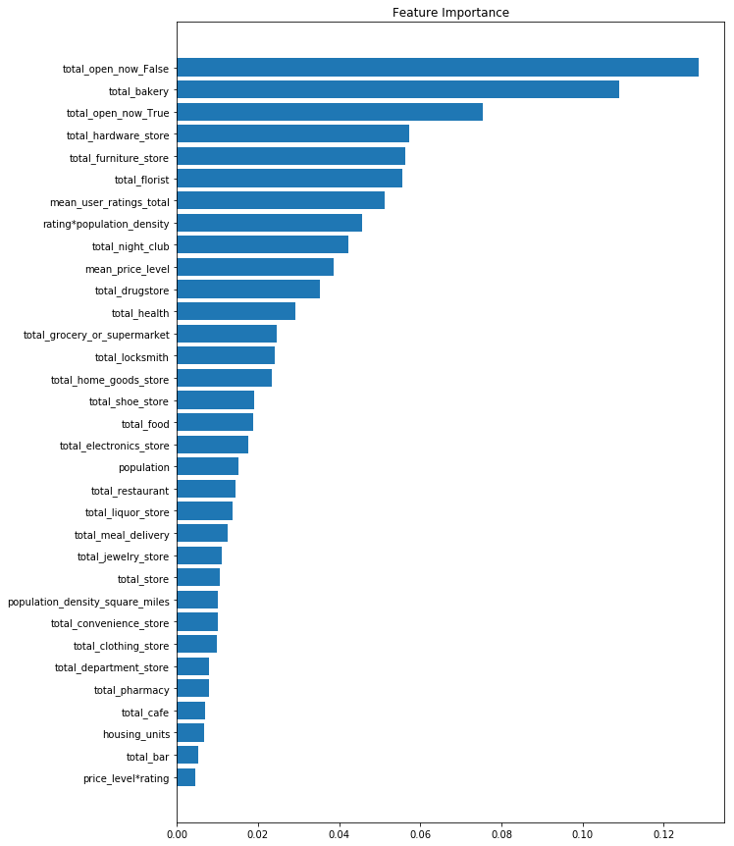
Modeling Phase 2: Aggregation • Best Model: BaggingRegressor Phase 2 Conclusion: • Census Data are important for model performance. • “open_now” features are good predictors.

Slide 12
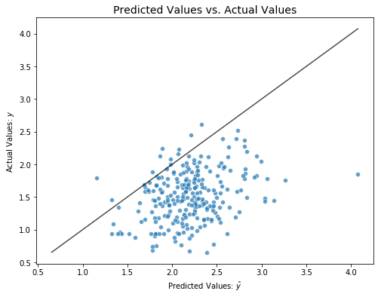
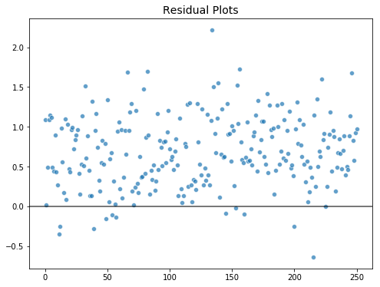
Modeling Phase 3: generalization • Original LA dataset (n = 8,128) -> Aggregated by ZCTA (n = 251) • Goal: Train the model on NYS dataset WITHOUT any census features, then test it on the LA Dataset • Model Types: Linear Regression(+ L1, L2, PCA), Polynomial Regression, KNN, Tree Based, SVR, Stochastic Gradient Decent • Best Model: Linear Regression Model with L1 Regularization • R2: Score Pattern 0 = -4.0596; Pattern 1 = -5.7796 • Baseline R2: Pattern 0 = -0.0057; Pattern 1 = -0.0128

Slide 13
Conclusion, Limitation, and Next Steps
Conclusion:
• Commercial activities information collected from Google Places API alone are not good predictors for home affordability ratios; Using features combined with Census data improved model performance.
• The model trained on NYS dataset is NOT transferable to LA
Next Steps:
• Improve data quality: Sampling data from different regions in the U.S, and stratify the samples
• Reevaluate the assumption: are commercial activities in a neighborhood predictive for home affordability ratios?
Limitations:
• Google Place API
• Budget

Slide 14
References
Home Price-to-Income Ratios by Joint Center for Housing Studies of Harvard University
Home Price to Income Ratio by longtermtrends.net
The Impact Of Commercial Development On Surrounding Residential Property Values by Jonathan A. Wiley, Ph.D.
Predicting Neighborhoods’ Socioeconomic Attributes Using Restaurant Data by Lei Dong, Carlo Ratti, and Siqi Zheng
Big Data and Big Cities: The Promises and Limitations of Improved Measures of Urban Life by Edward L. Glaeser, Scott Duke Kominers, Michael Luca, Nikhil Naik

