Slide 1
H1N1 Acceptance Rates Exploratory Analysis
Freddy Abrahamson
Mar27th, 2022

Slide 2

Outline
Business Problem
Data Understanding
Explaining the Metric
Model Recommendation
Feature Recommendation

Slide 3
Business Problem
As a consequence of the Covid 19 pandemic, there is a renewed
interest in the vaccination rates for the seasonal flu. We will be
performing an exploratory analysis to identify who is more likely to
take the seasonal flu vaccine.
To that end, we will go over the best metric to use, the most effective
predictive model, and feature Importance.

Slide 4
Data Understanding
The data comes from the National 2009 H1N1 Flu Survey, in the form of a ‘csv’ file.
The data is comprised of 36 columns, including the target variable, and 26,707 rows.
Each row represents a respondent in the survey.
It is an imbalanced dataset with the majority to minority class ratio at approximately 4:1 .
The survey is primarily comprised of binary and multiple choice
questions such as:
h1n1_knowledge : 0 = No knowledge 1 = A little knowledge 2 = A lot of knowledge
health_worker : 0 = no 1 = yes

Slide 5
The Metric: F1 Score Explained
We will use a predictive model to determine whether the respondent :
1. will take the h1n1 vaccine
2. will not take the h1n1 vaccine
A model that predicts one of two possible outcomes is called a binary predictive model.
The predictions made by this model can be put into 1 of 4 categories :
1. true positive: The respondent was predicted to take the vaccine and actually took the vaccine
2. true negative: The respondent was predicted to not take the vaccine and did not take it.
3. false positive: The respondent was predicted to take the vaccine, but did not take it.
4. false negative: The respondent was predicted to not take the vaccine, but did take it.
TN | FP
FN | TP
0-
Actual Label
1-
-
-
0
1
Predicated Label

Slide 6

The Metric: F1 Score Explained II.
In our use case, which is exploratory analysis, we simply want to predict the information as accurately as possible.
$$accuracy= \frac{number of correct predictions}{number of total predicitions}$$
Using a metric such as accuracy, for example, that calculates the number of correct predictions made, divided by the number of total predictions, can be misleading when working on an imbalanced data set.
Let us say for example, that we want to create a model that predicts how many boys playing baseball as high school seniors, will make it into the MLB. For argument’s sake, let us put the actual percentage as 1%, or (1/100). If we created a model that did nothing more than simply predict that nobody ever made it into the MLB, the accuracy score of that model would still be 99%.
This example illustrates how on an imbalanced data set, how even a ‘useless’ model, that does nothing more than choose the more likely possibility all the time, can still produce a high accuracy score.

Slide 7
The Metric: F1 Score Explained III
TN | FP
FN | TP
0-
This imbalance is what makes the f1 score metric a very appealing option. It takes data imbalance into consideration by penalizing false positives and false negatives, thereby, at the same time, rewarding true positives, and true negatives.
The f1 metric not only rewards the model for correct predictions, but is not ‘misled’ by imbalanced data sets.
Actual Label
1-
-
-
0
1
Predicated Label

Slide 8
Model Recommendation
*
model: Random Forest
metric: F1 score
F1 score: .65 (with optimized threshold at ~ .57)
model parameters:
class_weight : 'balanced’
criterion : 'gini’
max_depth : 5 max_features : 32
min_samples_split : 2
n_estimators : 150
4202 | 1056
300 | 1119
0-
Actual Label
1-
-
-
0
1
Predicated Label
how to handle class imbalance : SMOTE(sampling_strategy=0.40)
*with .5 threshold at .5

Slide 9
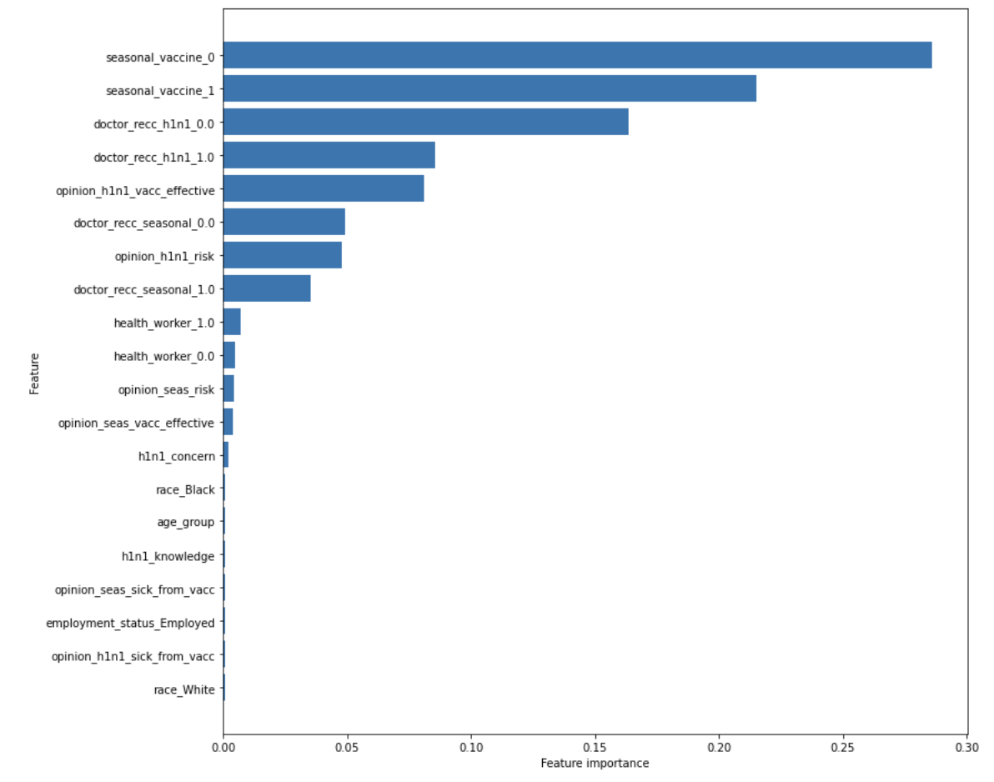
Feature Recommendation
The feature importance of a model
is a metric that measures how
useful a feature is to the model in
making its predictions.
A feature importance score ranges
from 0 to 1, with the sum of all
feature importances being equal
to one.
From the chart we can see that the
top 4 features account for
approximately 80% of the total
feature importance.
The 20 features in this plot account for
over 99% of all feature importance.
I highly recommend that a special
emphasis is placed on these features
when acquiring new information.

Slide 10
Any Questions?

Slide 11
Thank You

