Slide 1
Using a Neural Network to Distinguish Between a Healthy Patient and one with Pneumonia Proof of Concept
Freddy Abrahamson
July 1, 2022

Slide 2
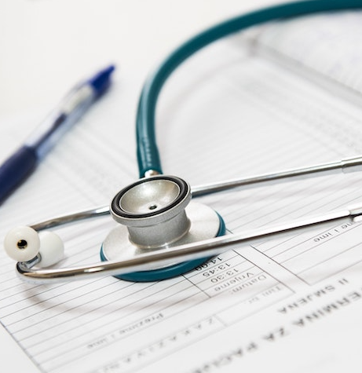
Outline
Business Problem
Data Understanding
Explaining the Model
Model Results and the metrics used

Slide 3
Business Problem
Stakeholder: Board of directors of a national network of hospitals.
Business Problem: Covid has caused a surge in emergency room visits. The hospital is looking for a way to better prioritize patients by the severity of their ailments, particularly pulmonary diseases.
Proposed Solution: A machine learning model that could correctly identify patients with pneumonia, thereby helping prioritize who the doctor will see first.
Solution Benefits:
1. Helps save lives, and protects from more severe damage caused by the disease. 2. non-invasive 3. cost-effective 4. no medical background necessary to run the model

Slide 4
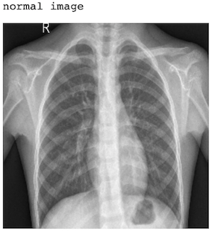
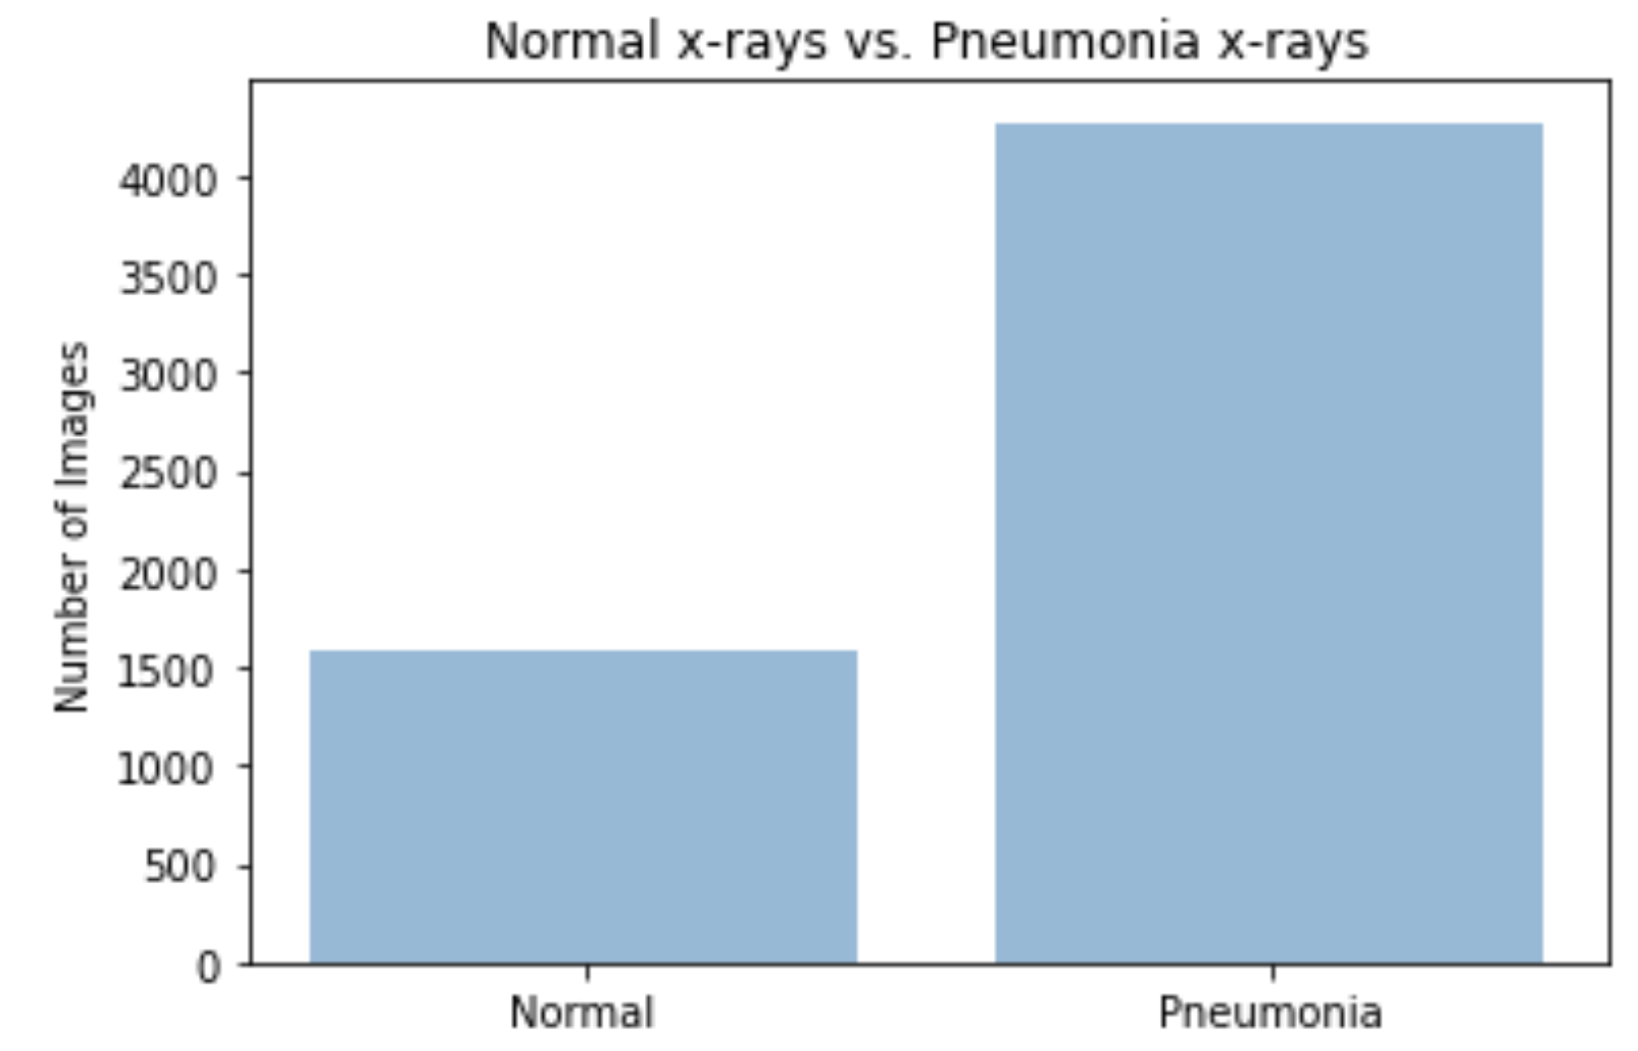
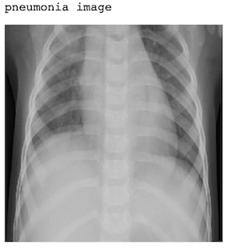
Data Understanding
The data comes from Kaggle.com.
There are a total of 5856 images.

Slide 5
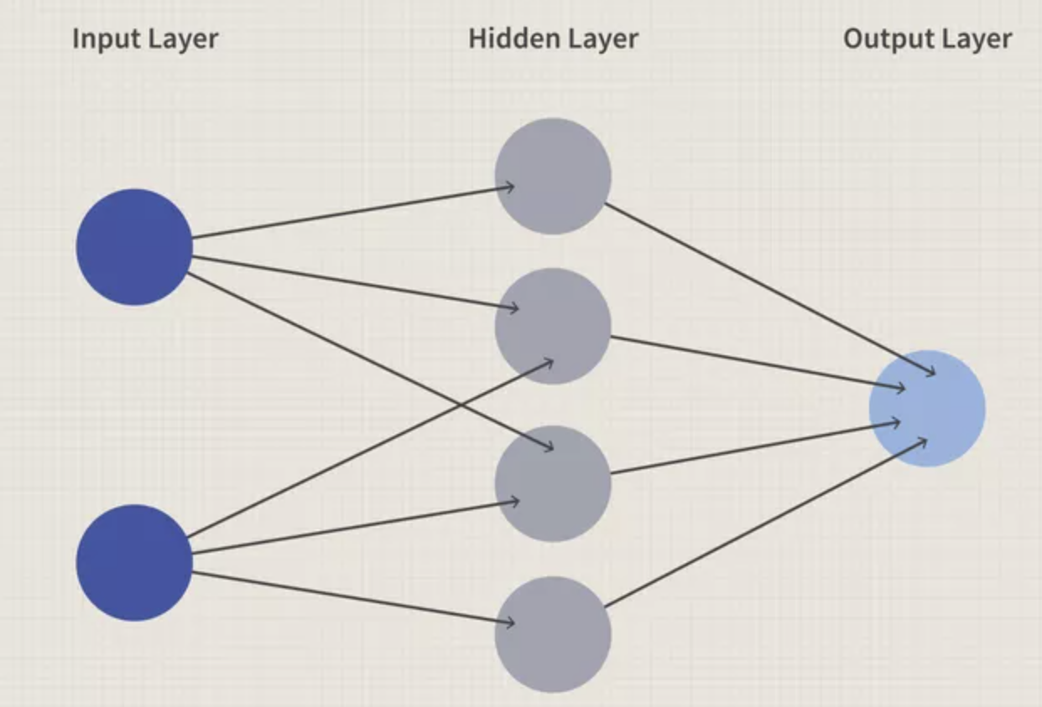
The Model: What are Neural Networks ?
Neural networks were inspired by the human brain.
The data moves from left to right
Neural networks are very scalable
The circles are the ‘artificial neurons’ or nodes. The input
layer receives the data. The output layer returns a result,
and the hidden layer(s) are any layers in between the input and output layers.

Slide 6
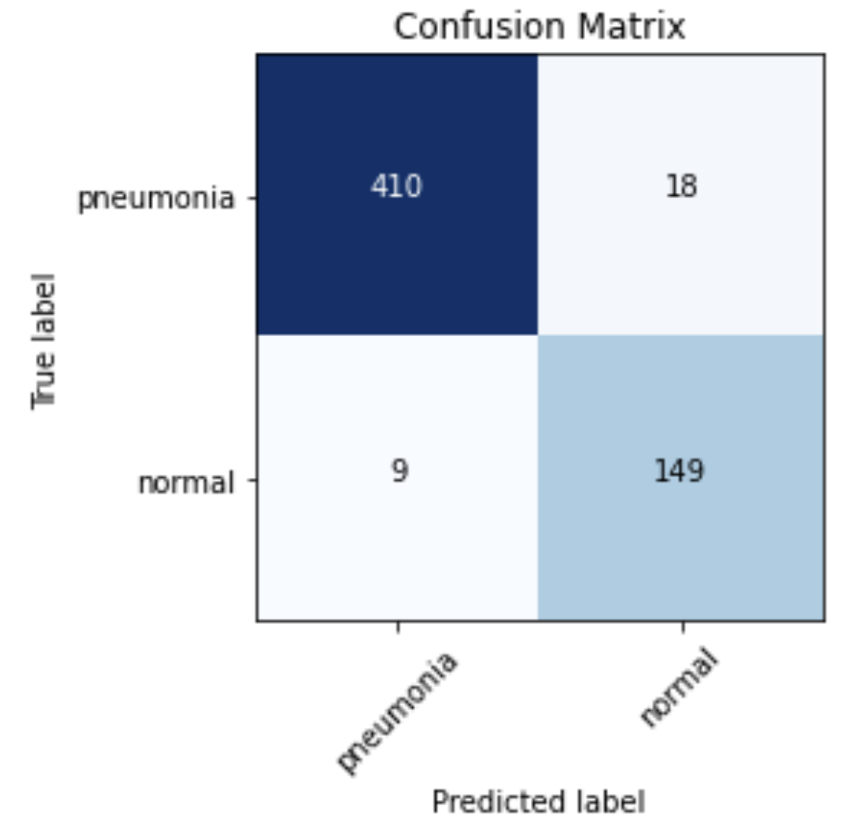
Model Results
Primary Goal: model to identify all the patients who had pneumonia.
Metric Used and Performance: Recall score of nearly 96%
Secondary Goal: model to correctly identify all the images.
Metric Used and Performance: Accuracy score of over 95%.

Slide 7
Any Questions?

Slide 8
Thank You

