Slide 1
41
41
43
49
-
Inv
-
-
-
5
42
44
0
4
Bail Off
1
2
3
45
46
50
+
+
+
+
6
47
48
* Axle: Up – Dec, Down – Inc. Most of the axles should be inverted.
* Throttle: Non-inverted, Dynamic: Inverted.
37
7 - 13
7 - 13
14 - 20
35
38
40
39
21 - 27
28 - 34
36

Slide 2
Germany/Austria
3: Direct Brake (IndependentBrake) | 6: Headlight Brightness (Headlights) | 35/36: AFB Speed (CruiseControlAdjust) | 37/39: Door Open/Close Open: +(37), Close: -(39) | 38/40: Door Selector Left: +, Right: -
42: PZB Ack (PZB_Acknowledge) | 43: PZB Override (PZB_Override) | 44: PZB Release (PZB_Release) | 45: Sifa Reset (Alerter) | 46: Sand (Sand)
47: Contact Signaller ($ContactSignaller, $ContactSignaller_B, $ContactSignaller_F) | 48: Brake Release (BrakeRelease) |  |  | If loco has speed selector and force selector, 1: force selector, 35/36: speed selector
* AFB: CruiseControl
* Train Line: $TrainLine_B, $TrainLine_F, $TrainHeating (Train Power) / CoachLighting, $PassengerLights (Pass. Light)
* Headlight Selector: HeadlightsBack, $SignalLights_F, $SignalLights_B
* Master Instrument Light: GaugeLights
* Parking Brake: Handbrake
* MCB: CircuitBreaker
* DoorSelector: $PassengerDoorsSideSelector / $PassengerDoorSelector_B / $PassengerDoorSelector_F / $PassengerDoorSelector / $DoorsSideSelectionSwitch_B / $DoorsSideSelectionSwitch_F
* Door Open/Close: $OpenClosePassengerDoors_M / $OpenClosePassengerDoors_L / $OpenClosePassengerDoors_R / $PassengerDoors_BR / $PassengerDoors_FR
* Brake Key: BrakeKey / $BrakeKey_B / $BrakeKey_F / $DriversBrakeCutOut_B / $DriversBrakeCutOut_F
* Brake Overcharge: BrakeCharge / $BrakeOvercharge_F / $BrakeOvercharge_B
* Desk Light: CabLightsAlt
* Speed Selector: $SpeedSelector_F / $SpeedSelector_B, * Force Selector: $ForceSelector_B / $ForceSelector_F

Slide 3
UK
3: Direct Brake (IndependentBrake) | 6: Headlights |  | 37/39: Door Open/Close Open: +(37), Close: -(39) | 38/40: Door Release Left: +, Right: -
43/44: Emergency brake (EmergencyBrake) 43: +, 44: - |  |  | 45: AWS/TPWS/DSD Reset | 46/48: Sand (Sand)
47: Contact Signaller ($ContactSignaller, $ContactSignaller_B, $ContactSignaller_F) |  |  |  | If loco has speed selector and force selector, 1: force selector, 35/36: speed selector

Slide 4
Other
CD 750: TTC_NJT_BiLevels
CD 843: TTC_SD40-2

Slide 5
General
Pause: #PauseMenu
Reverser Handle: MasterSwitch
1-Person Camera: #Camera_Vehicle
Exterior Camera: #Camera_ExteriorToggle
Next Cab: #Camera_NextDriverInterior
Prev Cab: #Camera_PreviousDriverInterior
HUD: #HUDVisibility
Schedule: #ToggleSchedule
Door: #GamepadToggleDoorsLeft, #GamepadToggleDoorsRight (Sometimes 38 and 40 swapped)

Slide 6
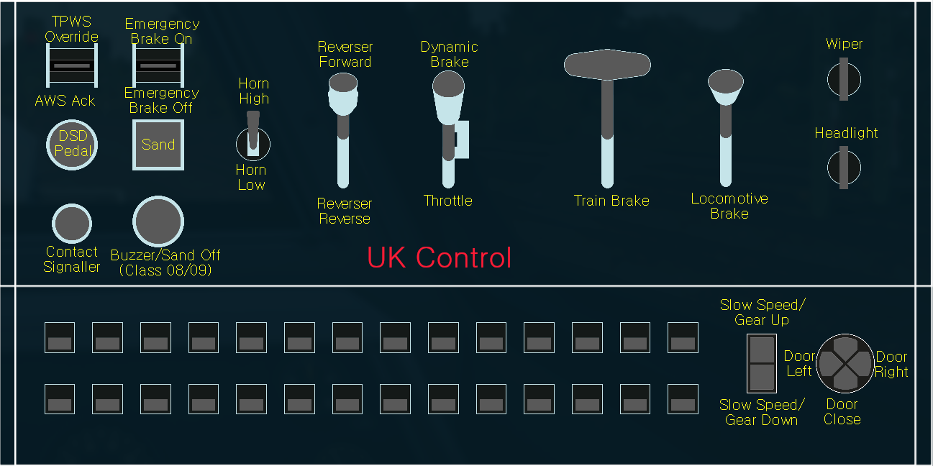
UK

Slide 7
UK route IDs
DSN: Tees Valley Line
GWB: Great Western Express
JT: WCML - Preston-Carlisle
LMC: Northern Trans-Pennine / BR Heavy Freight Pack
PBO: Blackpool Branch
WSR: West Somerset Railway
CL/SHG: Freight Pack
PNZ: West Cornwall Local
NJP: New Journey (Southeastern High Speed)
LE: Diesel Railtour
GDG: HST Farewell
GWR: Great Western Express
EMT / LDN: Midland Main Line
EMK: WCML South
SEH: Southeastern High Speed
EDN: Edinburgh Glasgow
ECW: East Coastway
PBD: East Coast Main Line
CLP: Cargo Line Petroleum, CLM: Military, CLI: Intermodal, CLA: Aggregates
ATS: Manchester Airport Commuter
TFW: Cardiff City Network
RIV: Riviera Line
NLL: London Overground: Mildmay Line
GOB: London Overground: Gospel Oak-Barking Riverside
BCC: Birmingham Cross City
FCE: Fife Circle Line
PFT: Peak Forest Railway
LPC: Spirit of Steam
SS: Steam Jubilee Livery (West Cornwall Local)
GCC: Cathcart Circle Line
MGP: Glossop Line
AABS: WCML: Birmingham-Crewe
MVL: Medway Valley Line
LBN: London Commuter
IOW: Isle of Wight
GOB: London Overground: Gospel Oak – Barking Riverside
THB: Thames Valley Branches
AWL: Airedale & Wharfedale

