Slide 1
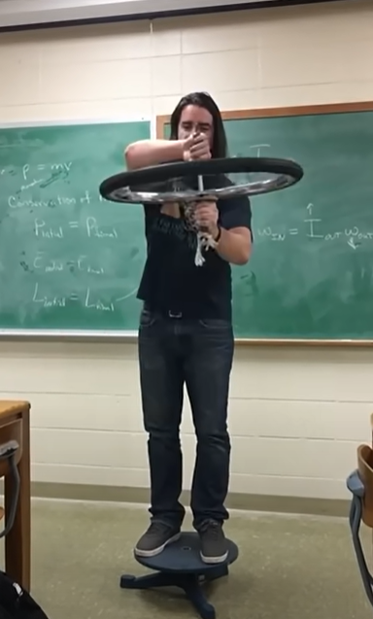
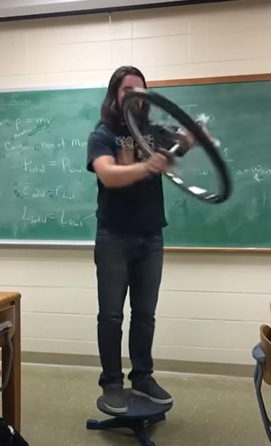
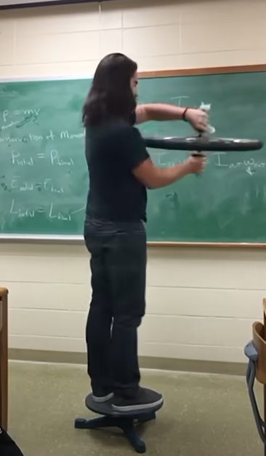





https://www.youtube.com/watch?v=0HFO8oHqOLc
L_wheel
L_wheel
$ω$_wheel
τ_hands
$ω$_wheel
$ω$_wheel
L_wheel
$ω$_stool=0
$ω$_stool
$ω$_stool

Slide 2
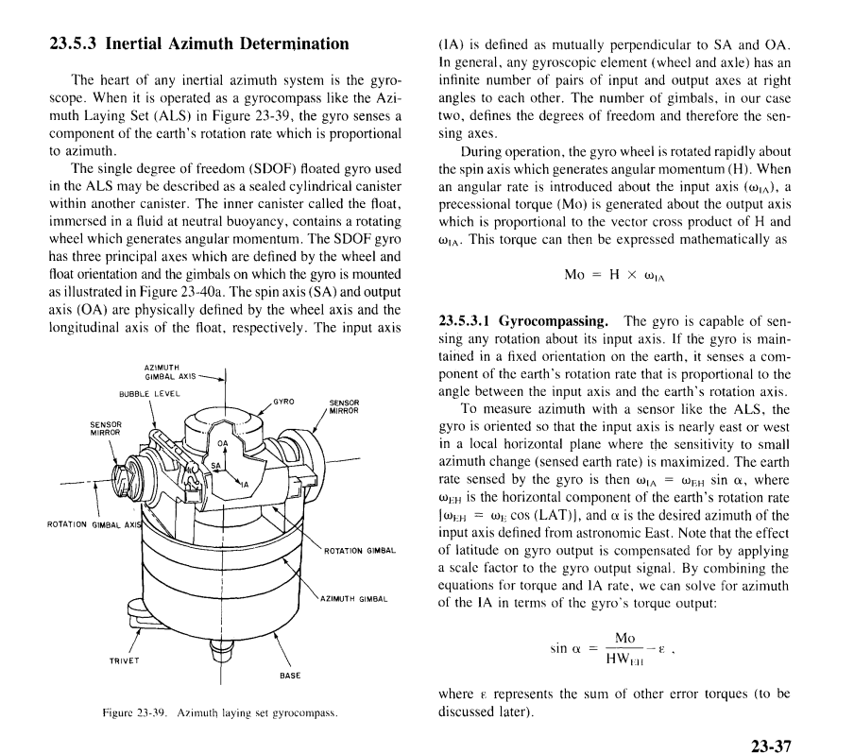

Slide 3
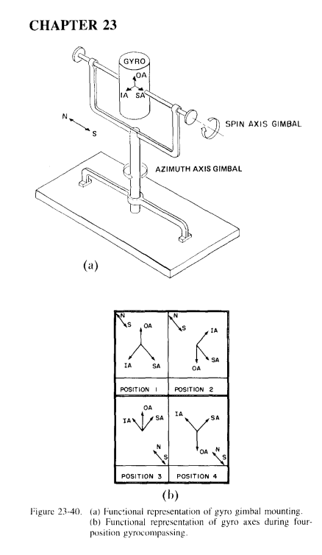
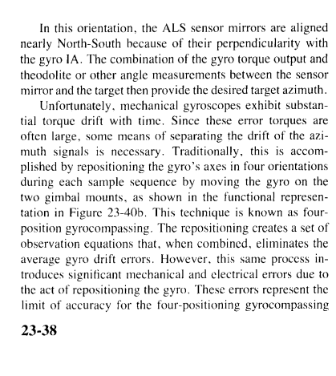

In https://www.ngdc.noaa.gov/stp/space-weather/online-publications/miscellaneous/afrl_publications/handbook_1985/Chptr23.pdf

