Slide 1
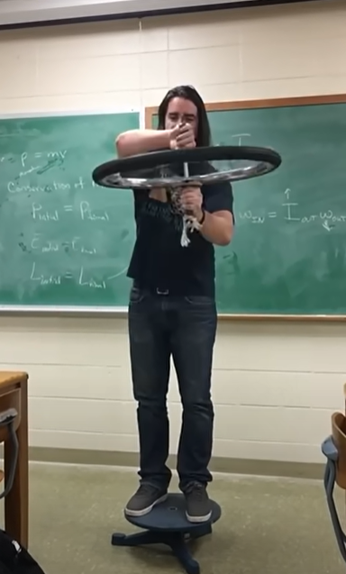
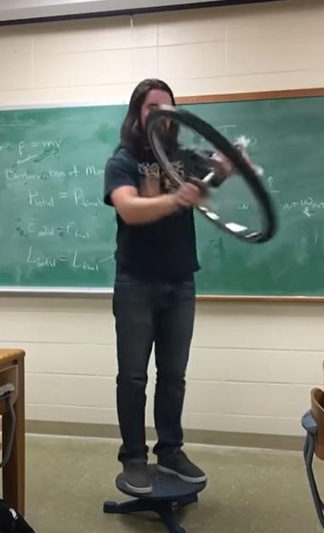
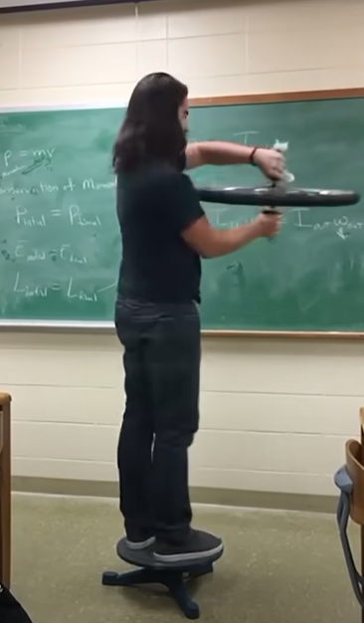





https://www.youtube.com/watch?v=0HFO8oHqOLc
L_wheel
L_wheel
$ω$_wheel
τ_hands
$ω$_wheel
$ω$_wheel
L_wheel
$ω$_stool=0
$ω$_stool
$ω$_stool

