Slide 1
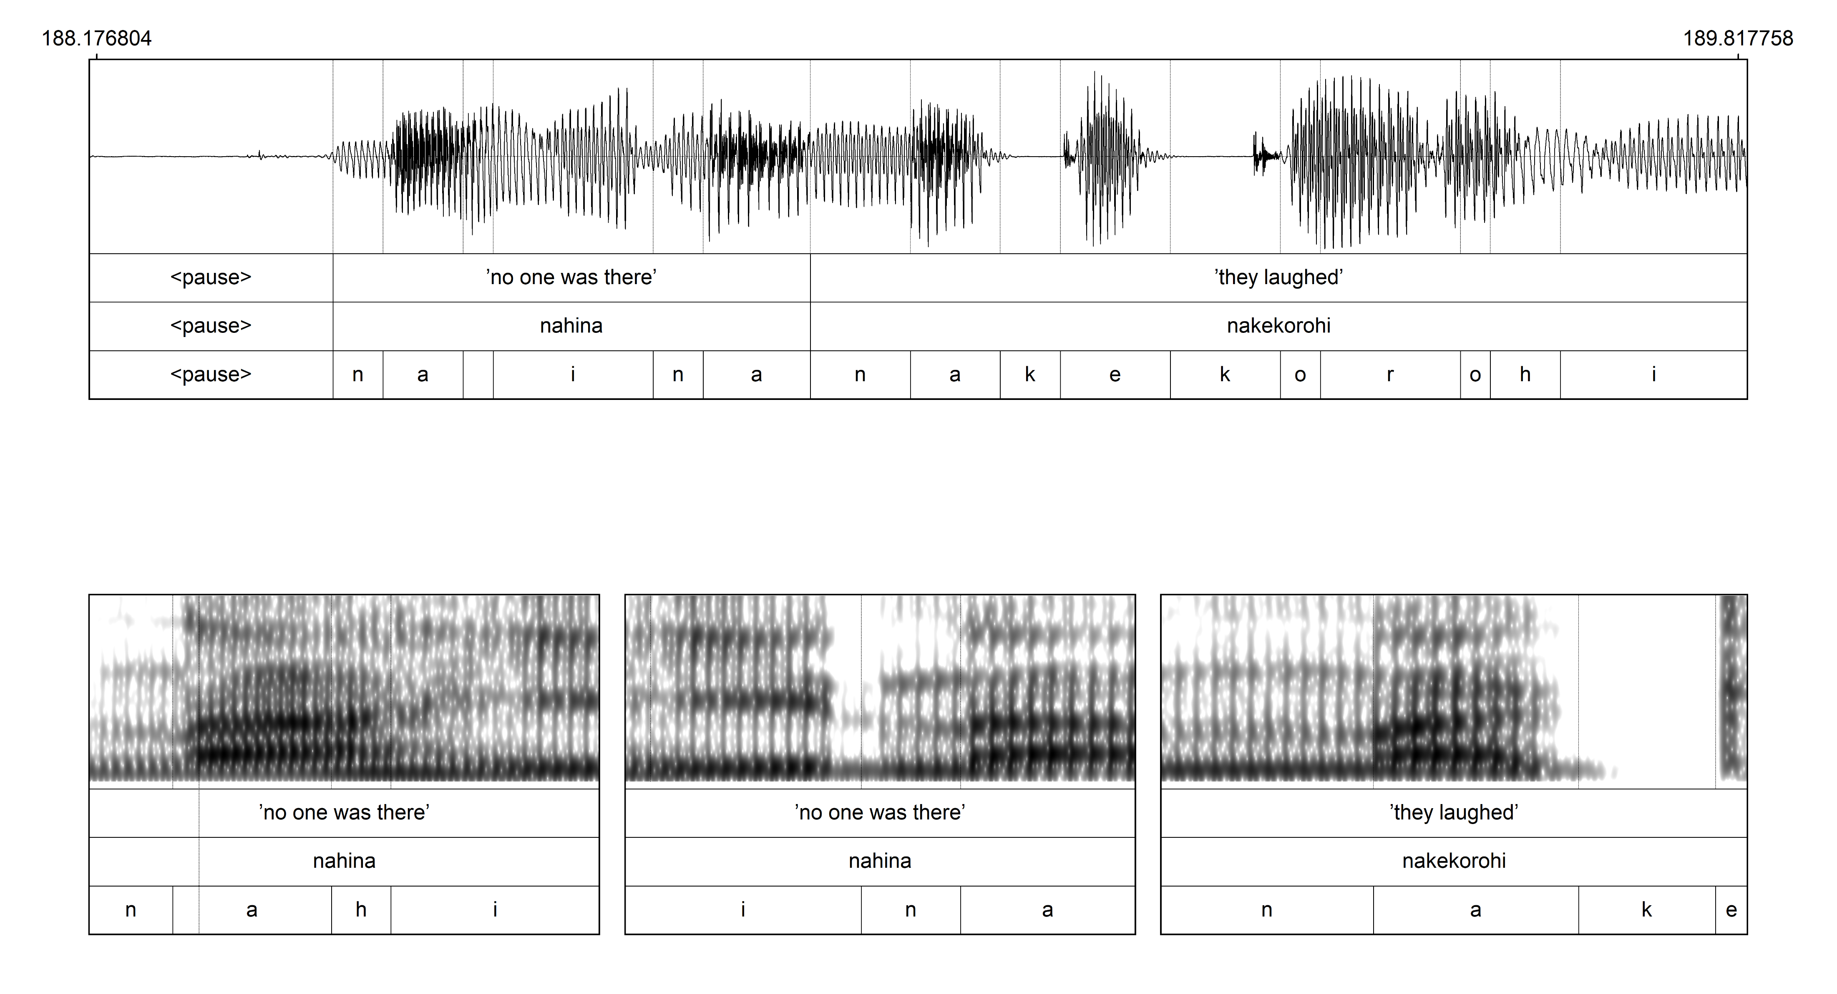
Continuous speech stream
Frequency (Hz) | Annotation
h
The nasal consonant [n] in three different positions within an utterance
Utterance and word-initial Word-internal Word-initial
50 ms 50 ms 100 ms

