Slide 1
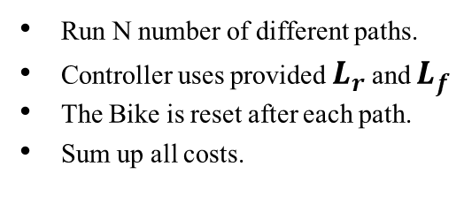

Bayesian Optimizer
Simulation
$L_{r}$and $L_{f}$
Run N number of different paths.
Controller uses provided $L_{r}$ and $L_{f}$
The Bike is reset after each path.
Sum up all costs.
cost

