Slide 1
Regulation of coral-algal interactions
This is a complex story: it involves competition, predation, pathogens, grazing, overfishing, climate change, and marine protected areas

Slide 2
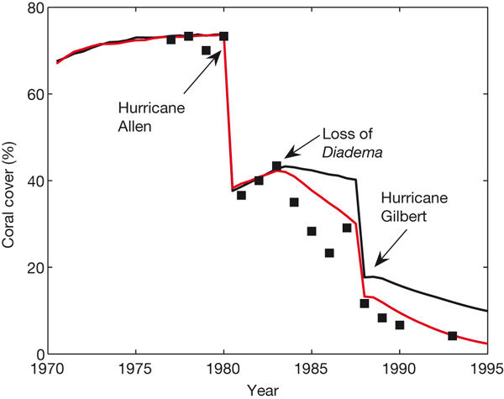
Coral decline

Slide 3
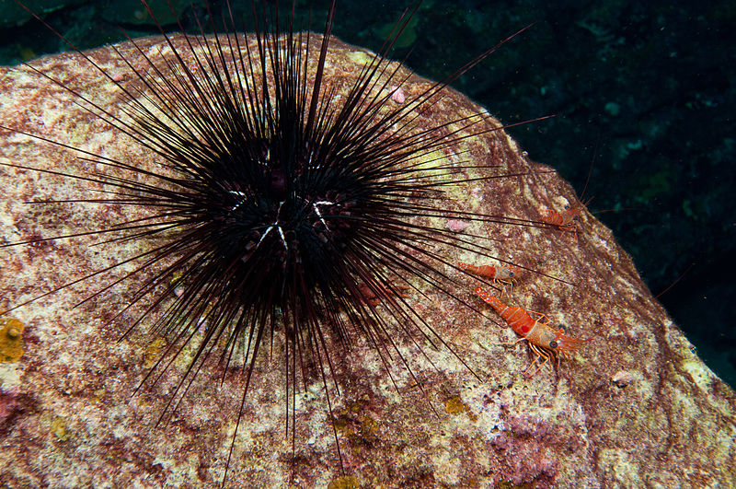
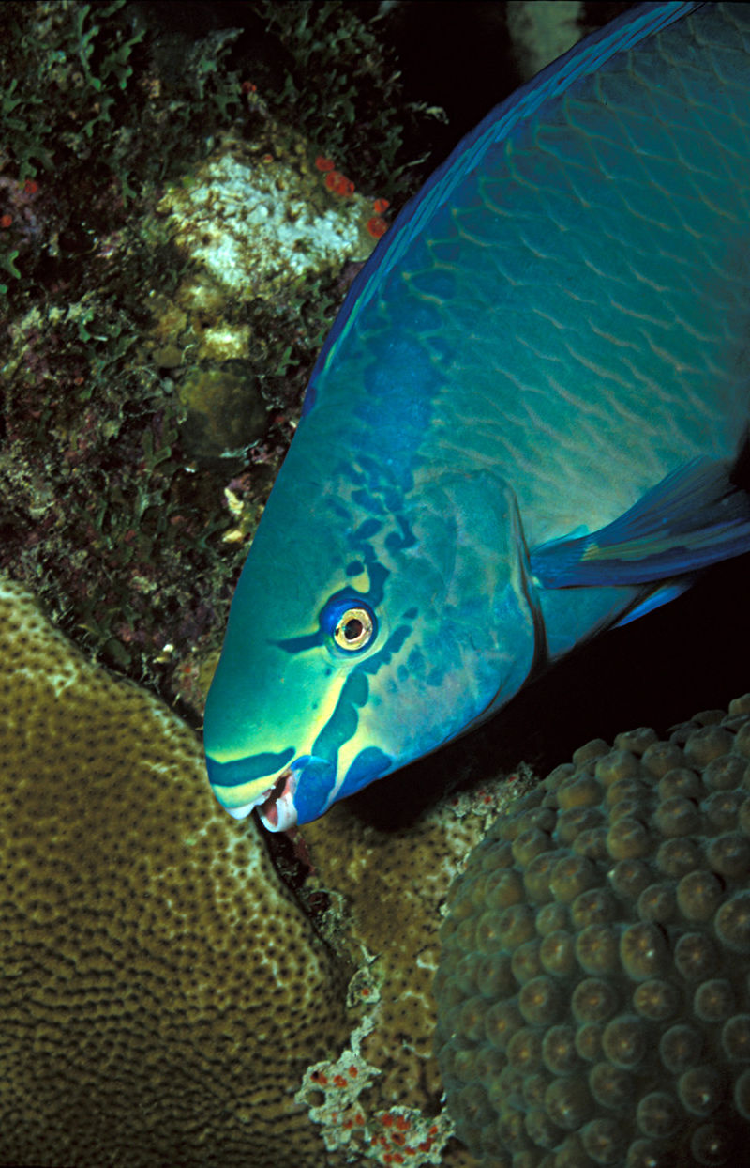
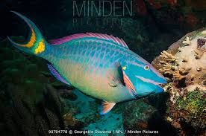
Grazers
Queen Parrotfish (Scarus vetula)
long-spined sea urchin (Diadema antillarum)
Stoplight parrotfish (Sparisoma viride)

Slide 4
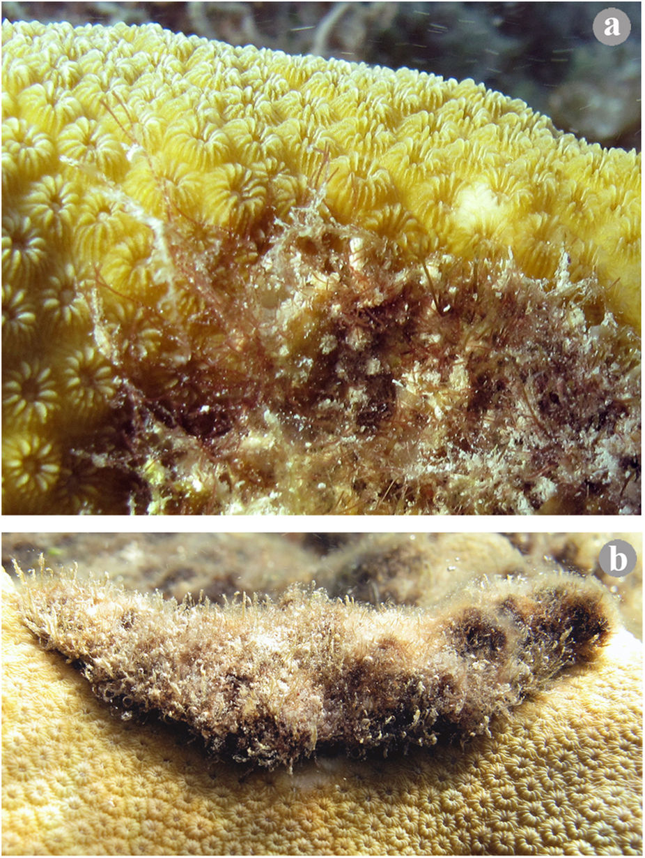
Interactions between the coral Orbicella annularis and turf algae containing sediment

Slide 5
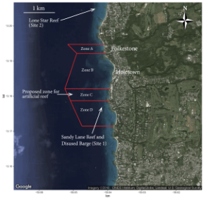
Marine protected areas

Slide 6
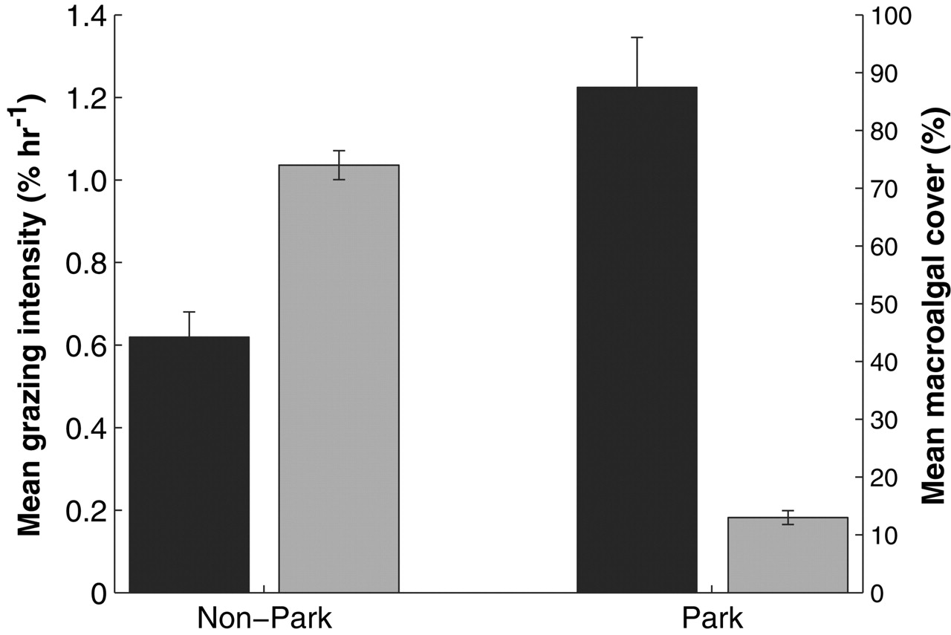

Fig. 4. Mean grazing intensity of parrotfishes (black bars) and macroalgal cover (gray bars) (±SE) inside and outside the ECLSP. Reserve impacts are significant (P < 0.01) for each variable.
Peter J. Mumby et al. Science 2006;311:98-101
Published by AAAS
Notes:
Mean grazing intensity of parrotfishes (black bars) and macroalgal cover (gray bars) (±SE) inside and outside the ECLSP. Reserve impacts are significant (P < 0.01) for each variable.

Slide 7
Fishing, Trophic Cascades, and the Process of Grazing on Coral Reefs
Since the mass mortality of the urchin Diadema antillarum in 1983, parrotfishes have become the dominant grazer on Caribbean reefs. The grazing capacity of these fish could be impaired if marine reserves achieve their long-term goal of restoring large consumers, several of which prey on parrotfishes.

Slide 8
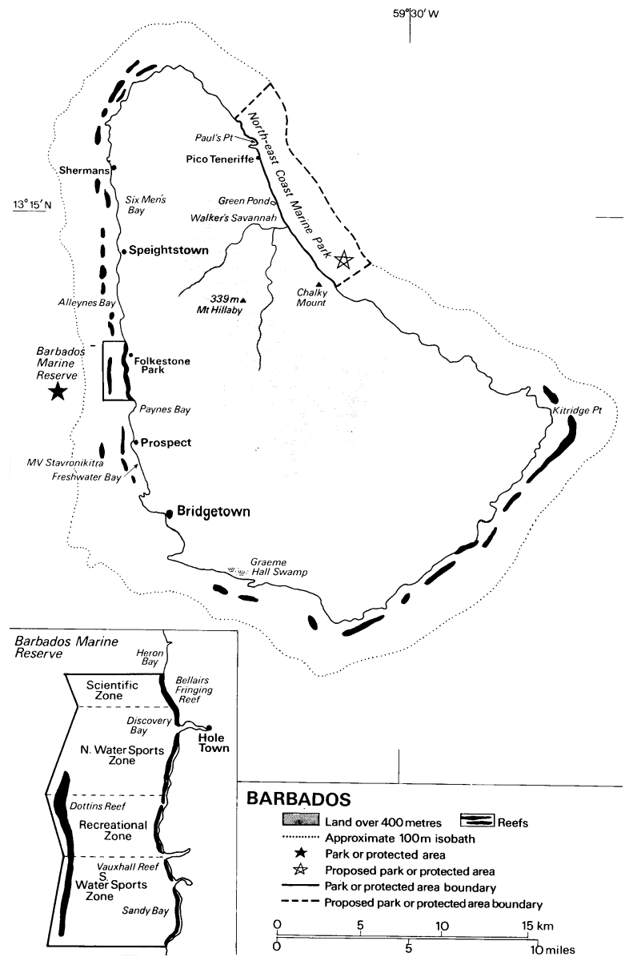

Slide 9
Folkestone Reef

Slide 10
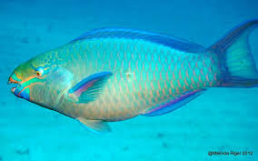
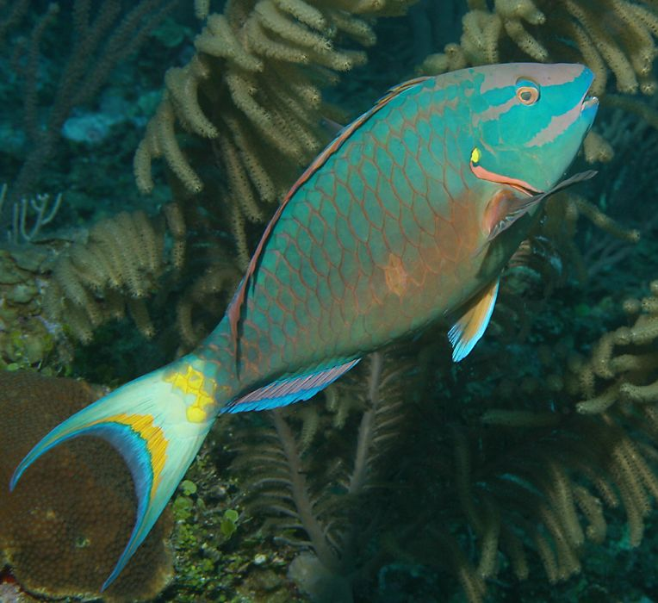
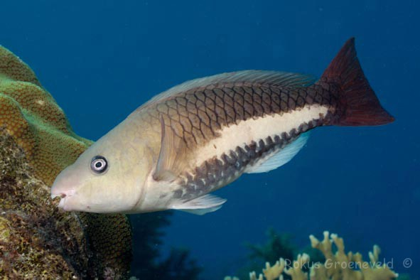
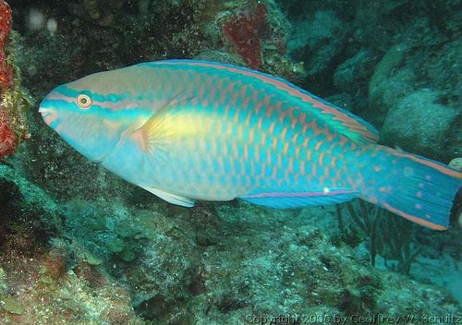
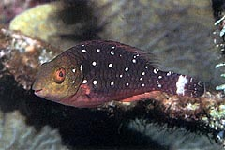
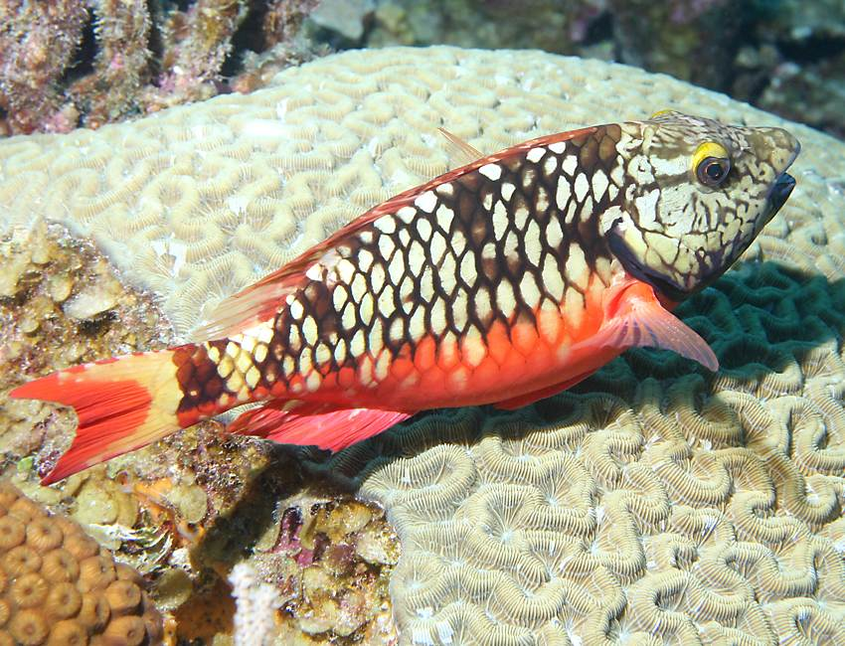
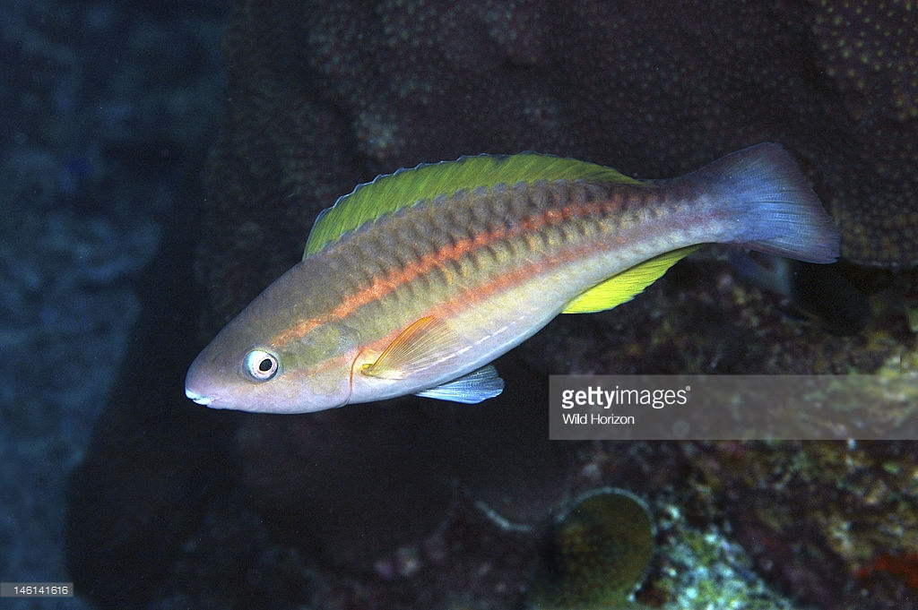
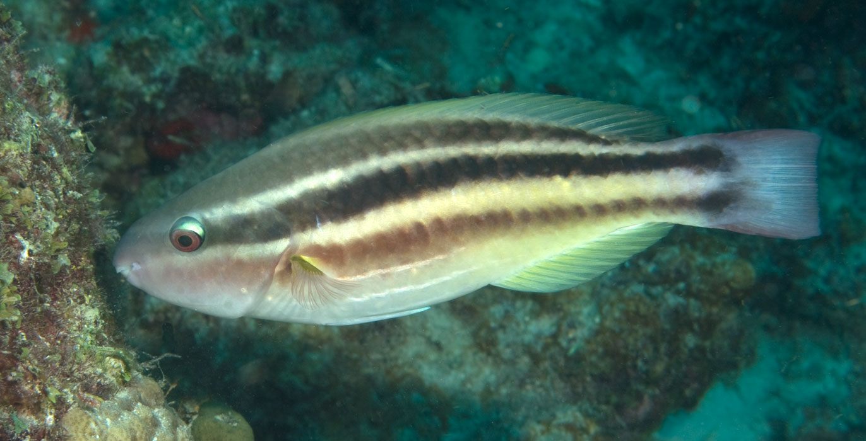
Queen - terminal
Queen – initial phase
Stoplight - terminal
Princess - terminal
Stoplight - initial
Stoptlight - juvenile
Princess – initial
Princess – juvenile

Slide 11
Sampling design
Quantitative assessment: spatial variation in grazing intensity, coral cover, and algal cover
Hypothesis testing: controlled observations vs. controlled experiments
Prediction: reef structure and substratum influence species distribution and specific grazing intensity
Measured variables
Grazing intensity: bite rate (of individual fish by species)
Coral and algal cover
Fish density, species composition
controlled variables (factors):
Habitat (depth gradient, reef structure): fixed effects
Site (reef, random variable): random effects

Slide 12
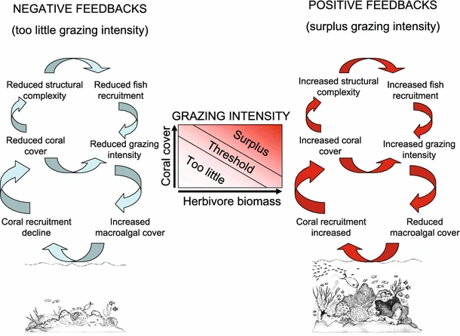
Mumby and Steneck 2008

Slide 13
Coral decline

Slide 14
Grazers
Queen Parrotfish (Scarus vetula)
long-spined sea urchin (Diadema antillarum)
Stoplight parrotfish (Sparisoma viride)

Slide 15
Interactions between the coral Orbicella annularis and turf algae containing sediment

Slide 16
Ecological interactions (competition) between coral and algae.
Top left: Coelothrix irregularis. Top right: Laurencia obtusa. Bottom left: Dictyota cervicornis. Bottom right: Halimeda opunt

Slide 17
competition, grazing and positive feedbacks
(i) macroalgae overgrows coral at a rate 𝑎, (ii) macroalgae
spreads vegetatively over algal turfs at a rate 𝛾, (iii) coral recruits to and overgrows algal turfs at a total
rate of 𝑟, (iv) coral has a natural mortality rate of 𝑑, which then gives rise to algal turfs, and (v) grazers
feed indiscriminately on both algal types at a fixed rate 𝑔

Slide 18
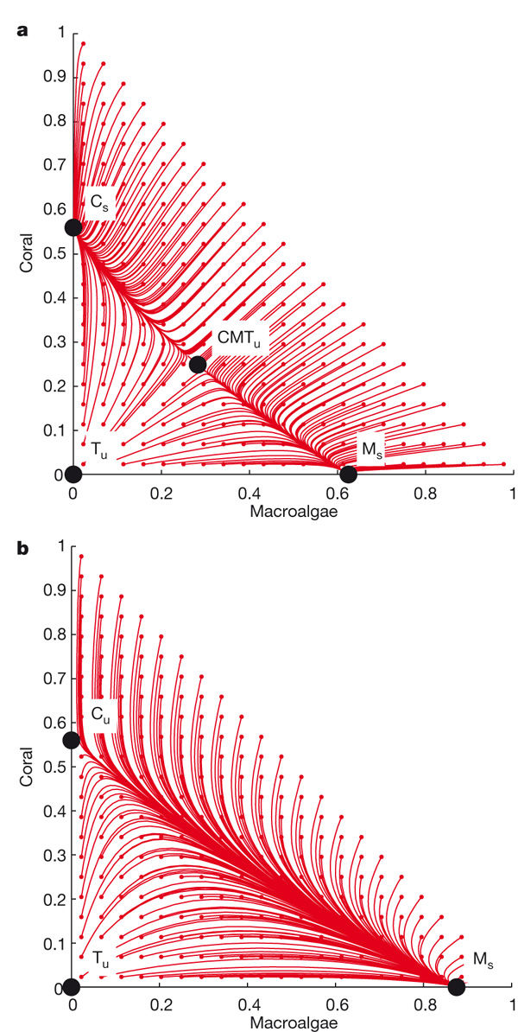
Equilibrium covers are denoted by black circles; trajectories are shown in red for grazing intensities of 0.3 (a) and 0.1 (b).

Slide 19
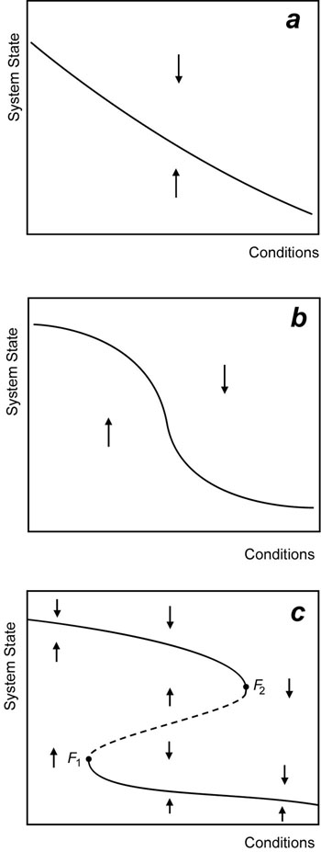
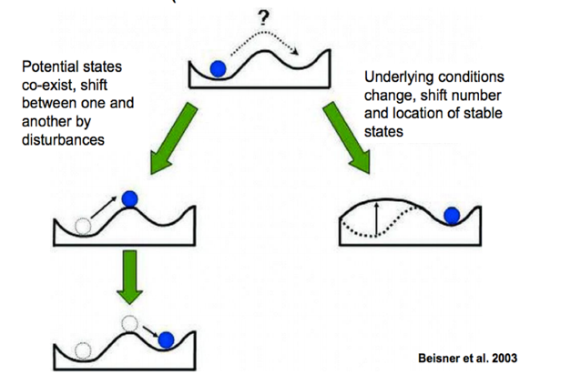
Alternate stable states

Slide 20
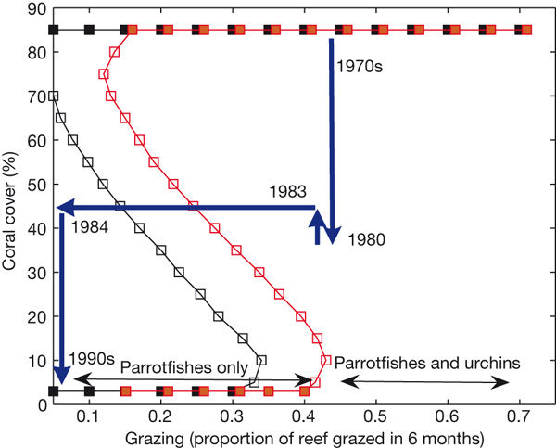
Thresholds and the resilience of Caribbean coral reefs

