Slide 1

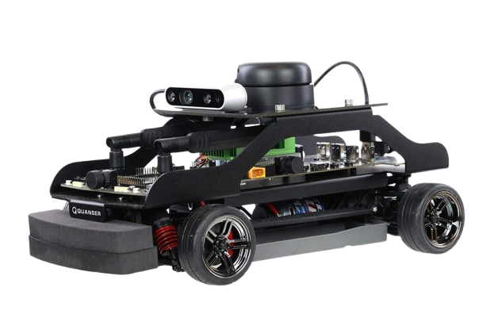
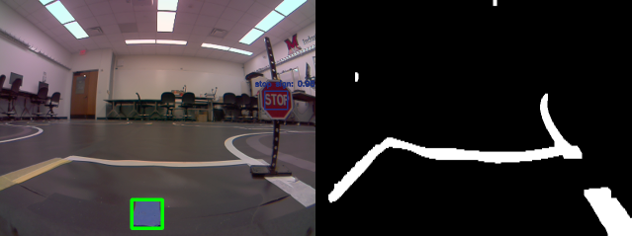
Self-Driving Car for Conference Competition
Team: Zach Copenhaver, Jakob Felts, Fred Levins, Josh Strong
Advisors: Dr. David Hartup, Dr. Bryan Van Scoy
Overview
QCar Components
Motor Controls
We developed a self-driving car that can travel between specific points in the road, emulating a taxi service.
This was accomplished by:
Camera feeds to process information on track
Mapping of track
Live-updates while car navigated the track
Vehicle ability to traverse track
NVIDIA Jetson TX2
Four CSI cameras
- 360 degree vision
Intel RGBD camera
LIDAR
Motor encoder
IMU sensor
Expandable IO
Motors have no bound on maximum speed
Speed value of 0.066 works best for our cases
Servo angle ranges from -0.5 to 0.5 radians (~28 degrees)
A* Algorithm
Camera Implementation
Uses nodes on grid based map
Easy to use with a start and end node
Creates shortest path between points
Quick computation time
f(n) = g(n) + h(n)
Controls feed set to binary image
Checks the location of white pixels
Adjust angle based on how far out of preset range white pixels are
YOLOv3-tiny trained on COCO dataset
Uses cv2 DNN to single pass itemize objects in frames to predict eight essential classes of roadway entities
Confidence threshold at 60% and non-max suppression at 40%
Detects nodes with blue RGB masking
Vehicle Operations
Given start and end destinations
Visual Representation
Find shortest path
All feeds use forward facing CSI camera
Each feed uses own threading of camera footage
Run function to travel to next node
References
https://www.quanser.com
https://github.com/vanscoy/qcar
https://opencv.org/about/
https://arxiv.org/pdf/1506.02640.pdf
https://doi.org/10.1109/cvpr.2016.91
https://cocodataset.org/
Check visual feeds to update position and predict objects
If path has not been completed, continue to next node
Node and YOLO feeds
Controls feed

