Slide 1
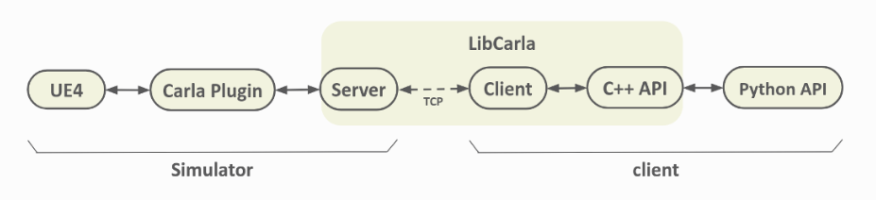

Slide 2
Start
GetSensorDefinition()
ARadar()
GetSensorDefinition()
Set()
GetSensorDefinition()
GetSensorDefinition()
GetSensorDefinition()
BeginPlay()
Wait for tick

Slide 3
Every tick
PostPhysTick()
DataStream.Send()
CalculateCurrentVelocity()
SendLineTraces()
CalculateRelativeVelocity()
Wait for tick

Slide 4
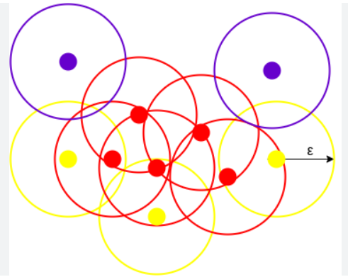
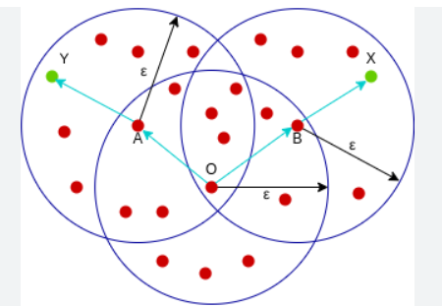
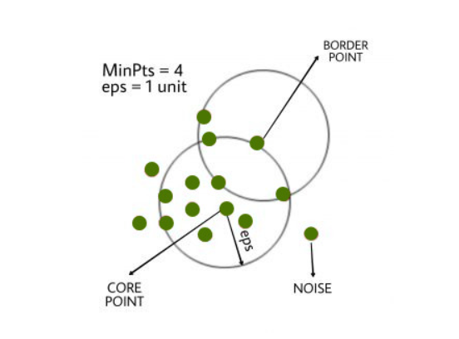

Slide 6
Core Points
Border Points
Noise
Eps
minPts: 3

Slide 7
minPts=4
Eps

Slide 8
Points E and P are Directly Density Reachable
Points D and K are Density Connected
Points D and G are Density Reachable
G
Eps
C
C
K
Eps
D
D
E
E
P

Slide 9
Points D and K are Density Connected
Eps
C
K
D
E

Slide 10
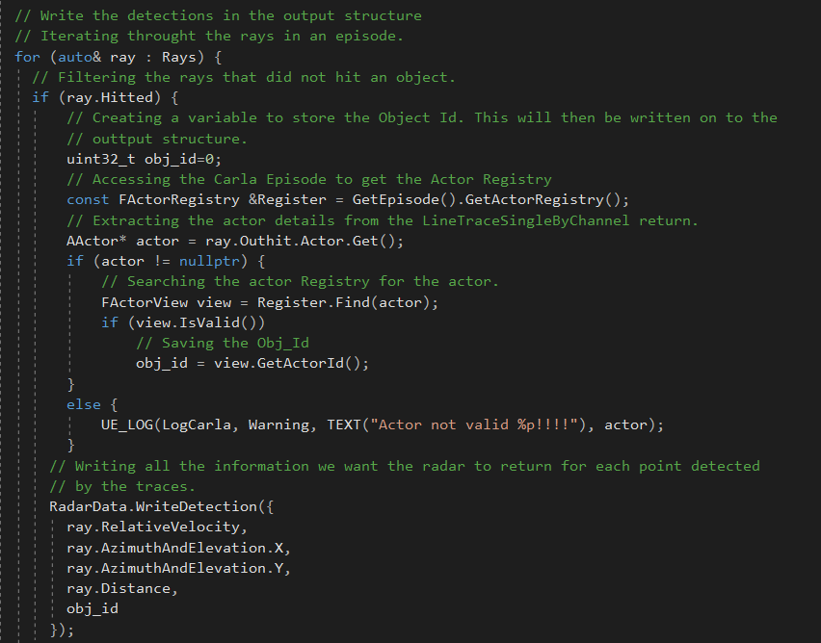

Slide 11
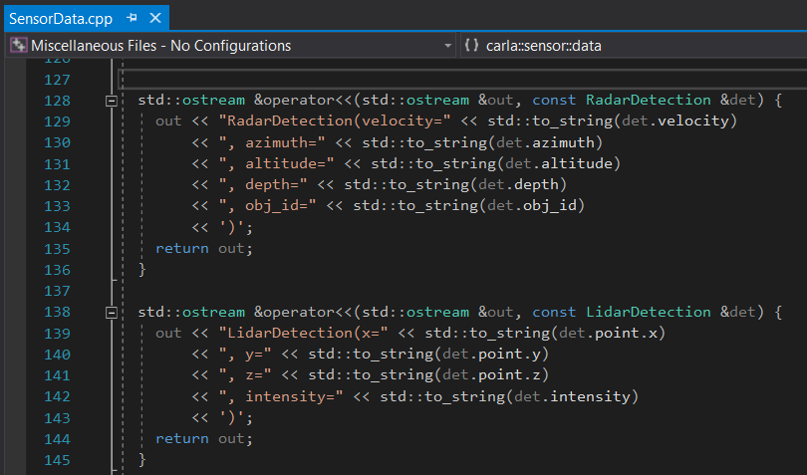

Slide 12
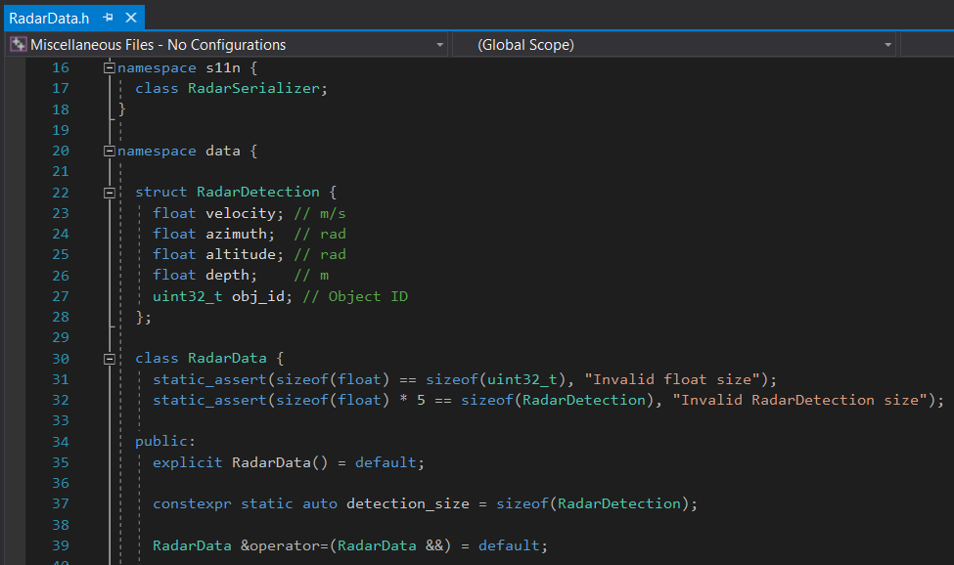

Slide 13
GetSensorDefinition()

Slide 14
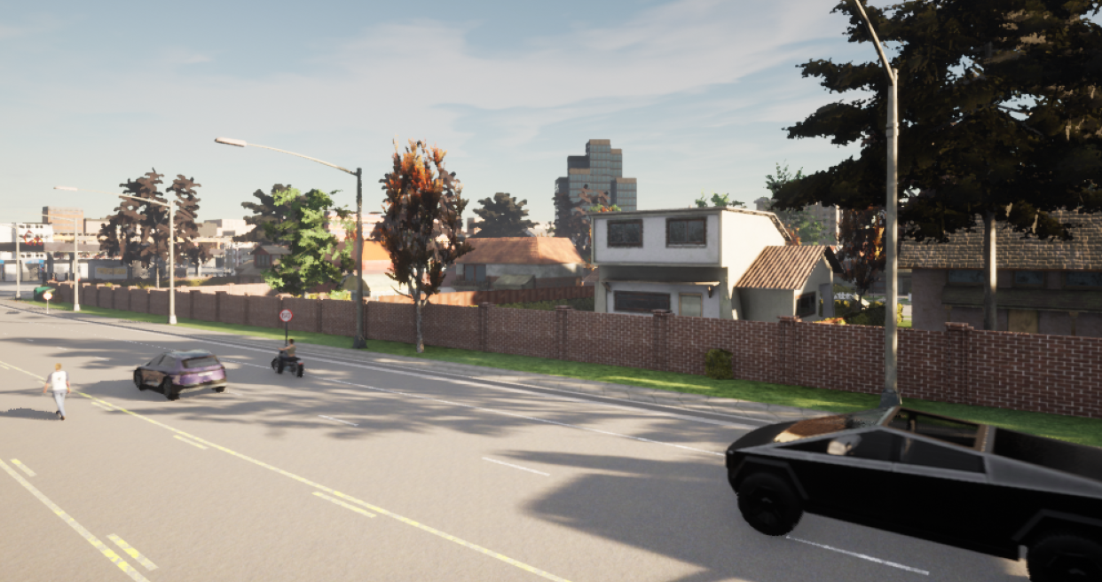
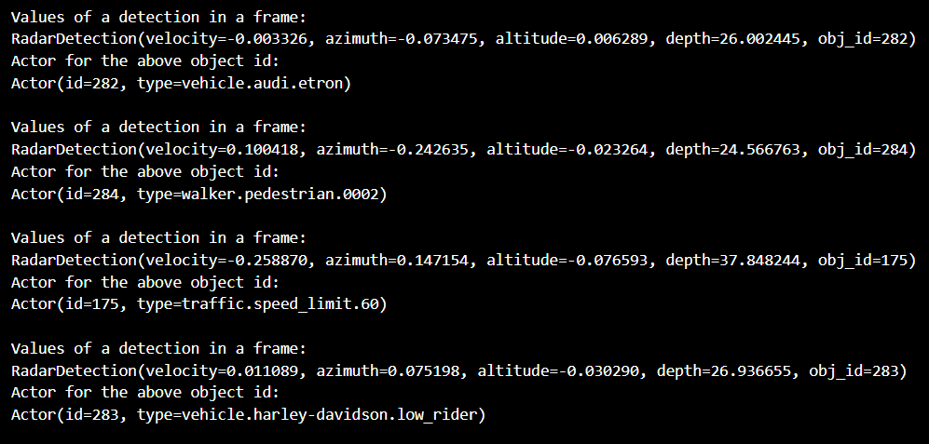

Slide 15
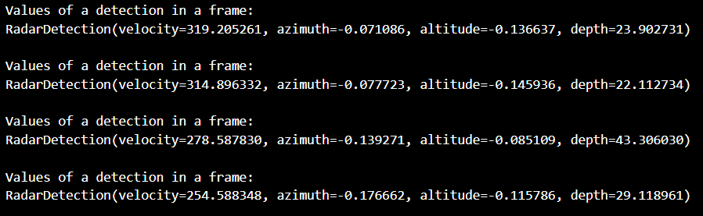
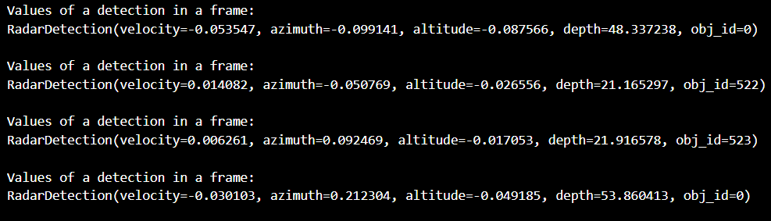

Slide 16
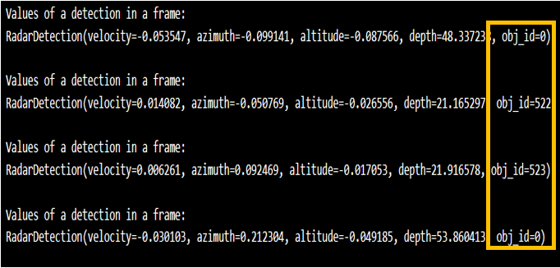
Unmodified sensor output
Modified sensor output

