Slide 1
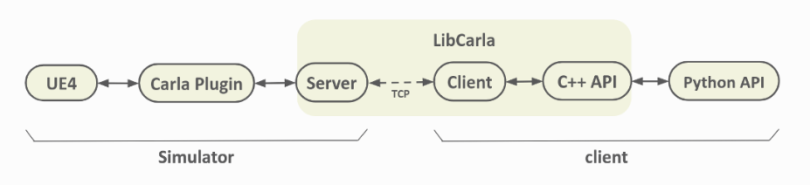

Slide 2
Start
Every tick
GetSensorDefinition()
PostPhysTick()
ARadar()
DataStream.Send()
CalculateCurrentVelocity()
GetSensorDefinition()
Set()
GetSensorDefinition()
SendLineTraces()
GetSensorDefinition()
GetSensorDefinition()
CalculateRelativeVelocity()
BeginPlay()
Wait for tick
Wait for tick

Slide 3
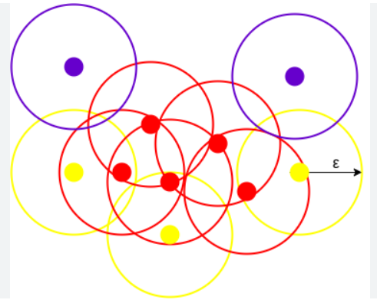
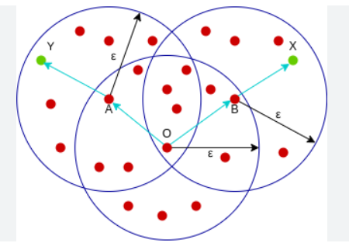
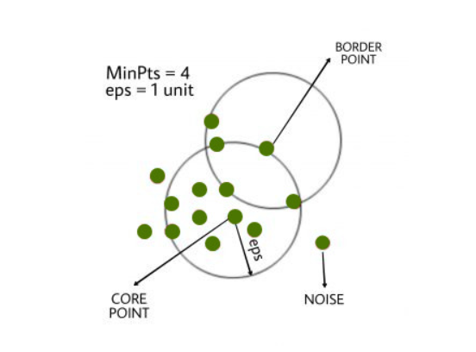

Slide 5
Core Points
Border Points
Noise
Eps
minPts: 3

Slide 6
minPts=4
Eps

Slide 7
Points E and P are Directly Density Reachable
Points D and K are Density Connected
Points D and G are Density Reachable
G
Eps
C
C
K
Eps
D
D
E
E
P

Slide 8
Points D and K are Density Connected
Eps
C
K
D
E

Slide 9
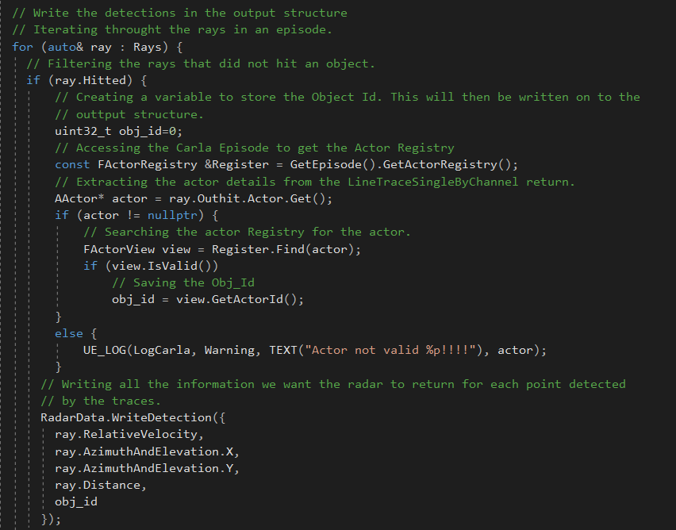

Slide 10
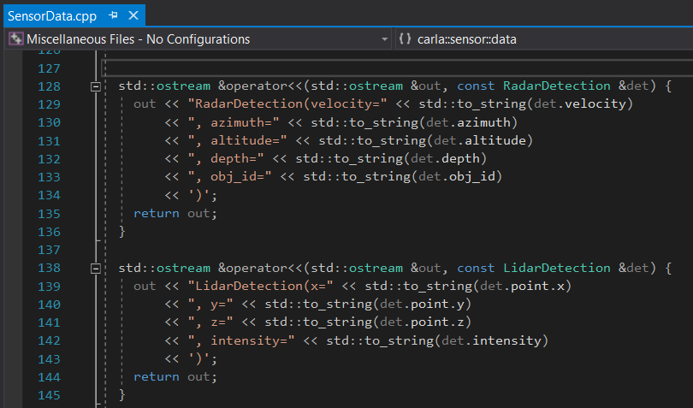

Slide 11
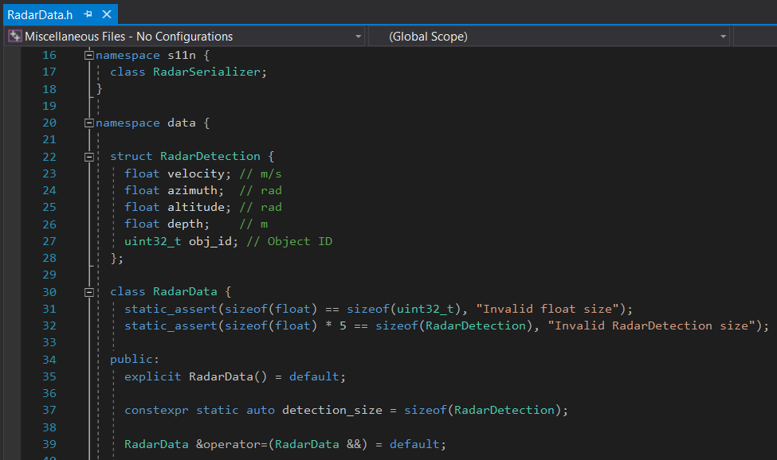

Slide 12
Calculate Radar FOV
Calculate number of traces, angle and radius of traces
Create Mutex and Parallel Threads
Shooting Traces and Storing Data
Close Threads

Slide 13
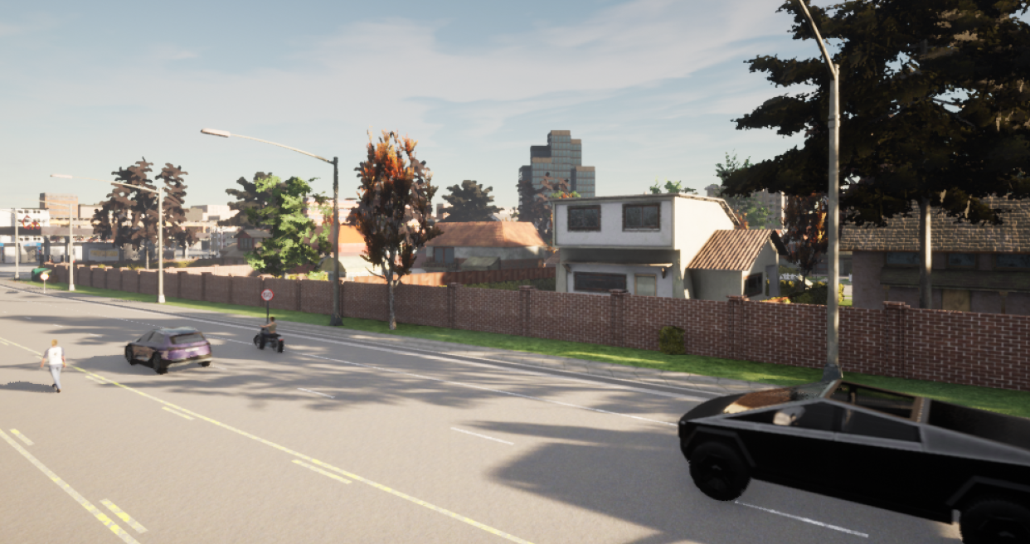
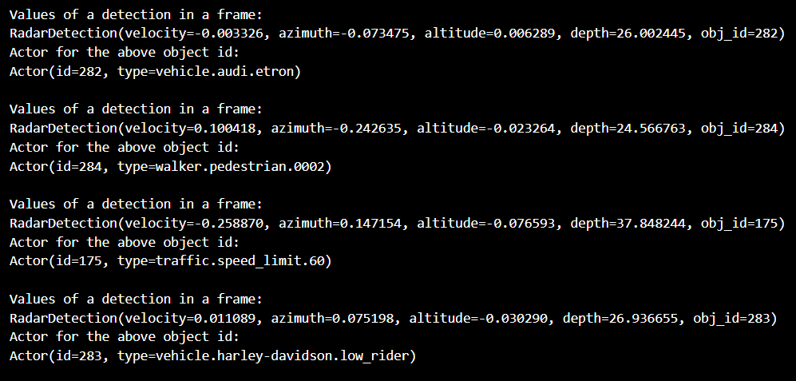

Slide 14
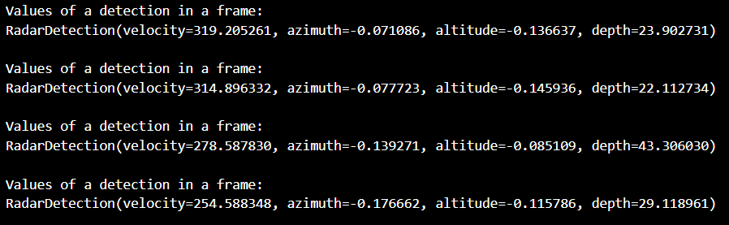
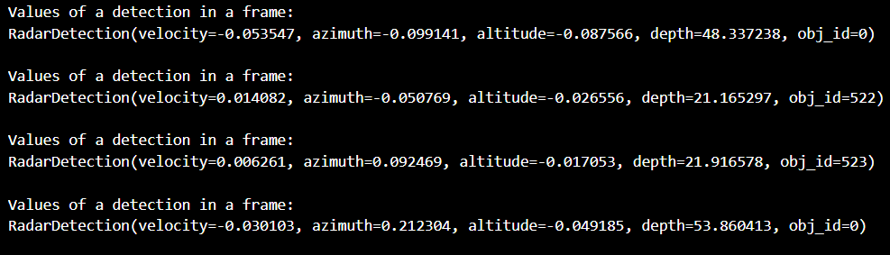

Slide 15
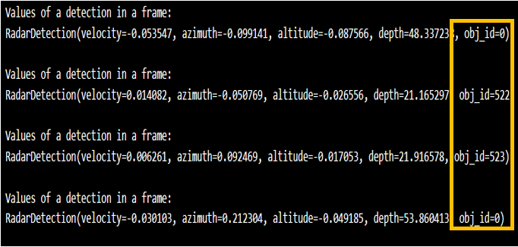
Unmodified sensor output
Modified sensor output

Slide 16
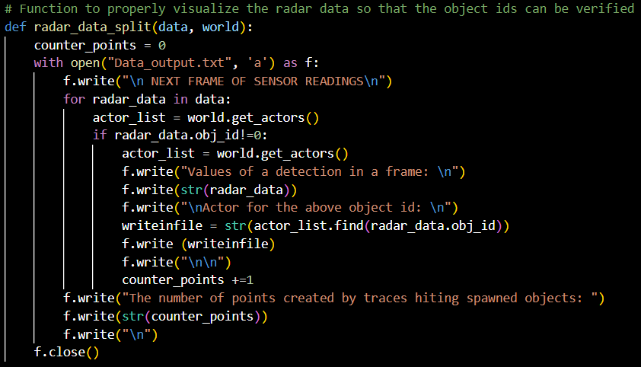
Loop to extract all detections in a frame
Accessing the Actor List from the World Object
Searching for Object IDs in the Actor list
Storing the data in a File

Slide 17
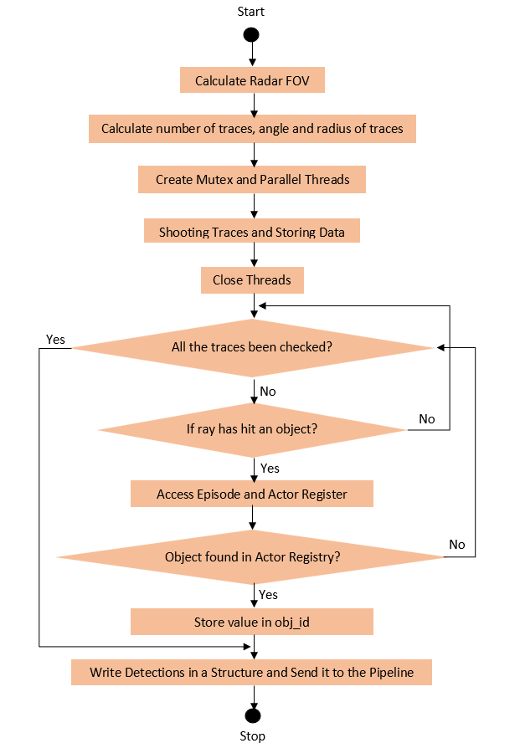

Slide 18
Byte Code Interpreter Application
Software that wants to use the Bytecode Interpreter
Sends Bytecodes for desired functionality
The application sends the bytecodes to the interpreter
Byte Code Interpreter

Slide 19

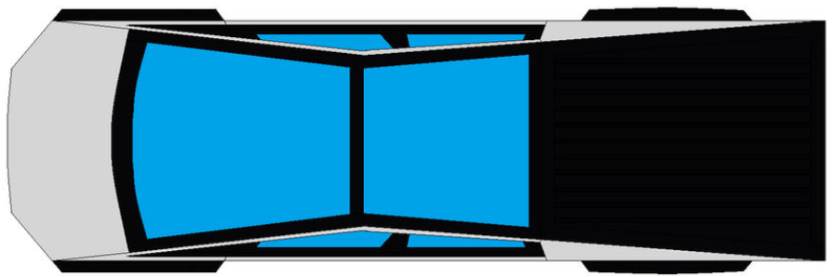



$$R_{v}\sin{ɵ}$$
$$R_{v}\cos{ɵ}$$
$$ɵ$$
V_ego
$$R_{v}$$
$$ɵ$$

Slide 20
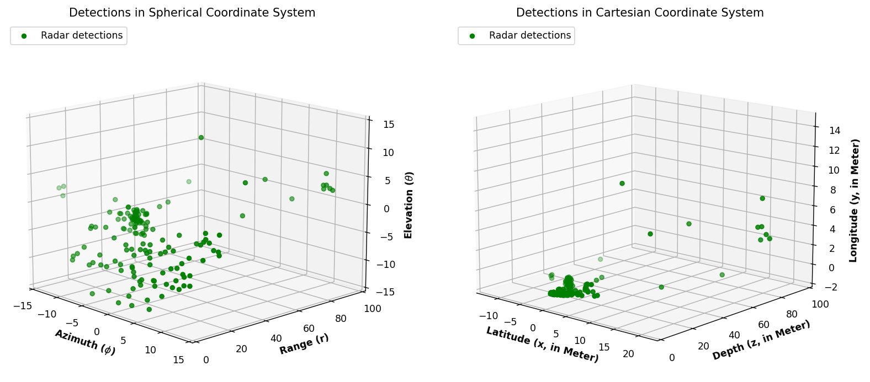

Slide 21
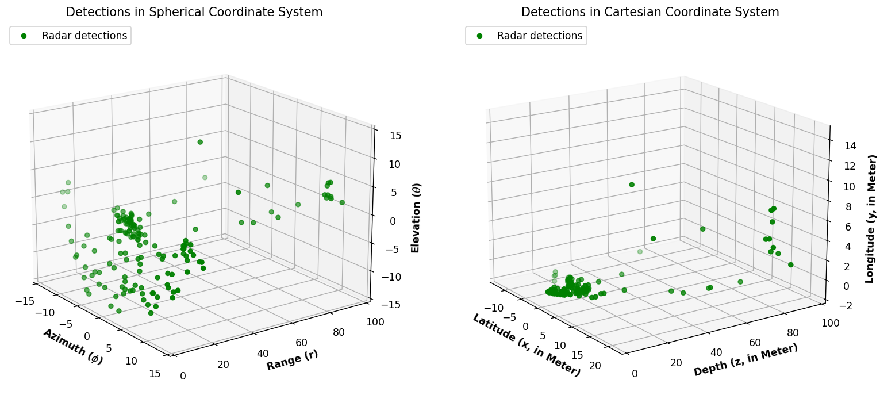
used

Slide 22
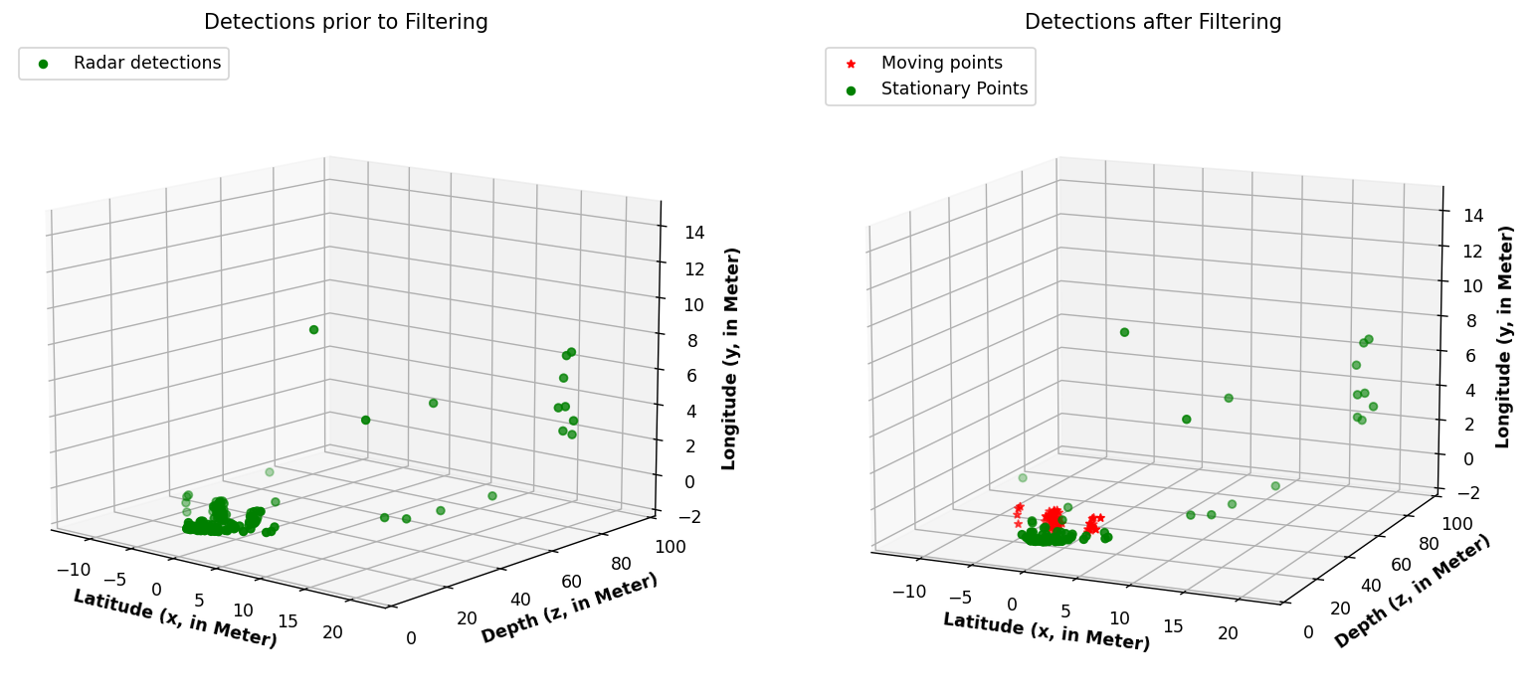

Slide 23
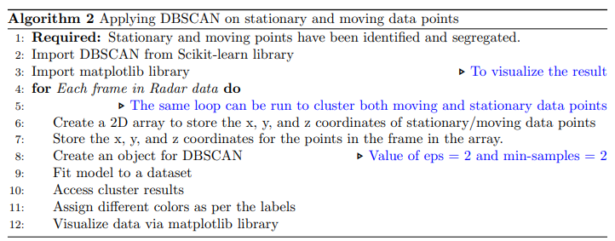

Slide 24
