Slide 1
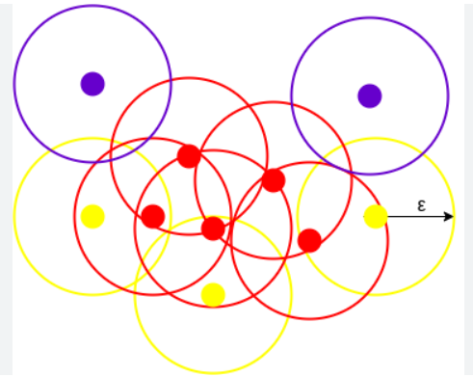
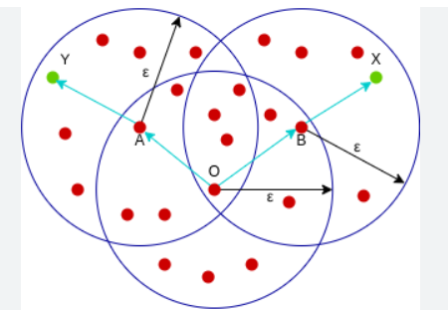
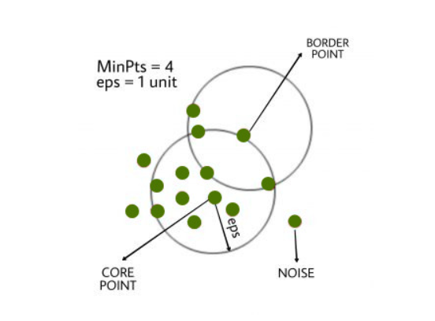

Slide 3
Core Points
Border Points
Noise
Eps
minPts: 3

Slide 4
minPts=4
Eps

Slide 5
Points E and P are Directly Density Reachable
Points D and K are Density Connected
Points D and G are Density Reachable
G
Eps
C
C
K
Eps
D
D
E
E
P

Slide 6
Points D and K are Density Connected
Eps
C
K
D
E

