Slide 1
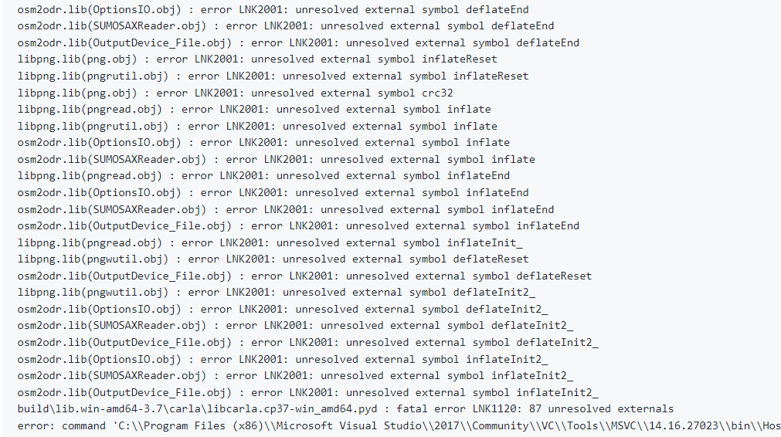
Figure showing the issue, LNK2001: unresolved external symbol Image source: Carla GitHub Issues [4]

Slide 2
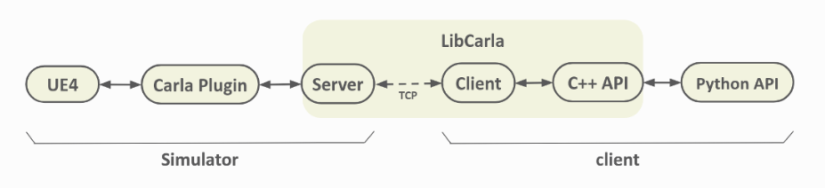
Communication pipeline of Carla Simulator. Image source: Carla's official Website [7].

Slide 3
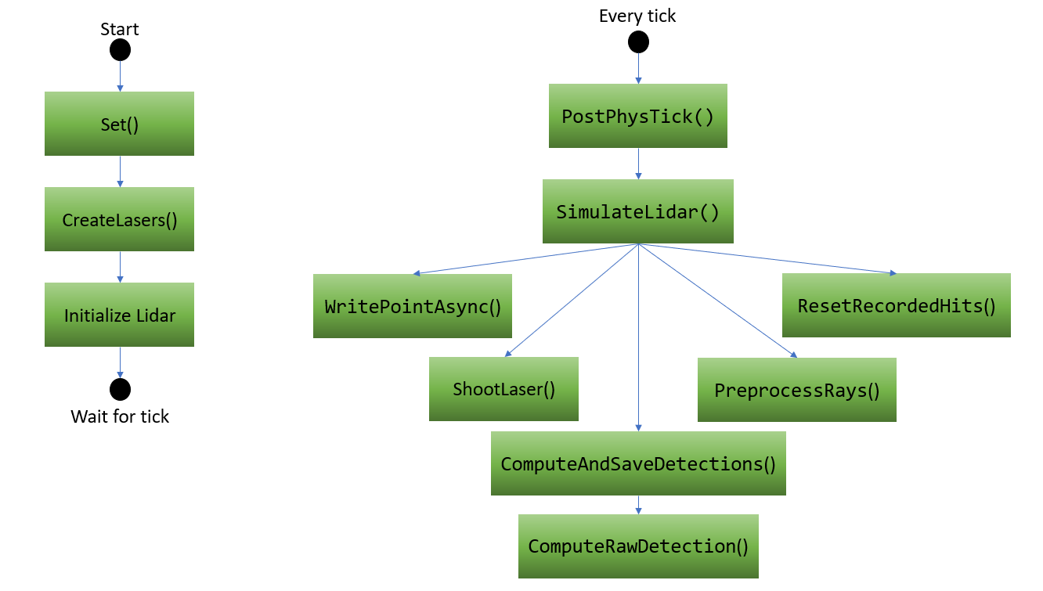
Flowchart showing the working of the Carla Semantic Lidar Sensor

Slide 4
Start
Every tick
GetSensorDefinition()
PostPhysTick()
ARadar()
DataStream.Send()
CalculateCurrentVelocity()
GetSensorDefinition()
Set()
GetSensorDefinition()
SendLineTraces()
GetSensorDefinition()
GetSensorDefinition()
CalculateRelativeVelocity()
BeginPlay()
Wait for tick
Wait for tick
Flowchart showing the working of the Carla Radar Sensor

Slide 5
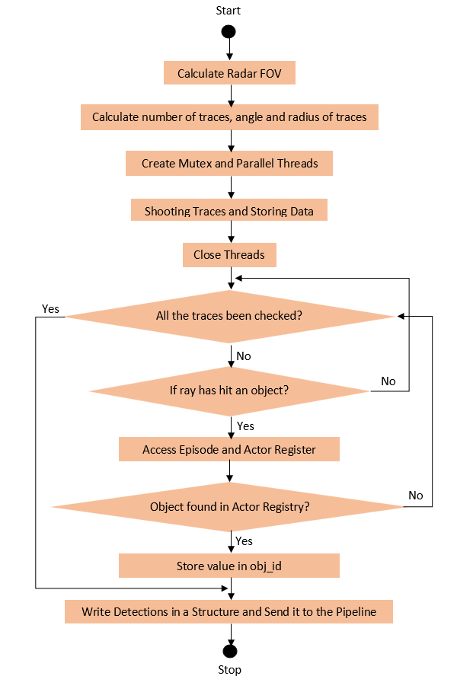
Flowchart of the SendLineTraces() Function.

Slide 6
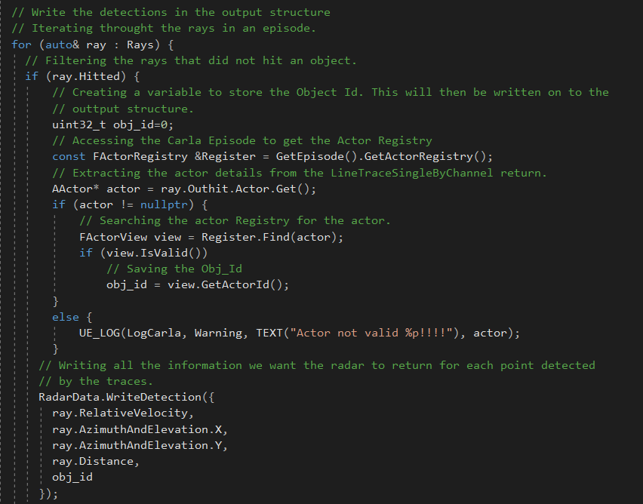
The modified code [8] extracts and returns the Object ID.

Slide 7
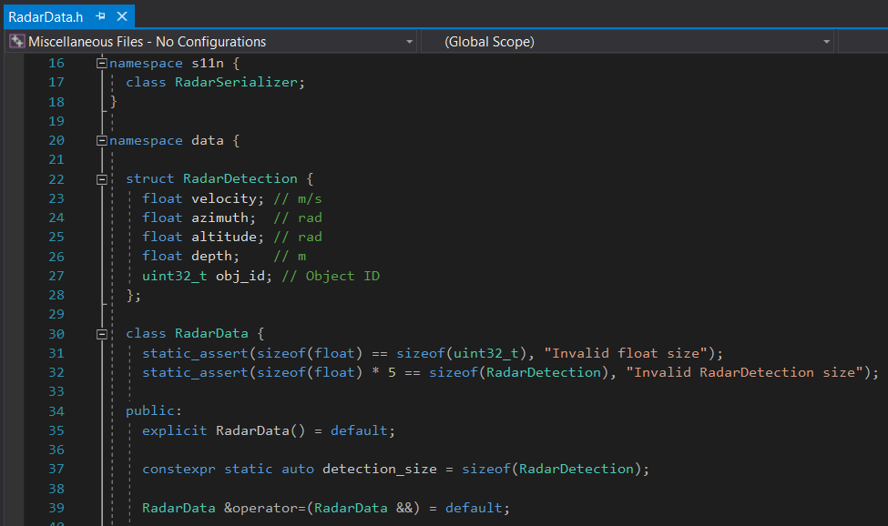
Structure containing radar detection components. Image source: Carla Simulator code [8]
with modification to include ‘obj-id’.

Slide 8
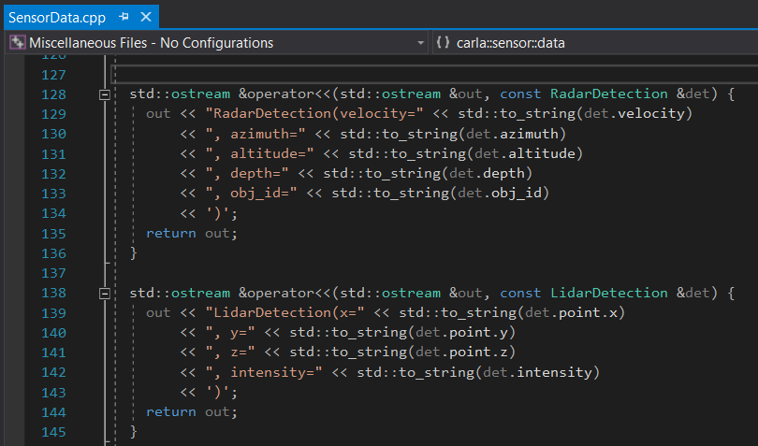
Output stream from the sensor to the User. Image source: Carla code [8] with modification to include ‘obj-id’.

Slide 9
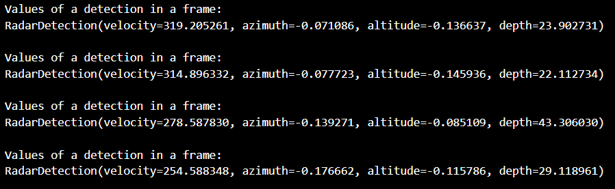
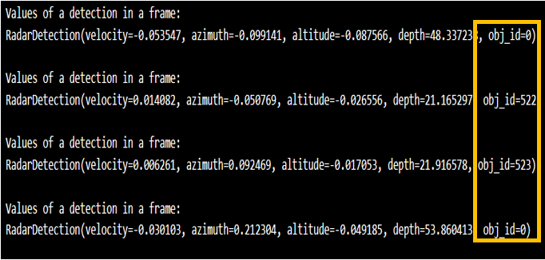
Unmodified sensor output
Modified sensor output
The radar detection from the unmodified and modified Carla simulator.

Slide 10
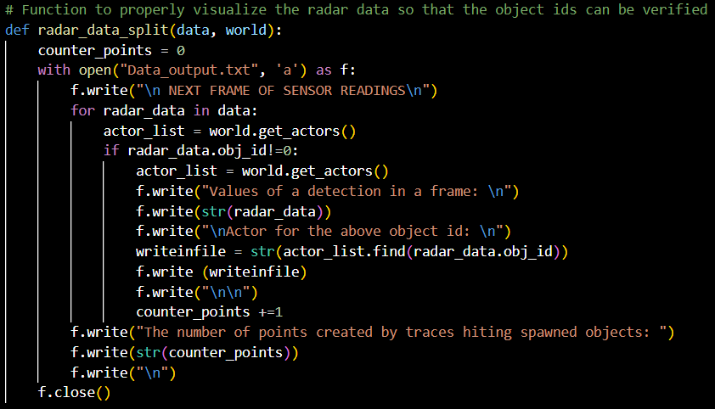
Loop to extract all detections in a frame
Accessing the Actor List from the World Object
Searching for Object IDs in the Actor list
Storing the data in a File
Code which searches the Actor List in the World Object and stores it in a file.

Slide 11
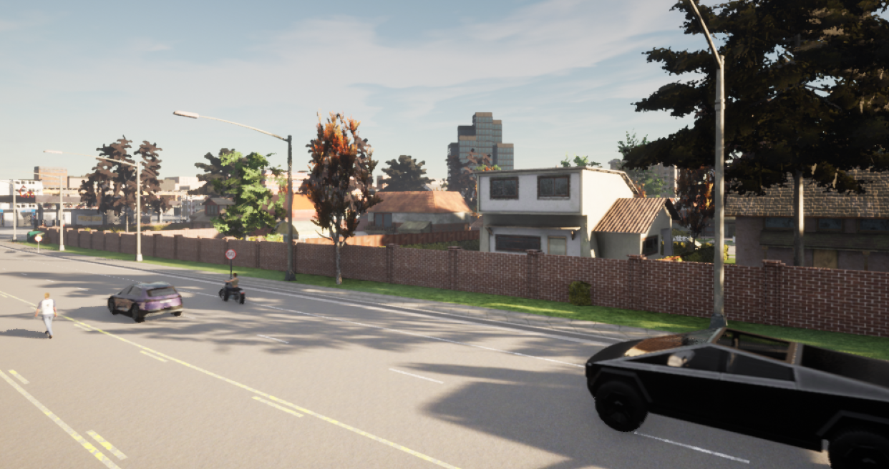
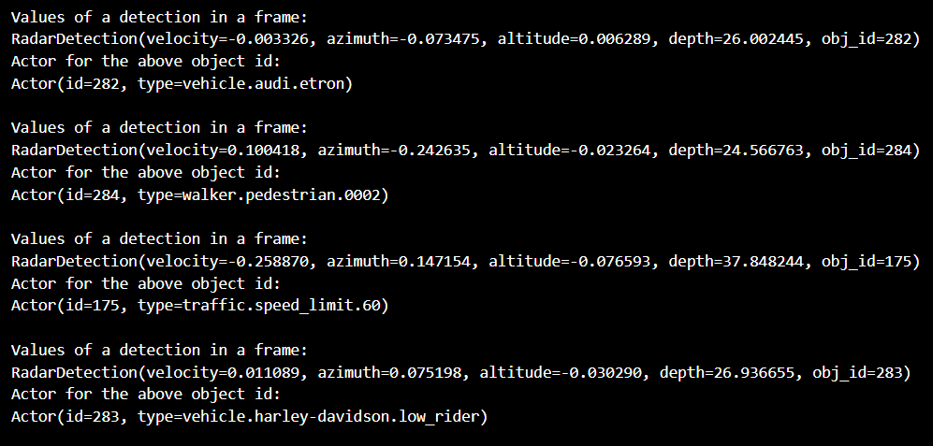
Displays the values returned by matching the Object IDs in the Actor list.

Slide 12
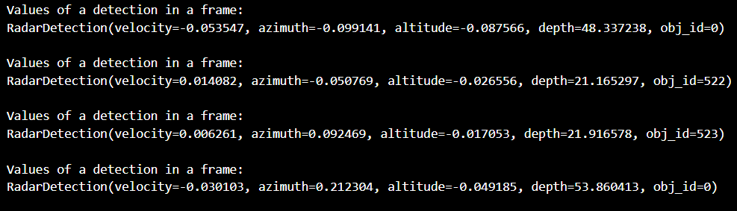

Slide 13
minPts=4
Eps
Parameters of DBSCAN Algorithm. Image inspired by [15].

Slide 14
Core Points
Border Points
Noise
Eps
minPts: 3
Parameters of DBSCAN Algorithm. Image inspired by [15].

Slide 15
Points E and P are Directly Density Reachable
Points D and K are Density Connected
Points D and G are Density Reachable
G
Eps
C
C
K
Eps
D
D
E
E
P
Direct Density Reachable, Density Reachable, and Density Connected points. Image inspired by [15].

Slide 16

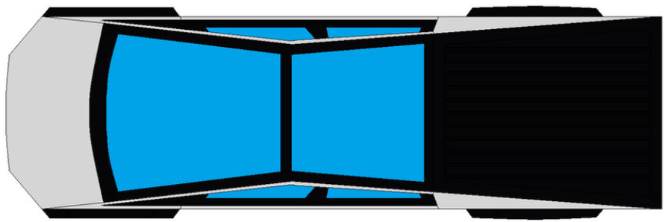



$$R_{v}\sin{ɵ}$$
$$R_{v}\cos{ɵ}$$
$$ɵ$$
Shows how the radial velocity can be split into their respective x and y components so that the velocity of the target vehicle can be determined. (Source: Top view of Tesla cyber truck [24], target vehicle [25])
V_ego
$$R_{v}$$
$$ɵ$$

Slide 17
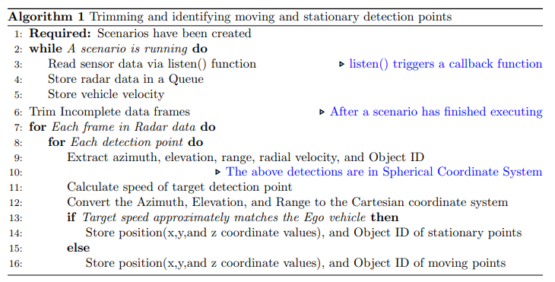
Algorithm of the code for filtering and identification of stationary and moving targets.

Slide 18
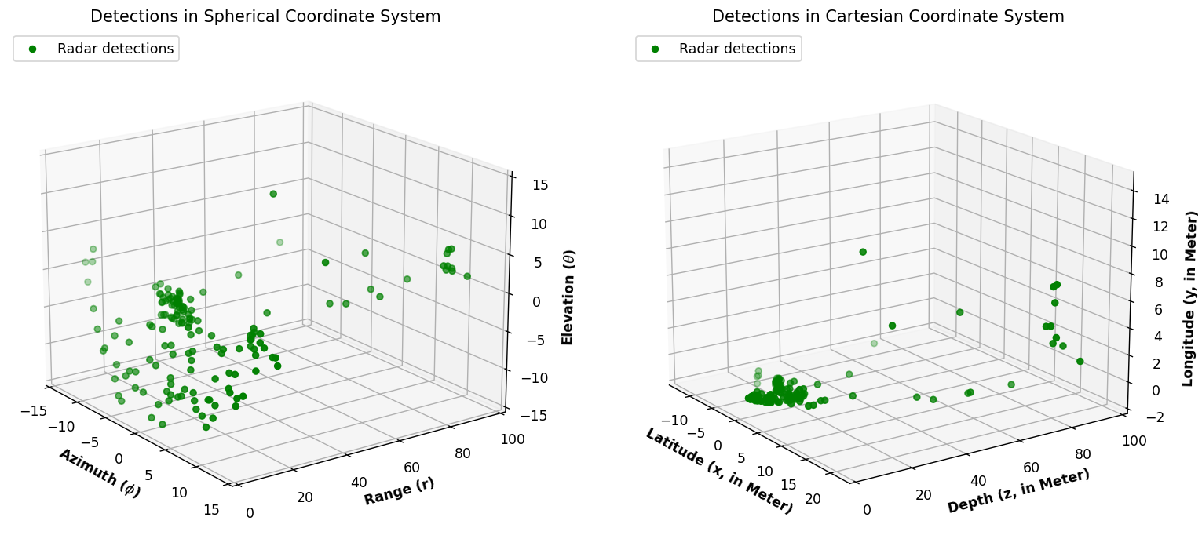
Shows the detections in the Spherical Coordinate system and Cartesian coordinate system.

Slide 19
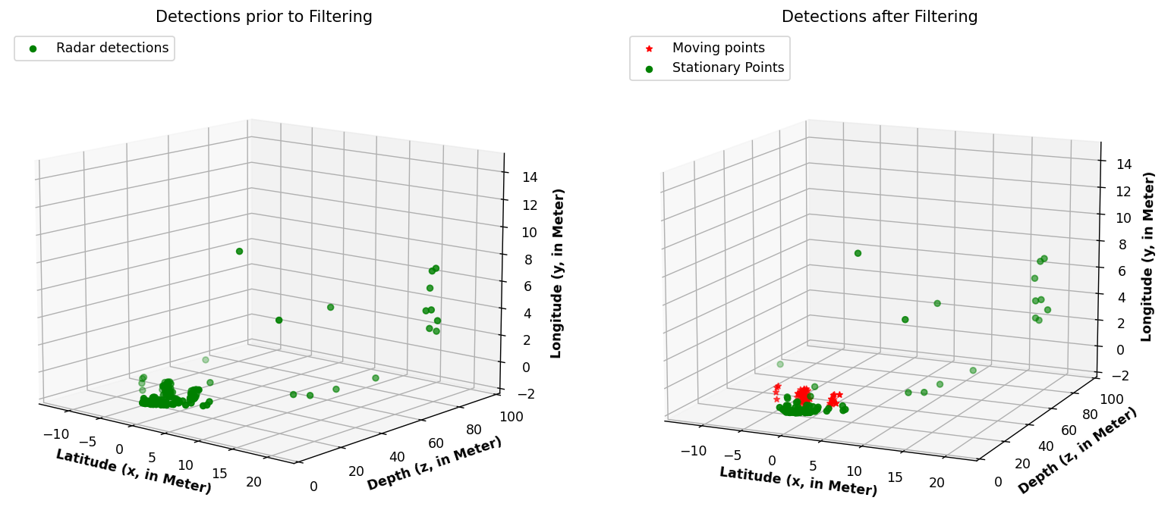
Identifying stationary and moving points from radar detections.

Slide 20
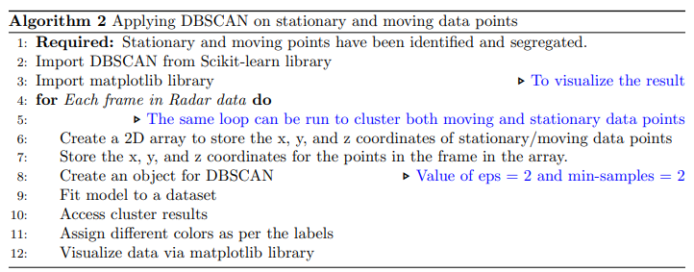
An overview of how the DBSCAN algorithm has been applied to the Carla dataset.

Slide 21
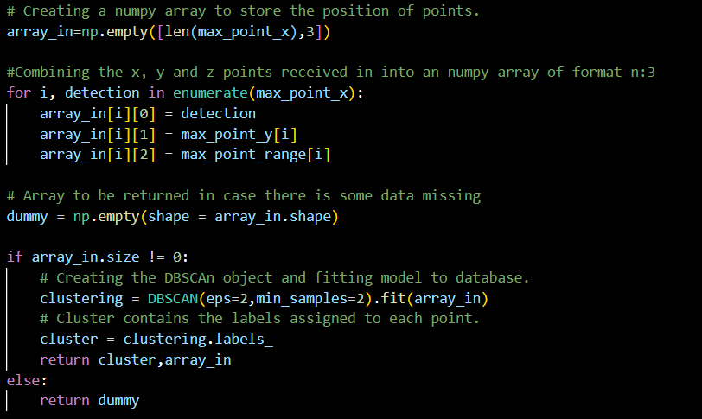
Shows the implementation of DBSCAN clustering using Scikit-learn.

Slide 22
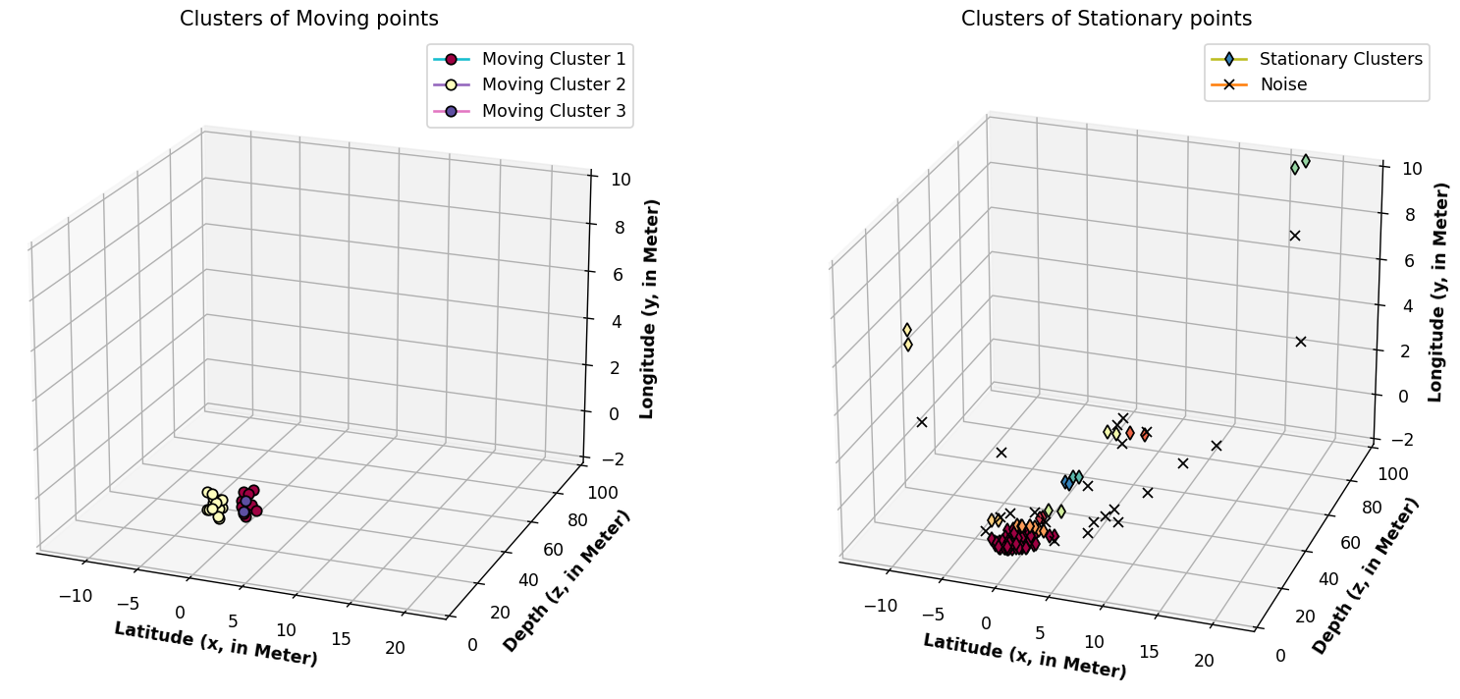
Shows the clusters Identified by applying DBSCAN on the point cloud generated by Scenario 1

Slide 23
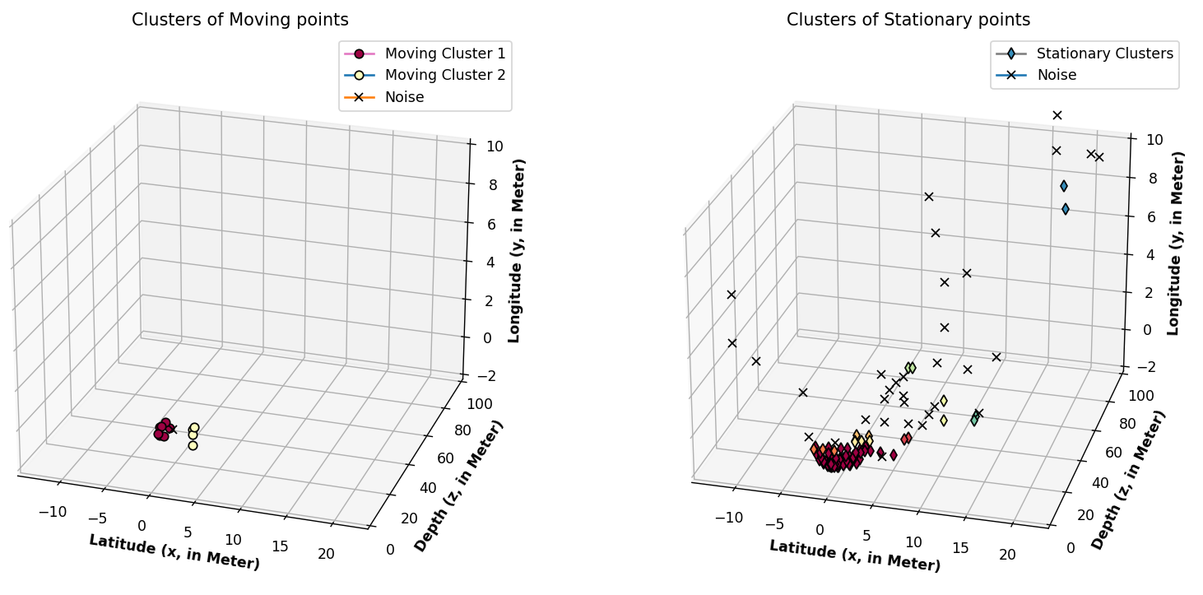
Shows the clusters Identified by applying DBSCAN on the point cloud generated by Scenario 2

Slide 24
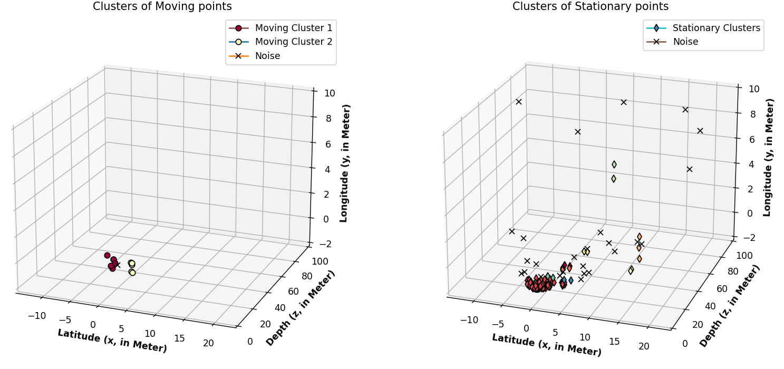
Shows the clusters Identified by applying DBSCAN on the point cloud generated by Scenario 3

Slide 25
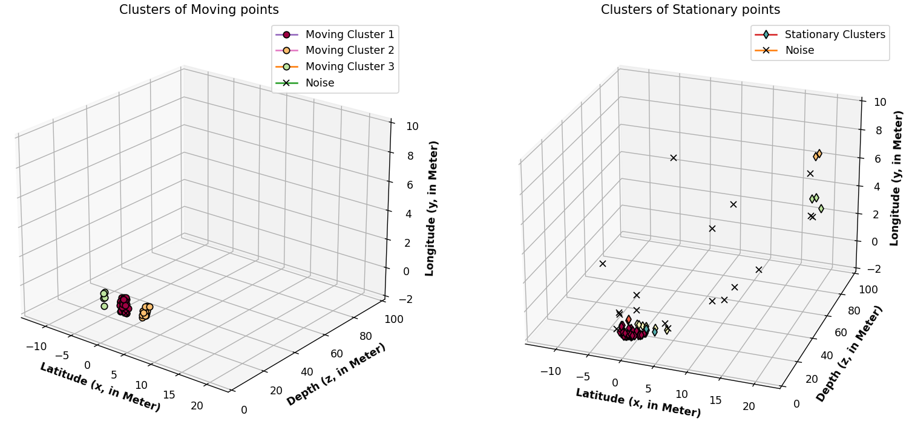
Shows the clusters Identified by applying DBSCAN on the point cloud generated by Scenario 4

Slide 26
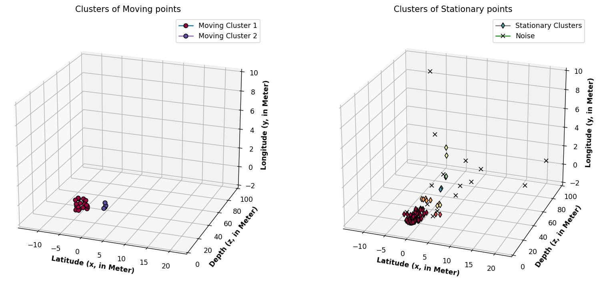
Shows the clusters Identified by applying DBSCAN on the point cloud generated by Scenario 5

