Slide 1
Embedded Systems Lab Project
Team 11
Ekaterina Bukharova – 7206936
Ananya Reginald Frederick – 7207003
Adwait Bajpai - 7206731

Slide 2
Working Principle – Digital Switch
Observation:
The Digital switch gave a series of 1s when the switch was not pressed, and 0s when the switched was pressed.
Implementation:
Create an array of size 5 for each of the Digital Sensor sensors.
If the array is all 1’s, then the switches are not pressed and 0’s of the switch has been pressed.
This data was stored and used to avoid obstacles.

Slide 3
Working Principle – Distance IR Sensor
Observation:
The IR sensor measures the distance by bouncing Infra Red rays off the object. According to our observation the readings recorded by the IR sensor were very low if the object was far off but increased significantly with decrease in distance between them.
Implementation:
Calibrate the sensor values so that we know what the reading is for for a given distance.
Set a threshold value, above which the bot should change its direction.
Use the 2 sensors in combination to avoid obstacles from either direction.

Slide 4
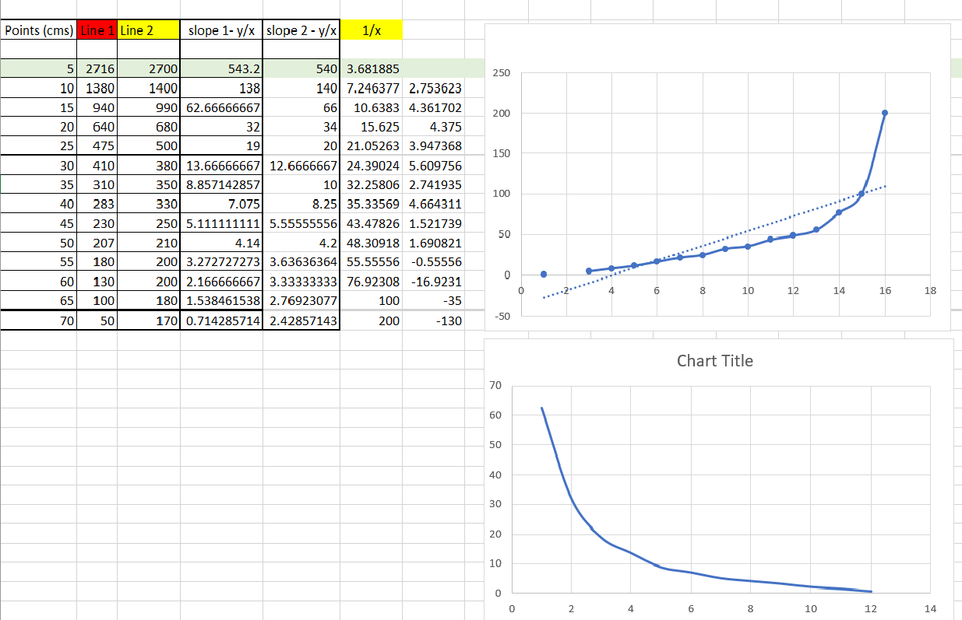
IR Sensor Calibration Graph:

Slide 5
Working Principle – Target Detection IR Sensor
Observation:
The transmitter is in range of the IR receiver, the SW reads the data transmitted in bursts of ‘0s’ and ‘1s’.
When the transmitter is out of sight of the receiver, SW reads the values in bursts of ‘1s’.
Implementation:
Create an array of size 10 for each of the IR sensors.
If the array is all 1’s, target is out of sight.
When the receiver is in range, bursts of 0s and 1s are received and stored in respective arrays.
How the collected data is used, is described in the below slides.

Slide 6
UML Modelling Diagrams
Sequence Diagram
State Chart
Activity Diagram

Slide 7
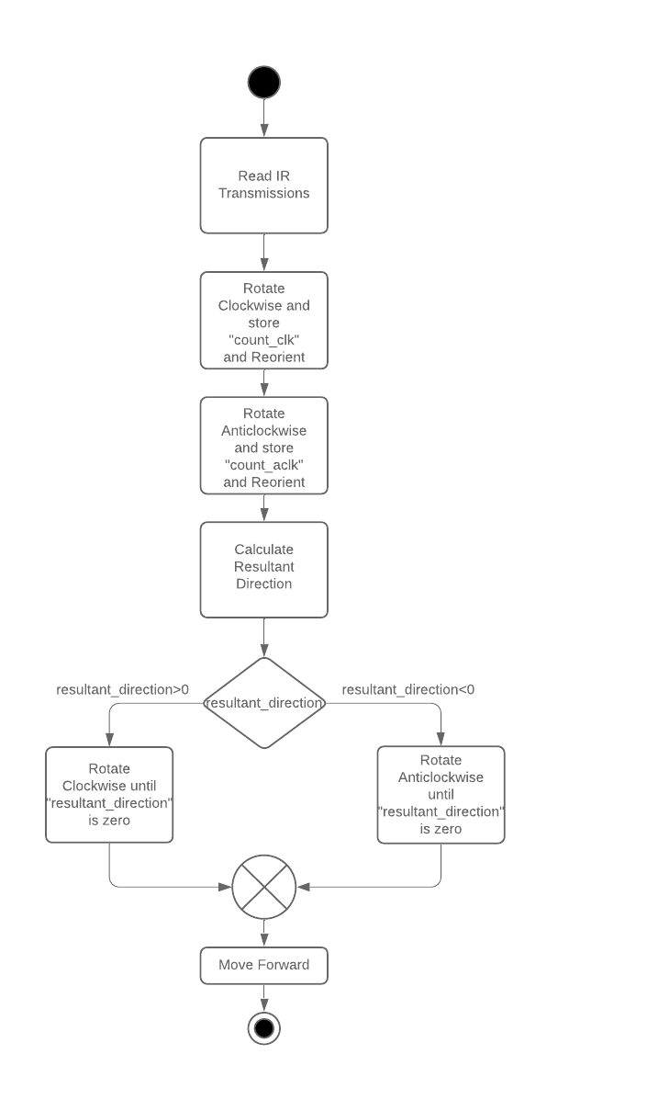
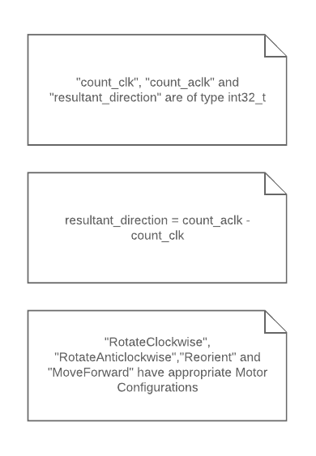
Algorithm for Target Detection

Slide 8
Thank You !

