Slide 1


MSc in Microbiome in Health and Disease
M2: Introduction to Linux
Frederick Clasen
(frederick.1.clasen@kcl.ac.uk)

Slide 2
Overview and agenda
Description | Activity Type | Date | Day | Start | Finish
Introduction to programming with Linux | Workshop | 10-Oct-23 | Tuesday | 12:00 | 14:00
Introduction to programming with Linux | Workshop | 11-Oct-23 | Wednesday | 12:00 | 17:00
Day 1: 10 October
Linux overview
Setup accounts for CREATE HPC
Create accounts for Cocalc to exercise terminal commands and scripting
Day 2: 11 October
Log in to CREATE, log out of CREATE
Basic introduction to Linux
Navigating paths and locations on Linux
Checking files and directories
Making, moving and deleting files and directories
Editing, viewing and saving files

Slide 3
Objectives of introduction to Linux workshop
The goal of this workshop is for you to be comfortable enough to start using Linux for the purpose of running computational biology tools and to use an HPC environment.
The goal is NOT for you to be a Linux expert or to be fluent in Linux.
You will not be explicitly be tested on using Linux
The specific objectives are:
To broadly understand the Linux architecture and how the command line differs from a graphical interface
To understand why we use Linux in bioinformatics/systems biology
To be able to navigate yourself in the Linux filesystem
To be able to edit files in the Linux environment
To be able to perform simple bash scripting

Slide 4
What is Linux? – according to Wikipedia
Linux is a family of open-source Unix-like operating systems based on the Linux kernel,^{[12]} an operating system kernel first released on September 17, 1991, by Linus Torvalds.^{[13][14][15]} Linux is typically packaged as a Linux distribution (distro), which includes the kernel and supporting system software and libraries, many of which are provided by the GNU Project.

Slide 5
What is Linux? – according to Wikipedia
Unix is a family of multitasking, multi-user computer operating systems that derive from the original AT&T Unix, whose development started in 1969
An operating system (OS) is system software that manages computer hardware and software resources, and provides common services for computer programs.
A Unix-like operating system is one that behaves in a manner like a Unix system
Linux is a family of open-source Unix-like operating systems based on the Linux kernel,^{[12]} an operating system kernel first released on September 17, 1991, by Linus Torvalds.^{[13][14][15]} Linux is typically packaged as a Linux distribution (distro), which includes the kernel and supporting system software and libraries, many of which are provided by the GNU Project.
The kernel is a computer program at the core of a computer's operating system and generally has complete control over everything in the system
A Linux distribution^{[a]} (often abbreviated as distro) is an operating system made from a software collection that includes the Linux kernel, and often a package management system.
The GNU Project (/ɡnuː/ ⓘ)^{[3]} is a free software, mass collaboration project announced by Richard Stallman on September 27, 1983. Its goal is to give computer users freedom and control in their use of their computers and computing devices by collaboratively developing and publishing software that gives everyone the rights to freely run the software, copy and distribute it, study it, and modify it

Slide 6
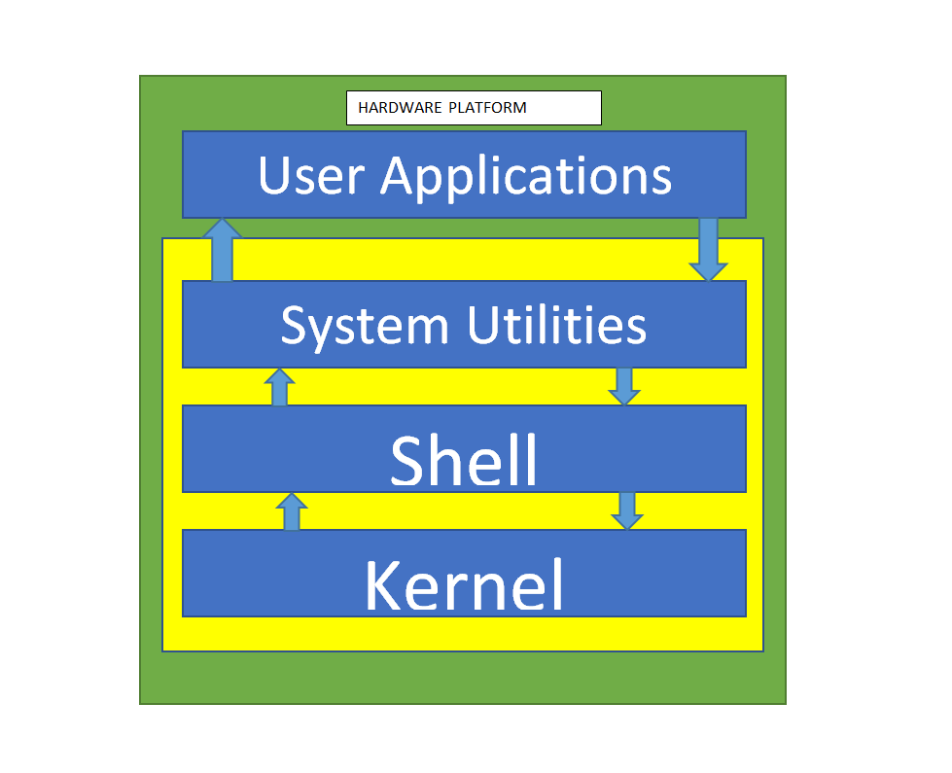
Linux OS architecture
Kernel (Linux):
The core component of the OS
Handling memory/processor allocation
Shell:
The user interface of the OS
Similar with CLI/Terminal
Similar to programming language: something that the OS and user both understand
Systems Utilities:
Liable to personal/individual task
We communicate with the Kernel (OS) through Shell

Slide 7

The Linux philosophy and why we use Linux?
The (reduced) *Nix philosophy:
Write programs that do one thing and do it well.
Write programs to work together
Write programs to handle text streams, because that is a universal interface.
General reasons why Linux is great:
It is FREE!!!
Because it is open source there is several online support resources and potential improvements
A big global community of users
It is SECURE!!!
Specifically for biological applications:
Most bioinformatics tools run in command line
Majority of HPC are Linux-based and we need HPCs for large-scale data
Several Linux distributions
A CLI (Command Line Interface) is a console or text based representation in which the user types the commands to operate the software or devices.
Linux is an OS (Operating System). Similarly, Windows and MacOS are also OS.
The reason why Linux is closely associated with command line is because Linux is widely used as servers and when operating with Linux servers, you usually don’t need graphics because graphics take up more resources and secondly, if you know CLI well, you can actually complete tasks faster compared to GUI (Graphic User Interface).

Slide 8
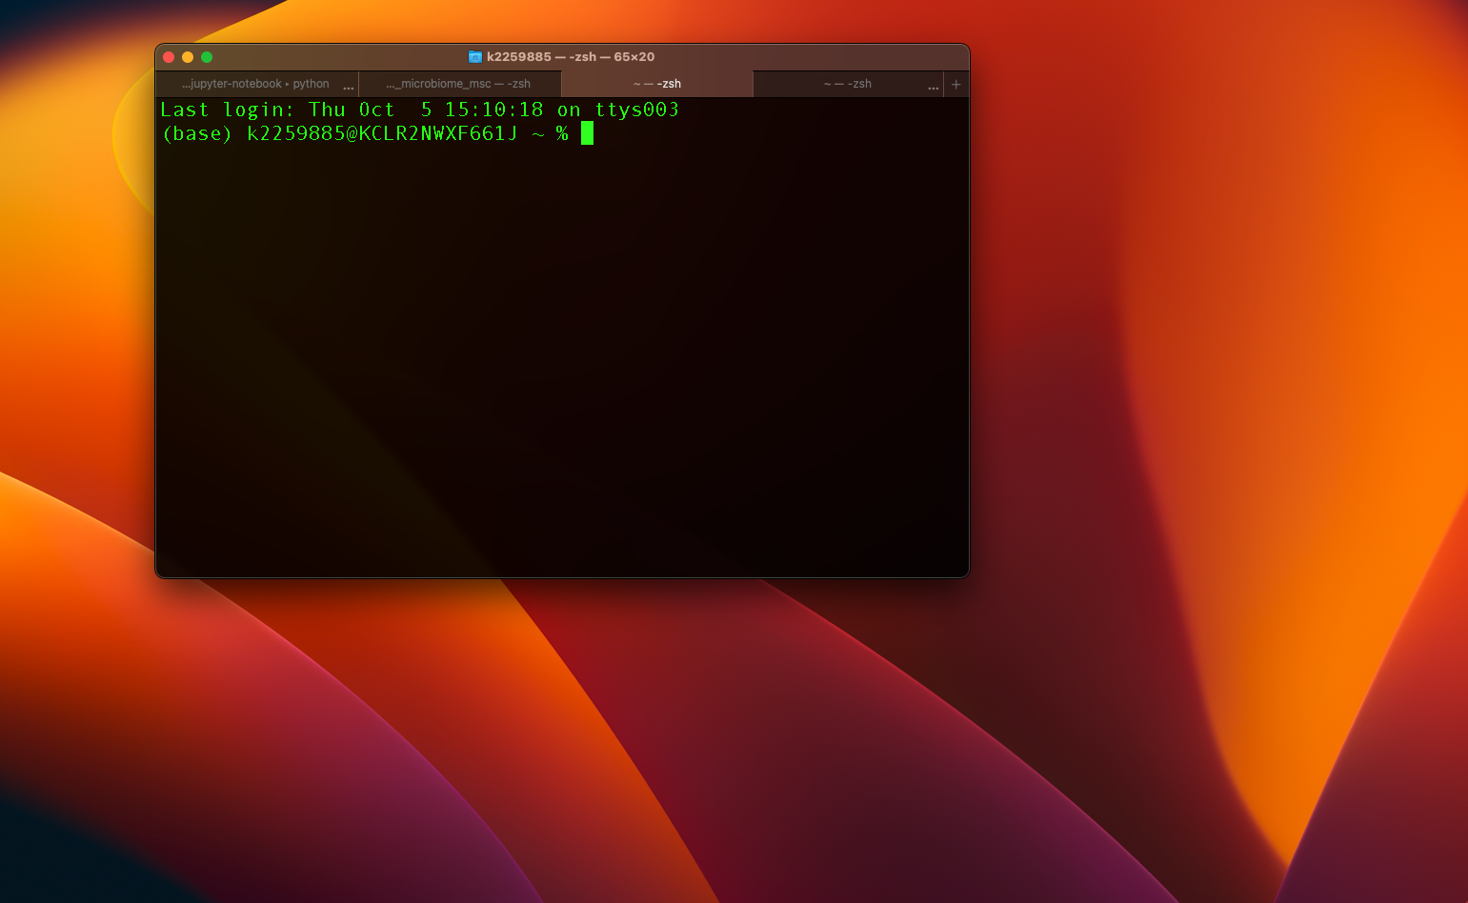
The command line
A CLI (Command Line Interface) is a console or text based representation in which the user types the commands to interact with the system
As opposed to a GUI (Graphical User Interface) that allow a user to interact with the system with the help of graphical elements like windows, menus, icons etc.

Slide 9
The command line
Parameters | CLI | GUI
Ease of Use | It is comparatively more difficult to understand and use. | It is comparatively easier to understand and use.
Memory Consumption | CLI consumes comparatively less memory. | The GUI consumes comparatively more memory.
Level of Precision | Higher precision of work can be obtained using CLI. | GUI offers a lower level of precision.
Speed | It works at a higher speed as compared to the GUI. | It works at a much slower speed as compared to the CLI.
Keyboard and Mouse | Its OS only requires a user’s keyboard. | Its OS requires both keyboard and mouse to work.
Modification of Appearance | We cannot change or modify the CLI operating system’s appearance. | We can change or modify the GUI operating system’s appearance.
Graphics | No graphs are included in CLI. | Graphics are always used in the GUI.
Menus | No menus are provided in CLI. | The GUI OS comes with menus.
Display of Information | The information that the user wants to view is displayed in files and plain text. | The information that the user wants to access is presented in various forms, like plain text, images, videos, gifs, videographs, etc.
Input of Information | The input is usually entered at the command prompt in CLI. | We can input the data anywhere on the computer screen in the case of GUI.
Pointing devices | Pointing devices are not used at all in CLI. | We use pointing devices in the GUI for choosing/selecting the items we want to.
Avoiding Errors | No typing errors or spelling mistakes can be avoided by CLI. | The typing errors or spelling mistakes cannot be avoided by the GUI.

Slide 10

High performance computing (HPC)
A set of computing servers that can be used in parallel to significantly improve computing power and decrease processing time
Used for analysis of large amounts of data and/or complex calculations
Several institutions have on-site HPC systems (KCL – CREATE HPC), but cloud-based HPC systems are becoming more popular (Amazon Web Services (AWS), Google Cloud etc)
HPC architecture
Login node
Grid Engine Scheduler
Computational node
Computational node
Computational node
x 100

Slide 11
To practice using command line
https://cocalc.com/
Why do we use this platform:
You cannot break anything!
If you start by using CLI on either your own machine or on the HPC you can easily make a mistake that cannot be revoked

Slide 12
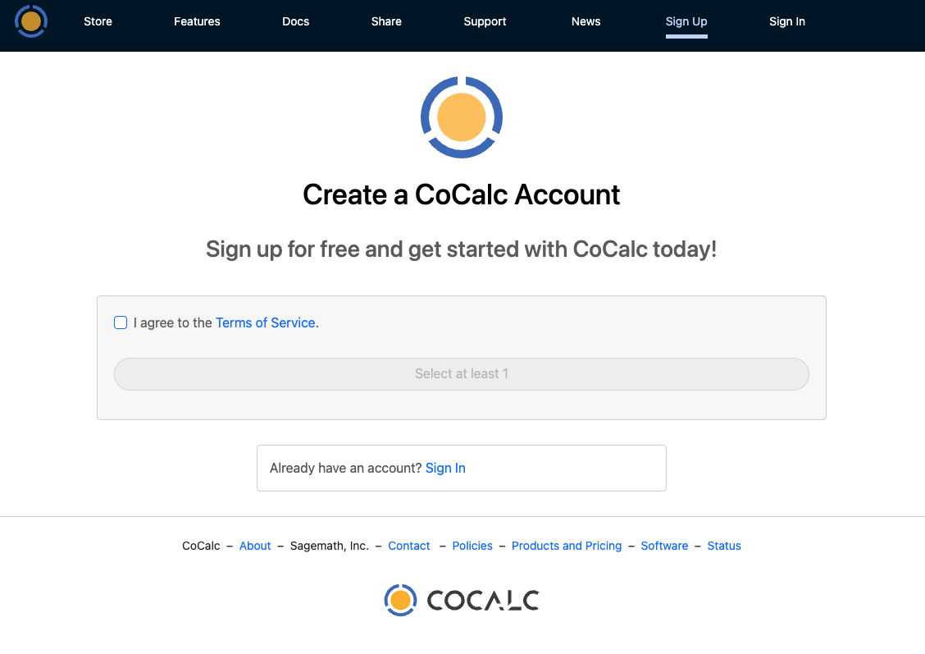
To practice using command line
https://cocalc.com/

Slide 13
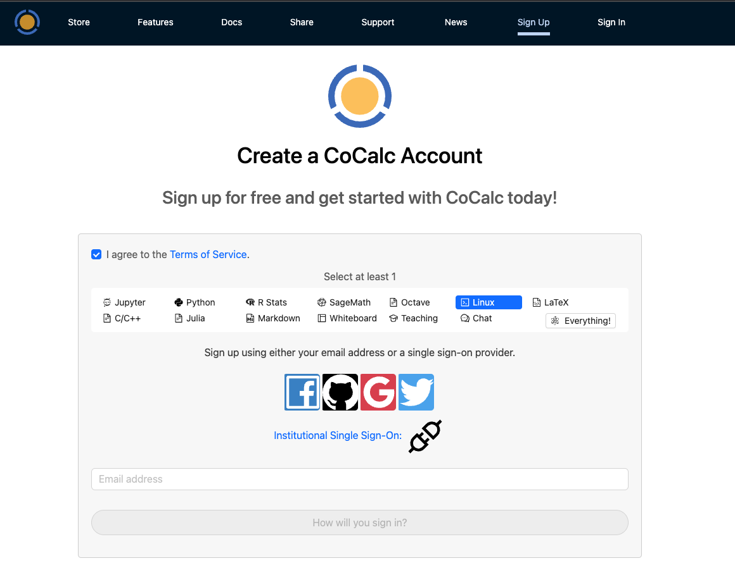
To practice using command line
https://cocalc.com/

Slide 14
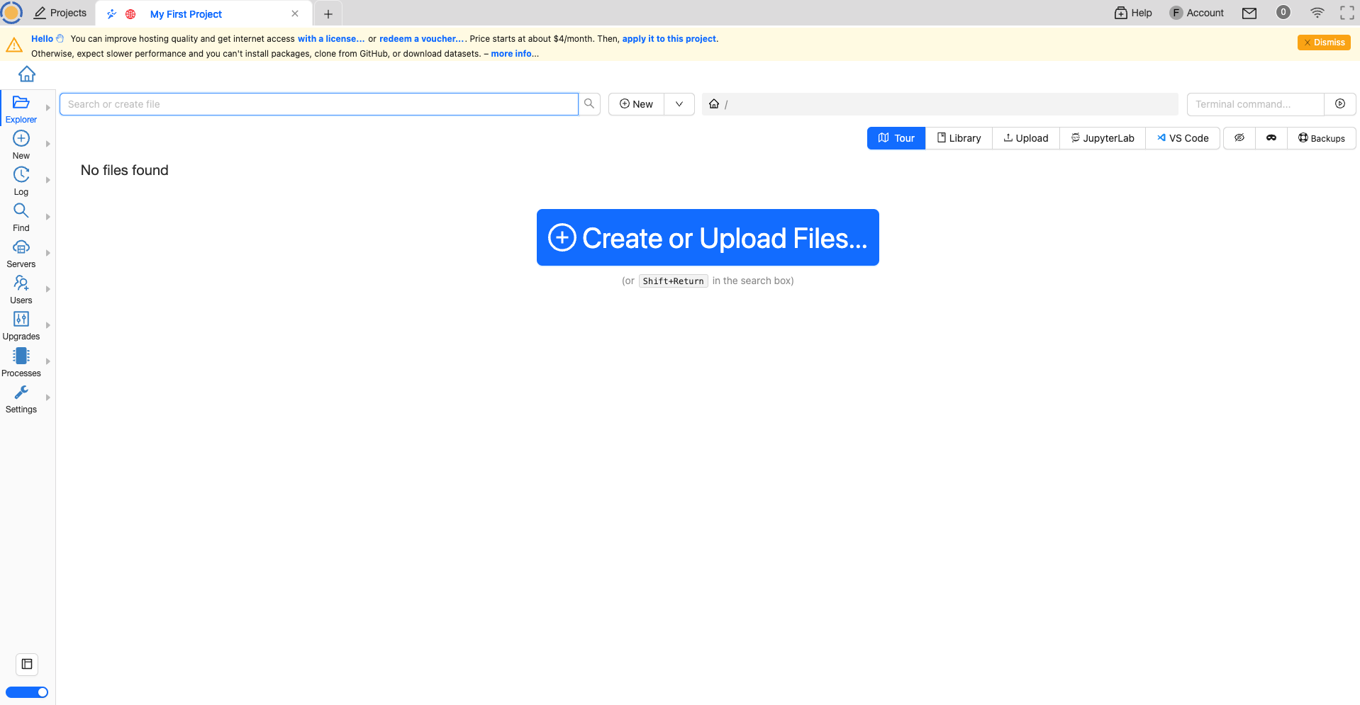
To practice using command line
https://cocalc.com/

Slide 15
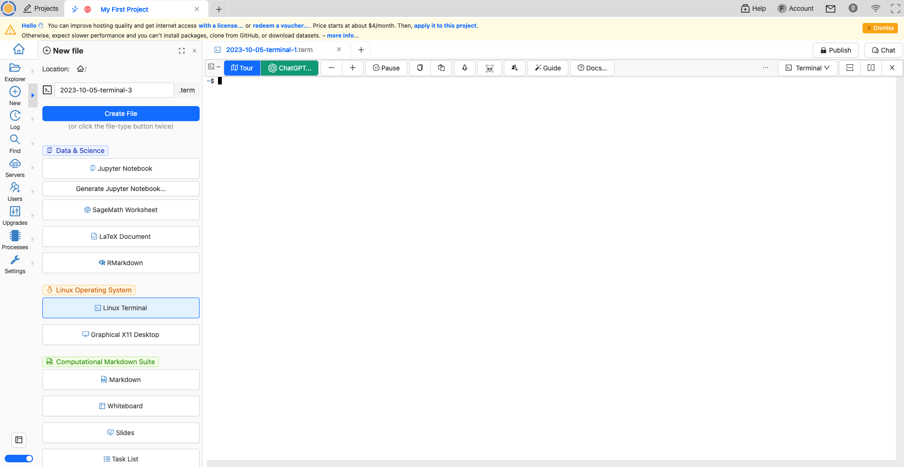
To practice using command line
https://cocalc.com/

Slide 16
Break

Slide 17
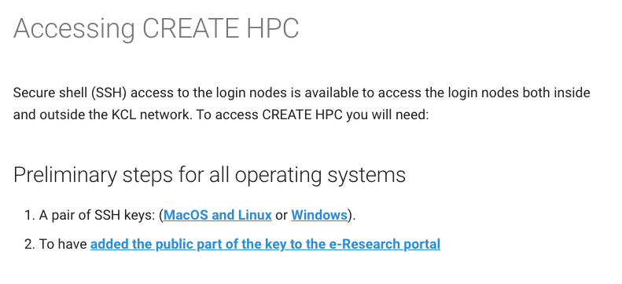
Setup your CREATE accounts
PLEASE FOLLOW EVERY STEP AND DO NOT CONTINUE TO THE NEXT STEP WITHOUT INSTRUCTION!
All the information we will follow is here:
https://docs.er.kcl.ac.uk/CREATE/access/

Slide 18
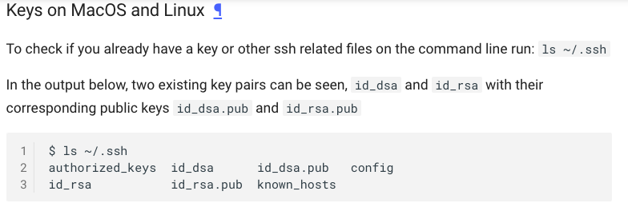
Setup your CREATE accounts
PLEASE FOLLOW EVERY STEP AND DO NOT CONTINUE TO THE NEXT STEP WITHOUT INSTRUCTION!
MacOS/Linux users

Slide 19
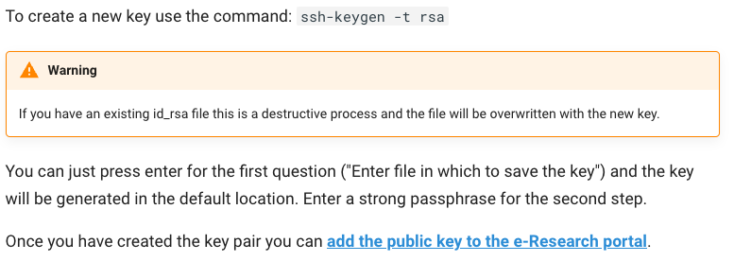
Setup your CREATE accounts
PLEASE FOLLOW EVERY STEP AND DO NOT CONTINUE TO THE NEXT STEP WITHOUT INSTRUCTION!
MacOS/Linux users

Slide 20
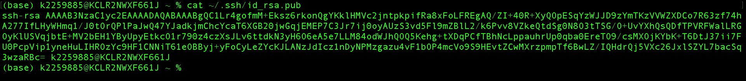
Setup your CREATE accounts
PLEASE FOLLOW EVERY STEP AND DO NOT CONTINUE TO THE NEXT STEP WITHOUT INSTRUCTION!
MacOS/Linux users
cat ~/.ssh/id_rsa.pub
Copy the highlighted part to a text file

Slide 21
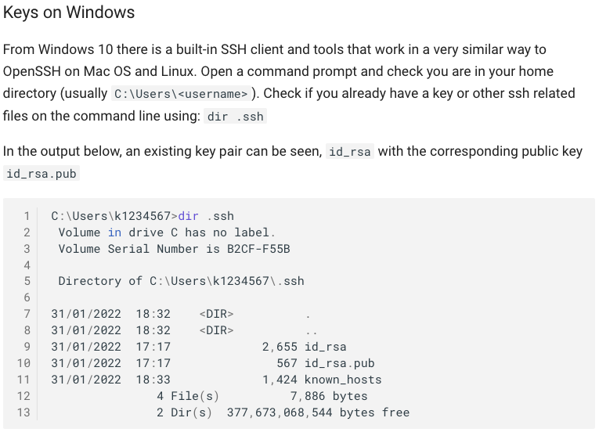
Setup your CREATE accounts
PLEASE FOLLOW EVERY STEP AND DO NOT CONTINUE TO THE NEXT STEP WITHOUT INSTRUCTION!
Windows users

Slide 22
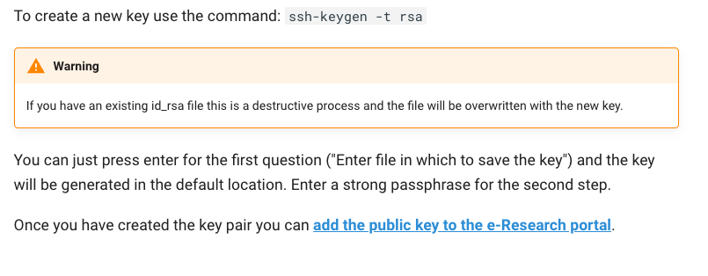
Setup your CREATE accounts
PLEASE FOLLOW EVERY STEP AND DO NOT CONTINUE TO THE NEXT STEP WITHOUT INSTRUCTION!
Windows users

Slide 23
Setup your CREATE accounts
PLEASE FOLLOW EVERY STEP AND DO NOT CONTINUE TO THE NEXT STEP WITHOUT INSTRUCTION!
All users
Go to:
https://portal.er.kcl.ac.uk/access/ssh

Slide 24
End of day 1

Slide 25
Overview of yesterday
Linux is a Unix-like operating system that allows easy communication with the kernel through Shell through the command line interface (CLI)
Several bioinformatics and systems biology tools are developed for the command line and the OS of most HPC systems are Linux
Set up your public keys (unique ID to your machine) so that you can access CREATE
Those that were not here – I will do this for you today individually

Slide 26
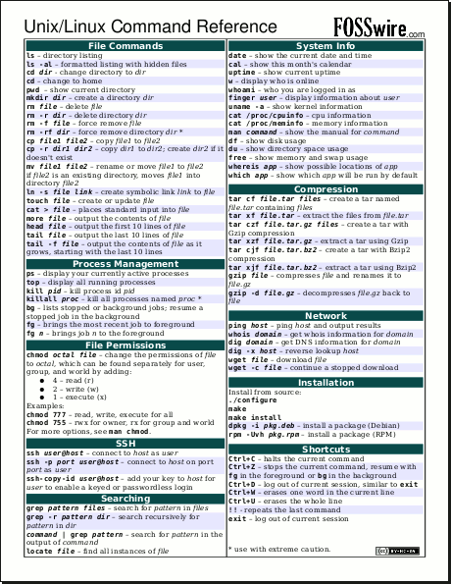
Linux commands – general overview
”Small programs that do one thing well”
command [OPTION][arg1…argn]
To see options and syntax for the command
command –h
OR
command --help

Slide 27
An overview of paths and directory structures
There are two types of pathnames
Absolute (Abs) – the full path to a directory or file; begins with the root symbol /
Relative (Rel) – a partial path that is relative to the current working directory

Slide 28
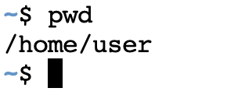
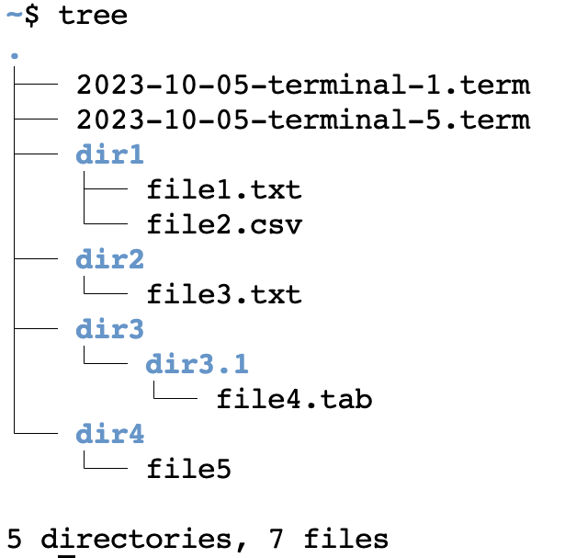
An overview of paths and directory structures
There are two types of pathnames
Absolute (Abs) – the full path to a directory or file; begins with the root symbol /
Relative (Rel) – a partial path that is relative to the current working directory
A totally made-up example:
The folder that I am currently in
All subfolders and files in /home/user
Absolute path:
/home/user/dir3/dir3.1/file4.tab
Relative path:
dir3/dir3.1/file4.tab
What would the relative and absolute path of file5 be?

Slide 29

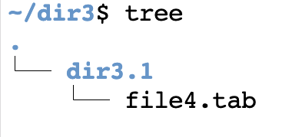
An overview of paths and directory structures
There are two types of pathnames
Absolute (Abs) – the full path to a directory or file; begins with the root symbol /
Relative (Rel) – a partial path that is relative to the current working directory
A totally made-up example:
The folder that I am currently in
All subfolders and files in /home/user/dir3
Absolute path:
/home/user/dir3/dir3.1/file4.tab
Relative path:
dir3.1/file4.tab
The absolute path for any file will remain the same whereas the relative path can change

Slide 30
Linux workshop
Please open Cocalc and a terminal in Cocal

Slide 31
Check and create new files and directories
List all files in current directory
ls
View all options for ls and use some options
ls –-help
ls -a
Create files
touch file1.txt
ls
touch file2.txt file3.txt
ls
Create new directory
mkdir dir1
ls
ls -l
View current path
pwd
Change into new directory
cd dir1
ls
pwd
Go back to previous directory
cd ..
pwd
ls

Slide 32
Exercise
Task 1: Create a new directory within dir1 with the name dir2 and then create a file named file1.txt within this new directory
Task 2: Navigate yourself back to /home/user and then use the command tree to view the directory structure
Bonus: Create a new directory within dir1 called dir3 while your working directory is /home/user

Slide 33
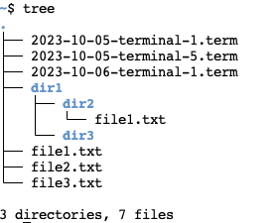
Copying, moving and deleting files and directories
Your directory structure will now look similar to this
View dir1, copy file1.txt to dir1 and view dir1 again
ls dir1
cp file1.txt dir1/
ls dir1
Move file2.txt to dir1
mv file2.txt dir1/
ls
(file2.txt will now be gone)
Create a new directory and copy all contents of dir1 to this directory
mkdir dir4
cp –r dir1/ dir4/
(what happens if you do not use the –r flag?)
Delete file3.txt and delete dir4
rm file3.txt
rm –r dir4/ or rmdir dir4/
Tip: use tab on your keyboard for autocompletion

Slide 34
Using wildcards
Create the following files
touch test1.txt test2.txt file5.csv file6.csv
ls
View all files that starts with test
ls test*
View all files that ends with csv
ls *csv
Remove all csv and text files
rm *.csv
rm *.txt

Slide 35
Break

Slide 36
Viewing, editing and saving files
Nano
Linux have different tools available to view and edit files. We will try and cover the most widely used programs
Task: clear everything in your /home/user directory except for the .term files
Create a new text file
touch file1.txt
Print the contents of this file to the command line (should be nothing)
cat file1.txt
Open the file in nano and write 5 lines of random text
nano file1.txt
After you edited the file do the following to save and exit nano
Hit <CONTROL>+X
Type Y
Hit <ENTER>
Print the contents of this file to the command line
cat file1.txt

Slide 37
Viewing, editing and saving files
Vim
Linux have different tools available to view and edit files. We will try and cover the most widely used programs
Task: clear everything in your /home/user directory except for the .term files
Create a new text file
touch file1.txt
Print the contents of this file to the command line (should be nothing)
cat file1.txt
Open the file in vim
vi file1.txt
To edit either hit the INSERT button or <SHIFT>+I
Write five lines of random words
To close and save hit <ESC> and type :wq! and hit <ENTER>
Print the contents of this file to the command line
cat file1.txt

Slide 38
Viewing, editing and saving files
View the contents of file1.txt with the less command (close by hitting ‘q’)
less file1.txt
Use head to print the first three lines of file1.txt
head –n 3 file1.txt
Exercise:
Create a file names file2.txt and use nano to edit this file with 20 lines of random text
Use the head command to print the top lines (head file2.txt)
How many lines are printed on the command line?
Bonus: print the last 5 lines of file2.txt (there is a command for that – look on the cheat sheet)

Slide 39
Break

Slide 40
More advanced commands and using pipe
Task 1:
Create a file called geekfile.txt that contains the following text:
unix is great os. unix is opensource
learn operating system.
unix linux which one you choose.
unix is easy to learn.unix is a powerful.
View contents of geekfile.txt
cat geekfile.txt
Count the lines in geekfile.txt (-l flag counts lines)
wc -l geekfile.txt
Search for the text ”unix” in geekfile.txt
grep unix geekfile.txt
Search for the text “unix is” in geekfile.txt
grep “unix is” geekfile.txt

Slide 41
More advanced commands and using pipe
Count the number of lines that have the word unix in it:
grep ”unix” geekfile.txt | wc –l
There are however five occurrences of the word unix. To count the number of occurrences run the following command
grep –o ”unix” geekfile.txt | wc –l
Tip: deconstruct this command and first run the grep command to see the output and then run it together with the wc –l
Replace unix with linux using the command sed (s specified substitution)
sed ‘s/unix/linux/’ geekfile.txt
Note the output: it will only replace the first occurrence in each line
Save this to a new file:
sed ‘s/unix/linux/’ geekfile.txt > geekfile2.txt
Replace the second occurrence of unix in each line
sed ‘s/unix/linux/2’ geekfile.txt
Replace all occurrences of unix
sed ‘s/unix/linux/g’ geekfile.txt

Slide 42
More advanced commands and using pipe
Like grep and sed, the awk command searches for patterns in a file line by line and performs some operations on each line. Specifically useful to split a document into columns.
Create a file called gene_exp.txt with the following text
gene sample1 sample2 sample3
gene1 4 5 1
gene2 10 70 100
gene3 0 0 5
Print the first column of the file gene_exp.txt
awk ‘{print $1}’ gene_exp.txt
Print the first and second column of the file gene_exp.txt
awk ‘{print $1,$2}’ gene_exp.txt
Exercise: use awk and grep to get the expression of gene2 for sample 3

Slide 43
Break

Slide 44
A short introduction to Bash scripting
All the commands use up to now is called Bash commands.
Bash is a Unix shell and command language that is used as the default login shell for most Linux distros
All the commands used (and MUCH MUCH more) can be used in Bash scripts like a programming language
We are only going to do one or two simple things to illustrate it.
Create a file called test_bash.sh and open it in an editor (nano)
Write the following commands in the file:
#!/bin/bash
# declare STRING variable
STRING="Hello World"
# print variable on a screen
echo $STRING
Run this file using
bash test_bash.sh
The same two commands can instead be run in the command line itself

Slide 45
A short introduction to Bash scripting
Exercise:
Task1: Create a directory termed dir1 and create 3 files in this directory
Task2: Change the bash script to list all the files in dir1 and run the bash script using bash test.sh to view the output

Slide 46
End of day 2

