Slide 1
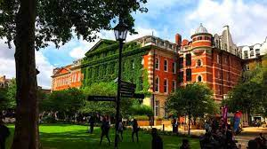

MSc in Microbiome in Health and Disease
Introduction to Module 2: Microbiome analysis
Frederick Clasen
(frederick.1.clasen@kcl.ac.uk)

Slide 2



My background
BSc in Biotechnology: Genetics, microbiology and biochemistry.
BSc (Hons) in Bioinformatics: Programming and tools in bioinformatics. Focus on bacterial genomics analysis.
MSc in Bioinformatics: Dissertation focusing on horizontal gene transfer detection in eukaryotes.
PhD in Bioinformatics: Computational modeling of metabolism. Developed tools in systems biology to analyze metabolic flux in liver cancer that included analysis and integration of all omics data types including metagenomcis. Close collaboration with experimental scientists.
Research associate in bioinformatics and systems biology: Microbiome-centric projects that focus on data integration and clinical associative studies. Several clinical and experimental collaborators

Slide 3



Module outline
This is the most programming heavy part of the MSc course
The idea is not to teach you to become a software developer but rather to give you the computational tools necessary to THINK how to solve a microbiome problem
Do not get lost in the details but try and understand why you are doing what!!!
This module will therefore provide you with the key data analysis tools required for microbiome analysis.
You will learn:
The necessary programming sills to perform bioinformatics analysis
A solid foundation of the statistical concepts used in microbiome analysis
How to plan the design, data generation and analytic parts of a microbiome project

Slide 4
Lecturers and tutors
Name | Email
Saeed Shoaie | saaed.shoaie@kcl.ac.uk
Frederick Clasen | frederick.1.clasen@kcl.ac.uk
Ali Kaynar | ali.kaynar@kcl.ac.uk
Yi Jin | yi.1.jin@kcl.ac.uk
Haizhuang Cai | haizhuang.cai@kcl.ac.uk
Ricardo de Oliveira Costeira | ricardo.de_oliveira_costeira@kcl.ac.uk
Elle Hill | elle.hill@kcl.ac.uk
Workshop format:
Frederick / Ali will lead the each of the workshops
The tutors will be there to assist you individually
PLEASE try and be on campus and in the room. If not, one of the tutors will be online to help you

Slide 5
Lecture dates
Description | Activity Type | Date | Day | Start | Finish
Module introduction | Lecture | 02-Oct-23 | Monday | 09:00 | 10:00
Introduction to programming and coding | Lecture | 02-Oct-23 | Monday | 12:00 | 14:00
Introduction to data analysis with R | Workshop | 03-Oct-23 | Tuesday | 12:00 | 17:00
Introduction to data analysis with R | Workshop | 04-Oct-23 | Wednesday | 12:00 | 17:00
Introduction to data analysis with R | Workshop | 05-Oct-23 | Thursday | 12:00 | 17:00
Introduction to programming with Linux | Workshop | 10-Oct-23 | Tuesday | 12:00 | 14:00
Introduction to programming with Linux | Workshop | 11-Oct-23 | Wednesday | 12:00 | 17:00
Experimental Design and ethics | Lecture | 17-Oct-23 | Tuesday | 11:00 | 12:00
Epidemiology and sociodemographic-related design | Lecture | 17-Oct-23 | Tuesday | 14:00 | 15:00
Sample preparation and storage | Lecture | 19-Oct-23 | Thursday | 11:00 | 12:00
Next Generation Sequencing (lecture) | Lecture | 23-Oct-23 | Monday | 10:00 | 11:00
Next Generation Sequencing (workshop) | Workshop | 23-Oct-23 | Monday | 12:00 | 17:00
Next Generation Sequencing (workshop) | Workshop | 24-Oct-23 | Tuesday | 12:00 | 17:00
Amplicon/targeted sequencing (lecture) | Lecture | 26-Oct | Thursday | 10:00 | 11:00
Metagenomics analysis (lecture) | Lecture | 30-Oct-23 | Monday | 10:00 | 11:00
Metagenomics analysis (workshop) | Workshop | 30-Oct-23 | Monday | 11:00 | 17:00
Metagenomics analysis (workshop) | Workshop | 31-Oct-23 | Tuesday | 10:00 | 17:00
Metagenomics analysis (workshop) | Workshop | 01-Nov-23 | Wednesday | 10:00 | 17:00
Metagenomics analysis (workshop) | Workshop | 02-Nov-23 | Thursday | 10:00 | 17:00
Metagenomics analysis (workshop) | Workshop | 03-Nov-23 | Friday | 10:00 | 17:00
Concepts of proteomics | Lecture | 06-Nov-23 | Monday | 09:00 | 11:00
Concepts of metabolomics | Lecture | 06-Nov-23 | Monday | 12:00 | 14:00
Metagenomics analysis (workshop) | Workshop | 06-Nov-23 | Monday | 15:00 | 17:00
Transcriptomics | Lecture | 07-Nov-23 | Tuesday | 10:00 | 11:00
Transcriptomics analysis (workshop) | Workshop | 07-Nov-23 | Tuesday | 12:00 | 17:00
Amplicon/targeted sequencing (tutorial) | Workshop | 13-Nov | Monday | 10:00 | 11:00
Ali Kaynar
Frederick Clasen
Cheng Zhang
Frederick Clasen
Frederick Clasen
Ali Kaynar
Frederick Clasen

Slide 6
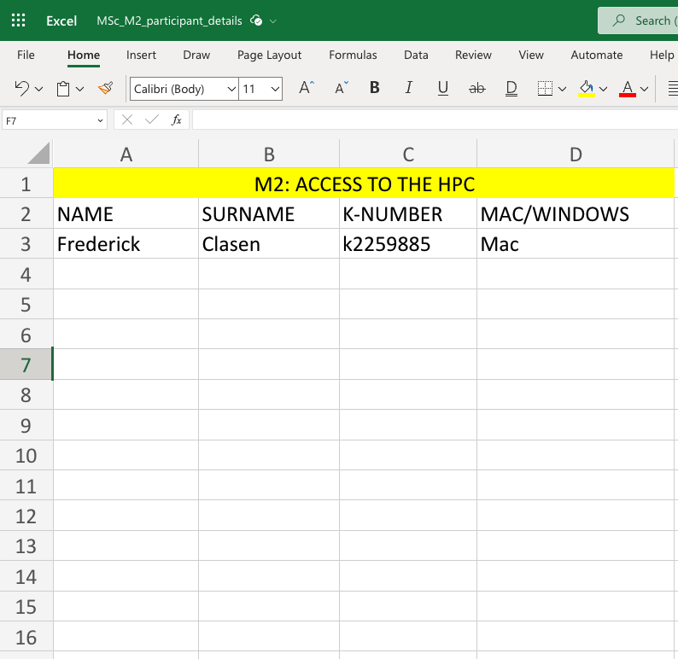
Access to the HPC
We will ask you:
Fill in this form in the next couple of days to get you access to CREATE HPC
Ask you to then give your public key (https://docs.er.kcl.ac.uk/CREATE/access/)
Log in to the HPC before the microbiome workshop

